Slide 1
Fundamentals of Literacy Coaching
Professional Development Modules
Introductory Session
Notes:
SAY Welcome to the Fundamentals of Literacy Coaching Professional Development Modules!

Slide 2
Purpose of these Literacy Coaching Modules
To increase the participants’ knowledge and ability to carry out the role of a literacy coach.
Notes:
SAY The purpose of these modules is to engage in learning experiences to increase your knowledge and ability to carry out your role as a literacy coach.
You will need the Literacy Coach PD Guide to participate in this course.

Slide 3
Goals for the course: Literacy Coaching Modules
To understand the evidence-based roles of coaches and to have the knowledge, skills, and abilities to be able to successfully fulfill those roles.
Notes:
SAY The Florida Center for Reading Research developed this course in partnership with ExcelinEd to help coaches, districts, and schools plan for and implement coaching models successfully.

Slide 4

Goals for Today
Define and Discuss Session Goals and Content
Overview the introductory materials and organization of the course.
Become familiar with the materials for Session 1.
Gain an understanding/rationale for the benefits of coaching.
Notes:
NOTES Share and discuss these goals for today’s session.

Slide 5
Definition of a Literacy Coach
A literacy coach is an instructional leader with specialized knowledge in
the science of reading, evidence-based practices, English Language Arts state standards, as well as the knowledge of how to work with educators as adult learners. The coach provides collegial, job-embedded support to ensure literacy instruction is data-informed and student-centered. Coaches accomplish this by collaborating with leaders and teachers, engaging in practices such as co- teaching, co-planning, modeling, reflective conversations and data chats with teachers to build teacher and school capacity to improve student achievement for all.
Notes:
SAY In the winter and spring of 2021, new domains and standards for literacy coaching were drafted by experts from across Florida and Florida Department of Education staff and approved by the Florida Department of Education.
This definition is from the Florida Department of Education. Please review Handout 1: Literacy Coach Domains and Standards found in your Literacy Coach Program PD Guide.
5 minutes: Skim and debrief.

Slide 6
Literature Review Aligned with the Domains and Standards
Researchers at the Regional Educational Laboratory Southeast, part of the Florida Center for Reading Research at Florida State University, completed a literature review aligned with the Florida Literacy Coach Domains and Standards. Review Handout 2: Literature Review for the Literacy Coach Domains and Standards in pairs or small groups. Share and discuss important findings from your review with the group.
Notes:
Have participants review Handout 2: Literature Review for the Literacy Coach Domains and Standards found in your Literacy Coach Program PD Guide.
15 minutes: Discuss and debrief.

Slide 7

About ExcelinEd
The Foundation for Excellence in Education (ExcelinEd) advances a broad range of student-centered policy solutions that increase student learning, advance equity and ready graduates for college and career. ExcelinEd’s comprehensive approach to improving literacy outcomes includes strategies that support teachers and administrators, students and families.
Notes:
SAY This course was co-developed and sponsored by the ExcelinEd. Here’s a little information about ExcelinEd.

Slide 8
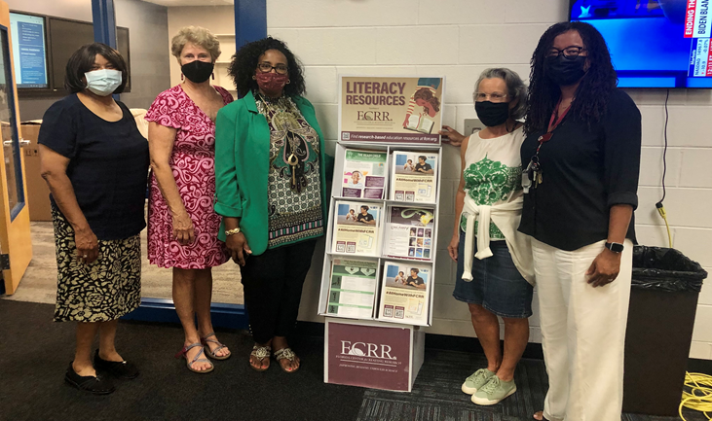
About FCRR
The Florida Center for Reading Research (FCRR) is a multidisciplinary research center at Florida State University that was established in 2002 by the Governor's office and Legislature. Drawing from multiple disciplines, FCRR investigates all aspects of reading and reading-related skills. Through rigorous and robust research, innovation, and engagement, FCRR advances the science of reading to improve learning and achievement from birth through adulthood.
Vision
Improving reading through science
Notes:
SAY This course was developed by the Florida Center for Reading Research. Here’s a little information about the center.

Slide 9



Norms for Our Course
Cell phones on silent
Pay attention to self and others
Presume
positive intentions
Notes:
NOTES Consider your group to determine how much detail about the norms will be helpful to review.
SAY Professional learning opportunities usually consist of a team of educators, like us, that meet regularly to learn new topics, share ideas, and problem solve. We will build a community, meaning that we learn from each other, so sharing and participation are really important.
Professional learning opportunities typically have norms that the group can agree to in order to be productive. Here are three norms, or ground rules, for our way of work: cell phones on silent; pay attention to yourself and others; and presume positive intentions.
Pay attention to self and others This means to contribute, listen, and be aware of how you and others are responding to each other. Be sure to give everyone a chance to talk and encourage others who seem reluctant to join in. Sometimes people who are reluctant to talk are thinking. They may not be comfortable jumping in, but may have something important to say. Professional learning opportunities like this one encourage educators to learn from one another. Therefore, sharing, discussing and participating are important components.
Presume positive intentions This means to pause before responding. Usually when people contribute to a conversation, they intend to be constructive. So, always respond positively to keep the discussions productive.

Slide 10

Introduce yourself.
Share your background in education and one little-known fact about yourself.
Notes:
NOTES As the facilitator, start by modeling this ice breaker activity.
Approximately 10 minutes: Depends on number of participants.

Slide 11
Module | Topic | Session | Minutes | Session Date
1 | Applying Principles and Practices that Foster a Positive Culture | Intro | 60
 |  | 1 | 120
 |  | 2 | 150
 |  | 3 | 150
2 | Applying Effective Pedagogy and Andragogy | 4 | 120
 |  | 5 | 120
 |  | 6 | 165
3 | Collecting Data to Inform Professional Learning | 7 | 150
 |  | 8 | 140
 |  | 9 | 170
4 | Planning, Implementing, and Analyzing Literacy Instruction | 10 | 175
 |  | 11 | 135
 |  | 12 | 165
 |  | 13 | 130
5 | Growing Professionally | 14 | 120
 |  | 15 | 120
6 | Planning and Implementing Coaching | 16 | 120
Notes:
NOTES
It is recommended that the sessions are completed in sequential order.
The timeline for completing the sessions can be flexible. If the recommended minutes for each session are not available, complete what you can with the time you have and then pick up where you left off the next time you meet.
Once a schedule of the sessions is established, have participants record the schedule in their Literacy Coach Program PD Guide if printed.
SAY Here is an overview of the modules and sessions of this course. There are six modules, and each module includes two to four sessions for a total of 15 content sessions. Module 1 addresses Applying Principles and Practices that Foster a Positive Culture, Module 2 covers Applying Effective Pedagogy and Andragogy, the focus of Module 3 is Collecting Data on Instructional Practices to Inform Professional Learning, the content of Module 4 is Planning, Implementing and Analyzing Standards-Based Literacy Instruction, the content of Module 5 is Growing Professionally, and the final module addresses Planning and Implementing Coaching.
You can record the date of each of our sessions in your Literacy Coach Program PD Guide.

Slide 12
Bridge to Practice Projects for Coaches
An activity designed to serve as a Bridge to Practice after each Module will provide evidence that coaches are able to apply the knowledge and skills they developed in this course in their schools. Coaches will complete the following activities:
A rubric is provided at the end of each Module for the corresponding Bridge to Practice project.
Module 1 | Develop a principal-coach partnership agreement.
Module 2 | Develop a needs assessment for professional development on evidence-based instructional practices, and complete an ADDIE model for planning this professional development.
Module 3 | Develop and describe planned implementation of a professional learning action plan.
Module 4 | Create a video that reflects coaching to help teachers plan, implement, and analyze standards-based literacy instruction.
Module 5 | Complete a reflection on the course, including plans for continued professional growth.
Module 6 | Choose one teacher with whom you have seen significant growth as a result of coaching support and complete a reflection on what worked, why it worked, and which areas of growth were most evident.
Notes:
SAY We want to remind you that participating coaches will complete a Bridge to Practice project after each module. These projects will provide evidence that coaches are able to apply the knowledge and skills they developed in this course in their schools. You will learn more about each project as we work through the modules. We’ve shared an overview of the projects with you on this slide.
Coaches will
Module 1: develop a principal/coach partnership agreement;
Module 2: conduct a needs assessment for professional development on evidence-based instructional practices and complete an ADDIE model for planning this professional development;
Module 3: develop, implement, and evaluate a professional learning action plan;
Module 4: create a video that reflects coaching to help teachers plan, implement, and analyze standards-based literacy instruction;
Module 5: complete a reflection on the course including plans for continued professional growth.
Module 6: Choose one teacher with whom you have seen significant growth as a result of coaching support and complete a reflection on what worked, why it worked and which areas of growth were most evident.
You may turn in all your artifacts for the projects to your facilitator at the end of each module if requested.

Slide 13
The Path for Meeting the Purpose and Goals
At the conclusion of the course, participants will have:
Completed more than 36 hours of professional learning
Read at least 15 research articles on various aspects of coaching related to coaching domains and standards
Viewed more than 20 videos of coaching conversations, interviews, and strategies for coaching
Completed self-study assignments to enhance their knowledge of the domains and standards of the coaching program
Completed a Bridge to Practice activity after each module, for a total of six projects, to demonstrate knowledge of the domains and standards of the coaching program and their ability to apply that knowledge
Notes:
SAY This program was developed as a rigorous, competency-based course that will require seat time, self-study, and application of learning in between sessions. By the time you have completed this course you will have engaged in multiple learning opportunities, including working with colleagues in sessions, reading a variety of research articles, viewing videos related to various aspects of coaching, completing self-study reflections and assignments, and developing a Bridge to Practice project for each module. You will have enhanced your knowledge of coaching and your ability to serve as a literacy coach. Finally, you will have demonstrated that you met the standards and domains for literacy coaches.

Slide 14




Process for Course Sessions
Debrief
Define and Discuss Session Goals and Content
Learn and Confirm
Collaborate and Practice
Reflect, Plan, and Implement
Notes:
SAY A process for collaborative learning is used for every session. The process was adapted from Wald and Castleberry’s (2000) five stages of work for groups engaging in a collaborative learning cycle. This framework will provide a predictable structure for our sessions and support our learning together. As I describe the process, notice the associated icons. You will see those on slides when we begin to engage in that part of the process.
During the Debrief, we will discuss your reflections about the content and self-study experiences you had since the previous session.
During the Define and Discuss Session Goals and Content, I will summarize our previous session’s goals and this session’s goal—a sort of “where we’ve been and where we’re going.” I will also share foundational and background information while we engage in discussions or activities that support the self-study activities that you completed prior to the session.
During Learn and Confirm we will look closely at and explore new practices and compare them to current practices. Here is where we will access and build background knowledge and experiences related to the topic of the session through, for example, models, videos, and discussions.
You will engage in activities that support the session’s goals and content in pairs or small groups during Collaborate and Practice.
During Reflect, Plan, and Implement you will reflect on what you learned during the session. You will continue building your knowledge by reading an article that addresses the topic of this session. You will also complete self-study activities that will allow you to apply the knowledge and skills in your local setting after each session.

Slide 15
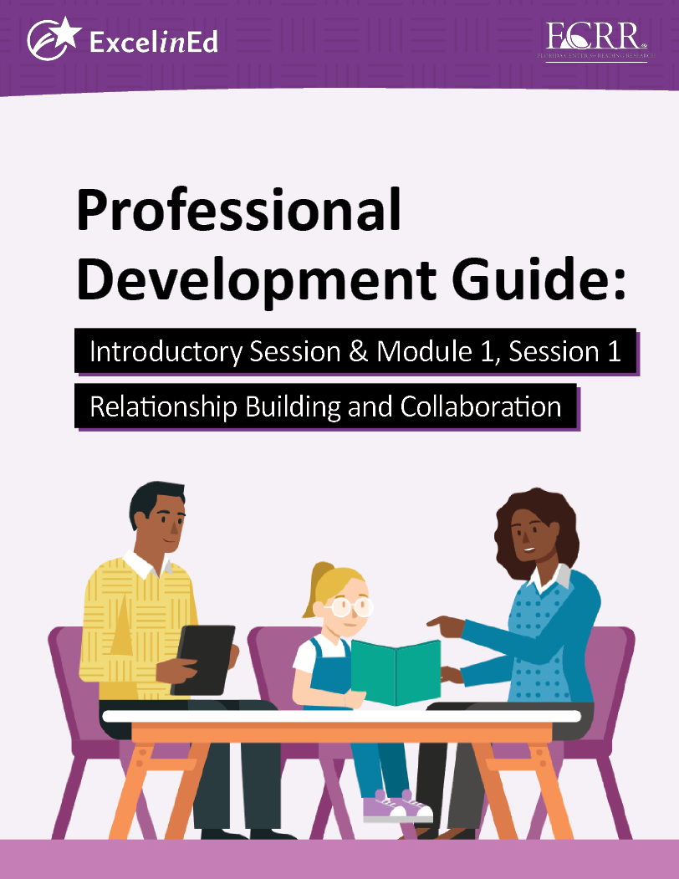
Literacy Coach Program PD Guide
In small groups preview the materials located in the guide for Session 1 of the course.
Note any comments or questions.
Be prepared to debrief in whole group.
Notes:
NOTES Divide participants into small groups and have them preview the Literacy Coach Program PD Guide for Session 1. After each group completes the review, have each group share comments or questions with the whole group for discussion.
5 minutes: Discuss and debrief.

Slide 16

We have completed
the Introductory
Session
Notes:
SAY This is the end of the Introductory Session. Thank you for your participation!
Confirm the date and time of the next session.

Slide 17
Fundamentals of Literacy Coaching
Professional Development Modules
Module 1, Session 1
Relationship Building and Collaboration
Notes:
SAY Welcome to the Fundamentals of Literacy Coaching Professional Development Modules – Session 1: Relationship Building and Collaboration.

Slide 18
Module | Topic | Session | Minutes | Session Date
1 | Applying Principles and Practices that Foster a Positive Culture | Intro | 60
 |  | 1 | 120
 |  | 2 | 150
 |  | 3 | 150
2 | Applying Effective Pedagogy and Andragogy | 4 | 120
 |  | 5 | 120
 |  | 6 | 165
3 | Collecting Data to Inform Professional Learning | 7 | 150
 |  | 8 | 140
 |  | 9 | 170
4 | Planning, Implementing, and Analyzing Literacy Instruction | 10 | 175
 |  | 11 | 135
 |  | 12 | 165
 |  | 13 | 130
5 | Growing Professionally | 14 | 120
 |  | 15 | 120
6 | Planning and Implementing Coaching | 16 | 120
Notes:
NOTES
It is recommended that the sessions are completed in sequential order.
The timeline for completing the sessions can be flexible. If the recommended minutes for each session are not available, complete what you can with the time you have and then pick up where you left off the next time you meet.
Once a schedule of the sessions is established, have participants record the schedule in their Literacy Coach Program PD Guide if printed.
SAY Here is an overview of the modules and sessions of this course. There are six modules, and each module includes two to four sessions for a total of 15 content sessions. Module 1 addresses Applying Principles and Practices that Foster a Positive Culture, Module 2 covers Applying Effective Pedagogy and Andragogy, the focus of Module 3 is Collecting Data on Instructional Practices to Inform Professional Learning, the content of Module 4 is Planning, Implementing and Analyzing Standards-Based Literacy Instruction, the content of Module 5 is Growing Professionally, and the final module addresses Planning and Implementing Coaching.
You can record the date of each of our sessions in your Literacy Coach Program PD Guide.

Slide 19
Bridge to Practice Projects for Coaches
An activity designed to serve as a Bridge to Practice after each Module will provide evidence that coaches are able to apply the knowledge and skills they developed in this course in their schools. Coaches will complete the following activities:
A rubric is provided at the end of each Module for the corresponding Bridge to Practice project.
Module 1 | Develop a principal-coach partnership agreement.
Module 2 | Develop a needs assessment for professional development on evidence-based instructional practices, and complete an ADDIE model for planning this professional development.
Module 3 | Develop and describe planned implementation of a professional learning action plan.
Module 4 | Create a video that reflects coaching to help teachers plan, implement, and analyze standards-based literacy instruction.
Module 5 | Complete a reflection on the course, including plans for continued professional growth.
Module 6 | Choose one teacher with whom you have seen significant growth as a result of coaching support and complete a reflection on what worked, why it worked, and which areas of growth were most evident.
Notes:
SAY We want to remind you that participating coaches will complete a Bridge to Practice project after each module. These projects will provide evidence that coaches are able to apply the knowledge and skills they developed in this course in their schools. You will learn more about each project as we work through the modules. We’ve shared an overview of the projects with you on this slide.
Coaches will
Module 1: develop a principal/coach partnership agreement;
Module 2: conduct a needs assessment for professional development on evidence-based instructional practices and complete an ADDIE model for planning this professional development;
Module 3: develop, implement, and evaluate a professional learning action plan;
Module 4: create a video that reflects coaching to help teachers plan, implement, and analyze standards-based literacy instruction;
Module 5: complete a reflection on the course including plans for continued professional growth.
Module 6: Choose one teacher with whom you have seen significant growth as a result of coaching support and complete a reflection on what worked, why it worked and which areas of growth were most evident.
You may turn in all your artifacts for the projects to your facilitator at the end of each module if requested.

Slide 20
Norms for Our Course
Cell phones on silent
Pay attention to self and others
Presume
positive intentions
Notes:
NOTES Consider your group to determine how much detail about the norms will be helpful to review.
SAY Professional learning opportunities usually consist of a team of educators, like us, that meet regularly to learn new topics, share ideas, and problem solve. We will build a community, meaning that we learn from each other, so sharing and participation are really important.
Professional learning opportunities typically have norms that the group can agree to in order to be productive. Here are three norms, or ground rules, for our way of work: cell phones on silent; pay attention to yourself and others; and presume positive intentions.
Pay attention to self and others This means to contribute, listen, and be aware of how you and others are responding to each other. Be sure to give everyone a chance to talk and encourage others who seem reluctant to join in. Sometimes people who are reluctant to talk are thinking. They may not be comfortable jumping in, but may have something important to say. Professional learning opportunities like this one encourage educators to learn from one another. Therefore, sharing, discussing and participating are important components.
Presume positive intentions This means to pause before responding. Usually when people contribute to a conversation, they intend to be constructive. So, always respond positively to keep the discussions productive.

Slide 21
Share an experience where, as a teacher, coaching was helpful or not so helpful.
What did the coach say?
How did you receive the feedback?
What would have made the experience better?
Notes:
NOTES As the facilitator, start by modeling this ice breaker activity.
Approximately 10 minutes: Depends on number of participants.

Slide 22
Module 1: Applying Principles and Practices that Foster a Positive Culture Goal: Participants will gain the knowledge and ability to apply principles and practices that foster an inclusive and collaborative culture. Session 1 Relationship Building and Collaboration Session 2 Communication Session 3 Establishing Expectations
Define and Discuss Session Goals and Content
Notes:
NOTES Provide an overview of the goal and content for Module 1.

Slide 23
Goals for Today
Define and Discuss Session Goals and Content
Gain an understanding/rationale for the benefits of coaching.
Learn about the importance of building relationships and collaboration through the use of symbolic gestures, selecting locations for interactions, shaping the content of discourse, and understanding how to build effective teams.
Notes:
NOTES Share and discuss these goals for today’s session.

Slide 24
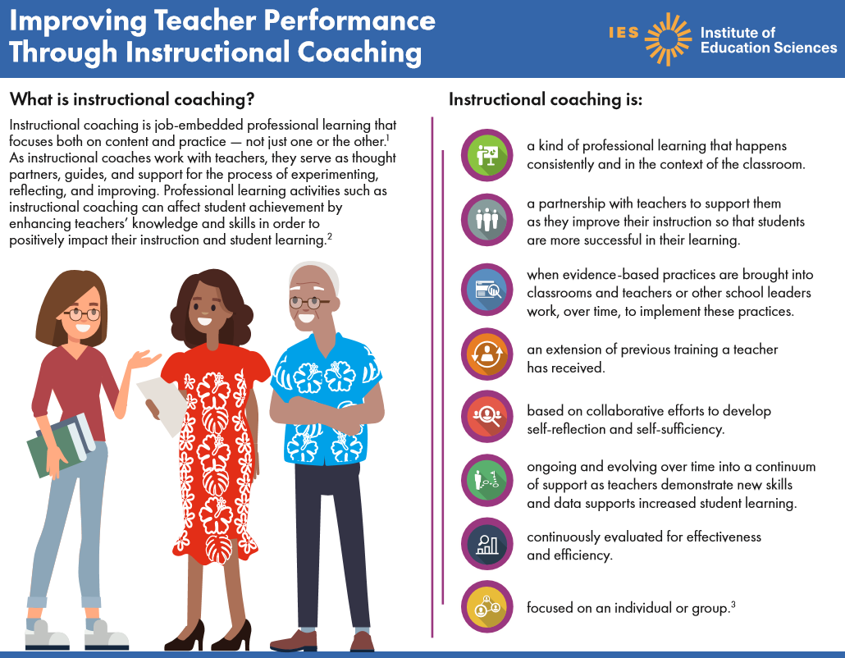
Learn and
Confirm
Notes:
SAY This Institute of Education Sciences infographic, Improving Teacher Performance Through Instructional Coaching, provides an overview of the evidence base for coaching. The next few slides will introduce each section of this infographic. I’ll describe each section and then ask a question to guide our discussion about the content.
Read or ask for a volunteer to read the What is instructional coaching? Paragraph on the slide.
Guiding question for this slide: Does this definition of instructional coaching align with your understanding?
Potential responses: It is important to consider BOTH content and practice. If participants have challenges with responses, consider comparing this definition to Florida’s definition provided on Handout 1.
Full Infographic available at:
https://drive.google.com/file/d/1R2v90QNpgiv0mOJzD85jshmReym5beUG/view?usp=sharing
References for this section:
Archibald, S., Coggshall, J. G., Croft, A., & Goe, L. (2011). High quality professional development for all teachers: Effectively allocating resources. Washington, DC: National Comprehensive Center for Teacher Quality. https://eric.ed.gov/?id=ED520732 2.
Yoon, K. S., Duncan, T., Lee, S. W. Y., Scarloss, B., & Shapley, K. (2007). Reviewing the evidence on how teacher professional development affects student achievement (Issues & Answers Report, REL 2007–No. 033). Washington, DC: U.S. Department of Education, Institute of Education Sciences, National Center for Education Evaluation and Regional Assistance, Regional Educational Laboratory Southwest. https://ies.ed.gov/ncee/edlabs/regions/southwest/pdf/REL_2007033.pdf
Cusmano, D., & Preston, A. (2018). Coaching practice profile. National Implementation Research Network. Chapel Hill, NC: Frank Porter Graham Child Development Institute. https://nirn.fpg.unc.edu/resources/coaching-practice-profile-0

Slide 25
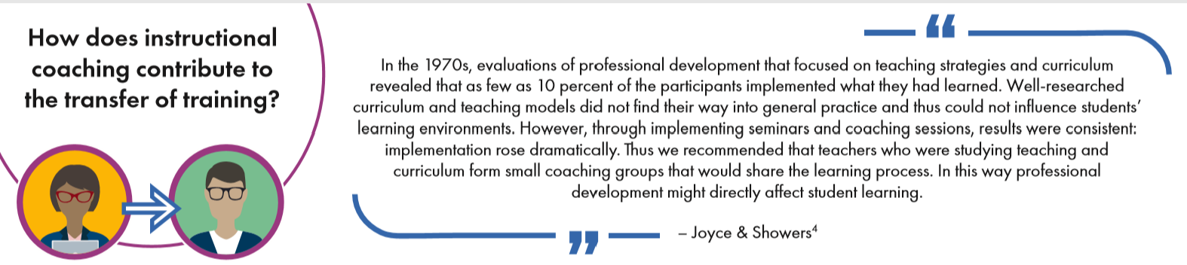
Notes:
SAY The next section of this infographic reviews research about instructional coaching might contribute to the transfer of training.
Read or have someone read the paragraph on the slide.
Guiding question for this slide: Why do you think so few participants implemented what they learned?
Potential responses: These may include answers such as there was often no follow-through, defined expectations, coaching, or administrative support.
Full Infographic available at:
https://drive.google.com/file/d/1R2v90QNpgiv0mOJzD85jshmReym5beUG/view?usp=sharing
Reference for this section:
Showers, B., & Joyce, B. (1996). The evolution of peer coaching. Improving Professional Practice, 53(6), 12–16. https://eric.ed.gov/?id=EJ519769

Slide 26
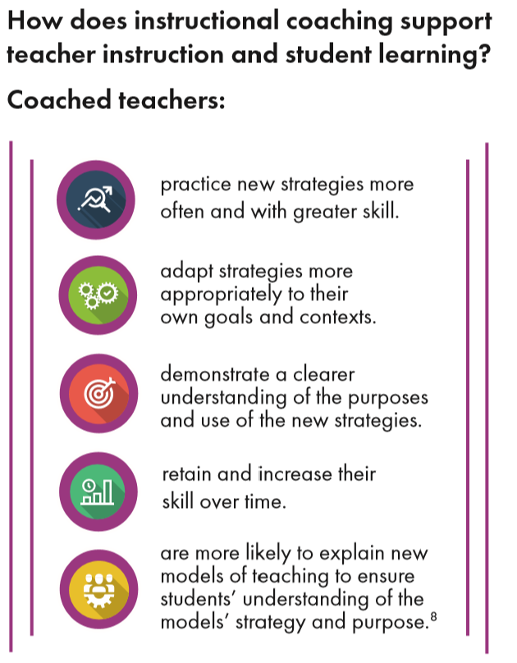
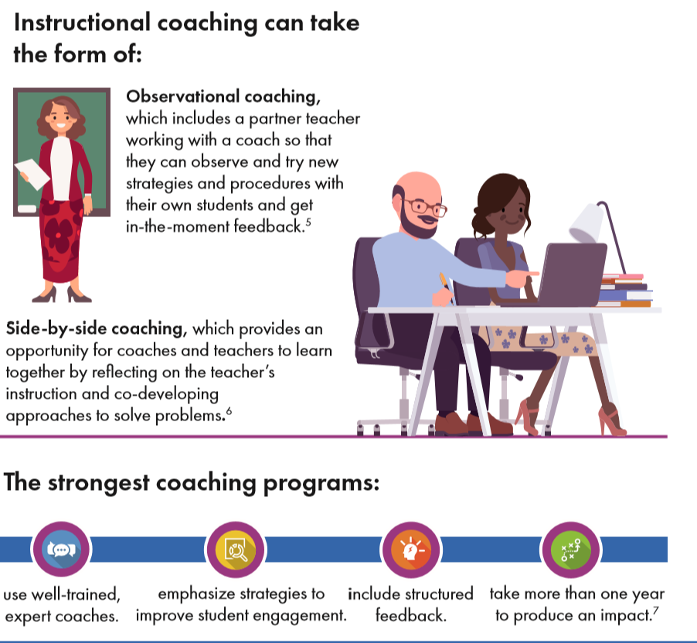
Notes:
SAY The next section of this infographic reviews research about the elements that make up strong coaching programs.
Review the slide.
Guiding question for this slide: Why do you think the four elements noted are part of the strongest coaching programs?
Potential responses: These may include ideas such as coaches often have received little training (which is important), student engagement may often not be considered but is also very important, structured feedback is difficult to provide effectively but important to coaching, and all of this takes time to develop and implement effectively.
https://ies.ed.gov/ncee/edlabs/infographics/pdf/REL_PA_Improving_Teacher_Performance_Through_Instructional_Coaching.pdf
References for this section:
Kretlow, A. G., & Bartholomew, C. C. (2010). Using coaching to improve the fidelity of evidence-based practices: A review of studies. Teacher Education and Special Education, 33(4), 279–299. https://journals.sagepub.com/doi/10.1177/0888406410371643
Akhavan, N. (2015). Coaching side-by-side: One-on-one collaboration creates caring, connected teachers. https://learningforward.org/journal/june-2015-issue/coaching-side-by-side/
Walters, K. (2014). Instructional coaching strategies to support student success in Algebra 1. (pg. 9). Washington, D.C: U.S Department of Education. https://www2.ed.gov/programs/dropout/instructionalcoaching092414.pdf
Showers, B., & Joyce, B. (2002). Student achievement through staff development. Alexandria, VA: Association for Supervision and Curriculum Development. https://www.unrwa.org/sites/default/files/joyce_and_showers_coaching_as_cpd.pdf

Slide 27
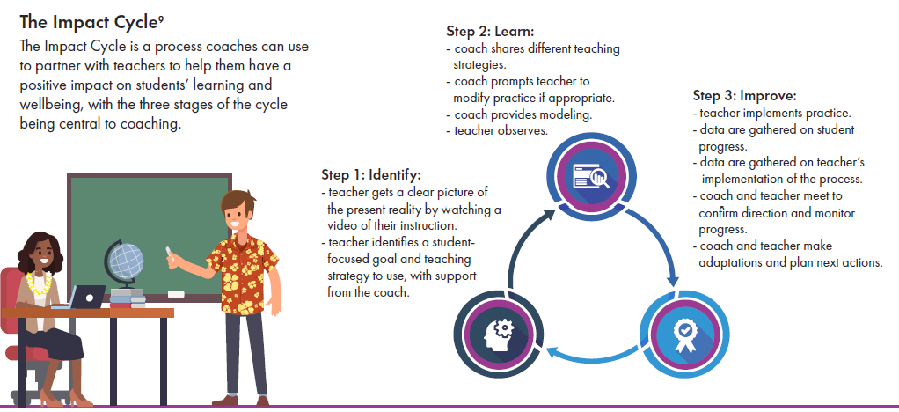
Notes:
SAY The next section of this infographic reviews the Impact Cycle, which is a process coaches can use to partner with teachers to help them have a positive impact on students’ learning and wellbeing. There are three stages of the cycle that are central to coaching: Step 1 is Identify, Step 2 is Learn, and Step 3 is Improve.
Review the Steps 1-3 on the slide.
Guiding question for this slide: Which of the three steps of the impact cycle do you think takes the most time and effort for coaches?
Potential responses: All steps will take time and effort, but answers will probably focus on Step 3: Improve, because this is often the most challenging aspect of coaching – collecting, sharing, and using data to confirm direction, monitor progress, and make adaptations.
Full Infographic available at:
https://drive.google.com/file/d/1R2v90QNpgiv0mOJzD85jshmReym5beUG/view?usp=sharing
Reference for this section:
Knight, J. (2018). The impact cycle: what instructional coaches should do to foster powerful improvements in teaching. Thousand Oaks, CA: Corwin.

Slide 28
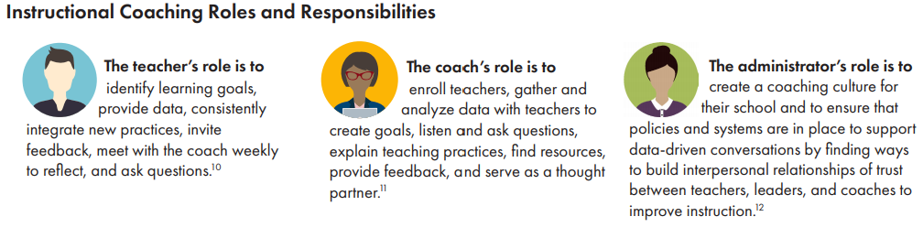
Notes:
SAY The final section of this infographic provides an overview of the roles and responsibilities of teachers, coaches, and administrators regarding instructional coaching.
Review the slide.
Guiding questions for this slide: How does an administrator successfully carry out their role of ‘creating a coaching culture for their school’? What role does a coach play in creating that culture? A teacher?
Potential responses: The administrator sets the tone and expectations for coaching. It is important for coaches to build trust and relationships with teachers. It is also important for teachers to be collaborative and willing to engage in the coaching process.
Full Infographic available at:
https://drive.google.com/file/d/1R2v90QNpgiv0mOJzD85jshmReym5beUG/view?usp=sharing
References for this section:
Knight, J. (2019). Why teacher autonomy is central to coaching success. Educational Leadership, 77(3), 14–20. http://www.ascd.org/publications/educational-leadership/nov19/vol77/num03/Why-Teacher-Autonomy-Is-Central-to-Coaching-Success.aspx10.
Knight, J. (2011). What good coaches do. Educational Leadership, 69(2), 18–22. https://eric.ed.gov/?id=EJ963528
Marsh, J. A., & Farrell, C. C. (2015). How leaders can support teachers with data-driven decision making: A framework for understanding capacity building. Educational Management Administration & Leadership, 43(2), 269–289.

Slide 29
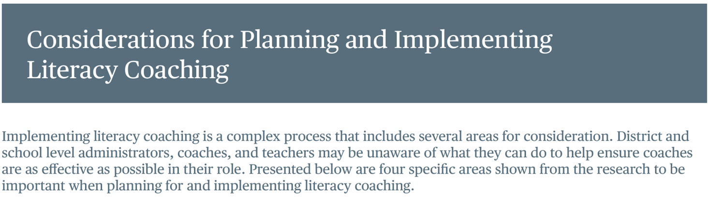
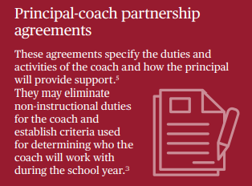
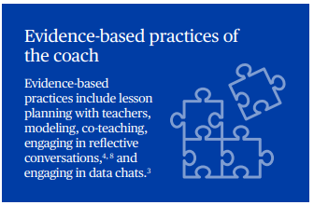
Notes:
SAY This Institute of Education Sciences infographic, Considerations for Planning and Implementing Literacy Coaching, provides an overview of four specific areas shown from the research to be important when planning for and implementing literacy coaching. Those four areas are: principal-coach partnership agreements, evidence-based practices of the coach, hiring and training practices, and communication.
Let’s look at the blue box on the slide. The evidence-based practices of the coach include lesson planning with teachers, modeling, co-teaching, engaging in reflective conversations, and engaging in data chats.
Guiding question for this slide: How are the evidence-based practices of the coach noted aligned with earlier descriptions?
Potential responses: Each of the descriptions have focused on the collaborative nature of coaching along with a focus on reflection and improvement.
Full Infographic available at: https://drive.google.com/file/d/1UYpqKevprG3569DJPprQmSGX8dcqt59x/view?usp=sharing
References for this section:
Marsh, J. A., McCombs, J. S., Lockwood, J. R., Gershwin, D., & Martorell, F. (2008). Supporting literacy across the sunshine state: A study of Florida middle school reading coaches (Vol. 762). Rand Corporation.
Matsumura, L. C., Garnier, H. E., & Spybrook, J. (2013). Literacy coaching to improve student reading achievement: A multi-level mediation model. Learning and Instruction, 25, 35-48.
Matsumura, L. C., Sartoris, M., Bickel, D. D., & Garnier, H. E. (2009). Leadership for literacy coaching: The principal’s role in launching a new coaching program. Educational Administration Quarterly, 45(5), 655–693.
Walpole, S., McKenna, M. C., & Morrill, J. K. (2011). Building and rebuilding a statewide support system for literacy coaches. Reading & Writing Quarterly 27(3), 261–280.

Slide 30
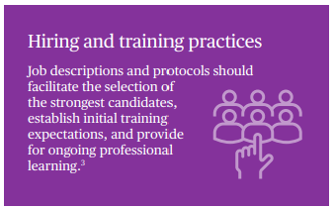
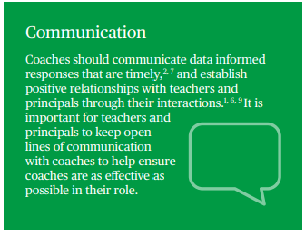
Notes:
SAY Let’s discuss communication, another important area described in this infographic. See the green box on the slide.
Read the green box.
Guiding question for this slide: Why is communication such an important area to emphasize for coaching?
Potential responses: Almost everything that coaches do is connected with their ability to be an effective communicator.
Full Infographic available at: https://drive.google.com/file/d/1UYpqKevprG3569DJPprQmSGX8dcqt59x/view?usp=sharing
References for this section:
Ippolito, J. (2010). Three ways that literacy coaches balance responsive and directive relationships with teachers. Elementary School Journal, 111(1), 164–190.
Kretlow, A. G., & Bartholomew, C. C. (2010). Using coaching to improve the fidelity of evidence-based practices: A review of studies. Teacher Education and Special Education: The Journal of the Teacher Education Division of the Council for Exceptional Children, 33(4), 279–299.
Marsh, J. A., McCombs, J. S., Lockwood, J. R., Gershwin, D., & Martorell, F. (2008). Supporting literacy across the sunshine state: A study of Florida middle school reading coaches (Vol. 762). Rand Corporation.
Neuman, S. B., & Wright, T. S. (2010). Promoting language and literacy development for early childhood educators: A mixed-methods study of coursework and coaching. Elementary School Journal, 111(1), 63–86.
Snyder, P. A., Hemmeter, M. L., & Fox, L. (2015). Supporting Implementation of evidence-based practices through practice-based coaching. Topics in Early Childhood Special Education, 35(3), 133–143.
Walpole, S., & Blamey, K. L. (2008). Elementary literacy coaches: The reality of dual roles. Reading Teacher, 62(3), 222–23.

Slide 31
Literacy Coach Domain and Standards: Session 1
A. Knowledge of and ability to apply principles and practices that foster an inclusive and collaborative culture. Coaches will be able to:
Identify and apply systems that foster an inclusive and collaborative culture (e.g., trust, confidentiality).
Identify and apply strategies that build effective teams.
Identify the strengths and needs of colleagues to engage in effective collaboration.
Notes:
SAY We will now begin to focus on the content of the literacy coach domains and standards. This is the literacy coach domain and three standards that will be covered during this session. Take a moment to review the domain and standards.

Slide 32
Learn and Confirm
Steps to Building a Teacher/Coach Relationship
Facilitating collaboration
Establishing trust
Being visible in the school building
Knowing your role as coach
Refining interpersonal skills
Figure 1. Steps to Building a Teacher/Coach Relationship
Pletcher, 2015
Notes:
SAY This graphic is from the article, Literacy Coaching Advice: Cultivating Healthy Working Relationships with Teachers by Bethanie Pletcher. It illustrates five steps to building a teacher/coach relationship. We will preview this article and share why each step is important to building teacher/coach relationships. The steps are refining interpersonal skills, knowing your role as coach, being visible in the school building, establishing trust, and facilitating collaboration.
Reference:
Pletcher, B. (2015). Literacy Coaching Advice: Cultivating Healthy Working Relationships with Teachers. Texas Journal of Literacy Education, 3(1), 50-56.
https://drive.google.com/file/d/1t0Lv-F4HdkXtEx1eiWYiEGZToXmQ5q3U/view?usp=sharing

Slide 33
Steps to Building a Teacher/Coach Relationship
Teachers are the owners of their classrooms, and their classrooms are often second homes – personal spaces where they choose what happens and when it happens. Coaches have to understand that they are outsiders, and even if they have previously been a part of a school’s faculty, they are now serving in a very different role that requires them to enter these personal spaces. It is up to the coach to maneuver this process delicately and seamlessly.
Refining interpersonal skills
Pletcher, 2015, p. 51
Notes:
SAY Let’s start with refining interpersonal skills.
Review slide.
Guiding question for this slide: What are some things that a coach might consider when transitioning from the role of teacher to coach?
Potential responses: If you have been part of a faculty, considering interactions with teachers outside of your ‘clique.’ If you are at a new school, making new interpersonal connections will be critical. Either way, gaining trust of the faculty members who will engage in coaching will be very important.
Reference:
Pletcher, B. (2015). Literacy Coaching Advice: Cultivating Healthy Working Relationships with Teachers. Texas Journal of Literacy Education, 3(1), 50-56.
https://drive.google.com/file/d/1t0Lv-F4HdkXtEx1eiWYiEGZToXmQ5q3U/view?usp=sharing

Slide 34
Steps to Building a Teacher/Coach Relationship
Interpersonal skills are paramount to being an effective coach (Casey, 2006; Ertmer et al., 2005; Jay, 2009). When school principals hire for a coaching position, they are looking for someone who works well with everyone. Knight (2004) equates this with being “flexible” and “likable” (p. 35). Being “likable” means something different to each coach and each teacher. This means that the coach needs to learn what each teacher thinks likability is. For one teacher, it may mean that the coach stops in and says hello every day. For others, simply leaving a complimentary note after classroom visits is suitable. And still for others, a smile can go a long way. Although some might argue that coaches do not need to be liked by every teacher, it certainly does not hurt.
Refining interpersonal skills
Pletcher, 2015, p. 51
Notes:
SAY Continuing with refining interpersonal skills…
Review slide.
Guiding question for this slide: Which interpersonal skills may be most helpful to develop for coaches?
Potential responses: Connecting with others by being observant, taking notes, remembering pets, children, and other personal and professional interests of the educators that you work with.
Reference:
Pletcher, B. (2015). Literacy Coaching Advice: Cultivating Healthy Working Relationships with Teachers. Texas Journal of Literacy Education, 3(1), 50-56.
https://drive.google.com/file/d/1t0Lv-F4HdkXtEx1eiWYiEGZToXmQ5q3U/view?usp=sharing

Slide 35
Steps to Building a Teacher/Coach Relationship
A significant role of successful coaches is that of a... “community builder, defined as the responsibilities for working both within and across teams of people to build or strengthen relationships. To successfully engage teachers in school-wide reform and facilitate changes in practice, literacy coaches spent much of their time creating, or improving, existing communication systems. They were critical in bringing together members of the school’s PLC, serving as bridges among administrators, teacher teams, and external partners (e.g., university, district). In this role, literacy coaches had to build trust among many people and finesse messages so that they made sense to specific audiences.” Knowing educator culture in the school and responding appropriately and equitably to various audiences is an important part of the community builder role of the coach.
Refining interpersonal skills
Weber, Goldman, Raphael, 2009, p. 28
Notes:
SAY Continuing with refining interpersonal skills…
Review slide.
Guiding question for this slide: What are some important considerations for the coach’s role as a community builder?
Potential responses: Connecting and responding to various audiences and groups, sometimes with conflicting priorities and viewpoints, is an important part of the coach’s role of community building. This includes finding ways to balance the needs of many various stakeholders and responding appropriately and equitable to their needs.
Reference:
Weber, C. M., Raphael, T. E., Goldman, S. R., Sullivan, M. P., & George, M. (2009). Literacy coaches: Multiple issues, multiple roles, multiple approaches. Elementary School Journal.

Slide 36
Steps to Building a Teacher/Coach Relationship
Plainly stated, a coach is not an evaluator (Hunt & Handsfield, 2013; L’Allier, Piper, & Bean, 2010). This understanding must be in place from the beginning, and the principal, especially, needs to internalize this in order for it to filter down to the teachers. Also, coaches who put themselves in the position of expert will, at some point, let their teachers down. Certainly, expert knowledge about one’s content area and how children learn is part of the job; however, to pigeonhole the coach in this manner reinforces the “banking” model of education (Freire, 1970, p. 72), implying that the coach is all-knowing and only to be used for the acquisition of answers. Coaches have to be careful on how feedback is provided. Questioning techniques are critical to this process.
Knowing
your role as coach
Pletcher, 2015, p. 52
Notes:
SAY The next step we’ll discuss is knowing your role as coach.
Review slide.
Guiding question for this slide: How might the role of the coach currently be set by the state? District? Schools?
Potential responses: The literacy coach domains and standards are one way that the role of the coach is being set by one state. Districts often have job descriptions for coaches and administrators are instrumental for setting the role of the coach at the school level.
Reference:
Pletcher, B. (2015). Literacy Coaching Advice: Cultivating Healthy Working Relationships with Teachers. Texas Journal of Literacy Education, 3(1), 50-56.
https://drive.google.com/file/d/1t0Lv-F4HdkXtEx1eiWYiEGZToXmQ5q3U/view?usp=sharing

Slide 37
Steps to Building a Teacher/Coach Relationship
In addition to informing stakeholders of their various duties, it is imperative that the coach’s work is evident in and around the school. This starts before the school year does, as, during the waning days of summer, the literacy coach walks the halls casually and makes early and easygoing contact with teachers. It is key for coaches to be highly visible, especially in common areas (Casey, 2006; L’Allier et al., 2010), by stepping out into the halls, visiting the teachers’ lounge or taking a walk outside when teachers are out at recess with their classes. They should also note when grade level planning times are and check in with teachers during those moments. Teachers are extremely busy people. It is up to the coach to seek out teachers - not the other way around. These visits should be informal and friendly, and it is important that the coach walks around with a smile on his or her face, rather than a look of constant intention.
Being visible in the school building
Pletcher, 2015, p. 53
Notes:
SAY The next step we’ll discuss is being visible in the school building.
Review slide.
Guiding question for this slide: What are some other ways a coach may be visible in the school building?
Potential responses: The coach may also be visible by engaging in literacy promotion activities with teachers, grades, and departments from across the school.
Reference:
Pletcher, B. (2015). Literacy Coaching Advice: Cultivating Healthy Working Relationships with Teachers. Texas Journal of Literacy Education, 3(1), 50-56.
https://drive.google.com/file/d/1t0Lv-F4HdkXtEx1eiWYiEGZToXmQ5q3U/view?usp=sharing

Slide 38

Steps to Building a Teacher/Coach Relationship
As you watch the video, record examples shared and consider how they might benefit collaboration and building teacher/coach relationships.
Being visible in the school building
Video 1: Being Visible in the School Building
Pletcher, 2015, p. 53
Notes:
SAY Now let’s watch Video 1: Being Visible in the School Building. Record a few notes about examples shared and how they might benefit collaboration and building teacher/coach relationships.
Show 7 minute video.
Guiding question for this slide: What were some examples shared and how could they benefit collaboration and building teacher/coach relationships? Are there any more ideas for coach visibility?
Potential responses: There were numerous examples such as the book drive, READ posters, and The Weave project that provided ways that this coach connected with different groups of teachers as part of high visible initiatives across campus to find ways to motivate students to read beyond required assignments. Other ideas may vary.
Reference:
Pletcher, B. (2015). Literacy Coaching Advice: Cultivating Healthy Working Relationships with Teachers. Texas Journal of Literacy Education, 3(1), 50-56.
https://drive.google.com/file/d/1t0Lv-F4HdkXtEx1eiWYiEGZToXmQ5q3U/view?usp=sharing

Slide 39
Steps to Building a Teacher/Coach Relationship
A coach does not automatically gain trust the first day on the job. He or she has to work diligently to lay the groundwork. Trust is a prerequisite to engaging in serious work with teachers (Costa & Garmston, 1994). This involves confidentiality, follow-through, equality, and getting to know teachers. Experts on coaching agree that, in order to gain and keep trust, it is crucial to maintain confidentiality (Bean & DeFord, 2007; Ertmer et al., 2005; L’Allier et al., 2010). There are administrators who sometimes, and possibly with good intentions, choose to use coaches as their eyes and ears in the school. In other words, what happens in coaching conversations should stay in coaching conversations. This is not to say that regular communication with the principal is not necessary, but coaches need to be mindful when sharing observations with administrators.
Establishing trust
Pletcher, 2015, p. 53
Notes:
SAY The next step we’ll discuss is establishing trust.
Review slide.
Guiding question for this slide: Why is establishing trust is so important?
Potential responses: If teachers feel that they cannot trust the coach, then they will be unwilling to be part of a coaching effort.
Reference:
Pletcher, B. (2015). Literacy Coaching Advice: Cultivating Healthy Working Relationships with Teachers. Texas Journal of Literacy Education, 3(1), 50-56.
https://drive.google.com/file/d/1t0Lv-F4HdkXtEx1eiWYiEGZToXmQ5q3U/view?usp=sharing

Slide 40
Steps to Building a Teacher/Coach Relationship
Another aspect of trust that often appears in the literature on coaching is following through. If a teacher reaches out to the coach, which in some cases may be a huge step on the part of that teacher, the coach is obligated to reply immediately (Bean & DeFord, 2007; L’Allier et al., 2010). Again, once a commitment is broken, even just one time, a signal is sent to the teacher that the coach is unreliable, and the teacher will be less likely to ask for assistance again.
To maintain a trusting relationship with teachers, coaches are to be mindful of treating teachers as equal colleagues who learn alongside one another (Ertmer et al., 2005). Every interaction with teachers should be as positive as it can be, building on a teacher’s strengths, just as one would do with students. Also, it takes conscious effort to see teachers through a lens of assistance and empowerment, rather than evaluation.
Establishing trust
Pletcher, 2015, p. 54
Notes:
SAY Continuing with establishing trust…
Review slide.
Guiding questions for this slide: Why is learning as equals important to building teacher/coach relationships?
Potential responses: This helps with both trust and building interpersonal relationships. As noted earlier, if the coach is perceived to be an all knowing fountain of knowledge, then sooner or later teachers are certain to be disappointed.
Reference:
Pletcher, B. (2015). Literacy Coaching Advice: Cultivating Healthy Working Relationships with Teachers. Texas Journal of Literacy Education, 3(1), 50-56.
https://drive.google.com/file/d/1t0Lv-F4HdkXtEx1eiWYiEGZToXmQ5q3U/view?usp=sharing

Slide 41
Steps to Building a Teacher/Coach Relationship
Coaches talk for a living. After all, they begin as teachers - figuring out exact language to use to reach students. Communicating with adults requires a different skill-set, and Knight (2009) asserts that a coach must be a “master of effective communication” (p. 511). To strive for this level, coaches have to spend time with teachers throughout each and every school day. This practice will help them become comfortable talking with teachers (Gibson, 2006). As coaches reach a relaxed level of conversation, it is then time to work on what is perhaps the most critical piece of effective communication: listening. Teachers want to know that they are being listened to and that their ideas are respected. This listening involves eye contact, open body posture, and sometimes calls for a nodding of the head, an inserted “mm-hmm,” and brief paraphrasing.
Facilitating collaboration
Pletcher, 2015, p. 54
Notes:
SAY The last step we’ll discuss is facilitating collaboration.
Review slide.
Guiding question for this slide: What are ways coaches can build collaboration within and among teachers in their school?
Potential responses: The coach can participate in and lead PLCs, faculty presentations, small group discussions, and listening sessions. It is important for coaches to be accessible and engaged with many teachers regularly.
Reference:
Pletcher, B. (2015). Literacy Coaching Advice: Cultivating Healthy Working Relationships with Teachers. Texas Journal of Literacy Education, 3(1), 50-56.
https://drive.google.com/file/d/1t0Lv-F4HdkXtEx1eiWYiEGZToXmQ5q3U/view?usp=sharing

Slide 42
Steps to Building a Teacher/Coach Relationship
Coaches are in schools to empower teachers and lift them to the next level of teaching. This entails meeting the teacher where he or she is (Bean, 2010). Each teacher is unique in that they have varying interests and are at different places in their learning. An effective coach works to figure out these things and knows when and how to engage in shared thinking with teachers (Ippolito, 2010). This process not only helps to build capacity; it can also “boost teachers’ self-efficacy.” (Shanklin, 2006, p. 2).
Facilitating collaboration
Pletcher, 2015, p. 55
Notes:
SAY Continuing with facilitating collaborations…
Review slide.
Guiding question for this slide: What are ways that coaches can differentiate support for teachers to meet them where they are?
Potential responses: The coach may set up small groups once similar interests and needs are determined. For example, the coach may wish to lead orientation efforts for new teachers.
Reference:
Pletcher, B. (2015). Literacy Coaching Advice: Cultivating Healthy Working Relationships with Teachers. Texas Journal of Literacy Education, 3(1), 50-56.
https://drive.google.com/file/d/1t0Lv-F4HdkXtEx1eiWYiEGZToXmQ5q3U/view?usp=sharing

Slide 43
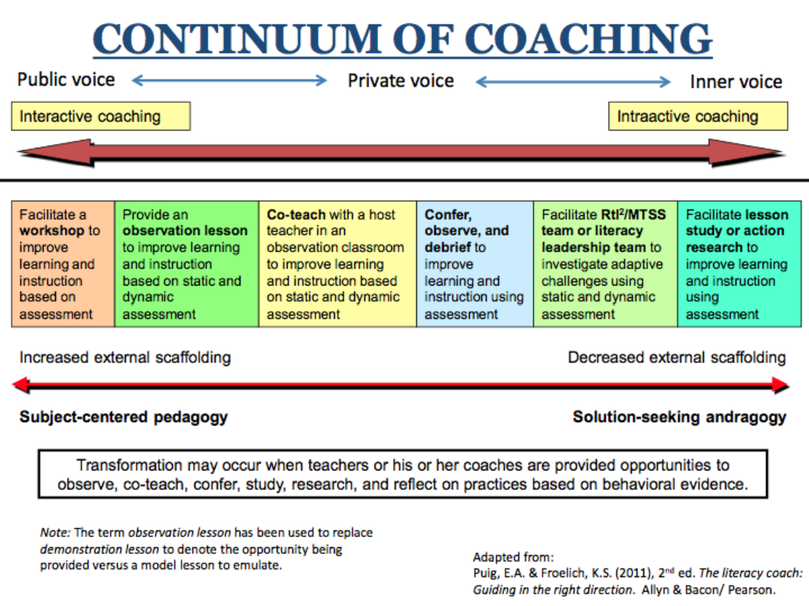
Facilitating collaboration
Notes:
This graphic provides a continuum of coaching with ideas for the different types of coaching support that may be provided to teachers, going from increased scaffolding for interactive coaching that is very much led by the coach to decreased scaffolding for intra-active coaching that may be facilitated by the coach but led by participating teachers.
5 minutes: Discuss and debrief. Share and discuss ways that coaches can differentiate support for teachers through a continuum of coaching like the one shared in this graphic.
Reference:
Puig, E.A.. & Froelich, K.S. (2011). The literacy coach: Guiding in the right direction. Allyn & Bacon/ Pearson. Image available at:
https://drive.google.com/file/d/1jTSnffKzqQEHk18eFwt4jZACKdV_eIQR/view?usp=sharing

Slide 44
Collaborate and Practice
Read Handout 1: How to Build Trust with Teachers: 5 Easy Steps for Instructional Coaches.
Summarize your assigned step.
Share your summary with the group.
While others are presenting, record a non-evaluative question to ask the presenter that may lead to collaborative discussion.
Dowd, 2019
Notes:
NOTE
Determine whether this will be an individual or group activity. Assign each individual or group one step from the article to summarize. After participants complete the activity, ask for volunteers to share.
While sharing, remind participants to record a non-evaluative question to ask the presenter that may lead to a collaborative discussion. Ask for volunteers to share this question after each summary.
30 minutes: Activity.
SAY Please turn to Handout 1: How to Build Trust with Teachers: 5 Easy Steps for Instructional Coaches.
Each of you (or your group) will be assigned one step from this article to summarize and share with the whole group.
While others are presenting, you will record at least one non-evaluative question to ask the person sharing that may lead to a collaborative discussion.

Slide 45

Video 2: 5 Key Roles of an Instructional Coach
Collaborate and Practice
Watch this 5-minute video.
Note any similarities with coaching roles shared previously during this session.
Debrief and discuss the five key roles.
Notes:
SAY Now let’s watch a video: Video 2: 5 Key Roles of an Instructional Coach . As you watch, record any similarities between these 5 key roles and coaching roles shared from other sources previously in this session.
For example, coaching roles were shared in the infographics and in both articles discussed.
Show video. Debrief with the group. 5 Key Roles:
Listener
Advocate
Content Area Expert
Partner in Learning
Data Collector

Slide 46

Post-Session Reflection, Planning, and Implementation
Reflect, Plan, and Implement
READ
Handout 2: Literacy Coaching Advice: Cultivating Healthy Working Relationships with Teachers. This will be helpful for Self-Study 1.
Complete the Self-Study 1: Steps to Building a Teacher-Coach Relationship.
Reflect on your participation in Session 1 by noting any questions about the content or format on Self-Study 1. Bring this self-study assignment to Session 2.
Video 3: Literacy Coaching Interview and complete Self Study 2: Video Viewing Guide for Reflective Coaching Conversation. Be prepared to debrief at the beginning of Session 2.
DO
WATCH
Notes:
NOTE Discuss the self-study participants will complete before Session 2.

Slide 47

Questions?
Notes:
Answer any questions.

Slide 48


We have completed
Session 1
Notes:
SAY This is the end of Session 1. Thank you for your participation!
Confirm the date and time of the next session and provide one final self-study assignment reminder.

