Slide 1
Fundamentals of Literacy Coaching
Professional Development Modules
Module 1, Session 3
Establishing Expectations
Notes:
SAY Welcome to the Literacy Coach Program – Session 3: Establishing Expectations.

Slide 2
Module | Topic | Session | Minutes | Session Date
1 | Applying Principles and Practices that Foster a Positive Culture | Intro | 60
 |  | 1 | 120
 |  | 2 | 150
 |  | 3 | 150
2 | Applying Effective Pedagogy and Andragogy | 4 | 120
 |  | 5 | 120
 |  | 6 | 165
3 | Collecting Data to Inform Professional Learning | 7 | 150
 |  | 8 | 140
 |  | 9 | 170
4 | Planning, Implementing, and Analyzing Literacy Instruction | 10 | 175
 |  | 11 | 135
 |  | 12 | 165
 |  | 13 | 130
5 | Growing Professionally | 14 | 120
 |  | 15 | 120
6 | Planning and Implementing Coaching | 16 | 120
Notes:
NOTES
It is recommended that the sessions are completed in sequential order.
The timeline for completing the sessions can be flexible. If the recommended minutes for each session are not available, complete what you can with the time you have and then pick up where you left off the next time you meet.
Once a schedule of the sessions is established, have participants record the schedule in their Literacy Coach Program PD Guide if printed.
SAY Here is an overview of the modules and sessions of this course. There are six modules, and each module includes two to four sessions for a total of 15 content sessions. Module 1 addresses Applying Principles and Practices that Foster a Positive Culture, Module 2 covers Applying Effective Pedagogy and Andragogy, the focus of Module 3 is Collecting Data on Instructional Practices to Inform Professional Learning, the content of Module 4 is Planning, Implementing and Analyzing Standards-Based Literacy Instruction, the content of Module 5 is Growing Professionally, and the final module, Module 6, addresses Planning and Implementing Coaching.
You can record the date of each of our sessions in your Fundamentals of Literacy Coaching PD Guide.

Slide 3
Bridge to Practice Activities for Coaches
A Bridge to Practice activity after each module will provide evidence that coaches are able to apply the knowledge and skills they developed in this course in their schools.
Coaches will
  Module 1: develop a principal/coach partnership agreement;
  Module 2: develop a needs assessment for professional development on evidence-based instructional practices and complete an ADDIE model for planning this professional development;
  Module 3: develop and describe planned implementation of a professional learning action plan;
  Module 4: create a video that reflects coaching to help teachers plan, implement, and analyze standards-based literacy instruction;
  Module 5: complete a reflection on the course including plans for continued professional growth.
  Module 6: choose one teacher with whom you have seen significant growth as a result of coaching support and complete a reflection on what worked, why it worked and which areas of growth were most evident.
A rubric is provided at the end of each Module for the corresponding Bridge to Practice project.
Notes:
SAY We want to remind you that participating coaches will complete a Bridge to Practice project after each module. These projects will provide evidence that coaches are able to apply the knowledge and skills they developed in this course in their schools. You will learn more about each project as we work through the modules. We’ve shared an overview of the projects with you on this slide.
Coaches will
Module 1: develop a principal/coach partnership agreement;
Module 2: conduct a needs assessment for professional development on evidence-based instructional practices and complete an ADDIE model for planning this professional development;
Module 3: develop, implement, and evaluate a professional learning action plan;
Module 4: create a video that reflects coaching to help teachers plan, implement, and analyze standards-based literacy instruction;
Module 5: complete a reflection on the course including plans for continued professional growth.
Module 6: choose one teacher with whom you have seen significant growth as a result of coaching support and complete a reflection on what worked, why it worked and which areas of growth were most evident.
You may turn in all your artifacts for the projects to your facilitator at the end of each module.

Slide 4



Norms For Our Course
Cell phones on silent
Pay attention to self and others
Presume
positive intentions
Notes:
NOTES Consider your group to determine how much detail about the norms will be helpful to review.
SAY Professional learning opportunities usually consist of a team of educators, like us, that meet regularly to learn new topics, share ideas, and problem solve. We will build a community, meaning that we learn from each other, so sharing and participation are really important.
Professional learning opportunities typically have norms that the group can agree to in order to be productive. Here are three norms, or ground rules, for our way of work: cell phones on silent; pay attention to yourself and others; and presume positive intentions.
Pay attention to self and others This means to contribute, listen, and be aware of how you and others are responding to each other. Be sure to give everyone a chance to talk and encourage others who seem reluctant to join in. Sometimes people who are reluctant to talk are thinking. They may not be comfortable jumping in but may have something important to say. Professional learning opportunities like this one encourage educators to learn from one another. Therefore, sharing, discussing and participating are important components.
Presume positive intentions This means to pause before responding. Usually when people contribute to a conversation, they intend to be constructive. So, always respond positively to keep the discussions productive.

Slide 5

Goals for Today
Define and Discuss Session Goals and Content
Determine and apply strategies that promote collective responsibility for student and professional learning, establish a coach/teacher partnership agreement, and establish a principal/coach partnership agreement.
Complete Module 1 of the Fundamentals of Literacy Coaching Professional Development Modules.
Prepare to complete the Module 1 Bridge to Practice Project: Develop a Principal/Coach Partnership Agreement.
Notes:
NOTES Share and discuss these goals for today’s session.

Slide 6

Review of Module 1, Session 2
Debrief
Discuss important aspects of appropriate practices to communicate
across lines of difference and facilitating dialogue that ensures
equitable participation.
Discuss the article, activity, and video-viewing guide completed
after Session 2.
Discuss any questions or comments regarding the last session.
Notes:
NOTES Allow about 7 minutes for this debrief. If you have a small group, ask for volunteers to share with the whole group. If you have a large group, consider having triads discuss and then ask for a volunteer from each triad to share with the large group.
Participants will need (from Module 1, Session 2):
-Handout 6: Coaching in Context (article)
-Self-Study 1: Reflections on Session 2 and Communication
-Self-Study 2: Video-Viewing Guide for Video 3 Coaching Conversations with Diana Beabout and Video 4 Observations and Feedback

Slide 7
Literacy Coach Domain and Standards: Session 2
Define and Discuss Session Goals and Content
A. Knowledge of and ability to apply principles and practices that foster an inclusive and collaborative culture. Coaches will be able to:
Determine and apply strategies that promote collective responsibility
for student and professional learning (e.g., Professional Learning Communities, collaborative planning, lesson study).
Establish a coach/teacher partnership agreement.
Establish a principal/coach partnership agreement.
Notes:
SAY This is the literacy coach domain and three standards that will be covered during this session.

Slide 8

Learn and Confirm
Establishing Expectations
Promoting collective responsibility for student and professional learning. Strategies to discuss and apply:
Professional Learning Communities (PLCs)
Lesson study
Collaborative planning
Notes:
SAY Coaches are expected to lead and facilitate professional learning efforts. There are several professional learning strategies or approaches that help promote collective responsibility for student and professional learning, such as PLCs, collaborative planning, and lesson study. Each approach will be discussed in this session along with determinations for the coach’s role to facilitate and apply these methods.

Slide 9
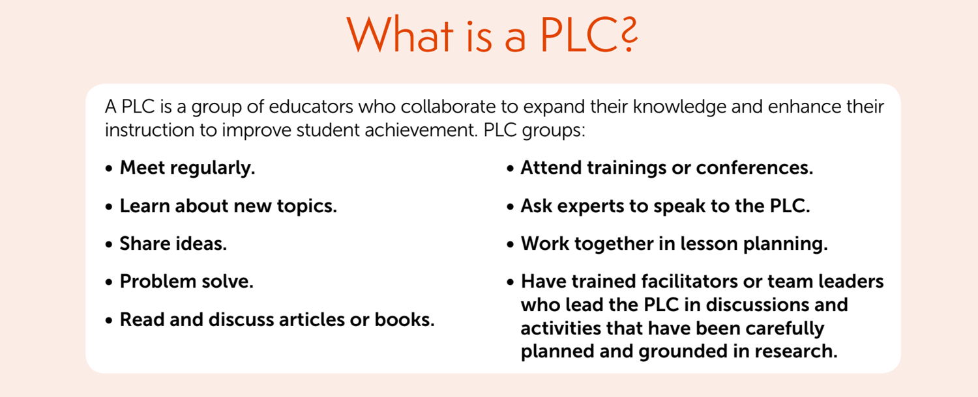
Establishing Expectations
Notes:
SAY This PLC definition from the Institute of Education Sciences infographic, Developing Early Literacy Professional Learning Communities (PLCs) provides an overview of what PLCs are and how they operate. The next slide will discuss the qualities that a PLC facilitator, often the literacy coach, should possess.
Guiding question for this slide: Does this definition of a PLC align with your understanding?
Full infographic available at:
https://drive.google.com/file/d/1qFhUGqVvesJeRFZuUB_Ti-myJhQNewKJ/view?usp=sharing

Slide 10
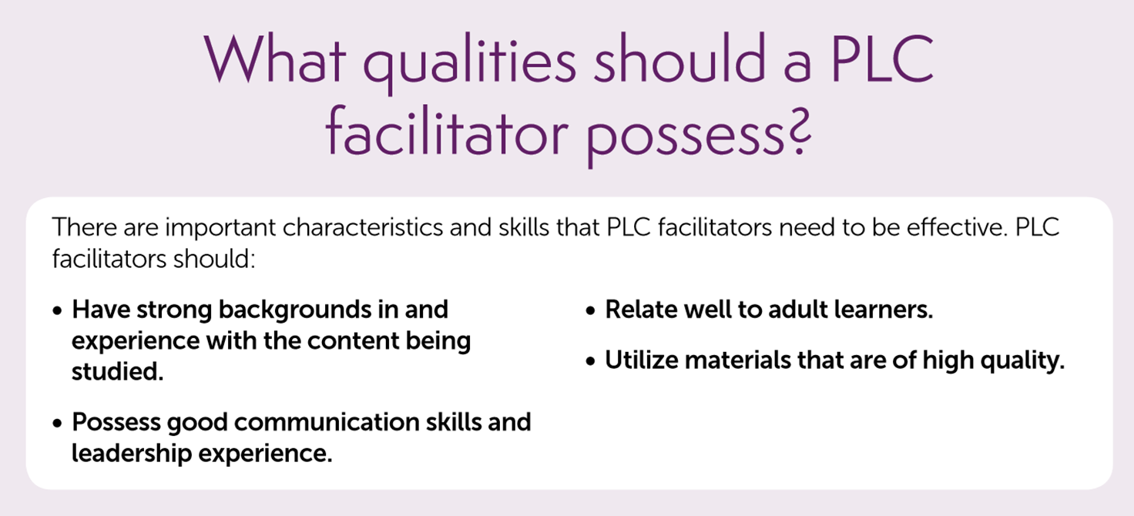
Notes:
NOTES This PLC facilitator qualities overview is from the Institute of Education Sciences infographic, Developing Early Literacy Professional Learning Communities (PLCs).
Guiding questions for this slide: What other qualities do you think a PLC facilitator should have? What role(s) could coaches play in facilitating PLCs?
Full infographic available at:
https://drive.google.com/file/d/1qFhUGqVvesJeRFZuUB_Ti-myJhQNewKJ/view?usp=sharing

Slide 11
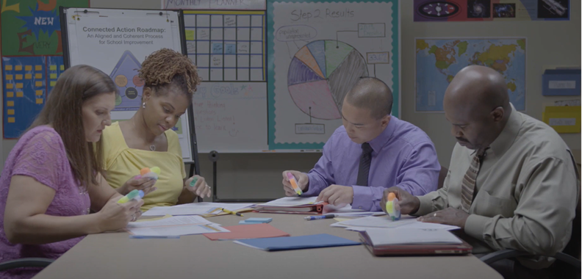
Establishing Expectations: PLCs at Work
Video 1: PLCs at Work Analyzing Data presents an overview of PLC expectations for a group of teachers analyzing and using formative assessment data.
Handout 1: Video-Viewing Guide for Video 1: Watch the video, complete the viewing guide, and discuss at your tables.
Notes:
NOTES
Allow 20 minutes for viewing the video and completing the activity. Show Video 1 (10 minutes) and allow time for participants to record their answers to the questions on Handout 1.
SAY Please review the questions on Handout 1: Video-Viewing Guide for Video 1: PLCs at Work Analyzing Data. Let’s watch a video of a group of teachers in a PLC setting expectations and discussing the analysis of data from their students for decision making about classroom instruction.
Ask for volunteers to share their answers to the questions on Handout 1.
Possible responses for questions:
Honor times. State objective and stay focused. Actively listen and participate. Respond positively. Address violations. Reflect.
Be honest about the data. No blaming. Focus on student progress. It is not about YOU, but it is about student learning. Reflect on revisions. Share best practices and what did not work well.
Stopping for questions. They’ve taken turns leading the discussion. They discussed how to analyze the data based on a four point rubric.
Examples: Many students were developing and emerging in one category. There was a balance under advanced and proficient in two categories. Great visual to see connections. The group brainstormed practices that might help student learning, such as highlighting supporting evidence in text and flexible grouping.
Strengths included the fact that there were established procedures that were used. The teachers seemed to have a positive relationship and respected one another; the focus of the conversation was student-focused and standards-based – what could be improved to ensure instruction resulted in students learning the standards.
The PLC group promoted collective responsibility for student and professional learning by discussing ways that they could support each other as a team, analyzing data across the teacher group and sharing strategies that may help address student skill gaps.

Slide 12
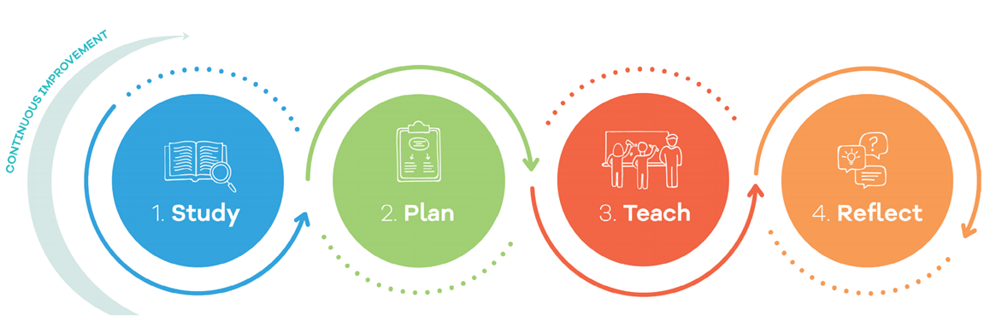
Lesson Study
A team of teachers
collaborates to:
Identify long-term goals for students
Choose the subject and unit to investigate
Study standards, research, and curricula
Using insights from the Study phase, the team:
Examines the unit and chooses one lesson to plan in depth
Articulates the lesson goals
Tries the lesson task and anticipates student thinking
Identifies data to be collected during the lesson
The team puts that lesson into action:
One team member teaches the lesson
Other team members observe and record student thinking and learning
The team then reflects on their work by:
Meeting after the lesson to discuss data on student thinking and learning
Having an outside specialist provide further commentary
Reflecting on what they learned during the cycle as a whole
Notes:
SAY This infographic on Lesson Study describes a 4-step process: Study, Plan, Teach, Reflect. Review the slide.
Guiding question for this slide: What should happen after the Reflect stage of Lesson Study?
Potential responses: The lesson study team could make revisions to the lesson based on data and specialist commentary. The team could also establish or review procedures for facilitating lesson study in the future.

Slide 13
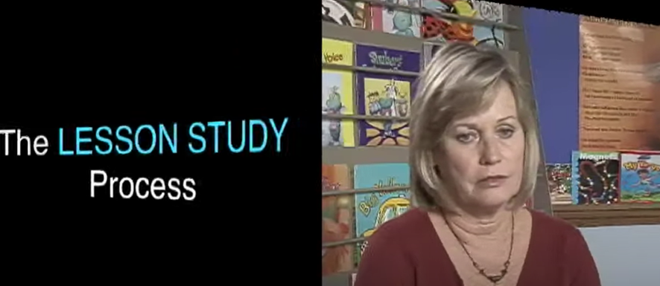
The Lesson Study Process: Understandings and Expectations
This video presents an overview of the lesson study process and helps provide expectations for the process and facilitation. As you watch it, consider how this process helps promote collective responsibility for student and professional learning.
Video 2: The Lesson Study Process
Notes:
SAY Now let’s watch Video 2: The Lesson Study Process. Record a few notes about examples shared and how this process helps promote collective responsibility for student and professional learning.
Show 14-minute video.
Guiding questions for this slide: How can this process help promote collective responsibility for student and professional learning?
Potential responses: By planning for and preparing the lesson together, analyzing data, and reflecting upon outcomes, the lesson study process helps promote collective responsibility for student and professional learning. Other ideas may vary.
What role(s) could coaches play in lesson study?
Potential responses: The coach could facilitate the lesson study process, help with data analysis, and serve as the ‘outside specialist’ providing further commentary.

Slide 14
Collaborative Planning
The coach’s role as a curriculum specialist
Read Handout 2: Coaches’ Multiple Roles Support Teaching and Learning.
In what ways is collaborative planning important to the coach’s role as a curriculum specialist?
Notes:
SAY We will now explore coaches’ multiple roles to support teaching and learning. We will start with reading Handout 2: Coaches Multiple Roles Support Teaching and Learning which describes the coach’s role as a curriculum specialist. As you read this article, consider how planning plays a significant part of the coach role as a curriculum specialist.
Guiding question for this slide: In what ways is collaborative planning important to the coach’s role as a curriculum specialist?

Slide 15

Collaborate and Practice
Collaborative Planning
Read Handout 3: Weekly Lesson Planning Template.
How could this template be used by coaches to scaffold weekly lesson planning?
Notes:
SAY We will now look at a lesson plan template that could be used for collaborative planning. Review Handout 3: Weekly Lesson Planning Template with your small group and consider the question noted on this slide.
Guiding question for this slide: How could this template be used by coaches to scaffold weekly lesson planning?

Slide 16
Coach Roles and Expectations
Read Handout 4: Overview of Coach Roles.
Summarize your assigned role(s).
Share your summary with the group.
While others are presenting, record a non-evaluative question to ask the presenter that may lead to collaborative discussion.
Notes:
NOTES
Allow 30 minutes for this activity.
Determine whether this will be an individual or group activity. Assign each individual or group one role from the handout to summarize. After participants complete the activity, ask for volunteers to share.
While sharing, remind participants to record a non-evaluative question to ask the presenter that may lead to a collaborative discussion. Ask for volunteers to share this question after each summary.
SAY Please turn to Handout 4: Overview of Coach Roles. Each of you (or your group) will be assigned one role from this tool to summarize and share with the whole group. While others are presenting, you will record at least one non-evaluative question to ask the person sharing that may lead to a collaborative discussion.

Slide 17
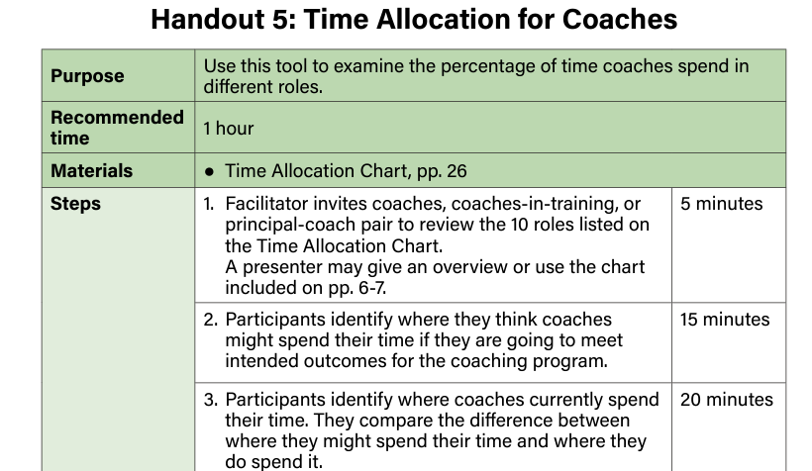
Coach Time Allocation
Read Handout 5: Time Allocation for Coaches
Notes:
NOTE Allow 10 minutes for this activity. Have each group or pair identify where they think coaches might spend their time in each of the roles noted on page 9. Ask for volunteers to share and discuss their responses.
SAY Please turn to page 8 of Handout 5: Time Allocation for Coaches.
Each of you (or your group) will complete and discuss time allocations for each of the roles based on intended outcomes for your coaching program.

Slide 18
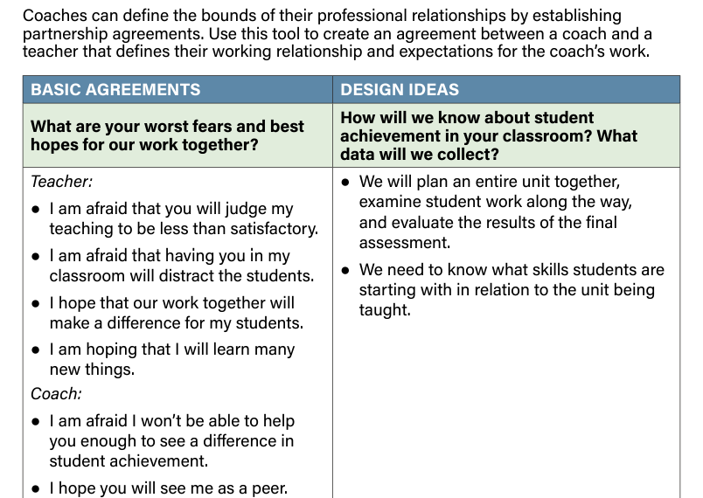
Collaborate and Practice
Teacher/Coach Partnership Agreements
Read Handout 6: Sample Partnership Agreement Between Instructional Coach and Teacher.
Establish the basic agreements and design issues important to your coach/teacher partnership agreement.
Notes:
NOTE Have each group or pair discuss the basic agreements and design issues presented in Handout 6.
10 minutes: Activity.
SAY Please turn to Handout 6: Sample Partnership Agreement Between Instructional Coach and Teacher. Each of you (or your group) will discuss the basic agreements and design issues shared in this sample. Consider the basic agreements and design issues that would be important to include as you establish a coach/teacher partnership agreement.

Slide 19
Principal/Coach Partnership Agreement
Use the following handouts to complete the Bridge to Practice project for Module 1:
Read Handout 7: Creating an Administrator-Coach Partnership.
Use Handout 8: Principal Coach Partnership Agreement Template to create a principal-coach partnership agreement.
Review Handout 9: Principal Coach Partnership Agreement Rubric.
Share any questions with your pair or small group and then with the whole group.
Notes:
NOTE Allow 10 minutes for this activity.
SAY Let’s prepare for the Bridge to Practice project for Module 1. You will use three handouts as resources to complete this project. For now, each of you (or your group) will review the three handouts listed on this slide and discuss. Then we will share thoughts and questions with the whole group.
Handout 7: Creating an Administrator-Coach Partnership
Handout 8: Principal Coach Partnership Agreement Template
Handout 9: Principal Coach Partnership Agreement Rubric

Slide 20

Post-Session Reflection, Planning, and Implementation
Reflect, Plan, and Implement
READ
Handout 10: Making the Most of the Teacher-Coach Relationship. This will be helpful for developing Partnership Agreements.
Self-Study 1: Teacher-Coach Partnership Agreement.
Video 3: Why Principals Must Support Coaches and complete Self-Study 2: Video-Viewing Guide for Principal Coach Support. Be prepared to debrief at the beginning of Session 4.
Retrieved from: https://www.youtube.com/watch?v=iCA3RRC9dUc on 1/04/2024.
Bridge to Practice Activity: COMPLETE PRINCIPAL/COACH PARTNERSHIP AGREEMENT using Handout 8: Principal Coach Partnership Agreement Template.
DO
WATCH
Notes:
NOTE Spend time discussing the self-study participants will complete before Session 4 and review the rubric for the Bridge to Practice activity.

Slide 21

Questions?
Notes:
SAY Are there any questions that you have regarding the content of this session, the self-study activities, or the course in general?

Slide 22




We have completed
Session 3 and Module 1
Notes:
SAY Congratulations on successfully completing Session 3 and Module 1! We look forward to seeing you for Session 4 as we begin Module 2.
Confirm the date and time of the next session.

