Slide 1
Fundamentals of Literacy Coaching
Professional Development Modules
Module 2, Session 5
Effective Practices in Teaching Adults
Notes:
SAY Welcome to Fundamentals of Literacy Coaching Professional Development Modules – Session 5: Effective Practices in Teaching Adults.

Slide 2
Module | Topic | Session | Minutes | Session Date
1 | Applying Principles and Practices that Foster a Positive Culture | Intro | 60
 |  | 1 | 120
 |  | 2 | 150
 |  | 3 | 150
2 | Applying Effective Pedagogy and Andragogy | 4 | 120
 |  | 5 | 120
 |  | 6 | 165
3 | Collecting Data to Inform Professional Learning | 7 | 150
 |  | 8 | 140
 |  | 9 | 170
4 | Planning, Implementing, and Analyzing Literacy Instruction | 10 | 175
 |  | 11 | 135
 |  | 12 | 165
 |  | 13 | 130
5 | Growing Professionally | 14 | 120
 |  | 15 | 120
6 | Planning and Implementing Coaching | 16 | 120
Notes:
NOTES
It is recommended that the sessions are completed in sequential order.
The timeline for completing the sessions can be flexible. If the recommended minutes for each session are not available, complete what you can with the time you have and then pick up where you left off the next time you meet.
Once a schedule of the sessions is established, have participants record the schedule in their Fundamentals of Literacy Coaching PD Guide if printed.
SAY Here is an overview of the modules and sessions of this course. There are six modules, and each module includes two to four sessions for a total of 15 content sessions. Module 1 addresses Applying Principles and Practices that Foster a Positive Culture, Module 2 covers Applying Effective Pedagogy and Andragogy, the focus of Module 3 is Collecting Data on Instructional Practices to Inform Professional Learning, the content of Module 4 is Planning, Implementing and Analyzing Standards-Based Literacy Instruction, the content of Module 5 is Growing Professionally, and the final module, Module 6, addresses Planning and Implementing Coaching.
You can record the date of each of our sessions in your Fundamentals of Literacy Coaching PD Guide.

Slide 3
Bridge to Practice Projects for Coaches
An activity designed to serve as a Bridge to Practice after each Module will provide evidence that coaches are able to apply the knowledge and skills they developed in this course in their schools. Coaches will complete the following activities:
A rubric is provided at the end of each Module for the corresponding Bridge to Practice project.
Module 1 | Develop a principal-coach partnership agreement.
Module 2 | Develop a needs assessment for professional development on evidence-based instructional practices and complete an ADDIE model for planning this professional development.
Module 3 | Develop and describe planned implementation of a professional learning action plan.
Module 4 | Create a video that reflects coaching to help teachers plan, implement, and analyze standards-based literacy instruction.
Module 5 | Complete a reflection on the course, including plans for continued professional growth.
Module 6 | Choose one teacher with whom you have seen significant growth as a result of coaching support and complete a reflection on what worked, why it worked, and which areas of growth were most evident.
Notes:
SAY We want to remind you that participating coaches will complete a Bridge to Practice project after each module. These projects will provide evidence that coaches are able to apply the knowledge and skills they developed in this course in their schools. You will learn more about each project as we work through the modules. We’ve shared an overview of the projects with you on this slide.
Coaches will
Module 1: develop a principal/coach partnership agreement;
Module 2: conduct a needs assessment for professional development on evidence-based instructional practices and complete an ADDIE model for planning this professional development;
Module 3: develop, implement, and evaluate a professional learning action plan;
Module 4: create a video that reflects coaching to help teachers plan, implement, and analyze standards-based literacy instruction;
Module 5: complete a reflection on the course including plans for continued professional growth.
Module 6: Choose one teacher with whom you have seen significant growth as a result of coaching support and complete a reflection on what worked, why it worked and which areas of growth were most evident.
You may turn in all your artifacts for the projects to your facilitator at the end of each module if requested.

Slide 4



Norms for Our Course
Cell phones on silent
Pay attention to self and others
Presume
positive intentions
Notes:
NOTES Consider your group to determine how much detail about the norms will be helpful to review.
SAY Professional learning opportunities usually consist of a team of educators, like us, that meet regularly to learn new topics, share ideas, and problem solve. We will build a community, meaning that we learn from each other, so sharing and participation are really important.
Professional learning opportunities typically have norms that the group can agree to in order to be productive. Here are three norms, or ground rules, for our way of work: cell phones on silent; pay attention to yourself and others; and presume positive intentions.
Pay attention to self and others This means to contribute, listen, and be aware of how you and others are responding to each other. Be sure to give everyone a chance to talk and encourage others who seem reluctant to join in. Sometimes people who are reluctant to talk are thinking. They may not be comfortable jumping in but may have something important to say. Professional learning opportunities like this one encourage educators to learn from one another. Therefore, sharing, discussing and participating are important components.
Presume positive intentions This means to pause before responding. Usually when people contribute to a conversation, they intend to be constructive. So, always respond positively to keep the discussions productive.

Slide 5

Goals for Today
Define and Discuss Session Goals and Content
Review Session 4 and debrief the Self-Study activities completed after the session.
Learn how to identify foundational principles of adult learning theory.
Learn how to apply foundational principles of adult learning theory.
Preview the Self-Study activities to be completed before Session 6.
Notes:
NOTES Share and discuss these goals for today’s session.

Slide 6

Review of Module 2, Session 4
Debrief
Handout 5: Teachers Taking Up Explicit Instruction: The Impact of a Professional Development and Directive Instructional Coaching Model
Share any questions or comments about this reading.
Self-Study 1: Reflections on Session 4
How can we ensure that teachers teach in ways that are most effective in promoting student learning?
Any comments or questions about Session 4?
Self-Study 2: Video 4: Video Viewing Guide for Active Participation Part 1
Share responses to questions about Self-Study 2.
Notes:
NOTES Allow about 7 minutes for this debrief. If you have a small group, ask for volunteers to share with the whole group. If you have a large group, consider having triads discuss and then ask for a volunteer from each triad to share with the large group.
SAY After Session 4, you had something to read, something to do, and something to watch. Let’s debrief. You read Handout 5: Teachers Taking Up Explicit Instruction: The Impact of a Professional Development and Directive Instructional Coaching Model
•What questions or comments do you have about this reading?
Answers to Session 1, Self-Study 1 may vary
You also watched Video 4: Viewing Guide Active Participation Part 1 and completed Self-Study 2: Video-Viewing Guide Active Participation Part 1. Ask participants to share their answers to the questions on Self-Study 2.

Slide 7
Literacy Coach Domain and Standards: Session 5
B. Knowledge of and ability to apply effective pedagogy and andragogy. Coaches will be able to:
2. Identify and apply foundational principles of adult learning theory.
Notes:
SAY We will now begin to focus on the content of the literacy coach domains and standards. This is the Literacy Coach Domain and standard that will be covered during this session. Take a moment to review the domain and standard on the slide.

Slide 8

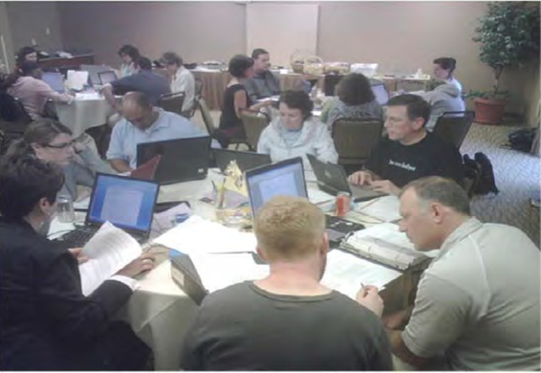
Learn and Confirm
Building Knowledge of Adult Learners
Notes:
SAY Coaching requires specialized knowledge – knowledge of adult learning theory, knowledge of content, and knowledge of differentiation.
As you guide the participants through Session 5, keep in mind how adults learn best and allow for opportunities to collaborate, and give participants choices for presenting and sharing information.

Slide 9
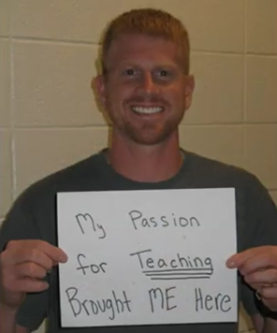
Building Knowledge of Adult Learners
Video 1: Vision of an Adult Learner presents aspects of adult learning.
How do you learn best?
What are the implications for your coaching after viewing this video?
Notes:
NOTES View Video 1: Vision of an Adult Learner (3:29).
SAY (after watching the video): How do you learn best? What are the implications for your coaching after viewing this video?
You may want to chart the participant’s answers to refer back to during the training.
Just as we saw the different goals and perspectives of the teachers in the video, all of our teachers have different goals and different perspectives as well.

Slide 10
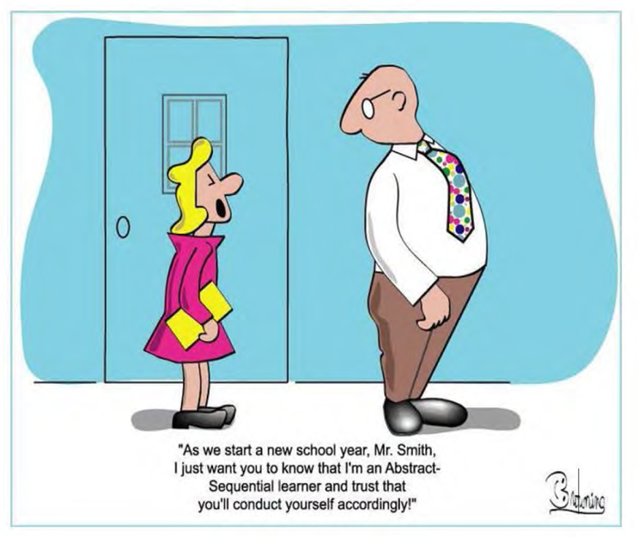
Building Knowledge of Adult Learners
Notes:
SAY Part of being an effective coach involves understanding adult learners. Just like our students, the teachers we work with are all different. As we support teachers as they learn, grow, and make shifts toward change, we need to really know and understand them – What is this teacher excited about? What do they care about? What motivates them? How are they thinking about their work? What are their beliefs and assumptions about their role as teacher?
Give participants an opportunity to identify specific teachers and answer the questions above. Share with participants: For coaching to be as effective as possible, we need to work at establishing a culture of adult learning.
SAY For coaching to be as effective as possible, we need to work at establishing a culture of adult learning.

Slide 11
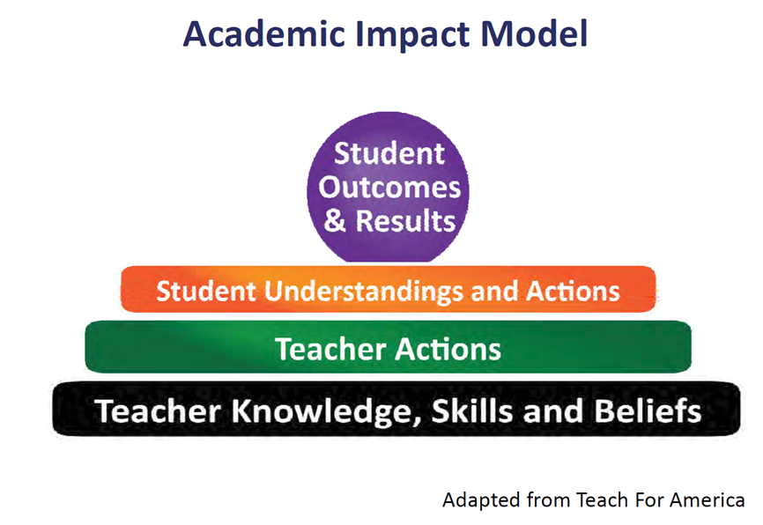
Building Knowledge of Adult Learners
Notes:
SAY As coaches, how we approach interactions with teachers may differ depending on teacher knowledge, experience and desire to change, but our interactions must always be built upon a respect for the goals and beliefs of individual teachers about teaching, learning and literacy.
Most adults enter a learning experience to create change – whether it’s for a change in our skills, our behavior, beliefs or attitudes or our level of knowledge. We know that our goal as coaches is to support teachers in ways that will have a positive impact on student learning!
This visual of the Academic Impact Model (AIM) is a framework that shows how we can provide professional learning experiences that will address adult learners as they look to change knowledge, skills and beliefs.
We know that our ultimate goal is positive student outcomes and academic results (the circle on the slide). What students know, understand and DO, will impact their achievement in the classroom (the orange bar). Underlying that…we see that what a teacher actually does in the classroom will impact student understanding and actions (green bar). At the very foundation of this model is what a teacher does, or does not, ”KNOW,” “DO” or “BELIEVE,” will impact the actions the teacher takes in the classroom (black bar).
Ask the participants to discuss the following:
Discuss the implications of this model as it pertains to your coaching.
How do we help teachers implement change?
How do we support our adult learners as they make changes after new learning experiences?
How does knowing this impact our coaching?

Slide 12

Learn and Confirm
Building Knowledge of Adult Learners
Andragogy
“The art and science of helping adults learn…is based on certain crucial assumptions about the differences between children and adults as learners” (Knowles, 1968).
Notes:
NOTES Share with participants the difference between Pedagogy and Andragogy.
SAY As we saw in the video, all adults approach learning from different perspectives ‐knowledge varies, skill levels vary, and we all have different backgrounds and experiences.
A Pedagogical model gives the teacher the responsibility of making decisions about the learning and development is based on the transmission of the content.
An Andragogical model notes that adult learner’s development is based on a process of facilitating the acquisition of content rather that transmitting the content. Adults learn differently from children, so adults require different instructional strategies.

Slide 13
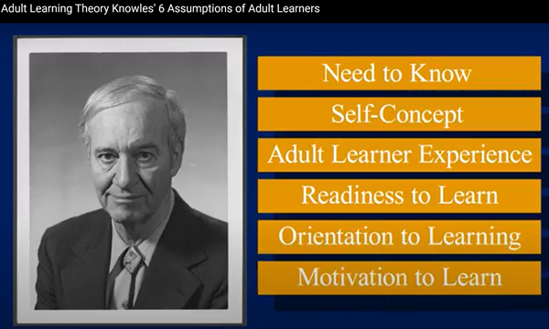
Building Knowledge of Adult Learners
Video 2: Adult Learning Theory: Knowles’s 6 Assumptions of Adult Learners presents assumptions and characteristics of adult learners that are important to consider for coaching.
Consider the importance of the assumptions/characteristics.
Video retrieved from https://www.youtube.com/watch?v=SArAggTULLU 01/04/24.
Notes:
NOTES View Video 2: Adult Learning Theory: Knowle’s 6 Assumptions of Adult Learners (3:52). The video will prepare the participants for the next activity.
Video retrieved from https://www.youtube.com/watch?v=SArAggTULLU on 1/04/24.

Slide 14

Collaborate and Practice
Building Knowledge of Adult Learners
What Does the Research Say?
Each table will use articles (Handouts 1-4) to research a characteristic of adult learners. (need to know; self-concept; adult learner experience; readiness to learn; orientation to learning; motivation to learn)
Describe the characteristics of the learner you have been assigned.
How is this characteristic different from a young learner?
What are the implications for coaching?
What are some strategies aligned with this characteristic that you can use with teachers?
Create a visual of your characteristic on chart paper and share your findings.
Notes:
SAY Many educators have researched the assumptions/characteristics of adult learners – some have recognized more, some less, however, they all agree that adult learners can be distinguished from young learners. These characteristics of adult learners serve as a foundation for any professional development and our coaching practices.
Activity time: 30 minutes
Assign a different assumption/characteristic to each table or partners. Assumptions are:
-need to know
-self-concept
-adult learner experience
-readiness to learn
-orientation to learning
-motivation to learn
Participants will research the assigned characteristic using Handouts 1-4 and create a visual using the information. Have participants share their findings. Post charts around the room to refer back to during the training

Slide 15
Building Knowledge of Adult Learners
Honor Each Learner
Literacy Coaches honor the characteristics of adult learners.
Honor each adult learner as an individual whose needs and interests are respected and incorporated into the coach/learner relationship.
Notes:
SAY Consider how literacy coaches can honor the characteristics of adult learners.

Slide 16

Building Knowledge of Adult Learners
Reflection
“There needs to be a clear vision of how to lead adult learning processes and a culture of adult learning needs to be in place in order for there to be significant student growth over time” (Bredenstein et al, 2012).
Notes:
SAY Reflect on the quote. Are there any thoughts that you can share with the group?

Slide 17

Building Knowledge of Adult Learners
Five Principles of Adult Learning
1. Personal Benefit
2. Experience
3. Self Direction
4. Application & Action
5. Methods of Learning
From "Facilitating Adult Learning:
How to Teach so People Learn" by Dr. Lela Vandenberg
Notes:
NOTES Review with participants the Five Principles of Adult Learning:
•Personal benefits Adult learners who are motivated by personal benefits are interested in personal and/or processional growth. They are motivated to learn if the learning solves or avoids a problem for them, provides an opportunity or increased status or leads to professional or personal growth.
•Experience Adult learners motivated by experience are interested in learning opportunities that provide a unique background of knowledge and experience. They are motivated to learn if they are provided opportunities to share what they know and if the material builds on what they know and validates their expertise.
•Self Direction Adult learners are typically self-directed and maintain some control over their individual learning. They are motivated to learn if they can take charge and make decisions about the content/process, contribute to the learning of their co-learners and have some degrees of independence in the learning process.
•Application & Action Most adult learners lead busy lives outside the school day. They prefer a practical, “learn by doing” approach, where they can immediately apply what they are learning and actively participate in the process, allowing them to practice or test new skills.
Learning Styles Adults learn in a variety of ways. Presenters should consider a variety of delivery methods for how materials will be presented in order to stimulate learning.

Slide 18

Coaching Adult Learners
Notes:
SAY Now that we’ve learned how to identify foundational principles of adult learning theory, we will now learn how to apply those foundational principles in coaching.

Slide 19
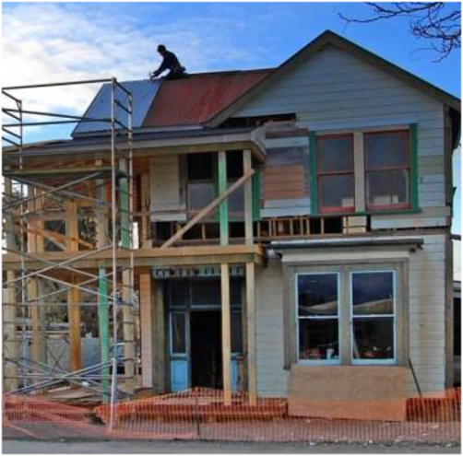
Learn and Confirm
Coaching Adult Learners
Adult Learner Characteristics
Resisters
Redecorators
Renovators
Accessorizers
Adapted from "Room to Improve"
by H. Hertberg and C. Brighton
Notes:
SAY During the next portion of the session, we will discuss the 4 types of teacher personalities using Handouts 5 and 6.
Allow time for participants to identify who these teachers may be in their schools and how they can better serve them.
Participants may share their experiences with each type of characteristic as the following slides are presented.

Slide 20
Collaborate and Practice
Coaching Adult Learners
Table Discussions:
Handout 5: Teacher Characteristics Coaching Guide – each table group will be assigned a characteristic described on this handout (Resister, Redecorator, Renovator, Accessorizer)
Handout 6: Room to Improve Article – read the section of this article pertaining to your assigned characteristic and discuss
Notes:
SAY Each table group will be assigned one of the characteristics from Handout 5: Teacher Characteristics Coaching Guide (Resister, Redecorator, Renovator, Accessorizer).
Read about your assigned characteristic on Handout 5 then read the particular section pertaining to your assigned characteristic on Handout 6: Room to Improve Article. Once your group is finished reading, discuss the characteristics of each type.
Activity Time: 15 minutes
Depending on the size of the group you may have several tables discussing the same characteristic or you may need to divide tables up differently in order to have participants discussing and sharing out about each of the different characteristics.
Allow time for participants to identify teachers fitting their assigned characteristic in their schools and how they can better serve them.
Participants may share their experiences with each type of characteristic as the following slides are presented.
During the following slides, each group will have opportunities to share with the entire group what they have learned about the type of learner they were assigned.

Slide 21

Coaching Adult Learners
The Resisters
Overt resistance: anger, resentment
Covert resistance: avoidance behavior
Lack of engagement
Dramatic refusals
Verbal acknowledgment of disagreement
Disdain for new practices
Notes:
NOTES Participants assigned the Resister may share out the character traits they identified during the table discussion (positive or negative). As the participants share with the group what they learned about the resister, be sure the following characteristics are mentioned.
• Teacher is OPENLY resistant to change or suggestions
• Teacher may HIDE their resistance, keeping their resistance behind the scenes
• These teachers often times are not engaged during professional development trainings
• Sometime the resister is more verbal of their resistance and dislike of new practices.
Facilitator can read the following statement pulled from the article:
“Through their words and actions, resisters communicate to anyone listening that the educational philosophy and associated classroom practices that the coach is suggesting are not workable options for them.”

Slide 22

Coaching Adult Learners
Reaching the Resisters
Reasons:
Fear, frustration, or anger
Feeling threatened
Lack of skills and covers up
Personal issues/illness
Cynical due to so many initiatives over the years
Turn and share any experiences with a resister that you may have had.
Notes:
NOTES Continue discussion by asking participants to share with the group some of the reasons teachers may resist new ideas, strategies, programs etc.
•Fear, frustration, or anger
•Feeling threatened
•Lack of skills and covers up
•Personal issues/illness
•Cynical due to so many initiatives over the years

Slide 23
Coaching Adult Learners
Reaching the Resisters
Try to uncover the real reason for the resistance
Wearing a Mask/Imposter Syndrome – The teacher has a fear of anyone knowing she is not as knowledgeable as she has pretended.
Cynical about another initiative or change
Health issues
Fear, frustration, or anger
Feeling threatened
Notes:
NOTES Review slide and discuss the impact of each of these traits.
• Wearing a Mask – the Resister may have a fear of anyone knowing he/she is not as knowledgeable as they have pretended
• Cynical about another initiative or change – resisters oftentimes have a negative attitude which they express to others in an effort to convince others to join them in resisting.
• Health issues – a change in routines, programs or a new initiative often times requires more planning and preparation by the teacher. Teachers in poor health may have a more difficult time making these adjustment and therefore become a resister to the change.
• Fear, frustration or anger – Teachers who are afraid of change are often time afraid of failure. This may create frustration or anger toward the change.
• Feeling threatened – feeling insecure about their ability to adjust or try a new initiative may leave a teacher feeling threatened.
Ask participants for suggestions on ways to reach the Resister.
1. Find ways to encourage the teachers outside the new initiative
2. Always include resisters in trainings or discussions about the initiative – leaving the door open for them to participate.
3. The Resister is the most challenging of all teachers and requires more support and TLC.
4. When all else fails – give them chocolate. :)

Slide 24
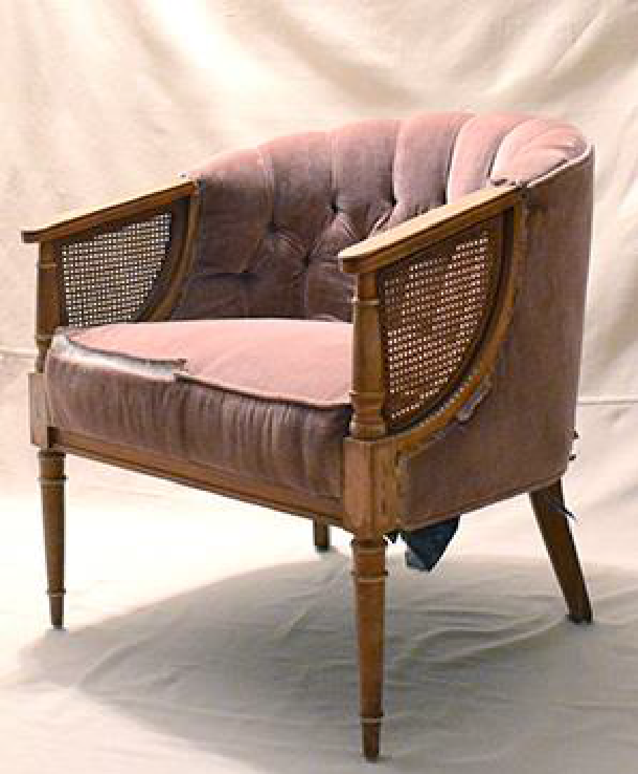
Coaching Adult Learners
The Redecorators
Deep beliefs about teaching and learning
Implements approaches but will not release beliefs
Holds strong to traditional beliefs regarding teaching
Not usually “showy”
Strong command of content
Notes:
NOTES Continue whole group discussion using the article and guides for the Redecorator.
Points to be made during the discussion:
• The teacher who is a Redecorator is typically stuck in her old ways, not willing to change to a modern look/approach.
• The redecorator may lack the obvious enthusiasm and outward signs of support, but brings a strong command of the content, an intellectual view of the teaching profession and a desire to provide a powerful learning experience for his/her students.”
Characteristics of Redecorators – as discussion is conducted make sure to expand on these bullets.
A Redecorator…
• may have deeply held and teacher centered beliefs about teaching and learning.
• may become committed to effectively implementing approaches, but will not release deeply held beliefs.
• holds strong (and often traditional) belief system regarding teaching.
• is open to conversations and discussions about possible changes in instructional practices.
• may have strong technical understanding of new practices.
• is not usually “showy”.
• has a strong command of content.

Slide 25
Coaching Adult Learners
Reaching the Redecorators
Give them time and care
Explain the logistics
Understand their workable solutions before they try new practices
They believe in the idea of new practices but don’t think they are workable
Approach them on an intellectual level
Turn and share your experience with a redecorator.
Notes:
NOTES Participants will share their experiences with Redecorators with other members at their table. Open the discussion to the whole group allowing participants to share experiences with everyone.
Following group discussion, the facilitator may want to allow participants to turn back to their table mates and further discuss options and solutions on how to work with the Redecorator.

Slide 26

Coaching Adult Learners
The Renovators
Knowledgeable of content
Willing to consider change
Reflective about beliefs
Motivated by students
Personal need to grow
Understands risk taking
Good classroom management
Views change as a complex journey, not
the final destination
Notes:
NOTES Continue whole group discussion using the article and guides for the Renovator, asking participants assigned this character trait to share some characteristics of the Renovator with the whole group. Open discussion up to others as time allows.
Follow up with a whole group discussion.
Renovators…
• are knowledgeable of content.
• are willing to consider change.
• are reflective about beliefs.
• are motivated by students.
• have a personal need to grow.
• understand risk taking.
• are good classroom managers.
• view changes as a complex journey, not the final destination.
“Teachers who rebuild their teaching practices and beliefs systems from the ground up when they are confronted.”

Slide 27

Coaching Adult Learners
The Renovators
Motivated and open to NEW ideas BUT MAY…
allow others’ resistance or cynicism to discourage them
become frustrated with lack of resources
become so excited they become anxious about timeline and implementation
require extra support
Turn and share your experience with a renovator.
Notes:
NOTES Continue discussion and share experiences with Renovators.

Slide 28

Coaching Adult Learners
The Accessorizers
Outspoken advocate but have trouble implementing in their own classrooms
Shallow understanding of the principles behind the practice
Talks the talk
Limited ability for self-reflection
Teaches students the names of strategies but doesn’t help them understand their purpose or how to use them for their own learning
High perception of personal competence, often reinforced by parents, administrators, and students
Notes:
NOTES Discuss with participants the characteristics of an Accessorizer:
“Teachers who initially are very involved with and excited about the topic, but never develop beyond a surface and somewhat inaccurate understanding.”

Slide 29

Coaching Adult Learners
The Accessorizers
Require a delicate balance between affirming efforts and honest feedback
MAY NOT…
have background knowledge to understand or implement new practices
be accustomed to reflecting
know the purpose of their instruction
MAY…
enjoy the showy qualities of teaching
be enthusiastic, charming, popular and have a desire to do the right thing for students
Notes:
NOTES Ask Participants to turn and share their experience with Accessorizers.

Slide 30

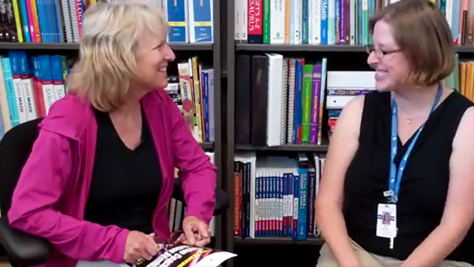
Coaching Adult Learners
Video 3: Model Coaching Conversation
Discuss with your tablemates and identify the teacher traits you might connect to this teacher.
Notes:
NOTES View Video 3: Model Coaching Conversation (6:03). After participants watch the video, provide an opportunity for them to discuss and identify the character traits of the teacher in the video. Allow participants to share whole group and explain why they picked that trait.
This teacher is likely a renovator. She is interested in a new approach but is concerned about resistance or cynicism from others.

Slide 31

Coaching Adult Learners
Coaching a Variety of Learners
Based on what you viewed how might you adjust the coaching provided?
Notes:
NOTES: Conduct an open discussion - How might you adjust or improve the coaching provided for this type of teacher?
The coach may need to explore with this teacher whether an expanded timeline or more support is needed.

Slide 32

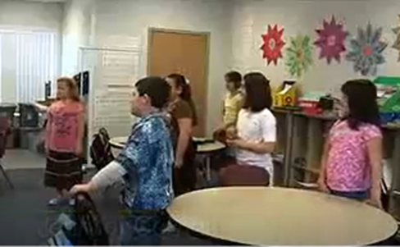
Coaching Adult Learners
Putting Your Skills to the Test
Video 4: Vocabulary Cheerleading
Discuss with your tablemates and identify the teacher trait you might connect to this teacher.
Notes:
NOTES View Video 4: Vocabulary Cheerleading (4:30)
After participants watch the video, provide an opportunity for them to discuss and identify the character traits of the teacher in the video.
Allow participants to share whole group and explain why they picked that trait.
This teacher may be an accessorizer. She is enthusiastically embracing showy qualities of teaching. She also taught her students the name of the strategy (Vocabulary Cheerleading), but may not have shared enough to help them understand the purpose of the strategy. Not enough was shown to determine if the other aspects of this trait may be applicable to this teacher.

Slide 33
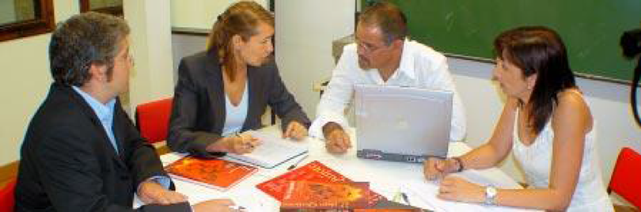
Coaching Adult Learners
Coaching a Variety of Learners
Based on what you viewed how might you adjust the coaching provided for this type of teacher?
Notes:
NOTES: Conduct an open discussion - How might you adjust or improve the coaching provided for this type of teacher?
The coach may need to ask reflection questions to determine whether this teacher has a deep understanding of the concepts taught and if more support is needed.

Slide 34

Facilitating Adult Learning
Notes:
SAY It is important to consider how to facilitate professional development like PLC meetings with adult learning principles in mind. Some questions for a facilitator to consider are below.
Set up – How will you plan and organize the environment? What resources will you have available? What methods will you use to present your information?
Participation – How will you ensure teacher’s needs are met and material is presented in a manner that is engaging and productive?
Learning objectives – Are the learning objectives relevant and valued?

Slide 35

Facilitating Adult Learning
Consider:
The Learning Environment
Learning Resources
Instructional Design
Session Planning
Communication
Listening/Questioning/Feedback
Evaluation
Notes:
NOTES Review the slide:
Provide tips and suggestions leading up to professional development set up.
• The Learning Environment – provide your PLC in an area of the school that is conducive to learning. Table setup, resources are available (copier, printer, sticky notes, highlighters, etc.)
• Learning Resources – provide resources such as data, articles or books related to the discussion.
• Instructional Design – have you created a long-term plan? Goals? Outcomes? Have you created a timeline from beginning to end that outlines the goals of the session?
• Session Planning - how will you deliver the individual PD sessions or facilitate the discussion, keeping in mind the various adult learner characteristics? Be prepared!
• Communication - part of planning is communicating the purpose and goal. Giving everyone a clear vision of what the sessions will contain, the time frame, the level of commitment from the teachers, etc.
• Listening/Questioning/Feedback – always take time to listen, ask questions and allow for feedback from your participants. Take what you receive and apply it to the next session. Don’t take it personally ☺
• Evaluation – this is another opportunity to get feedback – allowing those who may not speak up in the group to share their thoughts.

Slide 36
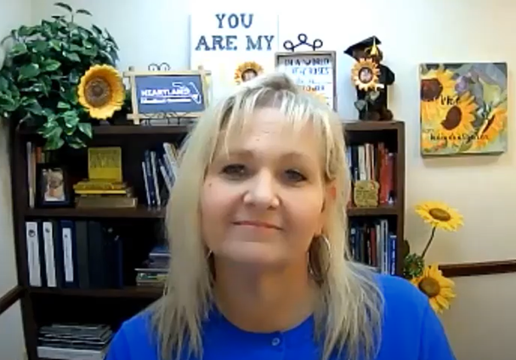
Facilitating Adult Learning
Coaching for Community
In Video 5, Donna Garcia, Executive Director of the Heartland Educational Consortium in rural South Florida, considers why concepts of adult learning are important and how coaches can focus on communication, collaboration, and community to find success.
Notes:
Notes Watch Video 5: Coaching for Community (2:39).
SAY Donna Garcia is a former educator in Okeechobee County, Florida and she now works as the Executive Director of the Heartland Educational Consortium, serving six mostly small and rural districts in south central Florida. Let’s watch while she shares why it is important to consider best practices in adult learning and how coaches can help their schools through building better communication, collaboration, and community. As you watch, jot down a couple of notes that capture the essence of what Mrs. Garcia shares. You’ll discuss your thoughts in small groups - be prepared to share out in whole group after your discussion.

Slide 37

Post-Session Reflection, Planning, and Implementation
Reflect, Plan, and Implement
Handout 7: Professional Development Needs Assessment Survey.
This will be helpful as you prepare you for Session 6.
Complete the Self-Study 1: Video Viewing Guide for ADDIE Model and Directed Notetaking for PD Needs Assessment.
Reflect on your participation in Session 5 by noting any questions about the content or format. Bring this self-study assignment to Session 6.
Video 6: The ADDIE Model Process.
This will be helpful as you prepare for Session 6.
Video retrieved from https://www.youtube.com/watch?v=BCJY_r7NJc0 on 01/04/24.
READ
DO
WATCH
Notes:
NOTES Spend time discussing the self-study participants will complete before Session 6.
Video retrieved from https://www.youtube.com/watch?v=BCJY_r7NJc0 on 01/04/24.

Slide 38

Questions?
Notes:
SAY Are there any questions that you have regarding the content of this session, the self-study activities, or the course in general?

Slide 39




We have completed
Session 5
Notes:
SAY Congratulations on successfully completing Session 5! We look forward to seeing you for Session 6 as we continue Module 2.
Confirm the date and time of the next session.

