Slide 1
Fundamentals of Literacy Coaching
Professional Development Modules
Module 2, Session 6
Selecting and Applying Methods to Support Teacher Growth
Notes:
SAY Welcome to Fundamentals of Literacy Coaching Professional Development Modules – Session 6: Selecting and Applying Methods to Support Teacher Growth

Slide 2
Module | Topic | Session | Minutes | Session Date
1 | Applying Principles and Practices that Foster a Positive Culture | Intro | 60
 |  | 1 | 120
 |  | 2 | 150
 |  | 3 | 150
2 | Applying Effective Pedagogy and Andragogy | 4 | 120
 |  | 5 | 120
 |  | 6 | 165
3 | Collecting Data to Inform Professional Learning | 7 | 150
 |  | 8 | 140
 |  | 9 | 170
4 | Planning, Implementing, and Analyzing Literacy Instruction | 10 | 175
 |  | 11 | 135
 |  | 12 | 165
 |  | 13 | 130
5 | Growing Professionally | 14 | 120
 |  | 15 | 120
6 | Planning and Implementing Coaching | 16 | 120
Notes:
NOTES
It is recommended that the sessions are completed in sequential order.
The timeline for completing the sessions can be flexible. If the recommended minutes for each session are not available, complete what you can with the time you have and then pick up where you left off the next time you meet.
Once a schedule of the sessions is established, have participants record the schedule in their Fundamentals of Literacy Coaching PD Guide if printed.
SAY Here is an overview of the modules and sessions of this course. There are six modules, and each module includes two to four sessions for a total of 15 content sessions. Module 1 addresses Applying Principles and Practices that Foster a Positive Culture, Module 2 covers Applying Effective Pedagogy and Andragogy, the focus of Module 3 is Collecting Data on Instructional Practices to Inform Professional Learning, the content of Module 4 is Planning, Implementing and Analyzing Standards-Based Literacy Instruction, the content of Module 5 is Growing Professionally, and the final module, Module 6, addresses Planning and Implementing Coaching.
You can record the date of each of our sessions in your Fundamentals of Literacy Coaching PD Guide.

Slide 3
Bridge to Practice Projects for Coaches
An activity designed to serve as a Bridge to Practice after each Module will provide evidence that coaches are able to apply the knowledge and skills they developed in this course in their schools. Coaches will complete the following activities:
A rubric is provided at the end of each Module for the corresponding Bridge to Practice project.
Module 1 | Develop a principal-coach partnership agreement.
Module 2 | Develop a needs assessment for professional development on evidence-based instructional practices and complete an ADDIE model for planning this professional development.
Module 3 | Develop and describe planned implementation of a professional learning action plan.
Module 4 | Create a video that reflects coaching to help teachers plan, implement, and analyze standards-based literacy instruction.
Module 5 | Complete a reflection on the course including plans for continued professional growth.
Module 6 | Choose one teacher with whom you have seen significant growth as a result of coaching support and complete a reflection on what worked, why it worked, and which areas of growth were most evident.
Notes:
SAY We want to remind you that participating coaches will complete a Bridge to Practice project after each module. These projects will provide evidence that coaches are able to apply the knowledge and skills they developed in this course in their schools. You will learn more about each project as we work through the modules. We’ve shared an overview of the projects with you on this slide.
Coaches will
Module 1: develop a principal/coach partnership agreement;
Module 2: conduct a needs assessment for professional development on evidence-based instructional practices and complete an ADDIE model for planning this professional development;
Module 3: develop, implement, and evaluate a professional learning action plan;
Module 4: create a video that reflects coaching to help teachers plan, implement, and analyze standards-based literacy instruction;
Module 5: complete a reflection on the course including plans for continued professional growth.
Module 6: Choose one teacher with whom you have seen significant growth as a result of coaching support and complete a reflection on what worked, why it worked and which areas of growth were most evident.
You may turn in all your artifacts for the projects to your facilitator at the end of each module if requested.

Slide 4



Norms for Our Course
Cell phones on silent
Pay attention to self and others
Presume
positive intentions
Notes:
NOTES Consider your group to determine how much detail about the norms will be helpful to review.
SAY Professional learning opportunities usually consist of a team of educators, like us, that meet regularly to learn new topics, share ideas, and problem solve. We will build a community, meaning that we learn from each other, so sharing and participation are really important.
Professional learning opportunities typically have norms that the group can agree to in order to be productive. Here are three norms, or ground rules, for our way of work: cell phones on silent; pay attention to yourself and others; and presume positive intentions.
Pay attention to self and others This means to contribute, listen, and be aware of how you and others are responding to each other. Be sure to give everyone a chance to talk and encourage others who seem reluctant to join in. Sometimes people who are reluctant to talk are thinking. They may not be comfortable jumping in but may have something important to say. Professional learning opportunities like this one encourage educators to learn from one another. Therefore, sharing, discussing and participating are important components.
Presume positive intentions This means to pause before responding. Usually when people contribute to a conversation, they intend to be constructive. So, always respond positively to keep the discussions productive.

Slide 5

Goals for Today
Define and Discuss Session Goals and Content
Learn how to select and apply appropriate methods to support effective teacher practice and growth in a variety of settings.
Learn how to identify and apply scaffolding strategies that address the strengths and needs of individual teachers.
Learn how to identify and apply appropriate strategies and resources for planning, facilitating, and evaluating professional learning aligned with school and district goals.
Notes:
NOTES Share and discuss these goals for today’s session.

Slide 6

Review of Module 2, Session 5
Debrief
Handout 7: Professional Development Needs Assessment Survey Instrument Share important aspects of the adult learner characteristics and learning practices and how those are important to coaching. Discuss any initial thoughts you have about the Professional Development Needs Assessment Survey Instrument.
Self-Study 1: Video 6: Video Viewing Guide for The ADDIE Model Process
Discuss the video viewing guide.
Any comments or questions about Session 5?
Reflection:
Discuss any questions or comments regarding the last session.
Notes:
NOTES Allow about 7 minutes for this debrief. If you have a small group, ask for volunteers to share with the whole group. If you have a large group, consider having triads discuss and then ask for a volunteer from each triad to share with the large group. Explain that the ADDIE Model Process and the Professional Development Needs Assessment will be discussed in depth during Session 6.
SAY Please access Handout 7: Professional Development Needs Assessment-Survey Instrument and the Video-Viewing Guide for ADDIE Model and Directed Notetaking for PD Needs Assessment that you completed in preparation for this session.

Slide 7
Literacy Coach Domain and Standards: Session 6
B. Knowledge of and ability to apply effective pedagogy and andragogy. Coaches will be able to:
Select and apply appropriate methods (e.g., co-planning, collaborative teaching, modeling, etc.) to support effective teacher practice and growth in a variety of settings, including elementary self-contained and departmentalized classrooms, secondary classrooms, content area classrooms, prioritizing English Language Arts and reading.
Identify and apply scaffolding strategies that address the strengths and needs of individual teachers (e.g., differentiation of coaching support based on strengths and areas of growth).
Identify and apply appropriate strategies and resources for planning, facilitating and evaluating professional learning (e.g., use of the Florida’s Professional Learning Standards) aligned with school and district goals.
Notes:
SAY We will now begin to focus on the content of the literacy coach domains and standards. This is the Literacy Coach Domain and standards that will be covered during this session. Take a moment to review the domain and standards.

Slide 8


Learn and Confirm
Maintaining a Consistent Focus on Improving Instruction (Recommendation 2)
Chronically low-performing schools need to maintain a sharp focus on improving instruction at every step of the reform process. To improve instruction, schools should use data to set goals for instructional improvement, make changes to immediately and directly affect instruction, and continually reassess student learning and instructional practices to refocus the goals.
Notes:
SAY Much of what we will discuss in this session focuses on improving instruction. This practice guide, Turning Around Chronically Low-Performing Schools, provides helpful evidence-based strategies for improving instruction in challenging situations. Recommendation 2 from this practice guide is maintaining consistent focus on improving instruction. The strategies shared for this recommendation will be helpful for any school focused on improving instruction.
As you guide the participants through Session 6, keep in mind the important role that coaches play in improving instruction.

Slide 9
Maintaining a Consistent Focus on Improving Instruction
Examine school-level data on student achievement to identify specific gaps in student learning.
Have teachers use formative data about individual students to analyze their instruction in light of student progress toward standards.
Establish priority areas for instructional focus and make necessary changes in those areas to strengthen teaching and improve student learning.
Arrange for targeted professional development based on analyses of achievement and instruction, differentiated according to teacher needs and the subject areas targeted for instructional improvement.
Have staff collaboratively conduct a comprehensive curriculum review to ensure that the curriculum aligns with state and local standards and meets the needs of all students in the school. Be sure to involve teachers in the review.
Ensure that all school leaders and instructional staff monitor progress regularly, and systematically make adjustments to strengthen teaching and student learning.
Notes:
SAY These how-to steps for this recommendation provide insight into evidence-based steps that schools can take to improve instruction.
Guiding question: What role should coaches play in these how-to steps?

Slide 10
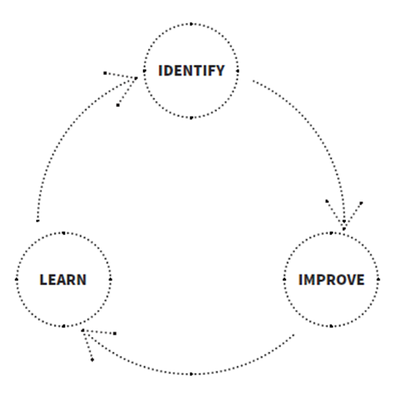
Learn and Confirm
Selecting and Applying Appropriate Coaching Methods
THREE APPROACHES TO COACHING:
It is very important for leaders to adopt the right approach to coaching for the kind of change they hope to see. Indeed, choosing the wrong coaching model can cause problems—like choosing a plumber to wire your house. For that reason, Jim Knight divides coaching into three approaches: facilitative, directive, and dialogical.
From The Impact Cycle
Notes:
SAY We discussed Jim Knight’s Impact Cycle in Session 1. We will now discuss the three coaching approaches he describes, including the one that is part of The Impact Cycle in an effort to build your knowledge in how to select and apply appropriate coaching methods based on the situation.

Slide 11

Selecting and Applying Appropriate Coaching Methods
FACILITATIVE COACHING: The Sounding Board.
These coaches encourage teachers to share their ideas openly. They refrain from sharing their own expertise or suggestions with respect to what a teacher can do to get better. This approach may be used in all types of situations, so it has the potential to address issues that dialogical or directive coaching is not able to address. The relationship is based on equality.
From The Impact Cycle
by Jim Knight
Notes:
SAY The facilitative coaching style may work best in situations where the coach does not have a deep understanding of the content being taught or as an initial entry point for a new coach to work with a seasoned veteran. For example, if a coach has an ELA background and is working with a content area teacher in another subject, then they may want to listen to the teacher experienced in that content area without providing advice or judgment. Asking non-judgmental questions about instructional practice after the teacher has shared may be particularly helpful for this coaching method.

Slide 12
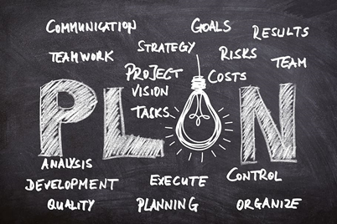
Selecting and Applying Appropriate Coaching Methods
CO-PLANNING FOR FACILITATIVE COACHING
Co-planning may be a good fit for the facilitative coaching model. While listening to the teacher, the coach may highlight the importance of items that are part of lesson planning without providing specific guidance in these areas:
a. Essential standards,
b. Assessments,
c. Teaching strategies,
d. Differentiation opportunities, and
e. Decisions based on student work.
Notes:
SAY The facilitative coaching style may work well with co-planning with individual teachers or teams. We discussed collaborative planning in Session 3. As a curriculum specialist, the coach may discuss the process of planning without providing guidance about the teacher’s content.

Slide 13

Selecting and Applying Appropriate Coaching Methods
DIRECTIVE COACHING: The Master and the Apprentice.
In many ways, directive coaching is the opposite of facilitative coaching. The directive coach has special knowledge, and his or her job is to transfer that knowledge to the teacher. In an instructional coaching scenario, the directive coach works from the assumption that the teachers they are coaching do not know how to use some practices needed to enhance instruction. The relationship is respectful, but not equal.
From The Impact Cycle by Jim Knight
Notes:
SAY The directive coaching style may work best aligned with agreed-upon professional development from school and/or district leadership that meet needed instructional changes where the coach has developed the training or has completed training and is scaling up at the school level. This coaching could occur in a variety of settings, but it is important that the coach has mastery and deep understanding of the expected approach and practices.

Slide 14
Selecting and Applying Appropriate Coaching Methods
MODELING FOR DIRECTIVE COACHING
Coaches can provide guidance as expert practitioners, providing new content knowledge and skills teachers need. Their skill set includes modeling for and assisting teachers in their initially hesitant performances of new and demanding forms of teaching (Walpole & McKenna, 2004).
When well implemented, the directive coaching process creates an apprenticeship environment (Collins, Brown, & Hollum, 1991) for learning and modeling knowledge, skills, and self-reflective strategies of effective literacy teachers.
(Matsumura, Garnier, & Spybrook 2013)
Notes:
SAY An important component of directive coaching is that coaches will model the approach shared in the professional development to assist the teacher with implementing the new practices in the classroom. Many of the large-scale studies on coaching are based on the directive coaching model where coaches are supporting a specific larger professional development effort such as the Matsumura, Garnier, & Spybrook (2013) Content Focused Coaching study, one of very few to apply an experimental design to assess the effectiveness of school-based literacy coaching programs on both teaching and reading outcomes. This study found positive effects for the quality of classroom text discussion and student reading outcomes and focused heavily on a directive coaching approach.

Slide 15

Selecting and Applying Appropriate Coaching Methods
DIALOGICAL COACHING: The Partner.
Dialogical coaches balance advocacy with inquiry. That is, they share strategies and options for improvements provisionally and help teachers describe precisely both what it is they want to achieve and how to get there. Furthermore, they go beyond mere conversation to dialogue, where thinking is done together and neither the teacher nor the coach is expected to withhold their ideas. The relationship is equal. This is the approach used in The Impact Cycle.
From The Impact Cycle
by Jim Knight
Notes:
SAY The dialogical coaching style may work best when the coach and teacher are able to work together to determine and identify the needs and methods that may lead to improvement. This approach can lead to positive changes in instruction through a partnership approach. As with many coaching models, it is challenging to scale up due to the time intensive nature of this coaching process.

Slide 16

Selecting and Applying Appropriate Coaching Methods
COLLABORATIVE TEACHING FOR DIALOGICAL COACHING
Dialogical coaches first identify teacher needs through observations and questioning that lead toward a student-focused goal. The coach then shares teaching strategies aligned with the goal that the teacher learns through reviewing a checklist for the strategy, watching the coach modeling the strategy, and then collaborative teaching through gradual release followed by teacher implementation and improvement.
From The Impact Cycle
by Jim Knight
Notes:
SAY An important component of the dialogical coaching style is collaborative teaching. Once the coach identifies and understands teacher needs then decides on a strategy aligned with that need, modeling of strategy instruction and co-teaching through gradual release leads to improvement through implementation and monitoring progress. In order to use this coaching approach, the coach needs a deep understanding of questioning techniques, goal setting, instructional strategies and techniques, and successful teaching practices.

Slide 17
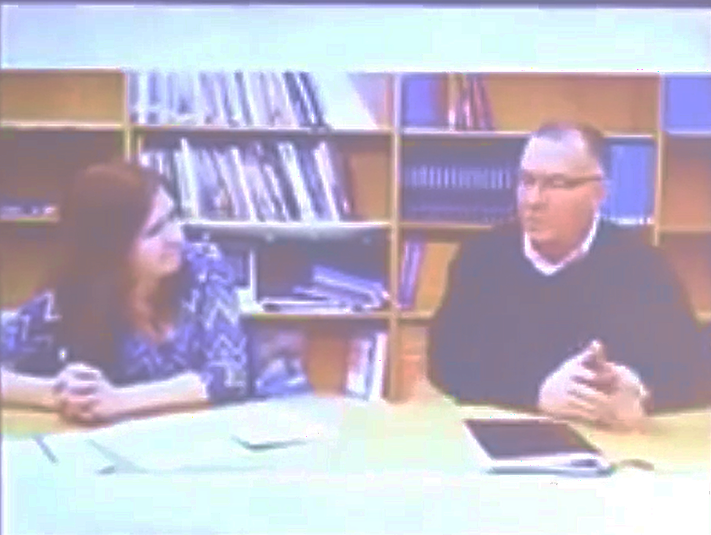
Selecting and Applying Appropriate Coaching Methods
Video 1: Jim Knight Impact Cycle presents an example of a coaching approach used in the book, The Impact Cycle. As you watch this video, consider how this is similar or different to coaching approaches you are familiar with. Which approach does this align with from the three (facilitative, directive, dialogical) discussed during this session?
Video retrieved at: https://youtu.be/2uaspok3UKY on 01/04/24.
Notes:
NOTES View Video 1: Jim Knight Impact Cycle (5:17).
SAY Discuss in small groups your reaction to the video and how similar or different this is to coaching approaches you are familiar with. Which coaching approach does this fit based on the three that we have learned about during this session? (facilitative, directive, dialogical)
Participants should be able to identify this as the dialogical approach of coaching.
Video retrieved at https://youtu.be/2uaspok3UKY on 1/04/24.

Slide 18
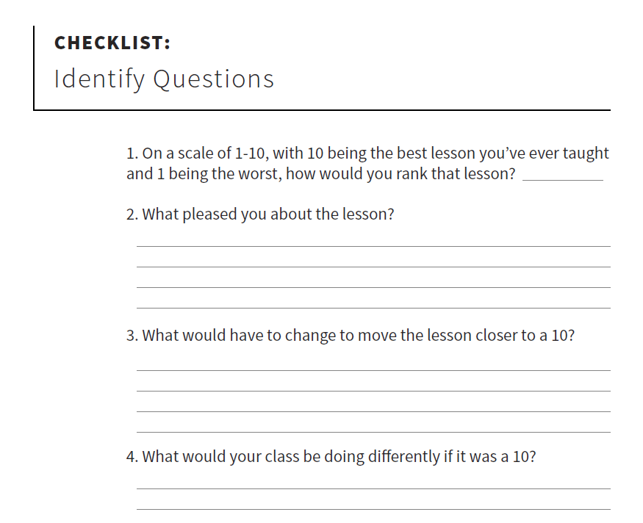
Selecting and Applying Appropriate Coaching Methods
Review Handout 1: The Impact Cycle with your shoulder partner or small group, paying particular attention to the Identify Questions noted below.
Handout retrieved at https://assets-global.website-files.com/61e9ed8efb92171b37cbfbfa/64596daa5b04410cb3d218cc_RL_VIRFL_identify-questions.pdf on 1/04/24.
Notes:
SAY In Video 1, we watched Jim Knight guide a teacher through a version of the Identify Questions. In order to select and apply appropriate coaching methods, it is important to identify and understand teacher needs, particularly in the dialogical coaching approach. On the next slide, we will use these questions for a role-playing activity after watching a video of classroom instruction.
Handout retrieved at https://assets-global.website-files.com/61e9ed8efb92171b37cbfbfa/64596daa5b04410cb3d218cc_RL_VIRFL_identify-questions.pdf on 1/04/24.

Slide 19


Collaborate and Practice
Selecting and Applying Appropriate Coaching Methods
Video 2: Primary Instruction Example presents an example of K-1 instruction teaching high frequency words.
After watching the video, use Handout 1: The Impact Cycle to role-play identifying teacher needs and selecting and applying appropriate coaching methods to support effective teacher practice and growth.
Video retrieved from https://www.youtube.com/watch?v=58-Sih184HM on 1/04/24.
Notes:
NOTES View Video 2: Primary Instruction Example (2:24). Circulate among the teams.
After watching the video, the role-playing activity will take participants about 15 minutes to complete.
SAY We will work in partners to complete a role-playing exercise after watching a video of primary classroom instruction. Select a shoulder partner and determine which of you will be playing the role of the teacher and which will be playing the role of the coach. After you watch the video, the coach will ask the Checklist: Identify questions on Handout 1: The Impact Cycle and the teacher will respond. The coach will take notes. Afterward, discuss the Identify: Modeling area and the Identify: Improve area and consider which coaching methods you would select and apply for this teacher. The Questions for the Improve Stage and Questions for Inventing Improvements may help with the discussion on the Identify: Improve section. Keep in mind that the Identify: Improve area will occur over time, after the teacher implements the practice and the data is collected. The coach and teacher in this scenario will need to anticipate what MIGHT happen.
Video retrieved from https://www.youtube.com/watch?v=58-Sih184HM on 1/04/24.

Slide 20

Selecting and Applying Appropriate Coaching Methods
Viewing an instructional example for role-playing
Video 3: Secondary Instruction Example presents an example of secondary instruction teaching vocabulary.
After watching the video, use Handout 1: The Impact Cycle to role-play identifying teacher needs and selecting and applying appropriate coaching methods to support effective teacher practice and growth.
Video was retrieved at https://www.youtube.com/watch?v=nX3kNk3NrJo on 1/04/24.
Notes:
NOTES View Video 3: Secondary Instruction Example (3:20). Circulate among the teams.
After watching the video, the role-playing activity will take participants about 15 minutes to complete.
SAY Switch roles with your shoulder partner so that the partner who played the role of the coach will be playing the role of the teacher for the second video with a Secondary Instruction Example, and the partner who played the role of the teacher will be playing the role of the coach. After you watch the video, the coach will ask the Checklist: Identify questions on Handout 1: The Impact Cycle and the teacher will respond. The coach will take notes. Afterward, discuss the Identify: Modeling area and the Identify: Improve area and consider which coaching methods you might select and apply for this teacher.
Video was retrieved at https://www.youtube.com/watch?v=nX3kNk3NrJo on 1/04/24.
.

Slide 21

Selecting and Applying Appropriate Coaching Methods
How do we differentiate our coaching for all teachers, keeping in mind that our goal is student achievement?
Adapted from the Just Read, Florida! Literacy Coach Academy Training at the Florida Department of Education
Notes:
SAY Now that we have learned how to select and identify coaching methods, we will learn about how to scaffold strategies for coaching individual teachers. When we think about coaching our teachers, we need to prepare just like we prepare for our students. We need to look at the data and ask ourselves what are their needs? One size does not fit all – all the time. Teachers have their own knowledge and expertise that they bring to the table. As coaches we need to draw from their knowledge, find their strengths and validate their past experiences.
Briefly discuss the question on the slide.

Slide 22
Selecting and Applying Appropriate Coaching Methods
What are some of the challenges you face as a literacy coach in meeting the different professional learning needs of your teachers?
In what ways do you differentiate coaching to support these needs?
What role does reflection play within the teacher’s learning process?
Notes:
SAY Differentiated support, based on teacher’s individual needs is crucial for the work of a literacy coach.
Have the participants read the questions on the slide and discuss at their table or with a partner (the second question is in response to the first question).You may want to chart the challenges and then discuss how to overcome those challenges.
Possible challenges:
• Lack of trust
• Past negative experiences
• Not feeling valued
• Lack of appreciation
• Lack of time
• Lack of support
• Lack of shared understanding
• Low expectations
After the activity:
SAY It is important for the literacy coach to support the teacher by differentiating the content being presented, the process in which the information is conveyed and learned, as well as how teachers then take that learning and implement it within their own teaching.

Slide 23
Scaffolding Strategies for Coaching Individual Teachers
Learning should be differentiated to provide multiple options for taking in information, making sense of ideas, and sharing the information learned.
(Tomlinson & McTighe, 2006)
Notes:
Ask the participants to read the quote on the slide.
SAY The teacher and coach can decide together on the learning experience. Let’s look at how we can provide multiple options for our teachers.

Slide 24
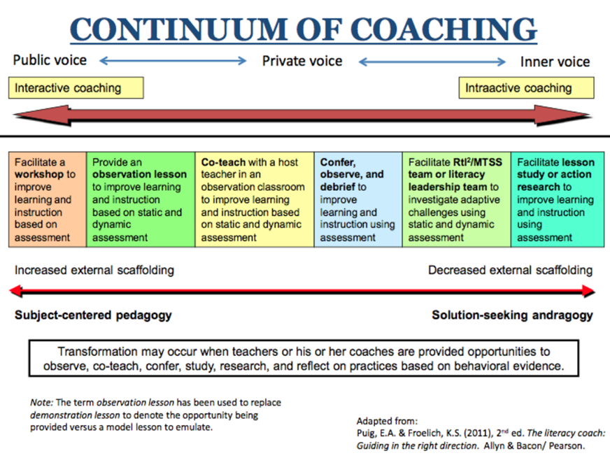
Learn and Confirm
Notes:
SAY We briefly discussed this graphic in Session 1. It is also provided as Handout 2: Continuum of Coaching. The Continuum of Coaching allows for true differentiation in the coaching process. It includes a range of possible professional development activities/opportunities that can be supported by the coach. The entry points are decided on by the teacher and the coach. It is not meant to be linear – a teacher can enter at any point according to the needs of the teacher and student achievement data. The activity (or opportunity) that is selected should provide a learning experience for the teacher and allow for the teacher and the coach to be co-learners as they move toward success for their students. Coaching can be done 1-to-1, small group, grade level, department, skill level, knowledge depending on the needs of teachers and goals of the school/district. The continuum provides a structure for learning that takes into account adult learning and scaffolding to meet the needs of individual teachers. It respects and builds on the knowledge that teachers bring to the table.
Briefly share each entry point and have the participants discuss the possibilities for professional development.
SAY Once an entry point is determined and coaching activities are initiated, a coach may determine that a teacher will go either direction on the continuum for further professional growth. How do you know when to shift on the continuum?
Discuss the increase/decrease of scaffolding as you move along the continuum. (Notice the entry points on the left of the continuum require more scaffolding, but decrease as you move to the right on the continuum)
SAY The continuum also moves from inter-active to intra-active coaching. Inter-active coaching is social interaction between someone and a more knowledgeable other; collegial conversation between coach and teacher. Intra-active coaching is being a reflective practitioner; when the teacher is self-extending and using their inner voice to reflect. The Continuum of Coaching is a framework for thinking – How can you differentiate coaching for professional learning opportunities?
Briefly discuss responses to the question.

Slide 25
Scaffolding Strategies for Coaching Individual Teachers
Confer
Agreed-upon focus
Reflective conversation
Clarify teacher’s focus
Evidence of student learning
Observe
Match pre-conference information with what you see
Record what you see and hear
Sketch physical environment
Debrief
Conversation linked to agreed-upon focus
Use questions to invite the teacher to share responses and reflections
Clarify
Paraphrase
Prompt
Evidence of student learning
Next steps
Notes:
SAY Confer-Observe-Debrief is just to the right of center on the Continuum of Coaching graphic and is similar to the dialogical coaching approach from The Impact Cycle. In this approach, the teacher, not the coach, drives the conversation.
Briefly discuss the steps noted on the slide.

Slide 26
Learn and Confirm
Notes:
SAY Where (on the continuum) do you spend most of your time? Why?
Briefly discuss these questions then ask participants to place dots or post-it notes on one of the continuums (enlarge the continuum if possible) so everyone can see where the majority of coaches spend most of their time.
SAY How do we decide where on the continuum to work with a teacher?
Briefly discuss responses.

Slide 27
Scaffolding Strategies for Coaching Individual Teachers
Considerations for continuum entry points vary and may include:
Years of teaching experience
Comfort level with change
Degree of self-directed behaviors exhibited by the teacher
Background knowledge of specific content
Knowledge of student strengths and needs
Effectiveness of established classroom routines and procedures
Notes:
SAY As discussed earlier, the coaching continuum is not linear. It allows for various points of entry for individual teachers, depending on their need, skill level, and professional learning goals. You will need to take into consideration:
• Years of teaching experience.
• Comfort level with change.
• Whether a teacher exhibits self-directed behaviors and is self-reflective; analytical.
• Background knowledge of specific content.
• Knowledge of student strengths and needs. Are the teachers collecting and using data?
• Routines and procedures effectively established. Whether or not they are established and effective is key in the coaches’ decision for a coaching activity.
What are some other things to consider when thinking about entry points?
Briefly discuss responses.
SAY The same teacher can be at different points in the continuum depending on the context. The continuum allows for teachers to participate in professional development based on their individual needs. The considerations for entry points vary as you take into account the knowledge that you have of the teacher. The knowledge of the teacher drives the decisions for coaching activities.

Slide 28
Scaffolding Strategies for Coaching Individual Teachers
By differentiating professional learning, we acknowledge that teachers are individuals who need and want various kinds of support depending upon content, circumstances, personal experience, and timing.
(Moran, 2007)
Notes:
SAY As new learning occurs, look for evidence that teachers have reorganized, refined or revised their thinking – look for the shift. How will you know when the teacher has made the shift?
Briefly discuss responses.

Slide 29
Collaborate and Practice
Scaffolding Strategies for Coaching Individual Teachers
Using the Continuum
At your table, choose a scenario from Handout 3: Coaching Continuum Scenarios. Determine the best entry for this teacher on the coaching continuum (Handout 2). Handout 4: Progress Monitoring Data will be used for scenarios 1-4.
Be prepared to share your ideas: Where on the continuum would you place this teacher? Why do you think this is the best place?
Notes:
NOTES Using Handout 3, participants will have an opportunity to read several scenarios and discuss where on the continuum they might be able to provide professional development for the teachers mentioned in the scenarios. Have each group select one of the four scenarios and determine the best entry point for the teacher on the coaching continuum.
As participants discuss the scenarios ask them to discuss considerations for entry points on the continuum.
Continue to stress that there is no right or wrong answer in using the continuum.
This activity should take approximately 15 minutes.
SAY What could be possible entry points for each scenario and why?
Discuss responses with the whole group.

Slide 30
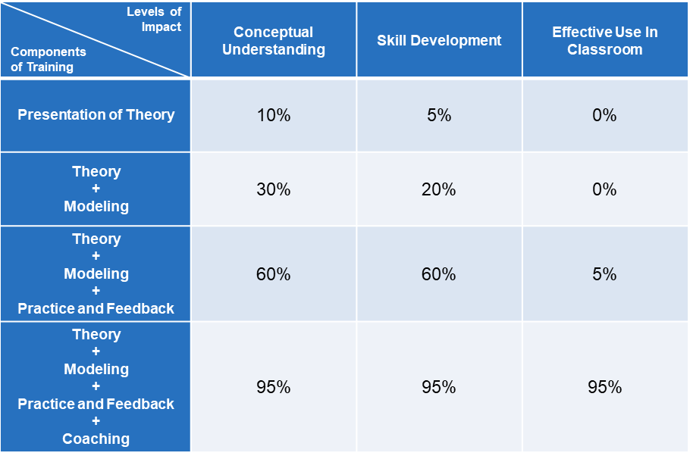
Relationship Between Levels of Impact and Components of Professional Development
(Joyce & Showers, 2002)
Notes:
SAY As noted in Session 1, the research of Joyce and Showers shows a significant increase in levels of impact when coaching and follow up is provided.
Think about your own professional development as you consider the following questions:
How effective was it when only theory was presented?
What about when modeling was added?
Did it help to add the feedback?
What happened to the impact when coaching was provided?
Coaching is an essential component of professional development. Too often it stops after modeling. First, teachers should learn about the theory, then see a modeling lesson, next they should have the opportunity to practice with feedback, then have the opportunity for the coach to assist with any misinterpretations or confusion and provide positive support to the teachers as they try the new practice.

Slide 31
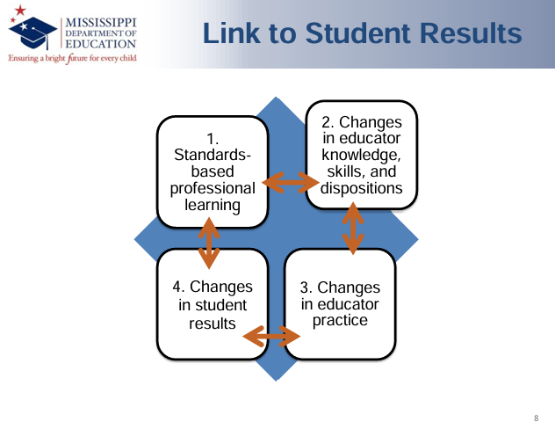
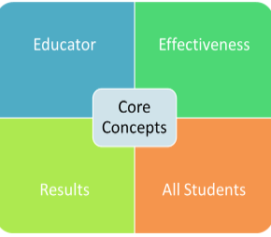
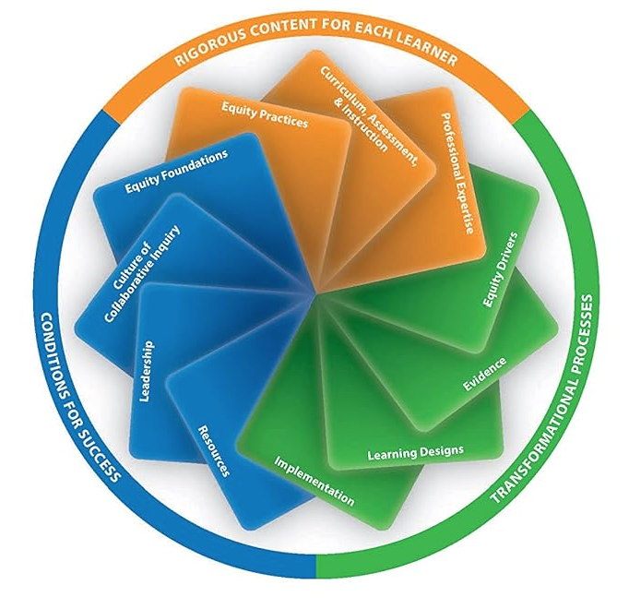
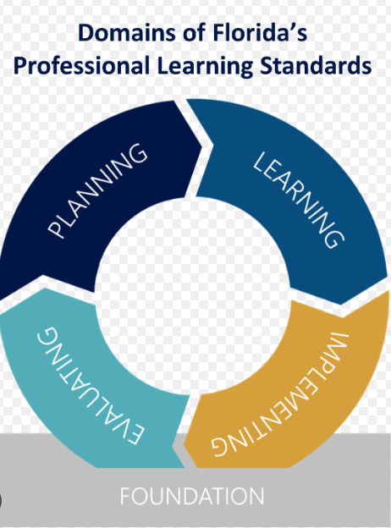
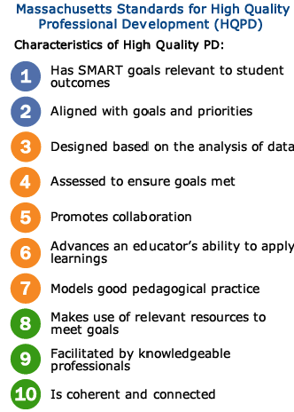
Learn and Confirm
Planning, Facilitating, and Evaluating Professional Learning
Delaware
Learning Forward
Notes:
NOTES If you have your state or district’s professional learning standards you may wish to provide a link or hard copies to participants. These could be referenced with the information on this slide and also used for the activity on Slide 33.
SAY Many states have established a framework or standards for professional learning. In addition, Learning Forward: The Professional Learning Association revised their standards for professional learning in 2022. The frameworks on the screen represent what professional learning should look like in Mississippi, Massachusetts, Delaware, and Florida. In the center you see the framework for the standards developed by Learning Forward. What commonalities do you see? If you have copies of professional learning framework or standards for your state or district you may ask participants what commonalities they see between your state/district standards and those displayed on the screen.
Reference:
https://standards.learningforward.org/standards-for-professional-learning/

Slide 32
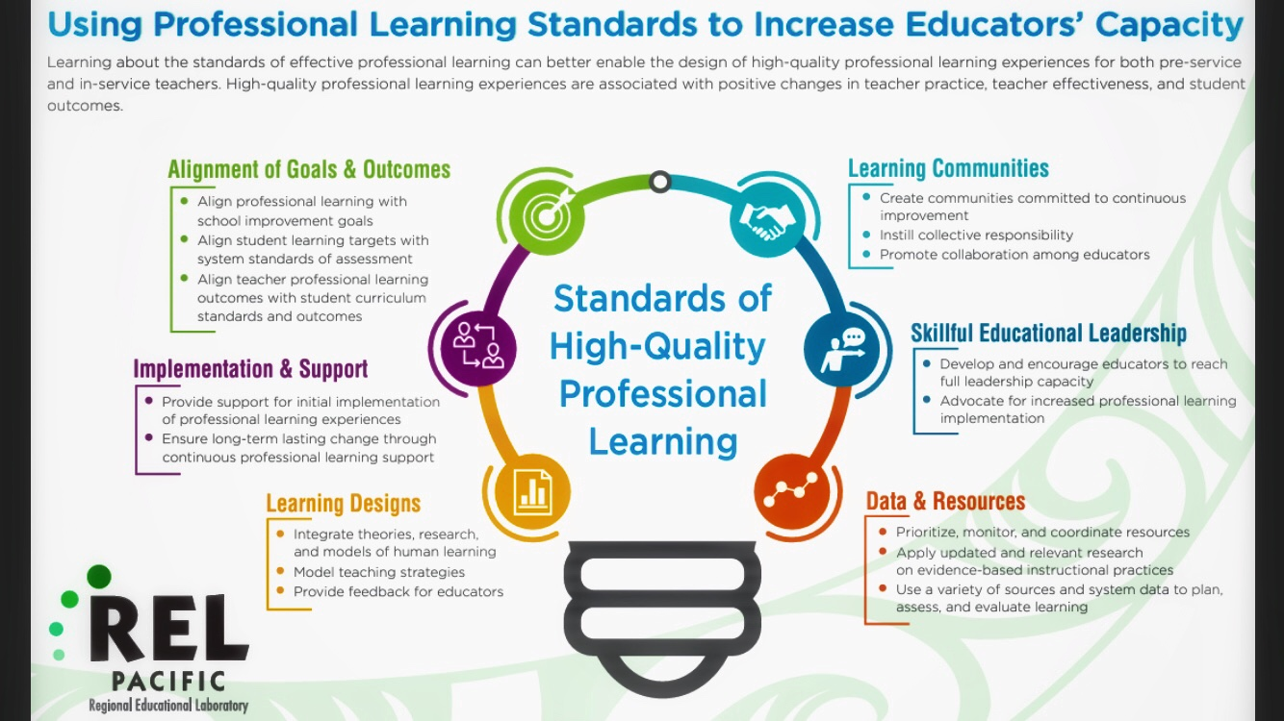
Planning, Facilitating, and Evaluating Professional Learning
Notes:
SAY This infographic from the Regional Educational Laboratory Pacific depicts characteristics of standards of high-quality professional learning. As you develop professional learning opportunities for your teachers, it will be helpful to keep these characteristics in mind.
Infographic found at https://ies.ed.gov/ncee/rel/infographics/pdf/REL_PA_Using_Professional_Learning_Standards_to_Increase_Educators_Capacity.pdf

Slide 33
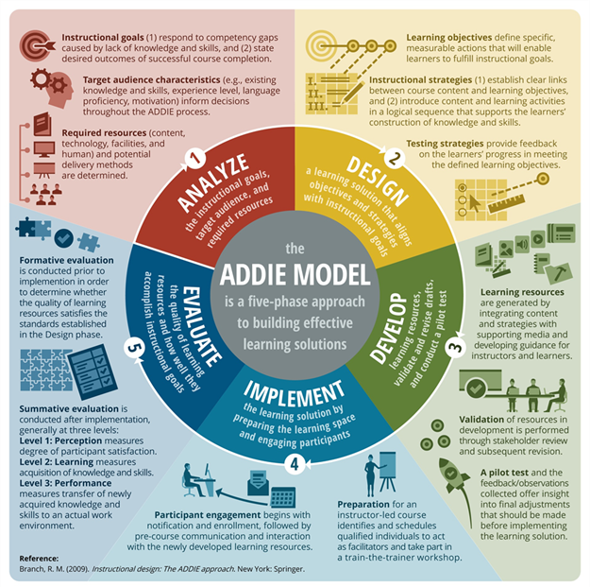
Collaborate and Practice
Planning, Facilitating, and Evaluating Professional Learning
For this activity, use Handouts 5 and 6 to compare Florida’s Professional Learning Standards with the ADDIE Model.
Notes:
NOTES If you have the professional learning standards from your state or district, you may want to use them for this activity. Otherwise, Florida’s professional learning standards are provided for use in the activity.
SAY You learned about the ADDIE model at the end of Session 5 and we just shared the professional learning standards of a number of states. With a partner, look at Handout 5: Florida’s Professional Learning Standards, and Handout 6, the internationally recognized ADDIE Model, and compare the steps of both models.
After the partner discussions, have participants share out similarities and differences between the standards and the ADDIE Model.
Participants may note the Needs & Planning section of the Florida Standards aligns with the Analyze section of the ADDIE Model. The Learning section of the Florida Standards aligns with the Design section of the ADDIE Model. Both models have a version of Implement and Evaluate. The Foundation section of the Florida Standards and the Develop section of the ADDIE model offer less-clear connections between the two models.

Slide 34

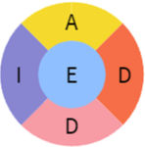
Collaborate and Practice
Planning, Facilitating, and Evaluating Professional Learning
To plan professional learning, analyze the instructional goals, target audience, and required resources.
Analysis: The analysis phase determines what goes into course content.
Review Handout 7: Professional Development Needs Assessment Survey. We reviewed this handout earlier. Discuss how analyzing items from this survey could help plan professional learning. Are there other questions you would include?
Complete the Analysis section of Handout 8: ADDIE Model Worksheet-Early Draft and discuss with your partner.
Notes:
SAY The analysis phase of the ADDIE model involves reviewing and analyzing district and school data and instructional goals. It is also important to conduct a needs assessment to determine specific needs for the target audience, strengths and needs from previous professional learning, and available resources to help meet those needs.
Review Handout 7: Professional Development Needs Assessment Survey. Discuss how those items may help with planning professional learning. Then complete the Analysis section of Handout 8: ADDIE Model Worksheet-Early Draft Template. Discuss your thoughts and plans with your partner.
After the partner discussions, have participants share out how the survey items may help plan professional learning opportunities and any additional questions that they feel may be helpful to include. Answer questions and discuss any participant thoughts about the Analysis section of the ADDIE Model Worksheet on Handout 8.

Slide 35

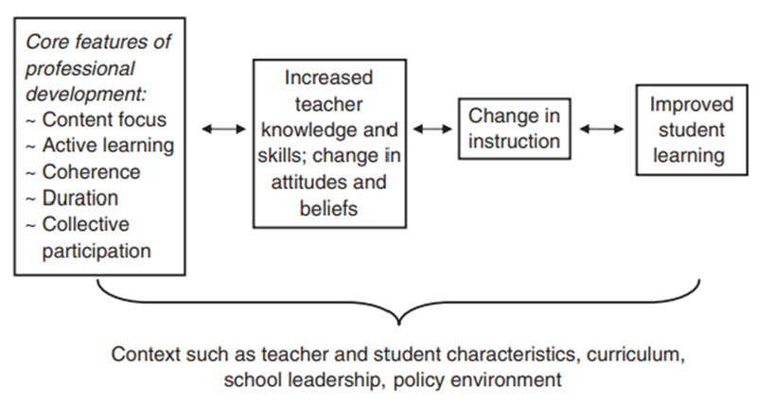
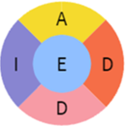
Planning, Facilitating, and Evaluating Professional Learning
To plan professional learning, analyze the instructional goals, target audience, and required resources.
Design: Core features of professional learning from Desimone (2009)
Notes:
SAY As a coach, it is important to know evidence-based core features of professional learning/development. This figure is from Desimone’s 2009 publication Improving Impact Studies of Teacher’s Professional Development. The figure shows a core conceptual framework for studying the effects of professional learning on teachers and students. Desimone found that recent research reflects a consensus about at least some of the characteristics of professional development that are critical to increasing teacher knowledge and skills and improving their practice, and which hold promise for increasing student achievement. These are (a) content focus, (b) active learning, (c) coherence, (d) duration, and (e) collective participation.
Content focus. The content focus of teacher learning may be the most influential feature. A compilation of evidence in the past decade points to the link between activities that focus on subject matter content and how students learn that content with increases in teacher knowledge and skills, improvements in practice, and, to a more limited extent, increases in student achievement.
Active learning. Opportunities for teachers to engage in active learning are also related to the effectiveness of professional development. Active learning, as opposed to passive learning typically characterized by listening to a lecture, can take a number of forms, including observing expert teachers or being observed, followed by interactive feedback and discussion; reviewing student work in the topic areas being covered; and leading discussions
Coherence. The third core feature emphasized in the literature is coherence, the extent to which teacher learning is consistent with teachers’ knowledge and beliefs. The consistency of school, district, and state reforms and policies with what is taught in professional development is another important aspect of coherence
Duration. Research shows that intellectual and pedagogical change requires professional development activities to be of sufficient duration, including both span of time over which the activity is spread (e.g., one day or one semester) and the number of hours spent in the activity. Research has not indicated an exact “tipping point” for duration but shows support for activities that are spread over a semester (or intense summer institutes with follow-up during the semester) and include 20 hours or more of contact time.
Collective participation. The final critical feature is collective participation. This feature can be accomplished through participation of teachers from the same school, grade, or department. Such arrangements set up potential interaction and discourse, which can be a powerful form of teacher learning.

Slide 36
Planning, Facilitating, and Evaluating Professional Learning
To plan professional learning, it is important to design a learning solution that aligns objectives, strategies, and content with district and school instructional goals.
Design: The design phase draws on the information gathered in the analysis phase, and practical decisions are made to guide the creation of the course content.
Review Handout 9: Designing High-Quality Professional Learning Checklist for other areas important to consider for Professional Learning Design.
Complete the Design section of Handout 8: ADDIE Model Worksheet and discuss with your partner.
Notes:
SAY As a coach, it is important to know and understand the instructional goals of your district and school. The design phase of the ADDIE model ensures alignment of the content with determined needs and instructional goals.
Discuss content that may be helpful to meet goals and the evidence-based core design features of professional learning with a partner and discuss how those items may help with planning professional learning. Review Handout 9: Designing High Quality Professional Learning Checklist from the REL Northeast and Islands. Then complete the Design section of Handout 8: ADDIE Model Worksheet. Discuss your thoughts and plans with your partner.
After the partner discussions, have participants share out considerations for aligning the content with needs and goals and evidence-based core design features of professional learning. Answer questions and discuss participant thoughts about the Design section of the ADDIE Model Worksheet on Handout 8.

Slide 37

Planning, Facilitating, and Evaluating Professional Learning
To plan professional learning, it is important to develop a learning solution that successfully presents necessary content to meet goals.
Development: The development phase includes all of the work that goes into creating the final professional learning course. The outlines created during the design phase will provide overall structure for the course, but the content is now procured or presented by the instructional designer. The delivery of each piece of content is decided, whether through infographics, articles, presentations, videos, discussion boards, or other forms of media.
Complete the Development section of Handout 8: ADDIE Model Worksheet and discuss with your partner.
Notes:
SAY The development phase of the ADDIE model ensures that the course is built in a way that will lead to successful delivery of the content. The availability of talent and resources is critical as the development phase is being planned.
Discuss considerations for development of your selected professional learning project with a partner including talent and resources that are important for developing the professional learning. Also talk about proposed timelines for development. Then complete the Development section of Handout 8: ADDIE Model Worksheet. Discuss your thoughts and plans with your partner.
After the partner discussions, have participants share out considerations for the development of their professional learning opportunities including talent, resources, and timelines. Answer questions about the Development section of the ADDIE Model Worksheet on Handout 8.

Slide 38
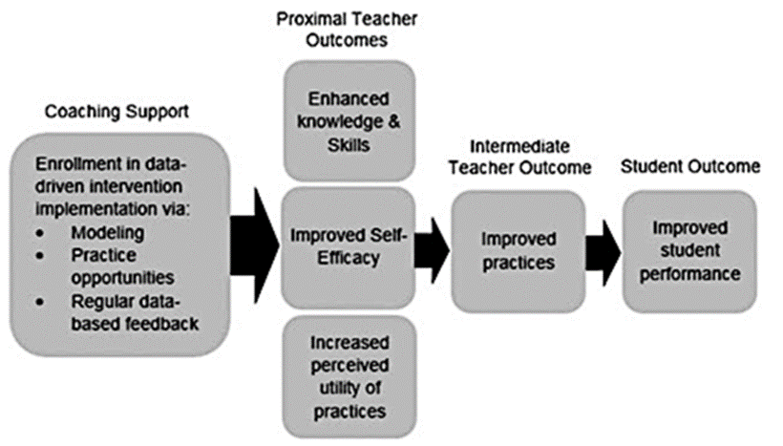
Planning, Facilitating, and Evaluating Professional Learning
To plan professional learning, it is important to develop a learning solution that successfully presents necessary content to meet goals.
Collaborative Development Process: Logic Model
A logic model can be collaboratively developed by a broad group of stakeholders to allow for multiple perspectives on how the program should operate.
Notes:
SAY The process of collaboratively developing a logic model can help stakeholders develop a common understanding of a program’s intended outcomes and how program components are intended to influence them. These conversations can create a shared vision and establish buy-in and shared ownership of the initiative.
This sample logic model is from Glover’s 2017 study on a Data-Driven Coaching Model Used to Promote Students’ Response to Early Reading Intervention. This logic model makes aspects of the program’s coaching support and the associated outcomes clear.
There is a section on Developing a Logic Model in the REL Northeast and Islands publication Evaluating Professional Learning: A Tool for Schools and Districts available at: https://ies.ed.gov/ncee/edlabs/regions/northeast/OurWork/Resource/7.

Slide 39

Planning, Facilitating, and Evaluating Professional Learning
To facilitate professional learning, it is important to consider all areas of implementation for successfully delivering the developed content.
Implementation: The implementation phase involves the actual delivery of the course content to the intended learners. For online courses, using a learning management system (LMS) can aid in the overall structure and delivery of the course, as well as in tracking metrics and reports associated to the learners. This phase is focused on logistics and on the learners taking the course.
Review Handout 10: Describe Implementation of Professional Learning Activities with your partner and then complete the Implementation section of Handout 8: ADDIE Model Worksheet.
Notes:
SAY The implementation phase of the ADDIE model ensures that the course is built in a way that will lead to successful delivery of the content. The availability of talent and resources is critical as the development phase is being planned.
Read Handout 10: Describe Implementation of Professional Learning Activities with your partner and then discuss considerations for implementation of your selected professional learning project. Then complete the Implementation section of the Handout 8: ADDIE Model Worksheet. Discuss your thoughts and plans with your partner.
After the partner discussions, have participants share out considerations for the implementation of their professional learning projects. Answer questions about the Implementation section of the ADDIE Model Worksheet on Handout 8.

Slide 40

Planning, Facilitating, and Evaluating Professional Learning
To evaluate professional learning, it is important to consider formative and summative processes.
Evaluation: The evaluation phase allows for the gathering of direct feedback and information on the success of the course. This is from both the perspective of the learners as well as of the organization. For formative evaluation, questions need to be asked throughout the ADDIE process to optimize instructional design and delivery. For summative evaluation, considerations need to be made for how to collect valuable feedback from the learners to determine effectiveness and how this will be used for possible revisions.
Read and discuss Handout 11: The Importance of Evaluating Professional Learning with your partner to learn more about evaluation.
Complete the Evaluation section of Handout 8: ADDIE Model Worksheet.
Notes:
SAY The evaluation phase of the ADDIE model ensures that the course development and implementation processes are effective and meet the needs of the organization and learners.
Read and discuss Handout 11: The Importance of Evaluating Professional Learning, with your partner to learn more about evaluation. Then complete the Evaluation section of Handout 8: ADDIE Model Worksheet. Discuss your thoughts and plans with your partner.
After the partner discussions, have participants share out considerations for the evaluation of their professional learning projects. Answer any questions about the Implementation section of the ADDIE Model Worksheet on Handout 8.

Slide 41
Needs Assessment
Use the following handouts to complete the Needs Assessment Bridge to Practice project for Module 2:
Review Handout 7: Professional Development Needs Assessment Survey.
Review Handout 12: Needs Assessment Survey Template to create a needs assessment survey for professional development on evidence-based instructional practices with at least 10 items.
Review Handout 13: Needs Assessment Rubric.
Share any questions with your pair or small group and then with the whole group.
Notes:
NOTE Allow 10 minutes for this activity. SAY Let’s prepare for the Bridge to Practice project for Module 2. You will use three handouts as resources to complete the Needs Assessment project. For now, each of you (or your group) will review the three handouts listed on this slide and discuss. Then we will share thoughts and questions with the whole group.
Handout 7: Professional Development Needs Assessment Survey
Handout 12: Needs Assessment Survey Template
Handout 13: Needs Assessment Rubric

Slide 42
Final ADDIE Model
Use the following handouts to complete the Needs Assessment Bridge to Practice project for Module 2:
Review completed Handout 8: ADDIE Model Worksheet.
Complete Handout 14: Final ADDIE Model Template.
Review Handout 15: Final ADDIE Model Rubric.
Share any questions with your pair or small group and then with the whole group.
Notes:
NOTE Allow 10 minutes for this activity. SAY Let’s prepare for the second part of the Bridge to Practice project for Module 2. You will use three handouts as resources to complete the ADDIE Model final project. For now, each of you (or your group) will review the three handouts listed on this slide and discuss. Then we will share thoughts and questions with the whole group.
Handout 8: ADDIE Model Worksheet
Handout 14: Final ADDIE Model Template
Handout 15: Final ADDIE Model Rubric

Slide 43

Reflect, Plan, and Implement
Post-Session Reflection, Planning, and Implementation
Handout 16: Sample ADDIE Tasks and Deliverables. This will be helpful for developing the Final ADDIE Model.
BRIDGE TO PRACTICE PROJECTS: Complete Handout 12: Needs Assessment Survey Template and complete Final ADDIE Model using Handout 14: Final ADDIE Model Template.
Video 4: Principal Coach Support. Be prepared to debrief at the beginning of Session 7.
READ
DO
WATCH
Notes:
NOTE Spend time discussing the Bridge to Practice projects that participants will complete before Session 7 and review the rubrics for the Bridge to Practice projects.

Slide 44

Questions?
Notes:
SAY Are there any questions that you have regarding the content of this session, the self-study activities, or the course in general?

Slide 45




We have completed
Session 6
Notes:
SAY Congratulations on successfully completing Session 6! We look forward to seeing you for Session 6 as we continue Module 2.
Confirm the date and time of the next session.

