Slide 1
Fundamentals of Literacy Coaching
Professional Development Modules
Module 3, Session 8
Analyzing and Interpreting Data
Notes:
SAY Welcome to Fundamentals of Literacy Coaching Professional Development Modules – Session 8: Analyzing and Interpreting Data

Slide 2
Module | Topic | Session | Minutes | Session Date
1 | Applying Principles and Practices that Foster a Positive Culture | Intro | 60
 |  | 1 | 120
 |  | 2 | 150
 |  | 3 | 150
2 | Applying Effective Pedagogy and Andragogy | 4 | 120
 |  | 5 | 120
 |  | 6 | 165
3 | Collecting Data to Inform Professional Learning | 7 | 150
 |  | 8 | 140
 |  | 9 | 170
4 | Planning, Implementing, and Analyzing Literacy Instruction | 10 | 175
 |  | 11 | 135
 |  | 12 | 165
 |  | 13 | 130
5 | Growing Professionally | 14 | 120
 |  | 15 | 120
6 | Planning and Implementing Coaching | 16 | 120
Notes:
NOTES
It is recommended that the sessions are completed in sequential order.
The timeline for completing the sessions can be flexible. If the recommended minutes for each session are not available, complete what you can with the time you have and then pick up where you left off the next time you meet.
Once a schedule of the sessions is established, have participants record the schedule in their Fundamentals of Literacy Coaching PD Guide if printed.
SAY Here is an overview of the modules and sessions of this course. There are six modules, and each module includes two to four sessions for a total of 15 content sessions. Module 1 addresses Applying Principles and Practices that Foster a Positive Culture, Module 2 covers Applying Effective Pedagogy and Andragogy, the focus of Module 3 is Collecting Data on Instructional Practices to Inform Professional Learning, the content of Module 4 is Planning, Implementing and Analyzing Standards-Based Literacy Instruction, the content of Module 5 is Growing Professionally, and the final module, Module 6, addresses Planning and Implementing Coaching.
You can record the date of each of our sessions in your Fundamentals of Literacy Coaching PD Guide.

Slide 3
Bridge to Practice Projects for Coaches
An activity designed to serve as a Bridge to Practice after each Module will provide evidence that coaches are able to apply the knowledge and skills they developed in this course in their schools. Coaches will complete the following activities:
A rubric is provided at the end of each Module for the corresponding Bridge to Practice project.
Module 1 | Develop a principal-coach partnership agreement.
Module 2 | Develop a needs assessment for professional development on evidence-based instructional practices and complete an ADDIE model for planning this professional development.
Module 3 | Develop and describe planned implementation of a professional learning action plan.
Module 4 | Create a video that reflects coaching to help teachers plan, implement, and analyze standards-based literacy instruction.
Module 5 | Complete a reflection on the course, including plans for continued professional growth.
Module 6 | Choose one teacher with whom you have seen significant growth as a result of coaching support and complete a reflection on what worked, why it worked, and which areas of growth were most evident.
Notes:
SAY We want to remind you that participating coaches will complete a Bridge to Practice project after each module. These projects will provide evidence that coaches are able to apply the knowledge and skills they developed in this course in their schools. You will learn more about each project as we work through the modules. We’ve shared an overview of the projects with you on this slide.
Coaches will
Module 1: develop a principal/coach partnership agreement;
Module 2: conduct a needs assessment for professional development on evidence-based instructional practices and complete an ADDIE model for planning this professional development;
Module 3: develop, implement, and evaluate a professional learning action plan;
Module 4: create a video that reflects coaching to help teachers plan, implement, and analyze standards-based literacy instruction;
Module 5: complete a reflection on the course including plans for continued professional growth.
Module 6: Choose one teacher with whom you have seen significant growth as a result of coaching support and complete a reflection on what worked, why it worked and which areas of growth were most evident.
You may turn in all your artifacts for the projects to your facilitator at the end of each module if requested.

Slide 4



Norms for Our Course
Cell phones on silent
Pay attention to self and others
Presume
positive intentions
Notes:
NOTES Consider your group to determine how much detail about the norms will be helpful to review.
SAY Professional learning opportunities usually consist of a team of educators, like us, that meet regularly to learn new topics, share ideas, and problem solve. We will build a community, meaning that we learn from each other, so sharing and participation are really important.
Professional learning opportunities typically have norms that the group can agree to in order to be productive. Here are three norms, or ground rules, for our way of work: cell phones on silent; pay attention to yourself and others; and presume positive intentions.
Pay attention to self and others This means to contribute, listen, and be aware of how you and others are responding to each other. Be sure to give everyone a chance to talk and encourage others who seem reluctant to join in. Sometimes people who are reluctant to talk are thinking. They may not be comfortable jumping in but may have something important to say. Professional learning opportunities like this one encourage educators to learn from one another. Therefore, sharing, discussing and participating are important components.
Presume positive intentions This means to pause before responding. Usually when people contribute to a conversation, they intend to be constructive. So, always respond positively to keep the discussions productive.

Slide 5

Goals for Today
Define and Discuss Session Goals and Content
Review Session 7 and debrief the self-study activities completed after the session.
Learn to better assist teachers with data analysis after students are assessed.
Learn to evaluate the data in addressing specific goals.
Learn to better analyze and interpret data to identify trends and patterns.
Notes:
NOTES Share and discuss these goals for today’s session.

Slide 6

Review of Module 3, Session 7
Debrief
Discuss questions and comments regarding Handout 10: Evaluating Professional Learning: A Tool for Schools and Districts.
Discuss Self-Study 1: Reflections on Session 7.
Discuss Self-Study 2: Webinar Reflection Guide on the webinar Evaluating Professional Learning: Introduction to a Tool for Schools and Districts.
Notes:
NOTES Allow about 7 minutes for this debrief. If you have a small group, ask for volunteers to share with the whole group. If you have a large group, consider having triads discuss and then ask for a volunteer from each triad to share with the large group.
SAY Let’s debrief regarding the reading and the self-study activities you completed related to Session 7 and the webinar you watched regarding the evaluating professional learning tool.

Slide 7
Literacy Coach Domain and Standards: Session 8
C. Ability to effectively collect and use data on instructional practices to inform and implement professional learning opportunities. Coaches will be able to:
2. Identify and apply appropriate student progress monitoring instrumentsand assist with data analysis after students are assessed.
3. Evaluate data in addressing specific goals.
7. Analyze and interpret data to identify trends and patterns.
Notes:
SAY This is the literacy coach domain and the three standards that will be covered during this session. Note that we focused on the first part of Standard 2 in Session 7 and we will talk about assisting teachers with data analysis in this session.

Slide 8
Data Analysis and Interpretation
The goal of data analysis and interpretation is to facilitate meaningful change – avoid “quick fixes.”
Data can be examined at the student, class, grade, school, or district level depending on the goal of the analysis.
In this session we will:
Discuss data and data interpretation.
Overview coaching teachers in data analysis and interpretation of their class and student data in order to differentiate instruction.
Delve into data analysis and interpretation at the grade or school level in order to identify trends and patterns, and to evaluate the data as it relates to specific goals.
Notes:
SAY When we analyze and interpret data, we want to make sure that we are using it to facilitate meaningful change. This means we have to spend time, do some thinking, and talk about the data with others. In this session we will be examining what that looks like overall, and overviewing what data analysis and interpretation looks like at the class and student level. However, we’ll spend a good deal of time talking about using data at the grade and school level.

Slide 9

Learn and Confirm
Data Analysis and Interpretation
Instructional coaches partner with teachers to:
Analyze current reality
Set goals
Identify and explain teaching strategies to meet goals
Provide support until goals are met
Notes:
SAY In his book, The Impact Cycle, Jim Knight summarizes the overall mission of a coach. The domains and standards in the literacy coach program support this mission. We will continue to focus on the first two bullets in this session, however, we will turn our attention to helping teachers analyze student data in grade or school level teams.
Knight, J. (2018). The impact cycle: What instructional coaches should do to foster powerful improvements in teaching. Corwin press.

Slide 10
Data Analysis and Interpretation
“Using data systematically to ask questions and obtain insight about student progress is a logical way to monitor continuous improvement and tailor instruction to the needs of each student. Armed with data and the means to harness the information data can provide, educators can make instructional changes aimed at improving student achievement.”
(Hamilton et al. 2009, p. 5)
Notes:
SAY This quote is from the Institute of Education Science practice guide Using Student Achievement Data to Support Instructional Decision Making. It emphasizes the fact that we should be analyzing and interpreting data in order to make changes to our instruction. The goal of making these changes is to improve student learning and achievement. Using data can help us work intentionally and systematically.
Hamilton, L., Halverson, R., Jackson, S. S., Mandinach, E., Supovitz, J. A., & Wayman, J. C. (2009). Using Student Achievement Data to Support Instructional Decision Making. IES Practice Guide. NCEE 2009-4067. National Center for Education Evaluation and Regional Assistance.

Slide 11
Data Analysis and Interpretation
Key responsibilities of the coach to help teachers use data effectively:
Create a safe, blame-free environment for data analysis.
Teach data access and organization.
Teach analysis and interpretation of data from multiple sources.
Engage teachers in data analysis and interpretation to determine student and teacher needs.
Design an action plan that incorporates professional learning to improve student achievement based on data analysis.
(Killion, 2008)
Notes:
SAY One of the most important responsibilities we have as coaches is to help teachers analyze and interpret data correctly. This can be challenging for us and intimidating, at times, for teachers. You see on the slide some of the steps we should take as coaches to ensure that teachers are building their skills in data use in order to improve instruction in their classrooms.
Killion, J. (2008). Coaches help mine the data. National Staff Development Council, 7-8.

Slide 12

Data Analysis and Interpretation
In Video 1, Dr. Lymaris Santana, former State Regional Literacy Director in Florida, shares why data is important and what coaches can do to help teachers analyze and interpret it.
Notes:
Notes Video 1: Data Analysis and Interpretation is 5 minutes.
SAY Dr. Lymaris Santana worked in Seminole County Public Schools and also as a State Regional Literacy Director. Let’s watch while she shares why data is important and how coaches can help teachers make good use of their data. As you watch, jot down a couple of notes that capture the essence of what Dr. Santana shares. You’ll discuss your thoughts in small groups - be prepared to share out in whole group after your discussion.

Slide 13
Data Analysis and Interpretation – Activity 1
Read Handout 1: Coaches Help Mine the Data by Joellen Killion.
In your small groups, discuss each of the five sections in the article that pertain to the responsibilities of the coach.
As a group, develop a summary statement for each responsibility – be prepared to share your statements with the group.
Notes:
Notes Allow about 10 minutes for this activity.
SAY Read this short article by Joellen Killion and discuss each of the five sections that talk about the responsibilities of the coach when it comes to helping teachers analyze and interpret data. In our groups, develop a summary statement for each area. You’ll need to work quickly, so simply capture the essence of each area in your statement. We’ll debrief in about ten minutes.
Killion, J. (2008). Coaches help mine the data. National Staff Development Council, 7-8.

Slide 14
Data Analysis and Interpretation – Caution!
Teachers may be prone to “explain” the reason for low student performance. While the explanation may be true, it may not lead to a discussion regarding potential changes to instructional practice.
(Evans, et al., 2019)
Notes:
SAY Killion provided some great information regarding how we can help teachers access data, analyze it, and move on to create action plans with professional learning. You see in her article that the intent was that the action plan involves teachers changing their practice based on the analysis and interpretation of the data. This is very important. We need to be careful that when we help teachers examine the data that we focus on what we can do to help improve student learning. In a study conducted by Evans et al., they found that oftentimes teachers offered explanations of the data that were largely centered on the behaviors of students. While these explanations may be true – for instance, it may be that their fifth period class, which meets right after lunch, always has difficulty concentrating when they begin class – focusing on these behaviors may not lead to a change in instruction. We need to focus our attention, and that of our teachers, on what can be done instructionally to address the needs of students.
Evans, M., Teasdale, R.M., Gannon-Slater, N., La Londe, P.G., Crenshaw, H.L., Greene, J.C., & Schwandt, T.A. (2019). How did that happen? Teachers’ explanations for low test scores. Teachers College Record, 121(2), 1-40.

Slide 15
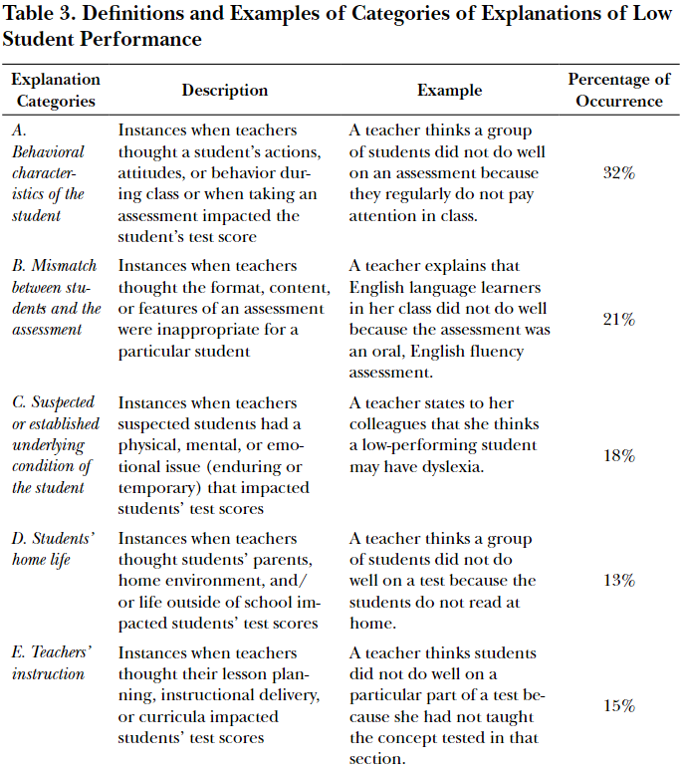
Data Analysis and Interpretation – Caution!
Evans, et al., (2019) found that there were five main categories teachers used to explain low student performance.
(Evans, et al., 2019)
Notes:
SAY Here are the five main categories that teachers in the study conducted by Evans referenced as explanations of why student scores may be low. State the five categories. Note that only 15 percent of the time did teachers indicate that low scores may have occurred because of something that was done, or not done, instructionally.
Evans, M., Teasdale, R.M., Gannon-Slater, N., La Londe, P.G., Crenshaw, H.L., Greene, J.C., & Schwandt, T.A. (2019). How did that happen? Teachers’ explanations for low test scores. Teachers College Record, 121(2), 1-40.

Slide 16
Data Analysis and Interpretation
“We suggest that this current political emphasis on ‘evidence-based’ teaching provides an opportunity to challenge subjective, negative claims about students and in turn place a greater value on teachers’ verifiable claims about students and their academic needs. In other words, we suggest that teachers’ knowledge of students is important in instructional decision making, but teachers’ low expectations and/or stereotypes of students are not.”
(Evans, et. al., 2019, p. 26)
Notes:
SAY Note that Evans does not suggest that the insight of teachers is not important – it definitely is. And there are student behaviors and situations that lead to low student achievement. However, we need to be careful that we continue to have high expectations for students and that we do not let bias affect our analysis and interpretation of the data.
Evans, M., Teasdale, R.M., Gannon-Slater, N., La Londe, P.G., Crenshaw, H.L., Greene, J.C., & Schwandt, T.A. (2019). How did that happen? Teachers’ explanations for low test scores. Teachers College Record, 121(2), 1-40.

Slide 17
Data Analysis and Interpretation – Class and Student Level Data
“The frequency with which coaches reviewed assessment data with teachers was associated with positive outcomes.”
(Marsh, et al., 2008, p. 188)
Notes:
SAY Even though we need to be cautious in analyzing and interpreting data, and work to bring the focus continually back to the actions we can take instructionally, if we do that, reviewing data with teachers can be very powerful.
Marsh, J. A., McCombs, J. S., Lockwood, J. R., Martorell, F., Gershwin, D., Naftel, S., . . . Crego, A. (2008). Supporting literacy across the Sunshine State: A study of Florida middle school reading coaches. Santa Monica, CA: RAND.

Slide 18
Data Analysis and Interpretation – Class and Student Level Data
Coaches should assist teachers in analyzing class and student data individually or in small groups so they can consider how to differentiate their instruction for individual students.
We will be looking at coaching teachers using individual student data in Session 11.
Notes:
SAY We can work with teachers to analyze and interpret data at the student, class, grade, or school level. As we think about using data at the class and student level, it might be helpful to work with teachers individually or in small groups so we can delve into specific ways to help students and to address the needs of their class. We will look at interpreting student data in Session 11.

Slide 19
Data Analysis and Interpretation – Class and Student Level Data
Goals of data analysis and interpretation:
Identify the class’s overall areas of strengths and needs to adjust time and resources to address most pressing needs.
Identify students’ individual strengths and needs to adapt assignments, instructional methods, and feedback in ways that address those individual needs.
(Hamilton, et. al., 2009)
Notes:
SAY When we look at data at the class and student level, these are our goals. Don’t forget to acknowledge the strengths of students along with their needs. Here you see the areas that might be targeted for change based on strengths and needs. You see these include not only instructional methods, but also how feedback is provided or adapting assignments. For instance, teachers may wish to adapt students’ class project assignments in ways that draw on students’ individual strengths while encouraging them to work on areas for growth.

Slide 20
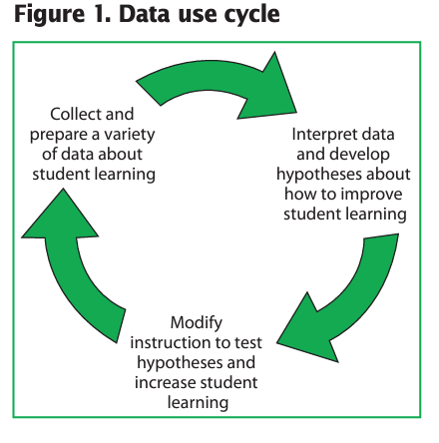
Data Analysis and Interpretation – Class and Student Level Data
This simple cycle involves collecting a variety of data, interpreting it, hypothesizing how we might improve student learning, and then modifying instruction to test that hypothesis.
(Hamilton, et. al., 2009)
Notes:
SAY This is a simple cycle that clearly depicts the data cycle. We addressed collecting data and planning in Session 7, we’re looking at analysis and interpretation during this session and we’ll start thinking about developing a hypothesis based on data. This cycle can be used whether we’re looking at individual student data, classroom data, or data at the grade or school level.

Slide 21
Data Analysis and Interpretation – Class and Student Level Data
Data that could be collected:
State Assessment Data
Progress Monitoring Data
Student Work Samples
Student Writing Samples
Foundational Skills Data
Other data such as attendance, behavioral, etc. that may provide insight into student performance
Notes:
SAY When we want to know about class or student performance, we should collect a variety of data. Review slide.
When analyzing student data, teachers may begin with one set of data, for instance progress monitoring data, and then move to other data sources to confirm the results of the progress monitoring. For example, teachers could consider progress monitoring data, and then look at student work samples and writing samples to establish additional data points. What other types of data might be helpful as teachers consider student or class performance?

Slide 22
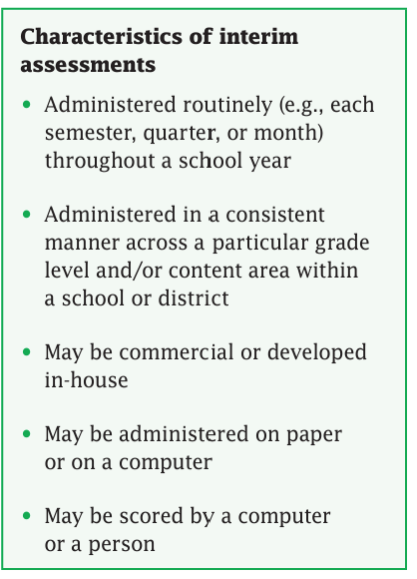
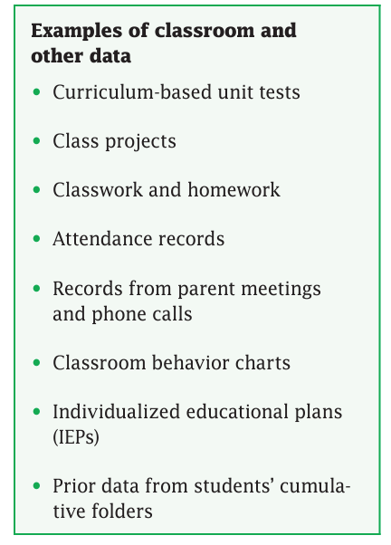
Data Analysis and Interpretation – Class and Student Level Data
Notes:
SAY Here we have some characteristics of interim assessments, some examples of the types of data that might be helpful to collect. We thought of some of these examples when we reviewed the last slide.

Slide 23
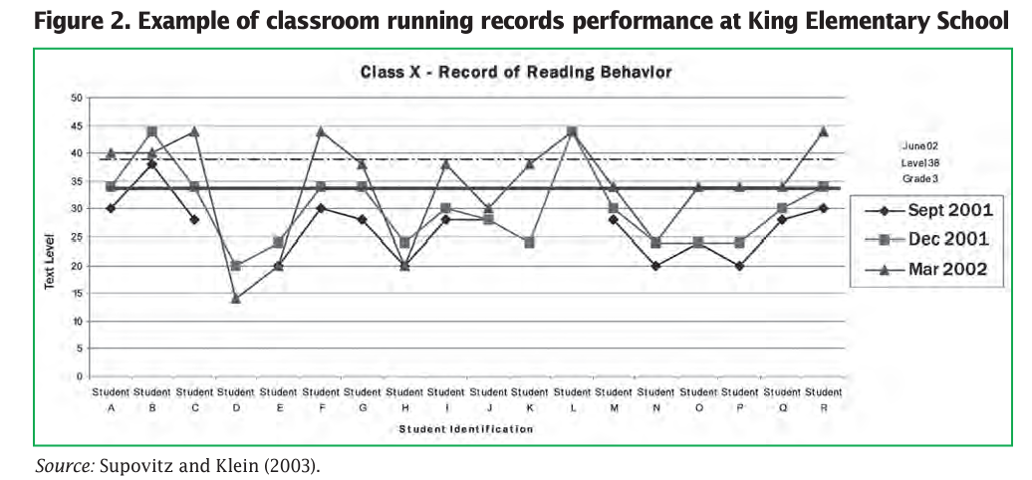
Data Analysis and Interpretation – Class and Student Level Data
Notes:
SAY Here is an example of how data was organized to reflect a class performance. What benefits do you see of organizing data in this or in other ways for teachers?

Slide 24
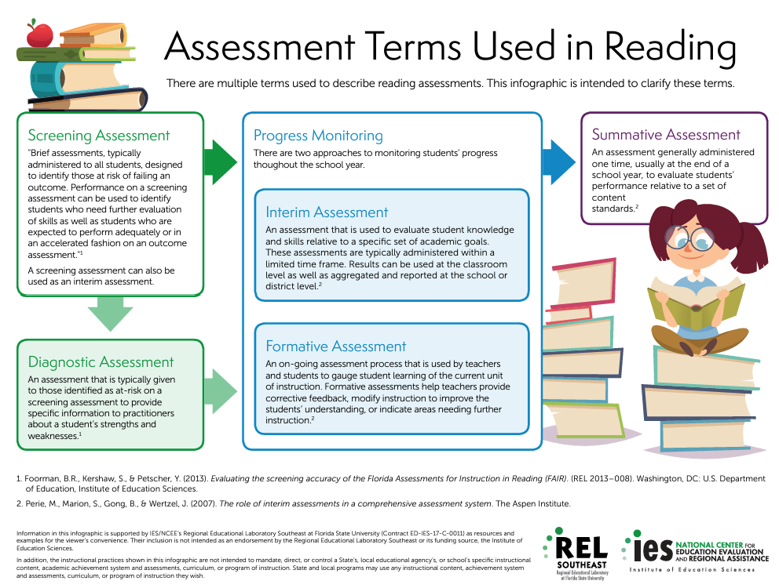
Data Analysis and Interpretation – Class and Student Level Data
Notes:
SAY It is helpful when we are using the same language when we talk about data and assessments. This infographic, developed by the Regional Educational Laboratory Southeast, provides a short description of various types of assessments. You have this as Handout 2. It is often the case that these assessments are referred to interchangeably when they are not the same. The purpose of the assessments is not the same and the data provided is different. It is important that your teachers have a clear understanding of the types of assessments that are administered.
Which of these assessments are administered in your school, and when are they given? Are there assessments that you think are redundant?
Assessment Terms Used in Reading
https://ies.ed.gov/ncee/edlabs/infographics/pdf/REL_SE_Assessment_Terms_Used_in_Reading.pdf

Slide 25
Data Analysis and Interpretation – Class and Student Level Data
To interpret data:
Use more than one data point (triangulate data).
Look for patterns.
Formulate a hypothesis based on what is seen.
We will look at student level data in more depth in Session 11.
Notes:
SAY To gain deeper insight into students’ learning needs, teachers should examine evidence from the multiple data sources. “Triangulation” is the process of using multiple data sources to address a particular question or problem and using evidence from each source to illuminate or temper evidence from the other sources. It also can be thought of as using each data source to test and confirm evidence from the other sources in order to arrive at well-justified conclusions about students’ learning needs. When multiple data sources (e.g., results from the annual state assessment and district interim assessment) show similar areas of student strength and weakness, teachers can be more confident in their decisions about which skills to focus on. We will be examining how to analyze and interpret student level data, with the goal of differentiating instruction, in Session 11.

Slide 26

Collaborate and Practice
Data Analysis and Interpretation – Class and Student Level Data Activity 2
In your small groups review Handout 3: First Grade Class Status Report. Discuss:
What do you think are reasonable expectations for assessment period one? Where would you think student performance would be as a class?
Evaluate the data – do you think this class meets expectations?
What patterns and trends do you notice?
What additional data do you need to provide additional insight for decision making?
Together, formulate a hypothesis that might improve student performance based on what you see, and be ready to share with the whole group.
Notes:
Notes Allow about 15 minutes for this activity. Ask participants to take out Handout 3: First Grade Class Status Report
SAY Please take out Handout 3. This is data for first grade Assessment Period 1. You see there are scores related to reading comprehension for some students, listening comprehension for others, and vocabulary. First of all, why don’t all students have reading comprehension scores and listening comprehension scores? (Response – only first grade students who are reading have comprehension scores, the listening comprehension assessment would have been given to students not yet reading).
Take a couple of minutes to review the data and then talk in your small groups about the questions on the slide. Be ready to share out in about 15 minutes.
Possible responses to the questions on the slide:
Although we might hope that more students were reading at this point, this is only Assessment Period 1 and we have not had much time to instruct. We have to adjust instruction based on the data.
The data tells us where students are in regard to their reading abilities. We would like more students to be in the “green” meaning they have a high probability of reading success.
Comprehension needs to be a focus for a number of students – only two students got all of the comprehension questions correct of the readers. More students got listening comprehension questions correct. Vocabulary also seems to be a need – no one has a score over 75 percent.
We need more specific data in regard to the foundational reading skills.
Hypothesis: Explicit instruction in vocabulary and building oral language might help increase comprehension and also build vocabulary.(there may be other responses)

Slide 27
Learn and Confirm
Data Analysis and Interpretation – Addressing the Big Picture to Change Instruction
Literacy leadership teams or grade-level teams may work together to analyze and interpret data.
Examining data at the grade or school level may reduce the possibility of explaining away students results (they didn’t pay attention; their home life is bad; they had a bad day) or to focus on “quick fixes” which may lead to overlooking what initially led to the students’ misunderstanding.
(Evans et al., 2019; Hill, 2021)
Notes:
SAY Now we are going to turn our attention to looking at grade level and school level data. Analyzing these data often takes place at grade level meetings or is done by a literacy leadership team. Analyzing data at this level can help with facilitating more comprehensive changes in instruction across grades or the school.
Content is from a video interview with Hill, H. (2021) Heather Hill: Cancel Those Data Team Meetings, Edthena.

Slide 28


State Assessment Data
Progress Monitoring Data
Student Work Samples
Student Writing Samples
Foundational Skills Data
Current Strengths and Weaknesses as a Team
Subgroup
Grade Level
Student Cohort Analysis
Teacher Cohort Analysis
Multi Year Analysis
Benchmark Analysis
Standard Strand Analysis
Notes:
SAY Coaches can be valuable members of the Literacy Leadership Team, and data drives the work of the team. The coach may be helpful in collecting and organizing data for the team to consider. Data can paint a picture of where you are as a team and catapult the planning of where you want to go as a team. You see on your screen some examples of the types of data that teams may want to consider and how they might want to analyze these data. What other data might be helpful to the Literacy Leadership Team?

Slide 29
Data Analysis and Interpretation – How Your Team Can Make Sense of it All
Be sure you have the right data.
Data should address what your focus is.
If everything is important, then nothing is important!
Remember that data is simply information – don’t let it intimidate you or your team!
Use protocols to help your teamwork through the data systematically.
Remember that every set of data represents an opportunity to improve our practices to help students be successful.
Debrief and record your next steps.
Notes:
SAY When working with a Literacy Leadership Team or a Grade level team, it is important that you know how to lead that team in making sense of the data you have. Let’s review the suggestions on the slide. Read the steps on the screen and briefly discuss.

Slide 30

Data Analysis and Interpretation – Grade and School Level
Complete Handout 4: Video Viewing Guide as you watch Video 2: What Do You See in These Data?
Video retrieved from https://www.youtube.com/watch?v=j13Gd7MSs7o on 01/4/24.
Notes:
Notes Allow about 15 minutes for this activity. The video is 6.30. Participants will view the video, complete Handout 4: Video-Viewing Guide for What Do You See in These Data? and debrief in small groups. They will then share some of their observations with the whole group.
SAY In your small groups, talk about the answers to the questions on the video-viewing guide.
Possible Responses to the Video-Viewing Guide questions:
What do you see in these data? That is an important question because it helps you to slow down so we don’t jump to conclusions. This also helps us make additional considerations, such as what do you notice, what other data are needed
It can help the team be more efficient, so the teachers can get to the story and the meaning of the data rather than have to figure out how it is organized.
Why? You stop when you get to something actionable.
The hypothesis is indeed “testable.” You can develop a query – If we did this, then this would happen. It should be grounded in literature.
Answers may vary.
Video retrieved from https://www.youtube.com/watch?v=j13Gd7MSs7o on 01/4/24.

Slide 31
Collaborate and Practice
Let’s Practice – Activity 3
Review the following handouts:
Handout 5: Looking at Data
Handout 6: Literacy Leadership or Grade-Level Team Meeting: Data Review Suggested Protocol
We will be completing the protocol, with the exception of the action plan mentioned in the “Reflections on Data” section.
Notes:
Notes Allow about 50 minutes for this activity. Each small group will need chart paper and markers. As you model the beginning of this activity, you will serve as Coach #1. You will set norms for the “literacy leadership team meeting” such as those we have for this course (or others) – cell phones on silent, pay attention to self and others, and presume positive intentions. The purpose of the meeting is to review the data and analyze it with the intent of identifying strengths and weaknesses and eventually establishing a hypothesis regarding how instruction might need to change to improve the literacy skills of students. You will communicate this to the participants. In addition, through your initial comments, you will make a connection between the video just viewed on slide 30 and the activity.
SAY The video we just watched talked about using protocols, or “structured conversations” to help analyze data. The goal is to be able to talk about data, which is extremely helpful, in a very efficient way. That said, we need to be sure that, as Dr. City shared, we do take time to think about the data and process it in a meaningful way before we jump straight to potential solutions. In this activity, we are going to be using a protocol to help analyze a set of data. The protocol provides the structure to have a conversation and ask questions, just like Dr. City suggested in the video. You will participate as a coach and as a member of the literacy leadership team at Sunshine Middle School. This is a fictional school. Your team will use a protocol to help analyze the data. I am going to review the activity, but you have written instructions that you can reference in Handout 9.
The first thing I would like for you to do is to review Handouts 5 and 6 which provide information about using the protocol. Then I’ll be happy to answer any questions that you have about them (allow 5-10 minutes for review). **We are not going to complete the entire protocol, but we will be working through Implications of the data section and spend some time reflecting on the process. During our next session, we’ll reflect on the data to create the action plan which is addressed in the “Reflections on Data” section of the protocol.

Slide 32
Collaborate and Practice
Let’s Practice – Activity 3
Now, review the following handouts:
Handout 7: Sunshine Middle School − Narrative
Handout 8: Demographic and State Assessment Data for 7th and 8th Grade at Sunshine Middle School
Handout 9: Assessment Period (AP) 1-2 Fictional Progress Monitoring Data for Sunshine Middle School
Handout 10: Instructions for Activity 3
Each group member will serve as the “coach” at some point during our practice time. Refer to Handout 9 if you need to review instructions for the activity.
Notes:
Notes Allow about 50 minutes for this activity. Each small group will need chart paper and markers. As you model the beginning of this activity, you will serve as Coach #1. You will set norms for the “literacy leadership team meeting” such as those we have for this course (or others) – cell phones on silent, pay attention to self and others, and presume positive intentions. The purpose of the meeting is to review the data and analyze it with the intent of identifying strengths and weaknesses and eventually establishing a hypothesis regarding how instruction might need to change to improve the literacy skills of students. You will communicate this to the participants.
SAY We are now going to review the following handouts . Handout 5: Atlas: Looking at Data provides some guidance regarding the use of the protocol. Handout 6 is the protocol itself. Handout 7 provides you with some background information about Sunshine Middle School. You also have Handout 8 which is a table with demographic information and state assessment data for reading and mathematics. Handout 9, is the literacy assessment data from Assessment periods 1 & 2 for 7th grade and periods 1, 2, and 3 for 8th grade. All of these data are fictional and being used for training purposes only. Finally, you have Handout 10, which is the written instructions for the activity that you can reference.
During our practice time, we’ll be sharing the role of the coach in your literacy leadership team meeting. I will serve as the first coach, and I will set norms as well as establish the purpose of the meeting. You have the data you need on the handouts. Members of each group will then serve as the coach at some point as we work through the activity. Here’s how you could divide the role:
Coach #1 – Lead the “Describe the Data” section
Coach #2– Lead the “Interpret Data section
Coach #3 – Lead the “Implications of Data section
Coach #4– Lead the “Reflect and Debrief the Process” section
If you have more or less than four people in your group, please divide the duties among yourselves as it makes sense to you. When you are serving as the coach, you will record the thoughts of the group on your chart paper. When you are not serving as the “coach” you will be participating as a team member. After we complete the activity, one of you will need to summarize the information you recorded on your chart paper for the whole group. One of your group members will need to take notes - you will need these for Session 9. You can also take a photo of your chart paper.
Before we get started, you will have about ten minutes to review Handouts 7, 8, 9, and 10 – the data for Sunshine Middle School and the instructions for the activity. You should be prepared to debrief with the whole group when we are finished.

Slide 33

Reflect, Plan, and Implement
Post-Session Reflection, Planning, and Implementation
Handout 11: Data-Driven Decision Making in Education Agencies Infographic and note any comments or questions you have after your reading.
Complete Self-Study 1: Reflections on Session 8.
Reflect on your participation in Session 8 by noting any questions about the content or format on Self-Study 1. Bring this self-study assignment to Session 9.
Video 3: Grade-Level Data Meeting with Third Grade Teachers and complete Self-Study 2: Video Viewing Guide. Be prepared to debrief at the beginning of Session 9
Video retrieved at https://www.youtube.com/watch?v=BLCbNX84ll4 on 1/24/24.
READ
DO
WATCH
Notes:
SAY As we near the end of today’s session, here are the self-study activities to complete before we meet for Session 9. First, spend some time reviewing the infographic Handout 11: Research Review: Data-driven decision making in education agencies. Think about the importance of data, and what data is relevant, for a variety of stakeholders. Complete Self-Study 1: Reflections on Session 8 and note any questions you have – be sure to bring this with you to Session 9. Then, please view the brief video of a grade-level data meeting with third grade teachers and complete the Self-Study 2: Video-Viewing Guide. We’ll debrief at the beginning of Session 9.
Video 3: Grade-Level Data Meeting with Third Grade Teachers (4:45)
Video retrieved at https://www.youtube.com/watch?v=BLCbNX84ll4 on 1/24/24.

Slide 34

Questions?
Notes:
SAY Are there any questions that you have regarding the content of this session, the self-study activities, or the course in general?

Slide 35




We have completed
Session 8
Notes:
SAY Congratulations on successfully completing Session 8! We look forward to seeing you for Session 9 as we complete Module 3.
Confirm the date and time of the next session.

