Slide 1
Fundamentals of Literacy Coaching
Professional Development Modules
Module 3, Session 9
Developing and Implementing a Professional Learning Action Plan
and Evaluating School, Teacher, and Student Outcomes
Notes:
SAY Welcome to Fundamentals of Literacy Coaching Professional Development Modules – Session 9: Developing and Implementing a Professional Learning Action Plan and Evaluating School, Teacher, and Student outcomes.

Slide 2
Module | Topic | Session | Minutes | Session Date
1 | Applying Principles and Practices that Foster a Positive Culture | Intro | 60
 |  | 1 | 120
 |  | 2 | 150
 |  | 3 | 150
2 | Applying Effective Pedagogy and Andragogy | 4 | 120
 |  | 5 | 120
 |  | 6 | 165
3 | Collecting Data to Inform Professional Learning | 7 | 150
 |  | 8 | 140
 |  | 9 | 170
4 | Planning, Implementing, and Analyzing Literacy Instruction | 10 | 175
 |  | 11 | 135
 |  | 12 | 165
 |  | 13 | 130
5 | Growing Professionally | 14 | 120
 |  | 15 | 120
6 | Planning and Implementing Coaching | 16 | 120
Notes:
NOTES
It is recommended that the sessions are completed in sequential order.
The timeline for completing the sessions can be flexible. If the recommended minutes for each session are not available, complete what you can with the time you have and then pick up where you left off the next time you meet.
Once a schedule of the sessions is established, have participants record the schedule in their Fundamentals of Literacy Coaching PD Guide if printed.
SAY Here is an overview of the modules and sessions of this course. There are six modules, and each module includes two to four sessions for a total of 15 content sessions. Module 1 addresses Applying Principles and Practices that Foster a Positive Culture, Module 2 covers Applying Effective Pedagogy and Andragogy, the focus of Module 3 is Collecting Data on Instructional Practices to Inform Professional Learning, the content of Module 4 is Planning, Implementing and Analyzing Standards-Based Literacy Instruction, the content of Module 5 is Growing Professionally, and the final module, Module 6, addresses Planning and Implementing Coaching.
You can record the date of each of our sessions in your Fundamentals of Literacy Coaching PD Guide.

Slide 3
Bridge to Practice Projects for Coaches
An activity designed to serve as a Bridge to Practice after each Module will provide evidence that coaches are able to apply the knowledge and skills they developed in this course in their schools. Coaches will complete the following activities:
A rubric is provided at the end of each Module for the corresponding Bridge to Practice project.
Module 1 | Develop a principal-coach partnership agreement.
Module 2 | Develop a needs assessment for professional development on evidence-based instructional practices and complete an ADDIE model for planning this professional development.
Module 3 | Develop and describe planned implementation of a professional learning action plan.
Module 4 | Create a video that reflects coaching to help teachers plan, implement, and analyze standards-based literacy instruction.
Module 5 | Complete a reflection on the course, including plans for continued professional growth.
Module 6 | Choose one teacher with whom you have seen significant growth as a result of coaching support and complete a reflection on what worked, why it worked, and which areas of growth were most evident.
Notes:
SAY We want to remind you that participating coaches will complete a Bridge to Practice project after each module. These projects will provide evidence that coaches are able to apply the knowledge and skills they developed in this course in their schools. You will learn more about each project as we work through the modules. We’ve shared an overview of the projects with you on this slide.
Coaches will
Module 1: develop a principal/coach partnership agreement;
Module 2: conduct a needs assessment for professional development on evidence-based instructional practices and complete an ADDIE model for planning this professional development;
Module 3: develop, implement, and evaluate a professional learning action plan;
Module 4: create a video that reflects coaching to help teachers plan, implement, and analyze standards-based literacy instruction;
Module 5: complete a reflection on the course including plans for continued professional growth.
Module 6: Choose one teacher with whom you have seen significant growth as a result of coaching support and complete a reflection on what worked, why it worked and which areas of growth were most evident.
You may turn in all your artifacts for the projects to your facilitator at the end of each module if requested.

Slide 4



Norms for Our Course
Cell phones on silent
Pay attention to self and others
Presume
positive intentions
Notes:
NOTES Consider your group to determine how much detail about the norms will be helpful to review.
SAY Professional learning opportunities usually consist of a team of educators, like us, that meet regularly to learn new topics, share ideas, and problem solve. We will build a community, meaning that we learn from each other, so sharing and participation are really important.
Professional learning opportunities typically have norms that the group can agree to in order to be productive. Here are three norms, or ground rules, for our way of work: cell phones on silent; pay attention to yourself and others; and presume positive intentions.
Pay attention to self and others This means to contribute, listen, and be aware of how you and others are responding to each other. Be sure to give everyone a chance to talk and encourage others who seem reluctant to join in. Sometimes people who are reluctant to talk are thinking. They may not be comfortable jumping in but may have something important to say. Professional learning opportunities like this one encourage educators to learn from one another. Therefore, sharing, discussing and participating are important components.
Presume positive intentions This means to pause before responding. Usually when people contribute to a conversation, they intend to be constructive. So, always respond positively to keep the discussions productive.

Slide 5

Goals for Today
Define and Discuss Session Goals and Content
Review Session 8 and debrief the self-study activities completed after the session.
Learn to collaborate with administration, instructional leaders, and teachers to develop a professional learning action plan that is informed by data analysis.
Understand how to facilitate the implementation of the action plan.
Learn how to analyze and evaluate school, teacher, and student outcomes to determine follow-up steps.
Discuss the completion of the Bridge to Practice project for Module 3.
Notes:
NOTES Share and discuss these goals for today’s session.

Slide 6

Review of Module 3, Session 8
Debrief
Self-Study 1 (Reflection, Handout 11: Data-Driven Decision Making Inforgraphic)
What insights did you gain from reviewing Handout 11?
How can you, as a coach, ensure that the focus remains on instruction and not on issues that are beyond the control of the teacher?
Any comments or questions about Session 8?
Self-Study 2: Video Viewing Guide: Grade-Level Data Meeting with Third Grade Teachers
Share responses to questions about Self-Study 2.
Notes:
NOTES Allow about 7 minutes for this debrief. If you have a small group, ask for volunteers to share with the whole group. If you have a large group, consider having triads discuss and then ask for a volunteer from each triad to share with the large group.
SAY After Session 8, you had something to read, something to do, and something to watch. Let’s debrief. You read Handout 10. Look at what you recorded on Self-Study 1: Research Review: Data-driven decision making in education. Review the questions on the side. Answer may vary.
You also watched the video Grade-Level Data Meeting with Third Grade Teachers and completed the video-viewing guide. Let’s review your responses to the questions on the guide.
Possible responses to Self-Study 2
Benchmark data.
Analyzed and spent time with the data and organized it; she wanted teachers to focus on specific benchmarks.
Teachers review the data individually; teachers review the data together; look at individual student results; review the data wall; share results with students.
The meeting was collegial, teachers were not afraid to share. They made suggestions to each other and everyone seemed positive. The focus was on helping students perform better and modifying instruction to help with that.
They can adjust instruction; rich conversation; helps the team to work better and to work better as individual teachers.
Answers will vary.

Slide 7
Literacy Coach Domain and Standards: Session 9
C. Ability to effectively collect and use data on instructional practices to inform and implement professional learning opportunities. Coaches will be able to:
Collaborate with administration, instructional leaders, and teachers to develop a professional learning action plan that is informed by data analysis.
Facilitate the implementation of an action plan based on data analysis.
Analyze and evaluate school, teacher, and student outcomes to determine follow-up actions.
Notes:
SAY This is the literacy coach domain and three standards that will be covered during this session. We are going to address all of these standards as we work through this session together.

Slide 8


Moving on From Data Analysis and Interpretation to Planning, Implementation, and Evaluation
Learn and Confirm
Notes:
SAY It is important that we take time to make sense of the data that we have collected, but we must go further than that. If we are going to take the time to collect the data, analyze, and interpret it, then we must use it to facilitate change. We must carefully plan the changes in instruction we intend to make, implement our plans, and then evaluate what we did to see if it made a difference in student learning. If we don’t do that, then we might as well not collect the data in the first place. In our session today, we will be using the data analysis and interpretation we completed in Session 8 as the basis for developing a professional learning action plan. The Bridge to Practice project for this module is for you to develop a professional learning action plan using your own data; therefore, the opportunity for us to collaborate in this session should help you as you complete your project.

Slide 9
What a Professional Learning Action Plan Is and Isn’t
A professional learning action plan is a “set of purposeful, planned actions and the support system necessary to achieve the identified goals. Effective [professional learning] programs are ongoing, coherent, and linked to student achievement.”
A professional learning action plan is not a series of events. Events are occasional, episodic, disconnected incidents throughout the school year and do little to produce substantial change.
(Killion, 2008)
Notes:
NOTES Review the slide.
SAY We need to keep this in mind as we plan professional learning opportunities. They should be organized into a system to support teachers as we all work together towards a common goal. Research reflects that in order to facilitate change, professional development sessions can be provided and then embedded classroom coaching conducted with individual teachers in order to facilitate the transfer from teacher learning to changes in practice. A variety of learning designs should be used to help teachers increase their knowledge and improve their skills. These could include lesson study, action research, professional learning communities, online professional development sessions, etc.

Slide 10
The Focus of a Professional Learning Action Plan
Professional learning action plans guide professional learning and implementation of that learning. They focus on the following:
Content
Learning designs
Implementation support
Evaluation of professional learning
(Killion, 2013)
Notes:
NOTES This entire workbook is included as a resource for you. You may choose to provide it to your participants, or only provide the handouts.
SAY In Session 6 we introduced the ADDIE Model and needs assessments to you, as well as the professional learning standards for Florida. Your Bridge to Practice project for Module 2 was to complete an ADDIE model using theory for evidence-based practice in professional development. This provided you with a foundation for creating an actual professional learning action plan. The professional learning action plan you will develop for this module will put that theory into practice. You may wish to review that model when we get to the Bridge to Practice project for Module 3, which requires you to develop a professional learning action plan based on data. For the content of this module, we will be using sections from the tool Professional Learning Plans: A Workbook for States, Districts, and Schools that was authored by Joellen Killion to help us examine content, learning designs, implementation support, and evaluation of professional learning. This aligns with the ADDIE model and the professional learning standards, and also provides us with an explicit and systematic process for developing our professional learning action plans. Handouts for this session have been created from this resource. The entire resource is available in the facilitator’s materials for this session.

Slide 11
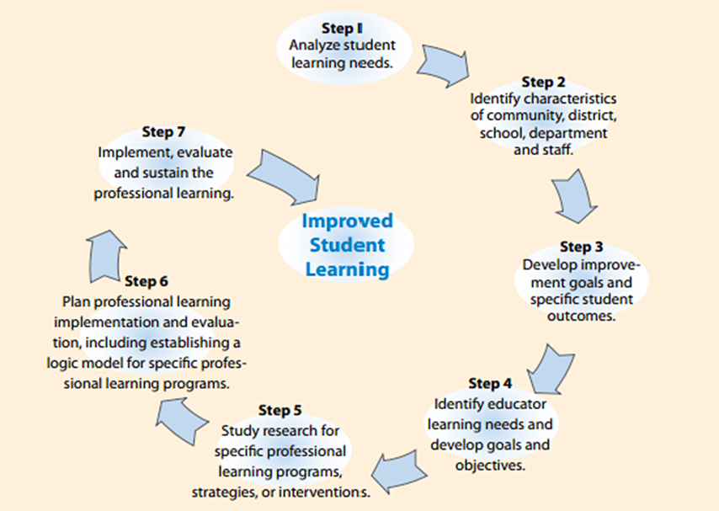
Professional Learning Action Plan Model
Notes:
SAY You see on your screen a seven-step process for planning professional learning included in the document by Killion. The steps probably seem familiar – they address the topics in the ADDIE model and in the Florida professional learning standards. They are also included in most state, school system, and school improvement planning processes. Improvement plans and professional learning action plan models complement one another and should be nested together. Professional learning is a primary means for improving schools. Improvement plans identify student learning goals; professional learning plans identify what educators learn to achieve those goals.

Slide 12
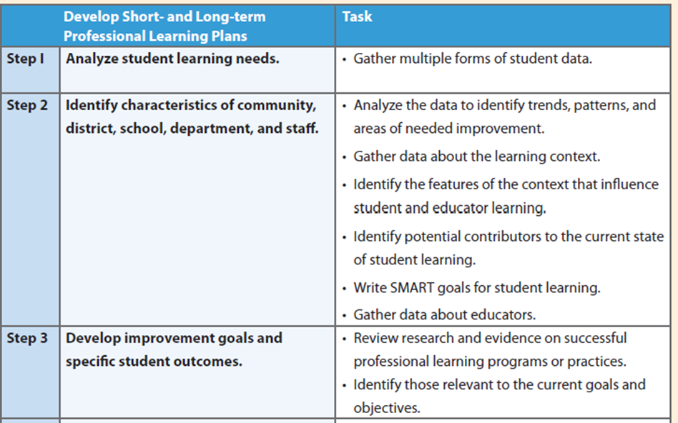
Steps for Developing a Professional Learning Action Plan
Notes:
SAY These are the first three steps that were included in the model on the preceding slide. Here you see some of the tasks that are required to ensure that each step is completed. During today’s session we will be building a professional learning action plan based on the data we analyzed and interpreted in Session 8. Handout 1 includes all six steps so you can document the completion of tasks and steps throughout our time together.

Slide 13
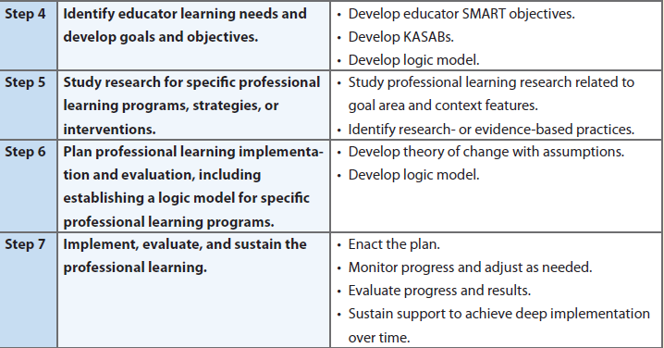
Steps for Developing a Professional Learning Action Plan
Notes:
SAY Here are the remaining steps from the model. We’ll talk about “SMART” objectives and the meaning of “KASABs” when we get to those steps.

Slide 14
Steps for Developing a Professional Learning Action Plan
Access and read Handout 1: Steps for Developing Professional Learning Plans.
Access and read Handout 2: Core Elements of a Professional Learning Plan (PLP).
Notes:
Allow about 5 minutes for this activity.
SAY We will be using these two handouts throughout our session.

Slide 15
Steps for Developing a Professional Learning Action Plan
Review Handout 3: Data Review Protocol from Session 8, paying particular attention to “Reflection on Data.”
Review your group notes from completing the protocol in Session 8.
Review Handouts 4, 5, and 6 – data from fictitious Sunshine Middle School.
Notes:
Allow about 10 minutes for this activity
SAY Let’s take a few minutes to remind ourselves about how we analyzed and interpreted data from Sunshine Middle School, a fictitious middle school in Florida, in Session 8. Review the protocol we used to help us analyze and interpret the data – you see that there is a section calling for us to create an action plan. We will address that during this session. In your small groups, review the notes that you took as you worked through the protocol in Session 8, and then peruse the data from Sunshine Middle School. We’ll use this as we work through the process of creating a professional learning action plan during this session and then discuss the implementation and evaluation of the plan.

Slide 16
Steps for Developing a Professional Learning Action Plan
Place a checkmark next to each task in Steps 1 and 2 on Handout 1 that was completed by using the protocol to analyze and interpret the data from Sunshine Middle School and by reviewing the narrative providing information regarding the community, school culture, and staff.
Place a checkmark next to Step 1 on Handout 1 as this should be complete.
Notes:
Allow 7 minutes for this activity.
SAY Handout 1 is the list of the six steps we reviewed along with the tasks necessary to complete them. Handout 2 contains a list of the core elements of a professional learning action plan along with an explanation of those elements. Place a checkmark or highlight each task that has been completed by the work you did in Session 8 when you completed the protocol to analyze and interpret Sunshine Middle School data. We should be able to deem Step 1 completed – so place a check beside that step.

Slide 17
Steps for Developing a Professional Learning Action Plan
In your small groups, write one SMART goal for student learning based on the area of focus (improving student vocabulary) and your analysis and interpretation of student data:
Specific
Measurable
Achievable
Relevant
Time-bound
Check off Step 2 on Handout 1.
Notes:
NOTES Allow 7 minutes for this activity. Ask for two or three groups to share their SMART goals. If you have more groups, you probably don’t want to take the time for all groups to share out.
SAY Our area of focus is improving student vocabulary in order to increase the comprehension skills of students. As a reminder, a SMART goal is one that is specific, measurable, achievable, relevant, and time-bound. In your small groups, develop a SMART goal and be ready to share with the whole group.

Slide 18
Steps for Developing a Professional Learning Action Plan
Read Recommendation 1 from Handout 7: Improving Adolescent Literacy: Effective Classroom and Intervention Practices practice guide to address Step 3 on Handout 1.
Check off Step 3 on Handout 1.
Notes:
NOTES Allow 7 minutes for this activity. Refer participants to Handout 7.
SAY Recommendation 1 in this practice guide contains information related to teaching vocabulary. Practice guides like this one are released by the What Works Clearinghouse after a panel of experts has reviewed quality studies and developed recommendations for practitioners to implement in their classrooms. Levels of evidence are also established by the panel, based on the types and number of studies that have been conducted. We’ll delve more deeply into practice guides in Session 10. For now, Recommendation 1: Provide explicit vocabulary instruction (in the adolescent literacy practice guide), has a strong level of evidence as a classroom practice for adolescents. When you develop your professional learning action plan, you will want to look at documents like this when you consider the content of the professional learning activities you provide your teachers. Since this session is building your knowledge and allowing opportunity for practice, we will not look at additional research, but you will want to look at multiple studies and evidence when you select your content.

Slide 19
Steps for Developing a Professional Learning Action Plan
In your small groups, write one SMART goal and one goal addressing knowledge, attitudes, skills, aspirations, or behavior (KASAB) for TEACHERS.
Check off Step 4 on Handout 1.
Notes:
NOTES Allow 7 minutes for this activity.
SAY In order to help students meet their goals, we need goals for teachers that are aligned. Now you are going to write one SMART goal for your teachers. In addition, you read about KASABs on Handout 5. With your group create one goal that addresses just ONE of the KASAB areas. For example, you may choose to write a goal that addresses attitudes…or you may choose to write a goal that addresses skills. You can choose any one of the KASAB areas. We will not take time to develop a logic model at this point. We will do that when we talk about Step 6.

Slide 20
Steps for Developing a Professional Learning Action Plan
Step 5 involves identifying evidence-based practices for delivering and supporting professional learning and determining those that are well-suited to your goals.
We are learning about many of these practices throughout this course, but you may want to do additional research to identify others.
Notes:
NOTES Review the slide.
SAY Session 6 emphasized the importance of selecting and applying appropriate methods for coaching and providing professional learning opportunities. This is an important part of your professional learning action plan.

Slide 21
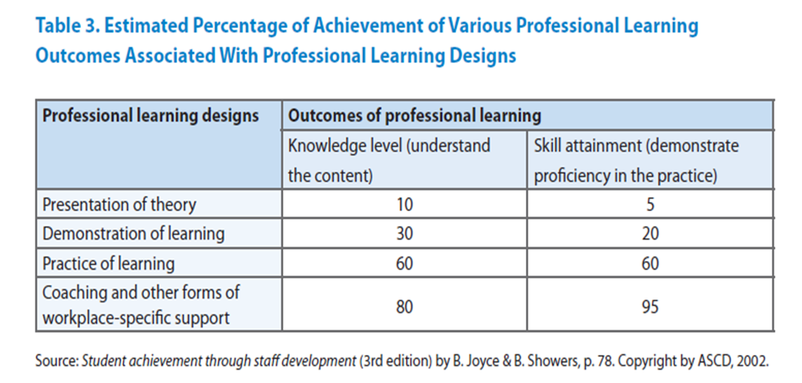
Effectiveness of Various Professional Learning Designs
Notes:
NOTES Allow five minutes for this discussion.
SAY This chart provides us with some important information to consider as we select professional learning designs. In your small groups, discuss some of the implications of the information you see here. Be ready to share with the whole group. You may recall seeing similar charts in Session 1 and again in Session 6.

Slide 22
Steps for Developing a Professional Learning Action Plan
Professional learning designs to consider when developing a professional learning action plan.
Consider delivery formats when developing a professional learning action plan.
Consider follow-up when developing a professional learning action plan.
Action research
Case studies
Critical friends groups
Examining student work
Lesson Study
Monitoring/Coaching
Peer Observation
Protocols
Study Groups
Training
Tuning Protocol
Face-to-face
Distance/Online
Blended format
Length
Other
Classroom-based
Non-classroom-based
Notes:
SAY The professional learning design that you select requires a good deal of thought because you will be investing time and resources. In some cases, teachers may be ready to pursue much of their learning on their own or with other teachers, and you may just need to check in with them. In other cases, teachers may need the opportunity to participate in structured learning opportunities, where significant knowledge-building occurs accompanied by embedded coaching. You may not be familiar with “tuning protocol.” This is a flexible critique protocol used to gather focused feedback that can aid planning. There are a variety of different formats of tuning protocols, and these tools have been in existence for several decades. You will read more about tuning protocols in your self study after this session. All of these professional learning processes on your screen are evidence-based – how would you decide which would be most appropriate to include in your professional learning action plan? Check off Step 5 on Handout 1 to reflect that we have thought about this step.

Slide 23
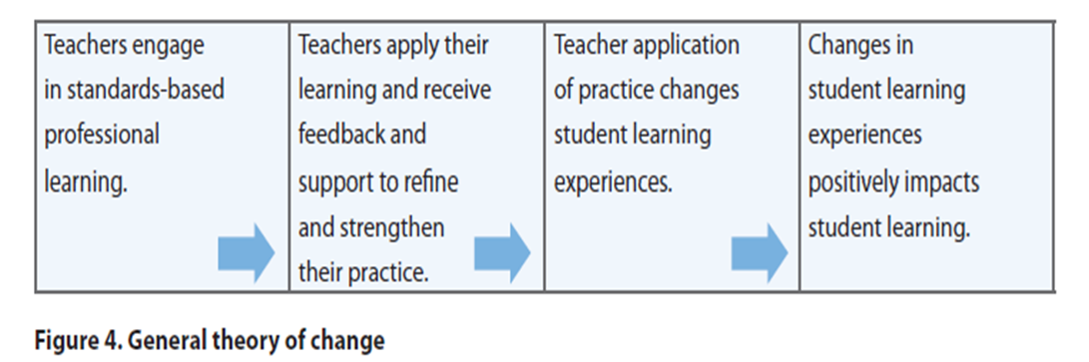
Steps for Developing a Professional Learning Action Plan
Step 6 – Theory of Change
Notes:
NOTES Allow 5 minutes for this activity
SAY Planning the actual strategic approach to professional learning requires attention to a long-term view of learning, continuous differentiated support for implementation, and formative and summative assessments of the application and impact of professional learning. Not all types of professional learning will generate positive results for educators and students. That is, some types of professional learning may show little or no positive effect primarily because the professional learning plans are insufficient to produce deep learning and sustain implementation. In addition, many professional learning plans fail to acknowledge that learners differ in what they need to learn and where and how they will apply their learning. We need to know what we want to happen, and the steps to take to ensure the goals we set are accomplished.
After the context analysis and research about viable strategic approaches is completed, the first part of mapping out a plan is developing a theory of change. You see on your screen a general theory of change depicted. A theory of change identifies the essential actions needed within a professional learning plan to achieve the intended goals and objectives, the sequence of those actions, and the underlying assumptions that drive the theory of change. After we’ve thought about the theory of change, which is the overall plan for the professional learning, a logic model can be used to delineate the outputs and outcomes.
In your small groups, talk about the information you’ve collected and used in Steps 1-5. Adapt the theory of change model on the screen to be more specific to what might be appropriate for the professional learning action plan for Sunshine Middle School. Be prepared to share with the whole group.
Possible responses:
Teachers engage in evidence-based professional learning on delivering vocabulary instruction……Teachers apply their learning and receive feedback and support to refine and strengthen their vocabulary instruction….Teacher application of evidence-based vocabulary instruction changes student learning experiences….changes in student learning experiences result in increased vocabulary knowledge and improved reading comprehension.

Slide 24
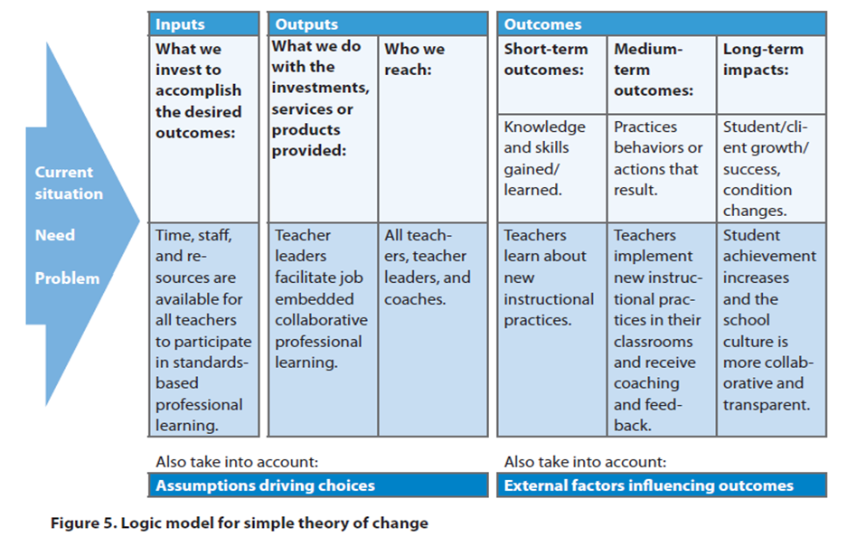
Steps for Developing a Professional Learning Action Plan
Step 6 – Logic Model (Example)
Notes:
NOTES Review the slide.
SAY While a theory of change provides an overview of the operation of the entire program, the logic model maps and predicts the intended changes that occur over time from outputs to short- and long-term outcomes for educators and results for students. A variety of formats can be used to create a logic model – here is one example. You saw a different example in Module 6.

Slide 25
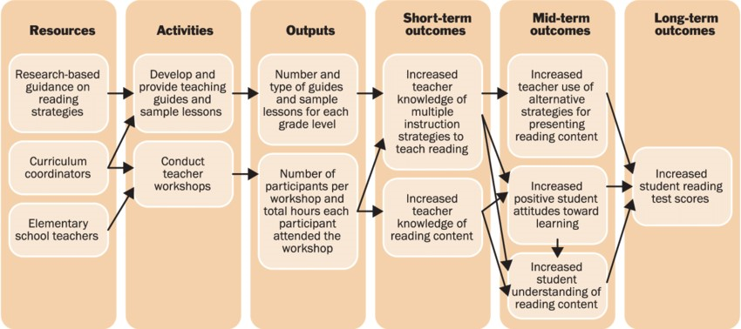
Steps for Developing a Professional Learning Action Plan
Step 6 – Logic Model (Example)
Notes:
SAY Here is another example of a logic model. Note on this example, you see actual activities represented – these are very similar to the “outputs” on the previous example.

Slide 26
Steps for Developing a Professional Learning Action Plan
Access Handout 8 – Logic Model Example.
Access Handouts 9 and 10 – Logic model templates.
In your small groups, select the template of your choice and complete one row of the logic model using the information you have acquired as you completed Steps 1-5.
Check off Step 6 on Handout 1.
Notes:
NOTES Allow 15 minutes for this activity – about 10 minutes to complete the logic model section and five minutes for sharing.
SAY In steps 1-5 we have examined data from Sunshine Middle School, created goals for students and teachers, reviewed research, considered a theory of action, and overviewed examples of logic models and templates. While we won’t have time to complete an entire logic model, we will complete a section to give you a taste of what this looks like. In your small groups, review the logic model example on Handout 8, choose a template (Handout 9 or 10), and complete one row of the logic model. Be prepared to share your thinking and what you entered in your template.

Slide 27
Steps for Developing a Professional Learning Action Plan
Access Handout 11: Professional Learning Action Plan Example and review in your small groups.
Access Handout 12: Professional Learning Action Plan Template.
Notes:
NOTES Allow about 7 minutes for this activity which is detailed on this slide and the next two slides. Participants need to access the two handouts on the slide. You will review Handout 11 on the next two slides, the example of a professional learning action plan, with the participants. Discuss any questions that they might have.
SAY Let’s look at Handout 11 together. This is an example of a professional learning action plan that is focused on improving student reading comprehension. The plan is divided into two sections – one that addresses the actions that need to be taken for student learning, and the other to address teacher learning. We’ll view and discuss each of these sections on the next two slides.

Slide 28
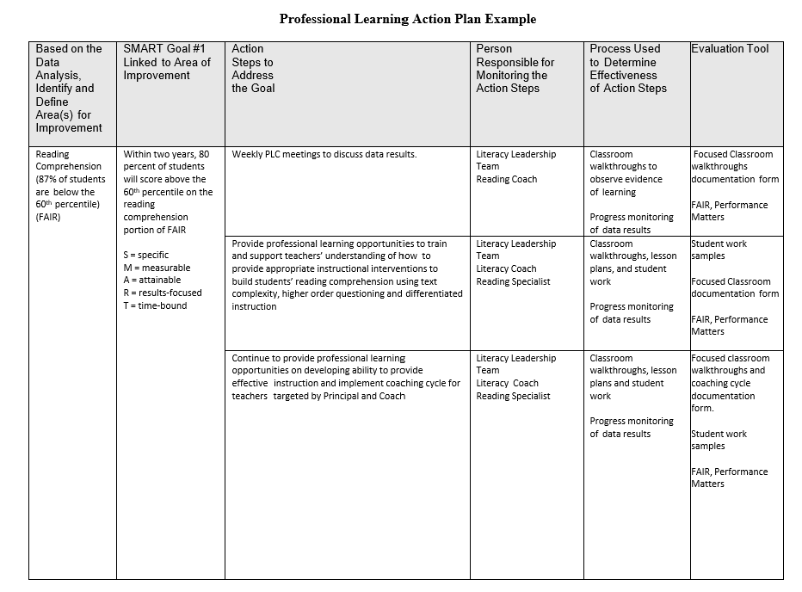
Notes:
NOTES Allow about three minutes for discussion and a minute to share out. You will want to note that the action plan includes a column related to evaluation. This will be important to consider as they create their own action plans.
SAY Here is the first section of an example of a professional learning action plan. In your small groups, discuss each of the sections and why they are important. Be ready to share out in the whole group.

Slide 29
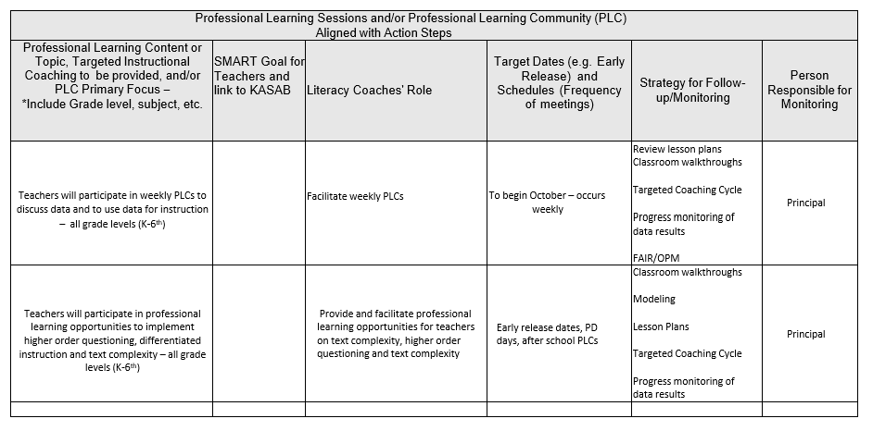
Notes:
NOTES Allow about 3 minutes to discuss the questions below.
SAY Here’s the second section of the plan. What connections do you see between the first section and the second? What practices are being addressed in order to meet the established goals? How are these reflected in the first section versus the second section of the plan?
Possible responses: This section of the document supports the first section. The professional learning sessions or PLC help to address the action steps and move teachers toward the goal. Monitoring occurs in both sections - one is monitoring the implementation of the professional development and the other the action plans.

Slide 30

Collaborate and Practice
Completing the Professional Learning Action Plan
In your small groups, use all the information you have to complete the template of the professional learning action plan.
Be prepared to share briefly some highlights of your plan.
Notes:
NOTES Allow about 20 minutes for this activity. The purpose of this activity is to provide participants with the opportunity to practice developing a professional learning action plan. They have been provided with data and have had opportunities during the session to think about goals, a theory of action, and develop a section of a logic model. Still, they may not feel that they have all they need. If that is the case, reassure them that this is for practice and not to worry if they need to make logical assumptions, or if they would rather, leave a section blank. This should give them a taste of formulating a plan and should help them with their Bridge to Practice project.
SAY We are going to use all the information we have completed in steps 1-6 of Handout 1 to complete this professional learning action plan. We know that this is fictional and was designed for training purposes. There may be information that you think you need, that you don’t have. That’s okay – just do the best you can. Note what you believe you might need, and feel free to make some assumptions. This experience should be helpful as you develop your own professional learning action plan as your Bridge to Practice project for this module.

Slide 31

Learn and Confirm
Facilitating Implementation of the Professional Learning Action Plan
What is implementation?
Implementation involves putting a plan into effect, including the process of monitoring progress, making adjustments, and evaluating impact.
Implementation is a process, not an event.
A strong implementation plan contributes to the overall safety and supportiveness of learning environments to help all students achieve.
Notes:
National Center on Safe Supportive Learning Environments - https://safesupportivelearning.ed.gov/topic-research/program-implementation#:~:text=Implementation%20involves%20putting%20a%20plan,making%20adjustments%2C%20and%20evaluating%20impact.&text=A%20strong%20implementation%20plan%20contributes,to%20help%20all%20students%20achieve
SAY Remember that we are looking at implementation of the professional learning action plan by you, the coach. That said, you will require the support of administration, your literacy leadership team, and teachers for implementation to be accomplished. As you implement this plan, you will need to monitor your progress by monitoring the progress of the teachers you serve. You will also need to adjust your plan. Remember that this is a process and that your plan will be implemented over the course of time. When you implement it effectively, you will establish a safe environment in which teachers can learn, incorporate new practices into their instruction, and ultimately positively affect student achievement.

Slide 32
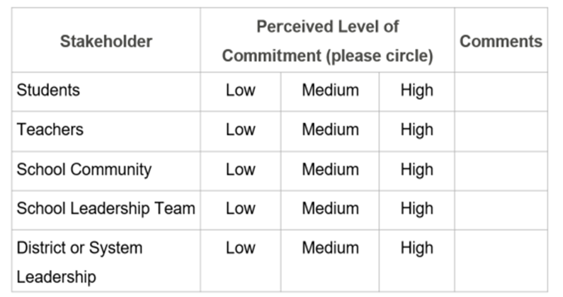
Facilitating Implementation of the Professional Learning Action Plan
Implementation involves:
Commitment and persistence of the implementers (you – the coach, administrators, literacy leadership team, and teachers).
Clear understanding, by all, of what is expected.
Willingness to engage in new practices.
Notes:
SAY In order for a full implementation of the professional learning action plan to occur, we must have commitment from those who will be assisting in implementation. It may be helpful for you to try to gauge that before you begin. As the plan is implemented, you may find that commitment increases, or wanes! It is also important that everyone understands what is expected of them. For example, teachers should understand that they will be incorporating new practices in their classrooms. Literacy leadership team members may need to understand that they will be promoting these new practices and may be involved in ensuring they are being incorporated. The principal should be providing valuable support, and you, as the coach, will be facilitating the implementation of the plan. Finally, everyone needs to be willing to implement.

Slide 33
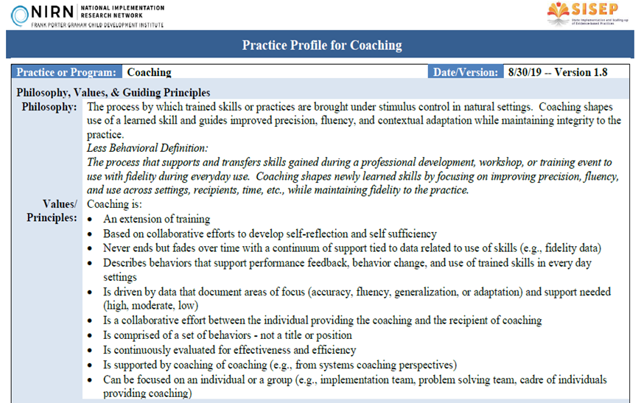
Facilitating Implementation of the Professional Learning Action Plan
Practice profiles can help establish expectations by:
Breaking the practice or program down into components.
Being a road map for implementation of the professional learning action plan.
Establishing a range of implementation levels from unacceptable to developing to ideal/expected.
Notes:
SAY We’ve looked at some practice profiles in earlier sessions. These can be created to address specific practices, like differentiated instruction, or roles, like the coaching role. If you have a practice profile in place for the role of the coach, this can guide you in the implementation of the professional learning action plan.

Slide 34
Facilitating Implementation of the Professional Learning Action Plan
In your small groups, examine Handout 13: Practice Profile for Coaching developed by the National Implementation Research Network. Be prepared to discuss in the whole group.
How could a document like this help you implement the professional learning action plan?
Who would be on a team that might develop a practice profile for coaching in your district or at your school?
What elements might you include in a principal-coach partnership agreement?
Notes:
NOTES Allow 10 minutes for this activity – seven minutes for review and discussion in small groups and three minutes to share out
SAY Let’s review Handout 13 in our small groups. After you have read the document, discuss the questions on the screen in your groups and be prepared to share out with our whole group.

Slide 35
Collaborate and Practice
Facilitating Implementation of the Professional Learning Action Plan
In your small groups, talk about the implementation of the professional learning action plan that you developed in this session. Be sure to consider the practice profile you just reviewed.
What should implementation look like?
What kinds of things do you do to implement the plan – thus supporting teachers in their implementation of new practices?
What support do you need for ideal implementation?
What do you do when implementation seems to stall?
How do you know when your plan has been fully implemented with quality?
Notes:
NOTES Allow 7 minutes for this activity. Review the slide and circulate around the room as the groups engage in discussion. You probably won’t have time for all groups to share out on each question – call on a group or two to answer the questions.
SAY In your small groups, talk about the professional learning action plan you developed together, especially in light of the practice profile you just reviewed. Talk about the questions on the slide in small groups. I’ll call on a couple of our groups to share their thoughts regarding each question.

Slide 36
Learn and Confirm
Analyzing and Evaluating School, Teacher, and Student Outcomes to Determine Follow-Up Actions
Analyzing and evaluating outcomes must occur on two levels in order to determine follow-up actions:
How well the professional learning action plan was implemented by the coach and others.
How well the instructional practices that were the focus of the plan were implemented by the teachers and has influenced student achievement.
These are related – one provides evidence of the other.
Notes:
NOTES Review the slide.
SAY As we analyze and evaluate outcomes, we will gain insight regarding how well our plan was implemented and whether we are seeing the results we had hoped to see. This information will inform our next steps.

Slide 37
Analyzing and Evaluating School, Teacher, and Student Outcomes to Determine Follow-Up Actions
Questions that relate to both levels:
What worked and how do I know it?
What didn’t work as well as expected and how do I know?
What will I continue doing, stop doing, and start doing?
What did I learn that will help me as I continue to refine my practice in this area?
What support do I want and how will I access it?
Notes:
SAY You see several questions on the slide that are good for self-reflection – these are great for coaches or teachers. What other questions can you think of that might be good to ask?

Slide 38


Analyzing and Evaluating School, Teacher, and Student Outcomes to Determine Follow-Up Actions
Tools for analyzing and evaluating outcome data regarding implementation of the professional learning action plan:
Self-Study Guide for Evidence-Based Literacy Coaching PreK-Grade 12
Program Evaluation Toolkit
Surveys
Observations (of teachers and of the coach)
Notes:
SAY Here are some tools that may be used to ensure that your coaching and professional learning plan is effective. Using these tools can help you gather data that gives insight into both.
Self-Study Guide for Evidence-Based Coaching for Literacy: PreK-Grade 12 https://ies.ed.gov/ncee/edlabs/regions/southeast/pdf/REL_2021062.pdf
Program Evaluation Toolkit https://ies.ed.gov/ncee/edlabs/regions/central/pdf/REL_2021112.pdf

Slide 39
Analyzing and Evaluating School, Teacher, and Student Outcomes to Determine Follow-Up Actions
School level data that may be helpful:
State assessment outcomes
Progress monitoring outcomes
Grade-level data
Attendance data (student and teacher)
Media center circulation data
Data gathered from surveys
Notes:
SAY These data may be helpful as you think about the implementation of your plan, the outcomes that you’ve seen, and what you need to do next. Are there other data that might be helpful?

Slide 40
Analyzing and Evaluating School, Teacher, and Student Outcomes to Determine Follow-Up Actions
Types of tools for analyzing and evaluating teacher and student outcomes to determine follow-up actions:
Classroom walkthroughs and observation forms
Student work including artifacts, portfolios, and assessments
Focus group protocols
Interview protocols
Surveys
Notes:
SAY Here are some types of tools for ensuring that the practices that have been the focus of the professional learning action plan are being implemented in classrooms. Some of these tools have been pre-developed and others you might have to create yourself. You will probably not use all of them, but you should use some. Are there other tools that you can think of?

Slide 41
Analyzing and Evaluating School, Teacher, and Student Outcomes to Determine Follow-Up Actions
Teacher level data that may be helpful:
State assessment outcomes
Progress monitoring outcomes
Attendance data (student and teacher)
Notes:
SAY These types of data might be helpful to review as you think about how you will follow up after your plan has been implemented. Are there other data that might be helpful?

Slide 42

Collaborate and Practice
Analyzing and Evaluating School, Teacher, and Student Outcomes to Determine Follow-Up Actions
Let’s discuss:
What trends are you looking for as you analyze and evaluate school, teacher, and student outcomes?
How do these trends influence your follow-up steps?
What do you do about outliers?
Notes:
SAY As we complete this session, let’s talk about the questions on the slide.

Slide 43
Recap of Module 3
Session 7 – Data: Planning and Collecting
Session 8 – Analyzing and Interpreting Data
Session 9 – Developing and Implementing a Professional Learning Action Plan and Analyzing School, Teacher, and Student Outcomes
Notes:
SAY Over the course of the three sessions in this module, we’ve talked a great deal about data. Ultimately, data is information that should be collected, analyzed and interpreted, and then used to formulate a plan of action. You are now ready to successfully complete your Bridge to Practice project for this module.

Slide 44
Bridge to Practice Project for Module 3
Develop and describe planned implementation of a professional learning action
plan.
Use Handout 12 (template), Handout 14 (instructions for development), and
Handout 15 (rubric) to develop the plan.
Write a one-paragraph description of what implementation of the plan will look
like in your local context.
Submit your plan and description to your facilitator as instructed.
Notes:
NOTES Review the slide. You may have participants submit their project to you electronically, or as a hard copy. It is up to you.
SAY Here is what you will be doing for your Bridge to Practice project. You will use the template to develop your plan, along with the instructions for completing it. In addition, you can review the rubric to view the criteria for a successfully completed plan. You will also write a brief description of what the implementation of your plan will look like in your local context.

Slide 45

Reflect, Plan, and Implement
Post-Session Reflection, Planning, and Implementation
READ
Handout 16: The Tuning Protocol: A Framework for Personalized Professional Development
Complete Self-Study 1: Reflections on Session 9. Note any questions about the content or format of Session 9.
Video 1: What is an Innovation Configuration Map
Video 2: Example of an Innovation Configuration Map
DO
WATCH
Notes:
SAY Your self-study activities will involve familiarizing yourself with the tuning protocol, reflecting upon Session 9, and an introduction to innovation configuration maps which are tools that can help you consider some important aspects of developing and implementing innovation configuration maps. Review the slide.
Video 1 retrieved from https://www.youtube.com/watch?v=LsN0tmDRHJA on 1/24/24.
Video 2 retrieved from https://www.youtube.com/watch?v=8TpsKImsSLQ on 1/24/24.

Slide 46

Questions?
Notes:
SAY Are there any questions that you have regarding the content of this session, the self-study activities, or the course in general?

Slide 47




We have completed
Session 9
Notes:
SAY Congratulations on successfully completing Session 9! We look forward to seeing you for Session 10 as we begin Module 4.
Confirm the date and time of the next session.

