Slide 1
Fundamentals of Literacy Coaching
Professional Development Modules
Module 3, Session 7
Data: Planning and Collecting
Notes:
SAY Welcome to Fundamentals of Literacy Coaching Professional Development Modules – Session 7: Data: Planning and Collecting

Slide 2
Module | Topic | Session | Minutes | Session Date
1 | Applying Principles and Practices that Foster a Positive Culture | Intro | 60
 |  | 1 | 120
 |  | 2 | 150
 |  | 3 | 150
2 | Applying Effective Pedagogy and Andragogy | 4 | 120
 |  | 5 | 120
 |  | 6 | 165
3 | Collecting Data to Inform Professional Learning | 7 | 150
 |  | 8 | 140
 |  | 9 | 170
4 | Planning, Implementing, and Analyzing Literacy Instruction | 10 | 175
 |  | 11 | 135
 |  | 12 | 165
 |  | 13 | 130
5 | Growing Professionally | 14 | 120
 |  | 15 | 120
6 | Planning and Implementing Coaching | 16 | 120
Notes:
NOTES
It is recommended that the sessions are completed in sequential order.
The timeline for completing the sessions can be flexible. If the recommended minutes for each session are not available, complete what you can with the time you have and then pick up where you left off the next time you meet.
Once a schedule of the sessions is established, have participants record the schedule in their Fundamentals of Literacy Coaching PD Guide if printed.
SAY Here is an overview of the modules and sessions of this course. There are six modules, and each module includes two to four sessions for a total of 15 content sessions. Module 1 addresses Applying Principles and Practices that Foster a Positive Culture, Module 2 covers Applying Effective Pedagogy and Andragogy, the focus of Module 3 is Collecting Data on Instructional Practices to Inform Professional Learning, the content of Module 4 is Planning, Implementing and Analyzing Standards-Based Literacy Instruction, the content of Module 5 is Growing Professionally, and the final module, Module 6, addresses Planning and Implementing Coaching.
You can record the date of each of our sessions in your Fundamentals of Literacy Coaching PD Guide.

Slide 3
Bridge to Practice Projects for Coaches
An activity designed to serve as a Bridge to Practice after each Module will provide evidence that coaches are able to apply the knowledge and skills they developed in this course in their schools. Coaches will complete the following activities:
A rubric is provided at the end of each Module for the corresponding Bridge to Practice project.
Module 1 | Develop a principal-coach partnership agreement.
Module 2 | Develop a needs assessment for professional development on evidence-based instructional practices and complete an ADDIE model for planning this professional development.
Module 3 | Develop and describe planned implementation of a professional learning action plan.
Module 4 | Create a video that reflects coaching to help teachers plan, implement, and analyze standards-based literacy instruction.
Module 5 | Complete a reflection on the course, including plans for continued professional growth.
Module 6 | Choose one teacher with whom you have seen significant growth as a result of coaching support and complete a reflection on what worked, why it worked, and which areas of growth were most evident.
Notes:
SAY We want to remind you that participating coaches will complete a Bridge to Practice project after each module. These projects will provide evidence that coaches are able to apply the knowledge and skills they developed in this course in their schools. You will learn more about each project as we work through the modules. We’ve shared an overview of the projects with you on this slide.
Coaches will
Module 1: develop a principal/coach partnership agreement;
Module 2: conduct a needs assessment for professional development on evidence-based instructional practices and complete an ADDIE model for planning this professional development;
Module 3: develop, implement, and evaluate a professional learning action plan;
Module 4: create a video that reflects coaching to help teachers plan, implement, and analyze standards-based literacy instruction;
Module 5: complete a reflection on the course including plans for continued professional growth.
Module 6: Choose one teacher with whom you have seen significant growth as a result of coaching support and complete a reflection on what worked, why it worked and which areas of growth were most evident.
You may turn in all your artifacts for the projects to your facilitator at the end of each module if requested.

Slide 4



Norms for Our Course
Cell phones on silent
Pay attention to self and others
Presume
positive intentions
Notes:
NOTES Consider your group to determine how much detail about the norms will be helpful to review.
SAY Professional learning opportunities usually consist of a team of educators, like us, that meet regularly to learn new topics, share ideas, and problem solve. We will build a community, meaning that we learn from each other, so sharing and participation are really important.
Professional learning opportunities typically have norms that the group can agree to in order to be productive. Here are three norms, or ground rules, for our way of work: cell phones on silent; pay attention to yourself and others; and presume positive intentions.
Pay attention to self and others This means to contribute, listen, and be aware of how you and others are responding to each other. Be sure to give everyone a chance to talk and encourage others who seem reluctant to join in. Sometimes people who are reluctant to talk are thinking. They may not be comfortable jumping in but may have something important to say. Professional learning opportunities like this one encourage educators to learn from one another. Therefore, sharing, discussing and participating are important components.
Presume positive intentions This means to pause before responding. Usually when people contribute to a conversation, they intend to be constructive. So, always respond positively to keep the discussions productive.

Slide 5

Goals for Today
Define and Discuss Session Goals and Content
Review Session 6 and debrief the Bridge to Practice activity completed after the session.
Learn how to determine an appropriate area of focus based on data and aligned to goals.
Learn how to identify and apply appropriate student progress monitoring instruments and assist with data analysis.
Learn how to identify and apply appropriate data collection methods to help colleagues develop action plans and to help measure the effectiveness of professional learning.
Notes:
NOTES Share and discuss these goals for today’s session.

Slide 6
Goals for Today (cont’d)
Define and Discuss Session Goals and Content
Learn how to observe classroom instruction and active student engagement to collect data that informs the analysis of teaching and learning.
Preview the self-study activities to be completed before Session 8.
Preview the Bridge to Practice activity for Module 3.
Notes:
NOTES Share and discuss these goals for today’s session (continued from previous slide).

Slide 7
Focus of the Session
Collecting and using observational data to inform analysis of teaching and learning and to focus on areas aligned to goals.
Collecting data (including student progress monitoring data) to help teachers develop an action plan.
Collecting data to measure the effectiveness of the professional learning you provide.
Notes:
SAY Since there are several standards to address in this session, we have grouped and summarized them. We begin by talking about observational data and how we can use it to inform analysis of teaching and learning and to ensure we are focusing on aspects of instruction that are important to our goals. We then move to collecting data – including student progress monitoring data – to help teachers develop a plan to improve their instruction, and we finish up by talking about what we can do, as coaches, to ensure that the professional development we provide is helpful to our teachers.

Slide 8

Review of Session 6 and Module 2 Bridge to Practice Project
Debrief
Bridge to Practice Activity for Module 2
Conduct a needs assessment for professional development on evidence-based instructional practices and complete an ADDIE model for planning this professional development.
Discussion of the Bridge to Practice Project for Module 2
Submit Bridge to Practice Activity for Module 2
Discuss the video watched after Session 6
Notes:
NOTES Allow about 7 minutes for this debrief. If you have a small group, ask for volunteers to share with the whole group. If you have a large group, consider having triads discuss and then ask for a volunteer from each triad to share with the large group.
SAY Let’s debrief about the Bridge to Practice activity for Module 2 before you submit it. Let’s talk about what went well and the challenges you faced in completing this project.

Slide 9

Review of Session 6 and Module 2 Bridge to Practice Project
Define and Discuss Session Goals and Content
Module 3: Collecting Data on Instructional Practices to Inform Professional Learning
Goal: Participants will gain the ability to effectively collect and use data on instructional practices to inform and implement professional learning opportunities. Session 7 Data: Planning and Collecting Session 8 Analyzing and Interpreting Data Session 9 Developing and Implementing a Professional Learning Action Plan and Evaluating School, Teacher, and Student Outcomes
Notes:
NOTES Provide an overview of the goal and content for Module 3.

Slide 10
Literacy Coach Domain and Standards: Session 7
C. Ability to effectively collect and use data on instructional practices to inform and implement professional learning opportunities. Coaches will be able to:
Determine appropriate area of focus based on observational data aligned to goals (e.g., school goals, coaching goals, learning goals, teacher goals).
Identify and apply appropriate student progress monitoring instruments and assist with data analysis after students are assessed.
Notes:
SAY This is the Literacy Coach Domain and the first two standards of the five that will be covered during this session. Note that we will focus on the first part of the second standard in this session and talk about assisting teachers with data analysis in the next session. You will see the remaining three standards on the next slide.

Slide 11
Literacy Coach Domain and Standards: Session 7
C. Ability to effectively collect and use data on instructional practices to inform and implement professional learning opportunities. Coaches will be able to:
Identify and apply appropriate data collection methods that assist colleagues in developing action plans.
Identify and apply appropriate data collection methods that measure the effectiveness of professional learning.
Observe classroom instruction and active student engagement to collect data that informs the analysis of teaching and learning.
Notes:
SAY Here is the Literacy Coach Domain again and the final three standards of the five that will be covered during this session. Although it appears we skipped standard three, know that we will address that standard in the next session.

Slide 12

Collecting Data Is Critical to the Coach-Teacher Partnership
Learn and Confirm
Instructional coaches partner with teachers to:
Analyze current reality
Set goals
Identify and explain teaching strategies to meet goals
Provide support until goals are met
Notes:
SAY In his book The Impact Cycle, Jim Knight summarizes the overall mission of a coach. The domains and standards in the literacy coach program support this mission. We will focus primarily on the first two bullets in this session.

Slide 13
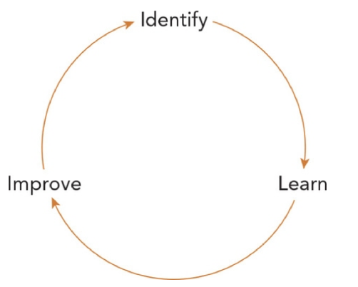
The Impact Cycle
The Impact Cycle involves 1) identifying a current reality, setting goals, and identifying practices to change that reality, 2) providing teachers with the opportunity to learn by providing them with teaching practices, modeling, co-teaching, etc., and 3) improving what happens when teachers implement what they have learned in their classroom. This session will focus on the first step – identifying.
(Knight, 2018, p. 33)
Notes:
SAY This is one way to look at the partnership between coaches and teachers. You learned a bit about The Impact Cycle – Identify, Learn, Improve - in Session 6. This cycle provides the opportunity for coaches and teachers work together to identify the current situation, help the teacher learn practices that might help address any challenges identified in their current context, and assist teachers in incorporating their learning into instructional practice in order to improve student achievement.

Slide 14
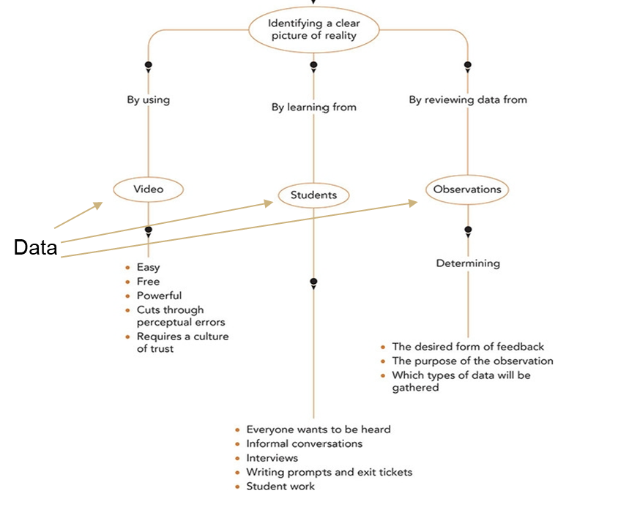
Identifying a clear picture of reality involves data collection.
(Knight, 2018, p. 48)
Notes:
SAY This graphic in Jim Knight’s book depicts the kind of data that can be gathered in order to get a clear view of reality. The knowledge of what reality looks like is necessary for both identifying an area of focus aligned to goals and to informing the analysis of teaching and learning. Although only one of these is labeled specifically as “observations” the use of videos and data gained from students also can be considered an observation of what is happening in the classroom. Keep in mind that coaches need to decide the desired form of feedback they will provide teacher - appreciation, coaching, or evaluative - the purpose of the observation, and the type of data that will be gathered during an observation.
Knight, J. (2018). The impact cycle: What instructional coaches should do to foster powerful improvements in teaching. Corwin press.

Slide 15
Conducting Observations and Using the Data
Tools for collecting data:
Needs Assessments
Checklists
Walkthrough Tools
Seating Charts
Templates/Charts
Videos
Notes:
SAY Here are some of the types of tools that can be used to conduct teacher observations. Are there others that you use?

Slide 16
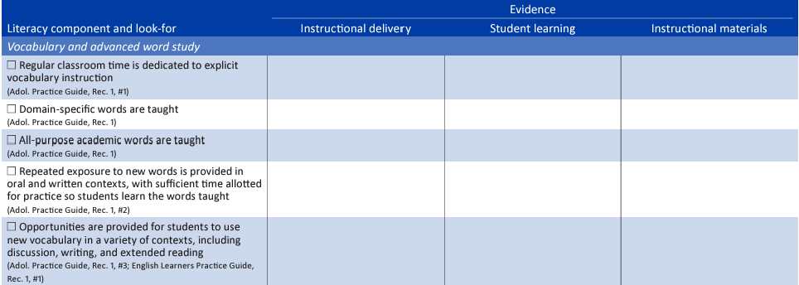
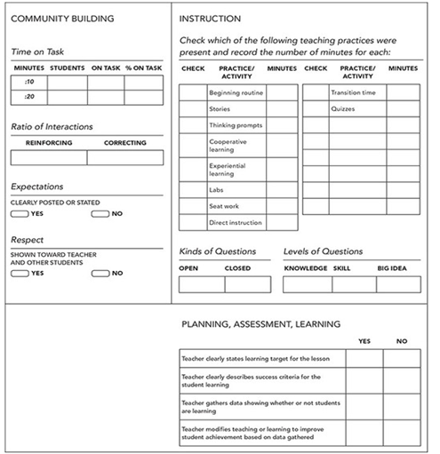
Examples of Data Collection Tools
Walkthrough Tool
(Lee, Smith, & Lancashire, 2020; Knight, 2018)
Notes:
SAY These are examples of tools that might be helpful to collect data.
Lee, L. E., Smith, K. G., & Lancashire, H. (2020). Guide and Checklists for a School Leader's Walkthrough during Literacy Instruction in Grades 4-12. REL 2020-018. Regional Educational Laboratory Southeast.
Knight, J. (2018). The impact cycle: What instructional coaches should do to foster powerful improvements in teaching. Corwin press.

Slide 17
Identifying Tools to Collect Data
Review the type of data that you might collect from Handout 1.
Jot down the type of tool (checklist, template/chart, walkthrough tool, etc.) you think would be best suited to gather this data.
Discuss in your small groups: Are there tools you need to develop to collect the data you need?
Be prepared to share out with our whole group.
Notes:
NOTES Allow 15 minutes for this activity. Review the directions on the slide. Use Handout 1: Data that May be Collected During Classroom Observations.

Slide 18

Collaborate and Practice
Let’s practice…
Scenario: One of the school’s goals is to increase second grade students’ vocabulary knowledge. As a coach, you have been charged with helping teachers improve their vocabulary instruction.
Notes:
SAY Read the scenario on the slide. We will be working from this scenario for the next few activities.

Slide 19

Let’s practice…
Collect data on this teacher’s vocabulary lesson review using the provided Second Grade Walkthrough Tool (Handout 2).
Video 1: Second Grade Vocabulary Lesson
Video retrieved at https://www.youtube.com/watch?app=desktop&v=8R1hy3uHds0 on 1/24/24
Notes:
SAY Please review Handout 2: Second Grade Walkthrough. This is just the second grade vocabulary page of the walkthrough tool as that is the grade level and focus of the teacher’s lesson review that we will view on the video.. We know that you don’t have the benefit of context, so let’s assume the teacher has taught these words prior to this interaction with students. She’s also conducted a read aloud that contains these words. The teacher has modeled using context clues and using the relationships between words in the read aloud to help address state standards.
We’ll watch the video twice. The first time, just watch and get a sense of what is going on with the teacher and students. The second time, please collect data about this lesson on the vocabulary section of Handout 2. The handout has a place to reflect what you see the teacher doing (teacher instruction), what you see the students doing (student learning), and the instructional materials that are being used. In addition, you will see at the bottom of the handout a place to document the evidence you see of a literacy rich environment, the classroom arrangement, and classroom management.
Video retrieved at https://www.youtube.com/watch?app=desktop&v=8R1hy3uHds0 on 1/24/24.

Slide 20
Let’s practice…
In your small groups, talk about the data you gathered and discuss:
What did the teacher do to make progress toward the goal of increasing students’ vocabulary knowledge?
What would you specifically focus on with her as next steps to help her students make even more progress toward the goal?
Notes:
NOTES Allow about 20 minutes for the activity that began on the previous slide and concludes on this one.
SAY Now review the data you collected using Handout 2: Second Grade Walkthrough, and in small groups, talk about the questions on the slide. This type of work helps to identify an area of focus that is related to the goal of the school and thus is a coaching goal for you, and a learning goal for students. Keep in mind this is only one observation. You will want to use additional data to confirm that you need to work on the area of focus you have identified. This will also help you to think about an action plan that you could develop with this teacher.

Slide 21
Determining an Area of Focus Based on the Current Identified Reality
Use multiple data points that include:
Needs Assessment
Observations (videos and in-person)
Student data
“The frequency coaches review assessment data with teachers has been associated with positive outcomes.”
(Marsh, McCombs, Lockwood, Matrorell, Gershwin, Naftel, et al., 2008, pg. xxi)
Notes:
SAY It is important that as you work to get an accurate picture of where instruction and learning are at the school, you use multiple data points. We’ll talk more about reviewing data with teachers in upcoming sessions, but this is a reminder that reviewing data with teachers is one of the most powerful things you can do.

Slide 22
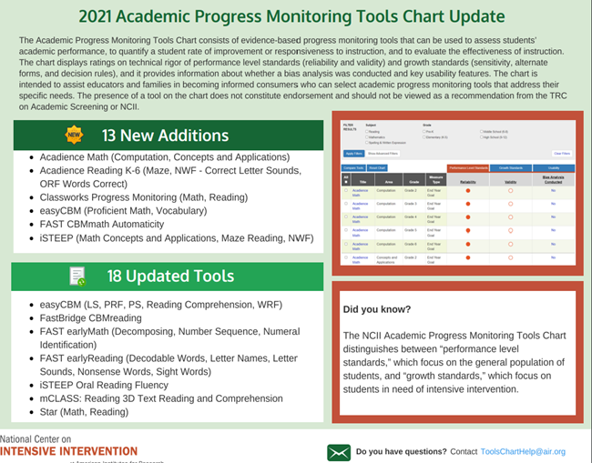
Learn and Confirm
The National Center on Intensive Intervention shares information on academic progress monitoring tools. This is a good place to start if your school or district is looking for a tool to use.
https://charts.intensiveintervention.org/aprogressmonitoring
Notes:
SAY If your district or school is looking for a progress monitoring tool, the National Center on Intensive Intervention is a good place to start. They review programs and include ratings on the technical rigor of the tools. While you will probably want to gather additional information, this is a very helpful website. In this session, we talk about identifying tools, and in the next session, we’ll talk about analyzing student data. Student data should be used in conjunction with the data you gather about instructional practices to help establish an area of focus and assist teachers in developing an action plan.

Slide 23
Collaborate and Practice
Review the Data to Determine an Area of Focus Based on the Current Identified Reality
In your small groups:
Examine the needs assessment completed by two fictional second-grade teachers.
Examine completed walkthroughs for the teachers.
Examine the class progress monitoring data for these teachers.
Determine an area of focus for the teachers – it can be individual to each teacher, or multiple teachers may have need to focus on the same area.
Be prepared to share out with whole group.
Notes:
NOTES Allow 20 minutes for this activity.
SAY You have two data packets – one for each fictional teacher. Handouts 3A, B, and C are for Ms. Jones and Handouts 4A, B, and C are for Ms. Miller. You will use these handouts for this activity. After you have determined areas of focus, be prepared to share out what you discussed in your small group and how you reached your conclusion.
Describe the activity.

Slide 24
Learn and Confirm
Using Data to Help Teachers Develop an Action Plan – Planning for Learning and Improvement
Develop goal for coaching.
Determine criteria for success.
Document what learning opportunities and support will be needed to address the goal such as:
Professional development sessions
Embedded professional development in the classroom (modeling by the coach, co-teaching, etc.)
Visiting other classrooms
Develop a timeline with time for learning and points for measuring progress toward the objective(s).
Notes:
SAY Once we have determined an area of focus related to our goal, we need to help teachers develop an action plan for addressing the area of focus. The action plan could include elements that are listed on the slide and is a plan for learning and improvement. Note that we have multiple goals – as shared in Standard 1. We are now addressing a goal at the teacher level – your goal as a coach will be to help this teacher meet their goal. Take a moment to review Handout 5: Coaching Action Plan. This template for creating an action plan, has been adapted from one developed by the National Implementation Research Network. There are others you could use, or you could develop your own.

Slide 25
Collaborate and Practice
Let’s practice…
Role-playing with a partner.
Use the data from one of the observation forms, class data, and needs assessment to complete an action plan.
One partner is the coach
The other partner is the teacher
Choose another teacher’s data and partners switch roles
Notes:
NOTES Allow 20 minutes for this activity.
SAY Now that you have reviewed the data that you have for each teacher, let’s practice creating an action plan. Get with a partner – one of you will be the coach and the other will be one of the teachers (Ms. Jones or Ms. Miller). Choose one set of teacher data and work together to create an action plan. You’ll have about 10 minutes – then we’ll switch roles.

Slide 26
Learn and Confirm
Overall Goals of Providing Professional Learning Opportunities in Your School
Professional learning opportunities provided in groups should address the school goal(s) and provide the foundation for future embedded professional learning in classrooms.
Embedded professional learning opportunities (coaching in classrooms) should help teachers move from knowledge building to implementation.
Implementation should result in increased student learning, which should be a part of the school goal.
Notes:
SAY We have looked at how to collect data and use it to make decisions regarding the types of professional learning opportunities in your school(s). You see on this slide the overall goals for providing professional learning for your teachers. It is very important that we don’t waste time conducting professional development that is not effective. In the next few minutes we’ll talk about evaluating the professional learning opportunities we provide to make sure they are beneficial and effective.

Slide 27
Evaluating Professional Learning Informs the Future
“Evaluating professional learning can help decision makers determine whether the results warrant further investment to continue or expand the professional learning activities, or whether it is time to discontinue efforts and try a new approach. Evaluation also provides important insight about the strengths and challenges of the professional learning and how current efforts can be improved.”
(Breslow & Bock, 2020, p. 1)
Notes:
SAY This quote from Breslow & Bock summarizes the reasoning behind the evaluation of professional learning. Take a moment to read this quote.
Breslow, N., & Bock, G. (2020). A TOOL FOR SCHOOLS AND DISTRICTS.

Slide 28
Evaluating Professional Learning
“Effective evaluation of professional learning requires consideration of five critical levels of information (Guskey, 2000, 2013):
Level 1: Participants’ reactions: Did participants feel the professional learning was useful?
Level 2: Participants’ learning: Did they acquire the intended knowledge and skills?
Level 3: Organization support and change: Was professional learning implementation advocated, facilitated, and supported at the school?
Level 4: Participants’ use of new knowledge and skills: Did participants effectively apply the new knowledge and skills?
Level 5: Student learning outcomes: What was the impact on students?”
(Breslow & Bock, 2020, p. 3)
Notes:
SAY The Institute of Education Sciences released a toolkit in 2020 to help schools and districts evaluate professional learning. This toolkit, Handout 10, may be a good resource for you as you develop professional learning initiatives related to the goals of your school. We will use parts of this toolkit today but know that the entire toolkit is in your Guide.
We are going to talk about the process; however, remember that you would not go through this process for every professional development or coaching session you provide. You would use this process to look at your professional learning opportunities more globally and their relationship to your goals. For instance, using our scenario, if the school goal was to increase the vocabulary of students in the school, you may offer professional learning sessions followed up by individual coaching sessions. Your evaluation would look at all of the support you provide. The information on this slide provides us with some aspects of the professional learning and questions to think about as we think about the evaluation process.

Slide 29
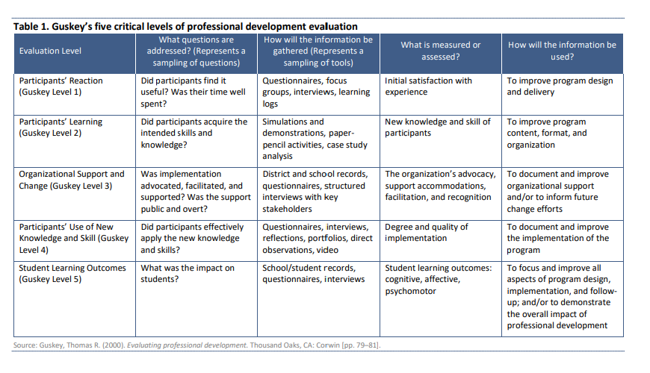
Evaluating Professional Learning
Notes:
NOTES Allow about five minutes for a short discussion.
SAY This chart may be found on page 3 of the Handout 10 – Evaluating Professional Learning – A Tool for Schools and Districts. It addresses each of the evaluation levels on the previous slide along with ideas of the types of tools that could be used to gather information about each one, what exactly would be measured, and how the information could be used. At your tables, talk about information you’ve gathered in the past to provide you with feedback on your professional learning activities.

Slide 30
Collecting Data to Measure the Effectiveness of Professional Learning Provided to Teachers
Design or select high-quality professional learning.
Develop a logic model.
Develop strong evaluation questions.
Develop a data collection plan.
Make meaning of your data.
Notes:
SAY These are the areas of the evaluation of professional learning that the toolkit addresses. Note that the process begins with your initiative and the design of your professional learning opportunities. We then move to developing a logic model – a plan for delivering the professional learning, crafting strong evaluation questions, developing a plan to collect data related to your questions, and finally making meaning of your data. We will discuss these components briefly, but will spend most of the time on developing a data collection plan. Your self-study activity for this session will involve examining Handout 10, the Evaluating Professional Learning Toolkit and viewing a webinar about the toolkit; therefore, although we will just provide an overview of the components here, you will be able to spend more time with them on your own.

Slide 31
Design or Select High-Quality Professional Learning
Keep in mind the features of effective professional learning:
Content focused
Incorporates active learning
Supports collaboration
Uses model of effective practice
Provides coaching and expert support
Offers feedback and reflection
Is of sustained duration
Notes:
NOTES Review the slide – this was mentioned in Session 6.
SAY We’ve talked about features of professional learning in other sessions – keep in mind these characteristics when you select or design professional learning opportunities for your teachers.

Slide 32
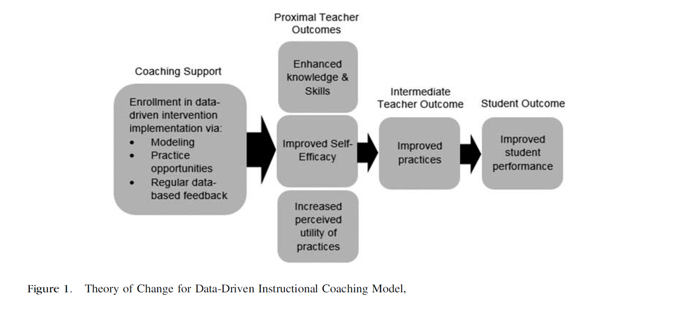
Develop a Logic Model
(Glover, 2017, p.14)
Notes:
SAY Logic models are simply a visual of what the plan looks like for solving a problem – in our case that problem will be related to improving teacher instruction. Logic models can either be very simple, like the one above, or a bit more detailed and complex. The logic model above provides the components of a coaching model and the anticipated outcomes from implementing that model.
Glover, T. A. (2017). A data-driven coaching model used to promote students’ response to early reading intervention. Theory Into Practice, 56(1), 13-20.

Slide 33
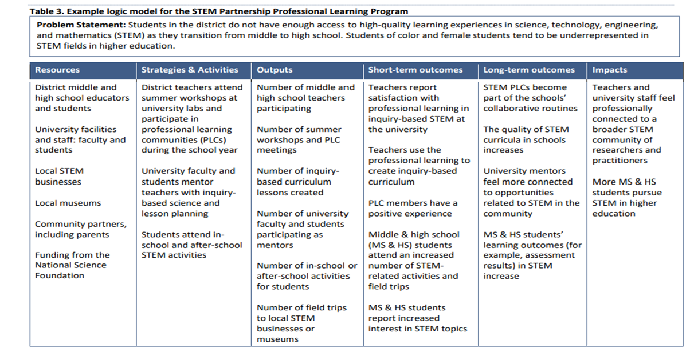
Develop a Logic Model
Notes:
SAY Here is an example of a more detailed logic model that may be found on page 7 of Handout 10 – Evaluating Professional Learning – A Tool for Schools and Districts. You see that it include the problem statement – in our case it would be something like “Students in the school do not have the vocabulary knowledge necessary to understand grade-level texts” or something to that effect. You see there is a column for resources that you have that could help with this problem, strategies and activities that you would facilitate – these are your professional learning activities – and outputs, which include the actual tangible results, meaning there will be an anticipated number of teachers attending professional learning sessions and the number you coached in support of the initiative.
The last three columns are dedicated to what is anticipated to happen as a result. For instance, a short-term outcome may be that teachers increase their knowledge of how to deliver vocabulary instruction, or one step further, that they change their practice to implement that knowledge. A long-term outcome may be that students increase their vocabulary. And finally, the impact might be that students are better able to comprehend grade-level texts, and therefore, increase their knowledge base overall.

Slide 34
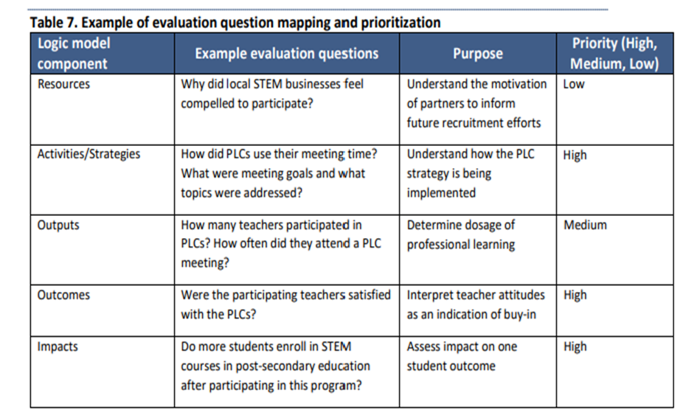
Develop Strong Evaluation Questions
Use the logic model to help develop evaluation questions.
Notes:
SAY Once the logic model is developed and you’ve depicted the problem and what you need to do to address it, you can then turn your attention to developing evaluation questions that help provide insight into each of the components of the logic model. Ultimately, you want to know whether outcomes are being met and the impact you hoped to see is happening.

Slide 35
Develop a Data Collection Plan – Questions to Ask
Are the data representative?
Do the data include all stakeholders involved in the professional learning initiative?
Do the data reflect the demographics of the population involved in the professional learning initiative?
Notes:
SAY As you begin to develop your data collection plan, there are some questions that you need to think about, including those on your screen. It is important that you do your best to ensure that as many stakeholders as possible are included in your data set and that they represent the demographics of the population that participated in the learning initiative.

Slide 36
Develop a Data Collection Plan – Questions to Ask
Are the data valid and reliable?
Have the data been collected in a consistent way?
Does the data collection instrument accurately measure the outcome of interest?
Notes:
SAY How you collect your data is important to its validity and reliability. The data should be collected in the same way for everyone, and the instrument you use, whether it be a survey, focus group, or interview should measure what you’re looking at.

Slide 37
Develop a Data Collection Plan – Questions to Ask
Are the data complete?
Was the sample size large enough?
Did enough people respond to the survey?
Notes:
SAY Be sure to collect all of the data you can. If you don’t have enough participants that provide you with data, then you can’t be sure that your data is representative of what really happened. Therefore, your evaluation may not be accurate.

Slide 38
Collaborate and Practice
Common Data Sources
In your small groups, review Handout 6: Existing Data Sources. Discuss the types of data that you currently collect to evaluate one of the professional learning initiatives you provide, even though the evaluation may not be a formal one. Each group member should complete Handout 6.
Are there other types of data that would be helpful for you to gather?
Be prepared to share with the whole group.
Notes:
NOTES Allow about 10 minutes for this activity.
SAY In your small groups, think about a professional learning initiative that each of you is implementing at your school. Talk about the goal of that initiative, the questions you might pose to ascertain the goal is being met, and the kind of data you would need to answer your question(s). On Handout 6: Existing Data Sources – jot down the data you are currently collecting that pertains to your professional learning initiative. It could be student progress monitoring data, teacher observation data, or data from your coaching log. Document how that data is currently being used and then formulate an evaluation question that this data might be used to answer. Share with your group. Talk about other sources of data that might be helpful. Be prepared to share out in our whole group.

Slide 39
Review the Tools to Assist with Data Collection
In your small groups, review Handouts 7-9. Discuss the following:
What are the benefits of these tools?
Is there anything else that might be helpful?
Which of the tools do you think you can most easily incorporate into your work?
Notes:
Note Allow about 10 minutes for this activity.
SAY There are a number of forms in the Evaluating Professional Learning toolkit that may be helpful to you. Review Handouts 7-9 in your small group and discuss the questions on the slide.

Slide 40
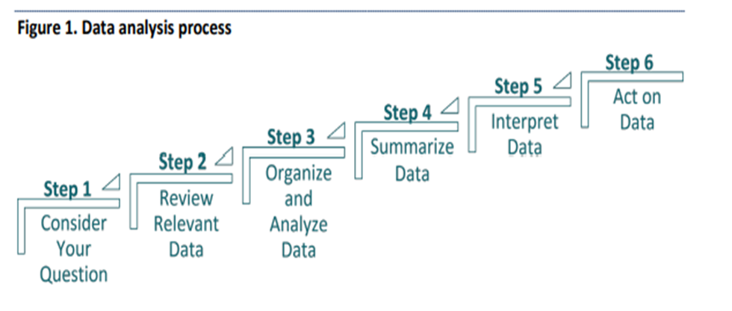
Learn and Confirm
Making Meaning of Your Data
In order to understand your data, you must analyze it. This figure depicts the steps in this process.
Notes:
SAY The standard related to evaluating professional learning in this session is the gathering of data; however, data is of no use unless you analyze that data. Note that in this figure from the Evaluating Professional Learning toolkit, the last step is acting on the data. There is no use in going through the process of collecting and analyzing data unless you use it in some way to change your practice. We’ll talk more about analyzing data in the next session.

Slide 41
Debrief
Recap of this Session
This session addressed the following:
Collecting and using observational data to inform analysis of teaching and learning and to focus on areas aligned to goals.
Collecting data (including student progress monitoring data) to help teachers develop an action plan.
Collecting data to measure the effectiveness of the professional learning you provide.
Notes:
SAY Since there are several standards to address in this session, we grouped and summarized them here. We began our session by talking about observational data and how we can use it to inform analysis of teaching and learning and to ensure we are focusing on aspects of instruction that are important to our goals. We then moved to collecting data – including student progress monitoring data – to help teachers develop a plan to improve their instruction, and we finished up by talking about what we can do, as coaches, to ensure that the professional development we provide is helpful to our teachers. Do you have any questions we need to discuss before we talk about the self-study activities?

Slide 42
Module 3 Bridge to Practice Activity
Bridge to Practice Activity for Module 3:
Develop and describe planned implementation of a professional learning action plan.
You’ve gained some of the information you need for this project in this session, and you’ll learn more in the next two sessions. Start thinking about what an action plan for your coaching might look like.
Notes:
NOTES Review the slide

Slide 43

Post-Session Reflection, Planning, and Implementation
Reflect, Plan, and Implement
READ
Handout 10: Evaluating Professional Learning: A Tool for Schools and Districts and note any questions.
Complete the Self-Study 1: Reflections on Session 7.
Reflect on your participation in Session 7 by noting any questions about the content or format on Self-Study 1. Bring this self-study assignment to Session 8.
Video 2: Evaluating Professional Learning: Introduction to a Tool for Schools and Districts (Webinar) and complete Self-Study 2: Webinar Reflection Guide. Be prepared to debrief at the beginning of Session 8.
DO
WATCH
Notes:
SAY As we near the end of today’s session, here are the self-study activities to complete before we meet for Session 8. First, spend some time with Handout 10: Evaluating Professional Learning: A Tool for Schools and Districts. That may help you as you reflect upon the content of today’s session and complete Self-Study 1.
Then, please view Video 2: Evaluating Professional Learning: Introduction to a Tool for Schools and Districts, which is a webinar (1:08). The webinar link is found on Self-Study 2: Webinar Reflection Guide and complete the reflection guide. We’ll debrief at the beginning of Session 8.
Video retrieved from https://www.youtube.com/watch?v=vvh8HZvYtQk&t=32s on 1/24/24.

Slide 44

Questions?
Notes:
SAY Are there any questions that you have regarding the content of this session, the self-study activities, or the course in general?

Slide 45




We have completed
Session 7
Notes:
SAY Congratulations on successfully completing Session 7! We look forward to seeing you for Session 8. We’ll begin that session by debriefing on the homework assignments which include an activity sheet that you complete where you will reflect on Session 7 and record any questions that you might have.
Confirm the date and time of the next session.

