Slide 1
Fundamentals of Literacy Coaching
Professional Development Modules
Module 4, Session 10
Helping Teachers Plan and Implement Engaging, Effective, Standards-Aligned Lessons
Notes:
SAY Welcome to the Literacy Coach Program – Session 10: Helping Teachers Plan and Implement Engaging, Effective, Standards-Aligned Lessons.
.

Slide 2
Module | Topic | Session | Minutes | Session Date
1 | Applying Principles and Practices that Foster a Positive Culture | Intro | 60
 |  | 1 | 120
 |  | 2 | 150
 |  | 3 | 150
2 | Applying Effective Pedagogy and Andragogy | 4 | 120
 |  | 5 | 120
 |  | 6 | 165
3 | Collecting Data to Inform Professional Learning | 7 | 150
 |  | 8 | 140
 |  | 9 | 170
4 | Planning, Implementing, and Analyzing Literacy Instruction | 10 | 175
 |  | 11 | 135
 |  | 12 | 165
 |  | 13 | 130
5 | Growing Professionally | 14 | 120
 |  | 15 | 120
6 | Planning and Implementing Coaching | 16 | 120
Notes:
NOTES
It is recommended that the sessions are completed in sequential order.
The timeline for completing the sessions can be flexible. If the recommended minutes for each session are not available, complete what you can with the time you have and then pick up where you left off the next time you meet.
Once a schedule of the sessions is established, have participants record the schedule in their Literacy Coach Program PD Guide if printed.
SAY Here is an overview of the modules and sessions of this course. There are six modules, and each module includes two to four sessions for a total of 15 content sessions. Module 1 addresses Applying Principles and Practices that Foster a Positive Culture, Module 2 covers Applying Effective Pedagogy and Andragogy, the focus of Module 3 is Collecting Data on Instructional Practices to Inform Professional Learning, the content of Module 4 is Planning, Implementing and Analyzing Standards-Based Literacy Instruction, the content of Module 5 is Growing Professionally, and the final module, Module 6, addresses Planning and Implementing Coaching.
You can record the date of each of our sessions in your Literacy Coach Program PD Guide.

Slide 3
Bridge to Practice Projects for Coaches
An activity designed to serve as a Bridge to Practice after each Module will provide evidence that coaches are able to apply the knowledge and skills they developed in this course in their schools. Coaches will complete the following activities:
A rubric is provided at the end of each Module for the corresponding Bridge to Practice project.
Module 1 | Develop a principal-coach partnership agreement.
Module 2 | Develop a needs assessment for professional development on evidence-based instructional practices and complete an ADDIE model for planning this professional development.
Module 3 | Develop and describe planned implementation of a professional learning action plan.
Module 4 | Create a video that reflects coaching to help teachers plan, implement, and analyze standards-based literacy instruction.
Module 5 | Complete a reflection on the course, including plans for continued professional growth.
Module 6 | Choose one teacher with whom you have seen significant growth as a result of coaching support and complete a reflection on what worked, why it worked, and which areas of growth were most evident.
Notes:
SAY We want to remind you that participating coaches will complete a bridge to practice project after each module. These projects will provide evidence that coaches are able to apply the knowledge and skills they developed in this course in their schools. You will learn more about each project as we work through the modules. We’ve shared an overview of the projects with you on this slide.
Coaches will
Module 1: develop a principal/coach partnership agreement;
Module 2: conduct a needs assessment for professional development on evidence-based instructional practices and complete an ADDIE model for planning this professional development;
Module 3: develop, implement, and evaluate a professional learning action plan;
Module 4: create a video that reflects coaching to help teachers plan, implement, and analyze standards-based literacy instruction;
Module 5: complete a reflection on the course including plans for continued professional growth.
Module 6: Choose one teacher with whom you have seen significant growth as a result of coaching support and complete a reflection on what worked, why it worked and which areas of growth were most evident.
You may turn in all your artifacts for the projects to your facilitator at the end of each module if requested.

Slide 4



Norms for Our Course
Cell phones on silent
Pay attention to self and others
Presume
positive intentions
Notes:
NOTES Consider your group to determine how much detail about the norms will be helpful to review.
SAY Professional learning opportunities usually consist of a team of educators, like us, that meet regularly to learn new topics, share ideas, and problem solve. We will build a community, meaning that we learn from each other, so sharing and participation are really important.
Professional learning opportunities typically have norms that the group can agree to in order to be productive. Here are three norms, or ground rules, for our way of work: cell phones on silent; pay attention to yourself and others; and presume positive intentions.
Pay attention to self and others This means to contribute, listen, and be aware of how you and others are responding to each other. Be sure to give everyone a chance to talk and encourage others who seem reluctant to join in. Sometimes people who are reluctant to talk are thinking. They may not be comfortable jumping in, but may have something important to say. Professional learning opportunities like this one encourage educators to learn from one another. Therefore, sharing, discussing and participating are important components.
Presume positive intentions This means to pause before responding. Usually when people contribute to a conversation, they intend to be constructive. So, always respond positively to keep the discussions productive.

Slide 5

Module 4: Planning, Implementing, and Analyzing Standards-Based Literacy Instruction Goal: Participants will gain the knowledge and abilities to coach teachers in planning, implementing, and analyzing standards-based literacy instruction Session 10: Helping Teachers Plan and Implement Engaging, Effective, Standards-Aligned Lessons Session 11: Using Data for Instruction Session 12: Addressing the Needs of All Students Session 13: Analyzing Implementation of Lessons with Teachers
Define and Discuss Session Goals and Content
Notes:
NOTES Provide an overview of the goal and content for Module 4.

Slide 6
Goals for Today
Define and Discuss Session Goals and Content
Learn about instructional design and planning strategies that support teachers in developing engaging, effective, standards-aligned lessons.
Learn how to apply standards-aligned systematic instruction and intervention for language and literacy development.
Learn about the strategic use of evidence-based instructional practices grounded in the science of reading.
Learn about the role of student motivation and active engagement in developing literacy.
Notes:
NOTES Share and discuss these goals for today’s session.

Slide 7

Review of Session 9 and Module 3 Bridge to Practice Project
Debrief
Bridge to Practice Project for Module 3
Develop and describe planned implementation of a professional learning action plan.
Discussion of the Bridge to Practice Project for Module 3
Submit Bridge to Practice Project for Module 3
Self-Study 1: Reflections on Session 9
What questions or comments did you have about the content or format of Session 9?
Handout 16: The Tuning Protocol
What did you learn about the framework for personalized professional development?
Discuss the videos watched after Session 9
What did you learn about configuration maps?
Notes:
NOTES Share and discuss these goals for today’s session.

Slide 8
Literacy Coach Domain and Standards: Session 10
D. Knowledge of and ability to apply effective methods for planning, implementing, and analyzing standards-based literacy instruction based on the science of reading and evidence-based practices. Coaches will demonstrate their abilities in and understanding of:
1. Instructional design and planning strategies that support teachers in developing engaging, effective, standards-aligned lessons (e.g., stacking benchmarks, curriculum mapping, vertical progression of the standards).
3. The application of standards-aligned systematic instruction and intervention for language and literacy development.
5. The strategic use of evidence-based instructional practices grounded in the science of reading.
9. The role of student motivation and active engagement in developing literacy.
Notes:
SAY We will now begin to focus on the content of the literacy coach domains and standards. This is the Literacy Coach Domain and standards that will be covered during this session. Take a moment to review the domain and standards.

Slide 9



Learn and Confirm
Planning for Engaging, Effective, Standards-Aligned Instruction
Video 1: Planning for Standards-Aligned Instruction
Notes:
SAY Standards define what we want our students to achieve. This video from Paige Michael, Executive Director of State Regional Literacy Directors at the Florida Department of Education, provides insight into planning for engaging, effective, standards-aligned instruction and provides an excellent framework for this session focused on this literacy coach standard.
The length of this video is 6:04.

Slide 10
Learn and Confirm
Planning for Engaging, Effective, Standards-Aligned Instruction
Why have standards?
To define what students should know and be able to do.
To identify clear expectations for students, parents, and teachers.
To ensure consistency throughout the state.
To improve teaching and learning.
To develop a student’s ability to compete in a global economy.
Adapted from the JRF! Literacy Coach Academy Training
Notes:
SAY Standards define what we want our students to achieve. Standards provide more clarity and consistency in what is expected of student learning. Standards give clear goals to teachers and eliminates random teaching practices that tap into preferences of the teacher rather than instructional needs of the students. Standards help prepare students with the knowledge and skills they need to succeed in college and their careers. Students not only compete with their American peers but also with students from around the world.

Slide 11
How Do Standards Impact Instruction?
Mastering the standards is the goal for ALL students.
Instruction should lead to student success in meeting the goal of mastering the standards.
Standards are NOT curriculum!
For students to be successful, the standards must be taught.
Instructional tools should assist teachers in helping students meet the standards.
Notes:
SAY Standards‐based instruction guides the planning, implementation, and assessment of student learning. The use of standards to streamline instruction ensures that teaching practices deliberately focus on agreed upon learning targets. Standards allow teachers to track student performance and plan focused instruction to meet the specific needs of students. Please note that the standards are NOT the curriculum.

Slide 12
Florida’s B.E.S.T. Standards for ELA are built on the following premises, and these are important considerations for any English Language Arts standards:
English Language Arts is not a discrete set of skills, but a rich discipline with meaningful, significant content, the knowledge of which helps all students actively and fully participate in our society.
The standards and benchmarks are clear and concise, so they are easily understood by every stakeholder.
The texts students read are meaningful and thought-provoking, preparing them to be informed, civic-minded members of their community.
Standards and benchmarks should not stand alone as a separate focus for instruction but should be combined purposefully.
Notes:
SAY These are the specific premises that Florida’s B.E.S.T. standards were built on and are important considerations for any English Language Arts standards. We will be focusing on some of these points as we discuss how to plan for engaging, effective, standards-aligned instruction. You may wish to use standards from your own state, district, or jurisdiction for the examples.

Slide 13
Learn and Confirm
Planning for Engaging, Effective, Standards-Aligned Instruction
Vertical Planning
Horizontal Planning
Examine standards across grade levels.
Ensure continuity and cohesion of instruction.
Address learning gaps and changes in knowledge demands across grade levels.
Examine standards within grade levels.
Allow teachers to share and reflect on best practices for grade level benchmarks.
Monitor the impact of instruction among grade levels.
Adapted from the JRF! Literacy Leadership Team Training
Notes:
SAY Vertical planning is an important aspect of aligning instruction with the standards. Coaches may engage Literacy Leadership Teams to collaborate in analyzing how the benchmarks progress across the grade levels. Structures should also address horizontal planning or grade-level planning. Teachers need to have a system to check in with grade-level partners to discuss instructional decisions.

Slide 14
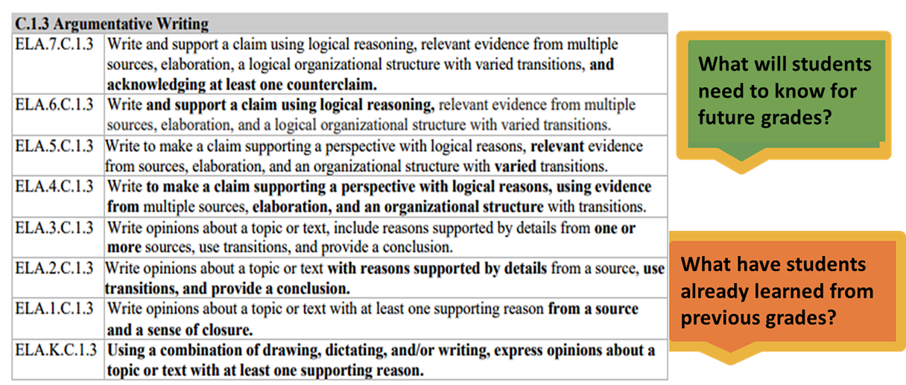
Examine the Vertical Progression
Planning for Engaging, Effective, Standards-Aligned Instruction
Notes:
SAY To support an examination of vertical progression, coaches could work with Literacy Leadership Teams to facilitate discussions across grade levels to determine instructional decisions. Turn and talk with a partner to discuss ways to use vertical progression or ways you have used this in the past.

Slide 15
Benchmark and Clarifications
ELA.7.R.1.2: Compare two or more themes and their development throughout a literary text.​
Benchmark Clarifications:​
Clarification 1: For the purposes of this benchmark, theme is not a one- or two-word topic, but a complete thought that communicates the author’s message. ​
Clarification 2: Students should continue to work with the concept of universal themes, although mastery isn’t expected until 9th grade. A universal theme is an idea that applies to anyone, anywhere, regardless of cultural differences. Examples include but are not limited to an individual’s or a community’s confrontation with nature; an individual’s struggle toward understanding, awareness, and/or spiritual enlightenment; the tension between the ideal and the real; the conflict between human beings and advancements in technology/science; the impact of the past on the present; the inevitability of fate; the struggle for equality; and the loss of innocence.
Notes:
SAY: While the idea of vertical progression presented on the last slide can be a great addition to standards, teachers cannot spend all of their time just looking at the vertical progression, because many benchmarks often have clarifications for instruction included. This example is from Florida’s standards, but additional information is also provided by many states and jurisdictions for their standards. Turn and talk to you partner about what you may learn from clarifications that is not in the benchmark itself. What implications do clarifications have for our work with classroom teachers?
Example Answer: Clarification 2 for this 7th grade benchmark advises teachers to introduce universal themes, although universal themes don’t appear in the standards for mastery until 9th grade. It will be helpful for teachers to be familiar with benchmarks and clarifications in their entirety, not just the vertical progression.
Taken together, standards, benchmarks, clarifications like the ones you see on this slide, and the additional appendices found in many standards represent expected outcomes for students.

Slide 16
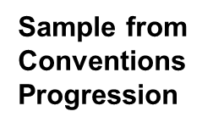
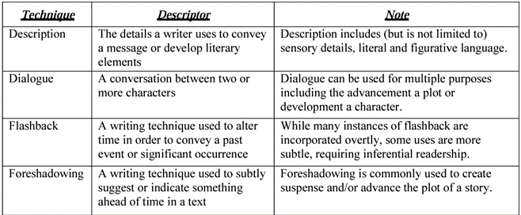
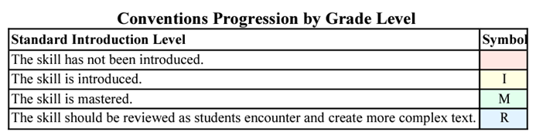
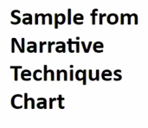
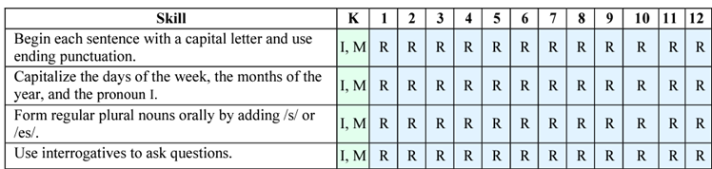
Appendices
Notes:
SAY As noted on the previous slide, there are often many supportive resources that may be found within the appendices of state standards. It is suggested to read through these as you study the standards/strands/benchmarks that align to various resources. This way we can easily see what supports are included for educators and be able to explain how they can utilize these with their instruction.
These Appendices can also be tools for coaching. They can help support planning, text selection and provide additional background for teachers.

Slide 17
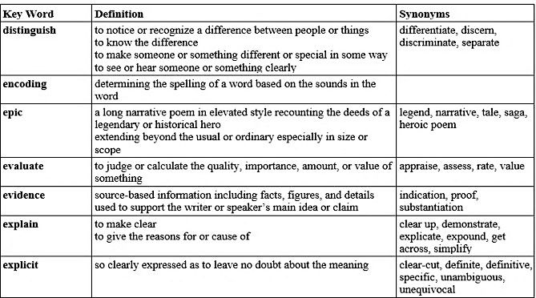
Glossary
Notes:
SAY In addition to benchmark clarifications and the appendices, glossaries often found in state standards include synonyms of the academic vocabulary so that teachers can purposely introduce students to variants of task language. Also, the glossary ensures that all teachers across a state share a common language.

Slide 18
Purposeful Professional Learning
Analyze the design of standards, clarifications, and appendices.
Include instructional ideas for the classroom around building knowledge.
Focus on integrating standards to maximize student learning.
Notes:
SAY Professional learning should focus on the design of the standards, instructional ideas to focus on building knowledge, and integration of standards. Building knowledge is a key approach for Florida’s B.E.S.T. Standards vs. strategies mastery, and the standards for many states and jurisdictions are focused on knowledge building as well.
How might coaches work with teams, such as Literacy Leadership Teams, to develop structures to address at least one of the bullet points from the slide?
How might you include these structures into the professional learning opportunities you plan to build?

Slide 19
Learn and Confirm
Sample of Stacking Benchmarks
As noted, it may be most helpful if benchmarks are not taught in isolation, but purposely combined or stacked to support student learning. A spotlight benchmark is considered to be the centerpiece or focus of a lesson. Supporting benchmarks can serve as review, introduce a new concept to be mastered later, or help students achieve the spotlight benchmark.
Review the sample of stacked benchmarks on Handout 1 and discuss the guiding questions with your shoulder partner. This example is from Florida. You may also wish to consider what stacked benchmarks may look like for standards in your state, district, or jurisdiction.
Notes:
SAY As noted previously, it may be helpful to integrate standards to maximize student learning. And this idea that standards and benchmarks should be intentionally combined is a premise that Florida’s standards were built on as noted earlier in this session and may be a helpful consideration for any state’s standards. Read Handout 1 and discuss the guiding questions that follow the example of stacked benchmarks. This information is from the Florida Department of Education’s Specifications for the 2020-2021 Florida Instructional Materials Adoption K-12 English Language Arts. You may also wish to consider what stacked benchmarks may look like for standards in your state, district, or jurisdiction.
That document is available at:
https://www.fldoe.org/core/fileparse.php/5574/urlt/20-21K-12ELASpec.pdf

Slide 20
Systematic Review of Materials
Develop structures to regularly review the use of curriculum materials to monitor the following:
Ensure materials are taught with fidelity.
Address potential gaps in materials.
Reach consensus on evidence-based supplemental resources.
Evaluate the impact of materials on student learning and assessment results.
Notes:
SAY Systematically reviewing materials and curriculum mapping is another practice that coaches can support to ensure successful planning and instruction. The next few slides will share tools that may be helpful for these purposes.

Slide 21

Learn and Confirm
What is curriculum mapping?
Review Handout 2 on Curriculum Mapping with a partner to learn more about curriculum mapping and its four goals: vertical coherence, horizontal coherence, subject-area coherence, and interdisciplinary coherence.
What roles should coaches play in this process?
Review the Curriculum Map Template on Handout 3 with your partner.
How might a template like this one be helpful for the curriculum mapping process?
Notes:
SAY Curriculum mapping is a process in which educators work together to plan the content that students will learn over the course of the year for coherence across grades, courses, subject areas, and disciplines. Review Handouts 2 and 3. Handout 2 provides details regarding this work. Handouts 3 is a sample template designed for this process. Discuss what roles coaches should play in curriculum mapping and how a template like that one could be helpful.

Slide 22
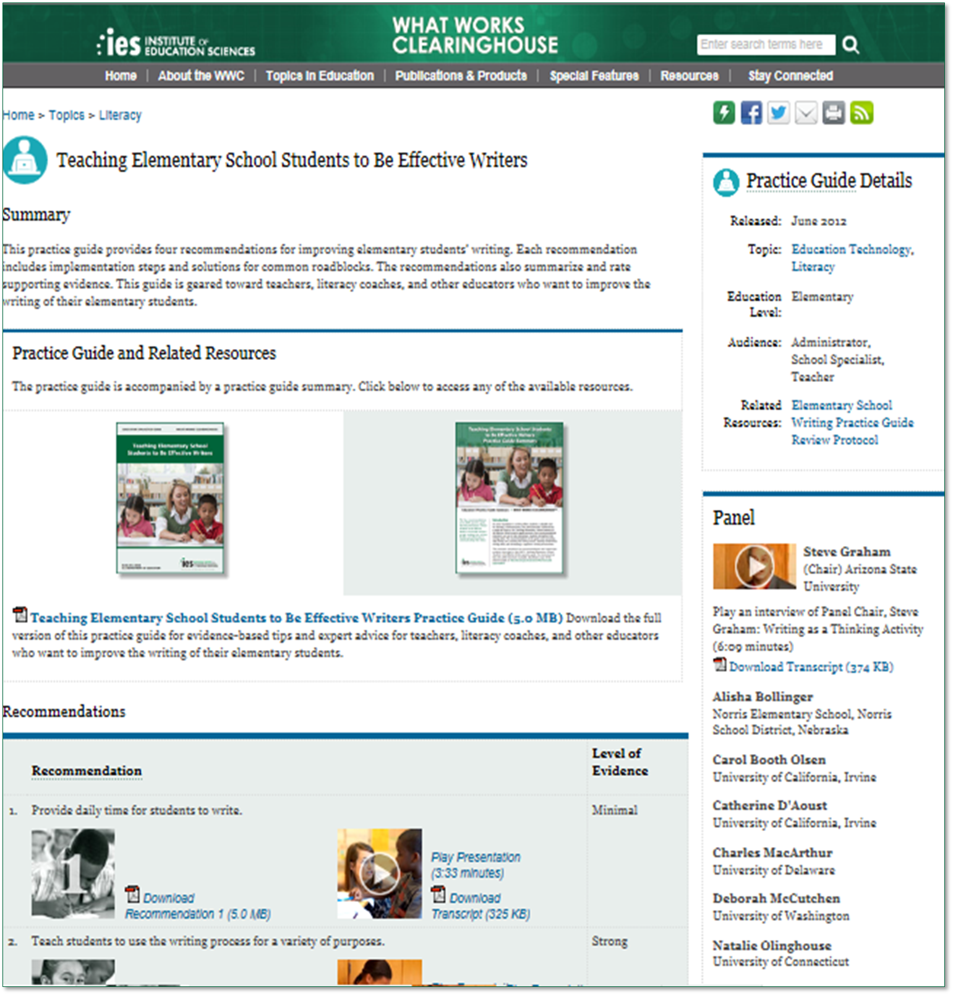
IES/WWC Practice Guides
Practice guides are:
Geared toward helping educators and administrators address challenges in classrooms and schools.
Focused on a specific topic.
Guided by an expert panel.
Based on rigorous evidence.
Comprised of evidence-based instructional
recommendations.
The WWC has produced over 20 practice guides.
Notes:
SAY The Institute of Education Sciences (IES) at the US Department of Education has produced over 20 practice guides on a variety of important educational topics through the What Works Clearinghouse (WWC). A practice guide is a publication that presents recommendations for educators to address challenges in their classrooms and schools. They are based on reviews of research, the experiences of practitioners, and the expert opinions of a panel of nationally recognized experts.
Several of these guides are focused on literacy instruction and intervention and serve as the basis for multiple tools that will be shared during this session beginning with the instructional materials rubric on the next slide. These are some of the best tools available to draw from in teaching evidence-based practices based on the science of reading.

Slide 23
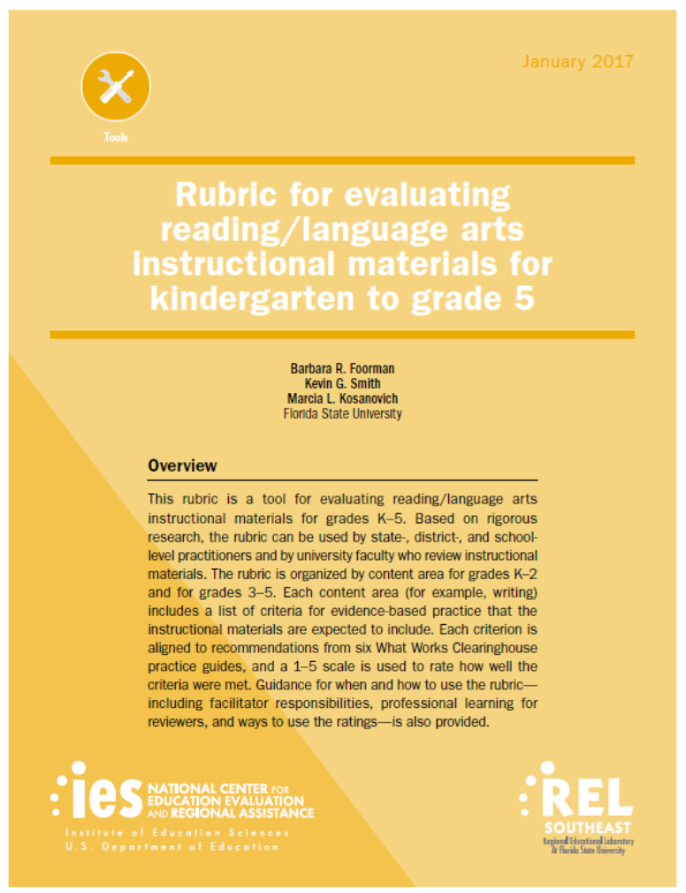
Learn and Confirm
Application of Standards-Aligned Systematic Instruction and Intervention
Rubric for Evaluating Reading Language Arts Instructional Materials K-5
The content areas for grades K–2:
- foundational reading skills (print concepts, phonological awareness, phonemic awareness, phonics, and fluency);
- reading comprehension for literary and informational texts;
- writing development and skills;
- speaking and listening development and skills; and
- language development and skills (academic language skills and vocabulary).
The content areas for grades 3–5:
- foundational reading skills (advanced word analysis such as affixes, Greek and Latin roots, and syllable patterns);
- reading comprehension for literary and informational texts and text complexity;
- writing development and skills; speaking and listening development and skills; and
- language development and skills.
Notes:
SAY This rubric was developed by the REL Southeast in response to a request by the Florida Department of Education for use in previous instructional materials review processes. It is a tool for evaluating reading/language arts instructional and intervention materials in grades K–5 based on rigorous research and standards. It can be used by educators at the state, district, or school level involved in reviewing instructional materials. The rubric is organized by content area for grades K–2 and for grades 3–5. These are listed on the slide. Each item is aligned to recommendations from six What Works Clearinghouse (WWC) practice guides. We will learn more about these practice guides during this session. Each content area includes a list of criteria that describe what should be consistently found within the instructional materials. Reviewers use a 1–5 scale to rate the degree to which the criteria were met. The rubric includes a guide for when and how to use it, including facilitator responsibilities, professional learning for reviewers, and ways to use the scores.
The full rubric is available at:
https://ies.ed.gov/ncee/edlabs/projects/project.asp?projectID=4506

Slide 24
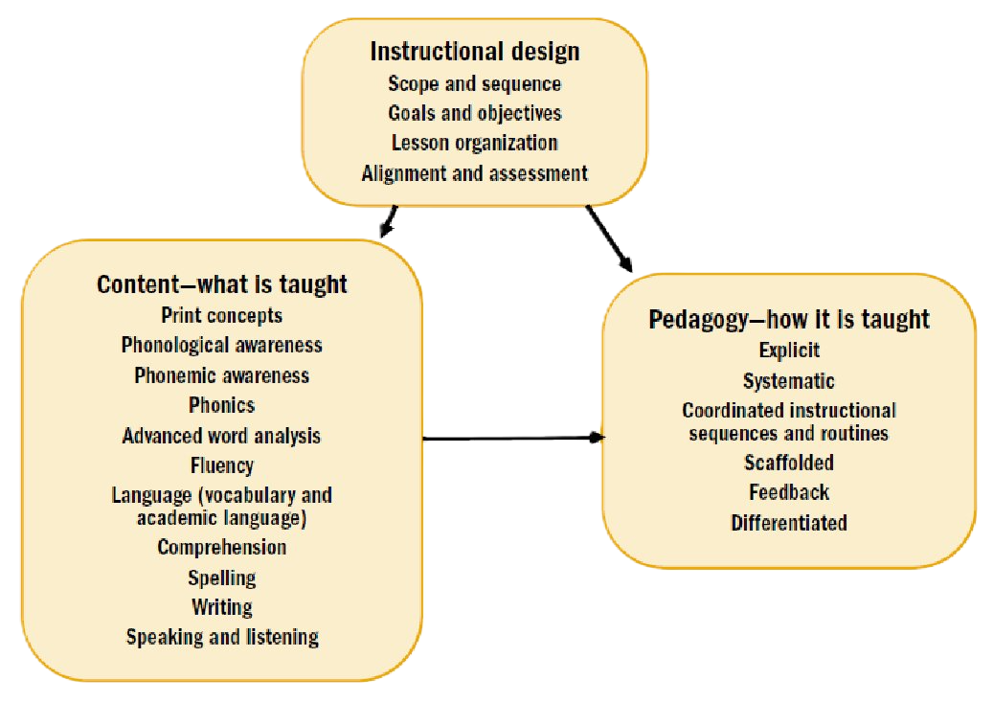
Elements of Design for Reading/Language Arts Instructional Materials
Notes:
SAY This graphic is from the REL Southeast resource described on the previous slide. For coaches considering elements of instructional design, understanding how a curriculum is created is important. It is imperative to understand how to identify a systematic scope and sequence, how goals and objectives are related, what the elements of an organized lesson are, and how to align materials and embed formative assessments. The content is what is taught during reading/language arts instruction (such as phonics, spelling, comprehension, and writing). Pedagogy is how the content is taught (such as explicitly using routines or differentiated instruction). Differentiated instruction materials include activities that address both intervention for students with special learning needs and extension/enrichment for students ready for further work.
Guiding question: What roles do coaches have in helping ensure that these elements of design for instructional materials are successfully implemented in the reading/language arts classroom?

Slide 25
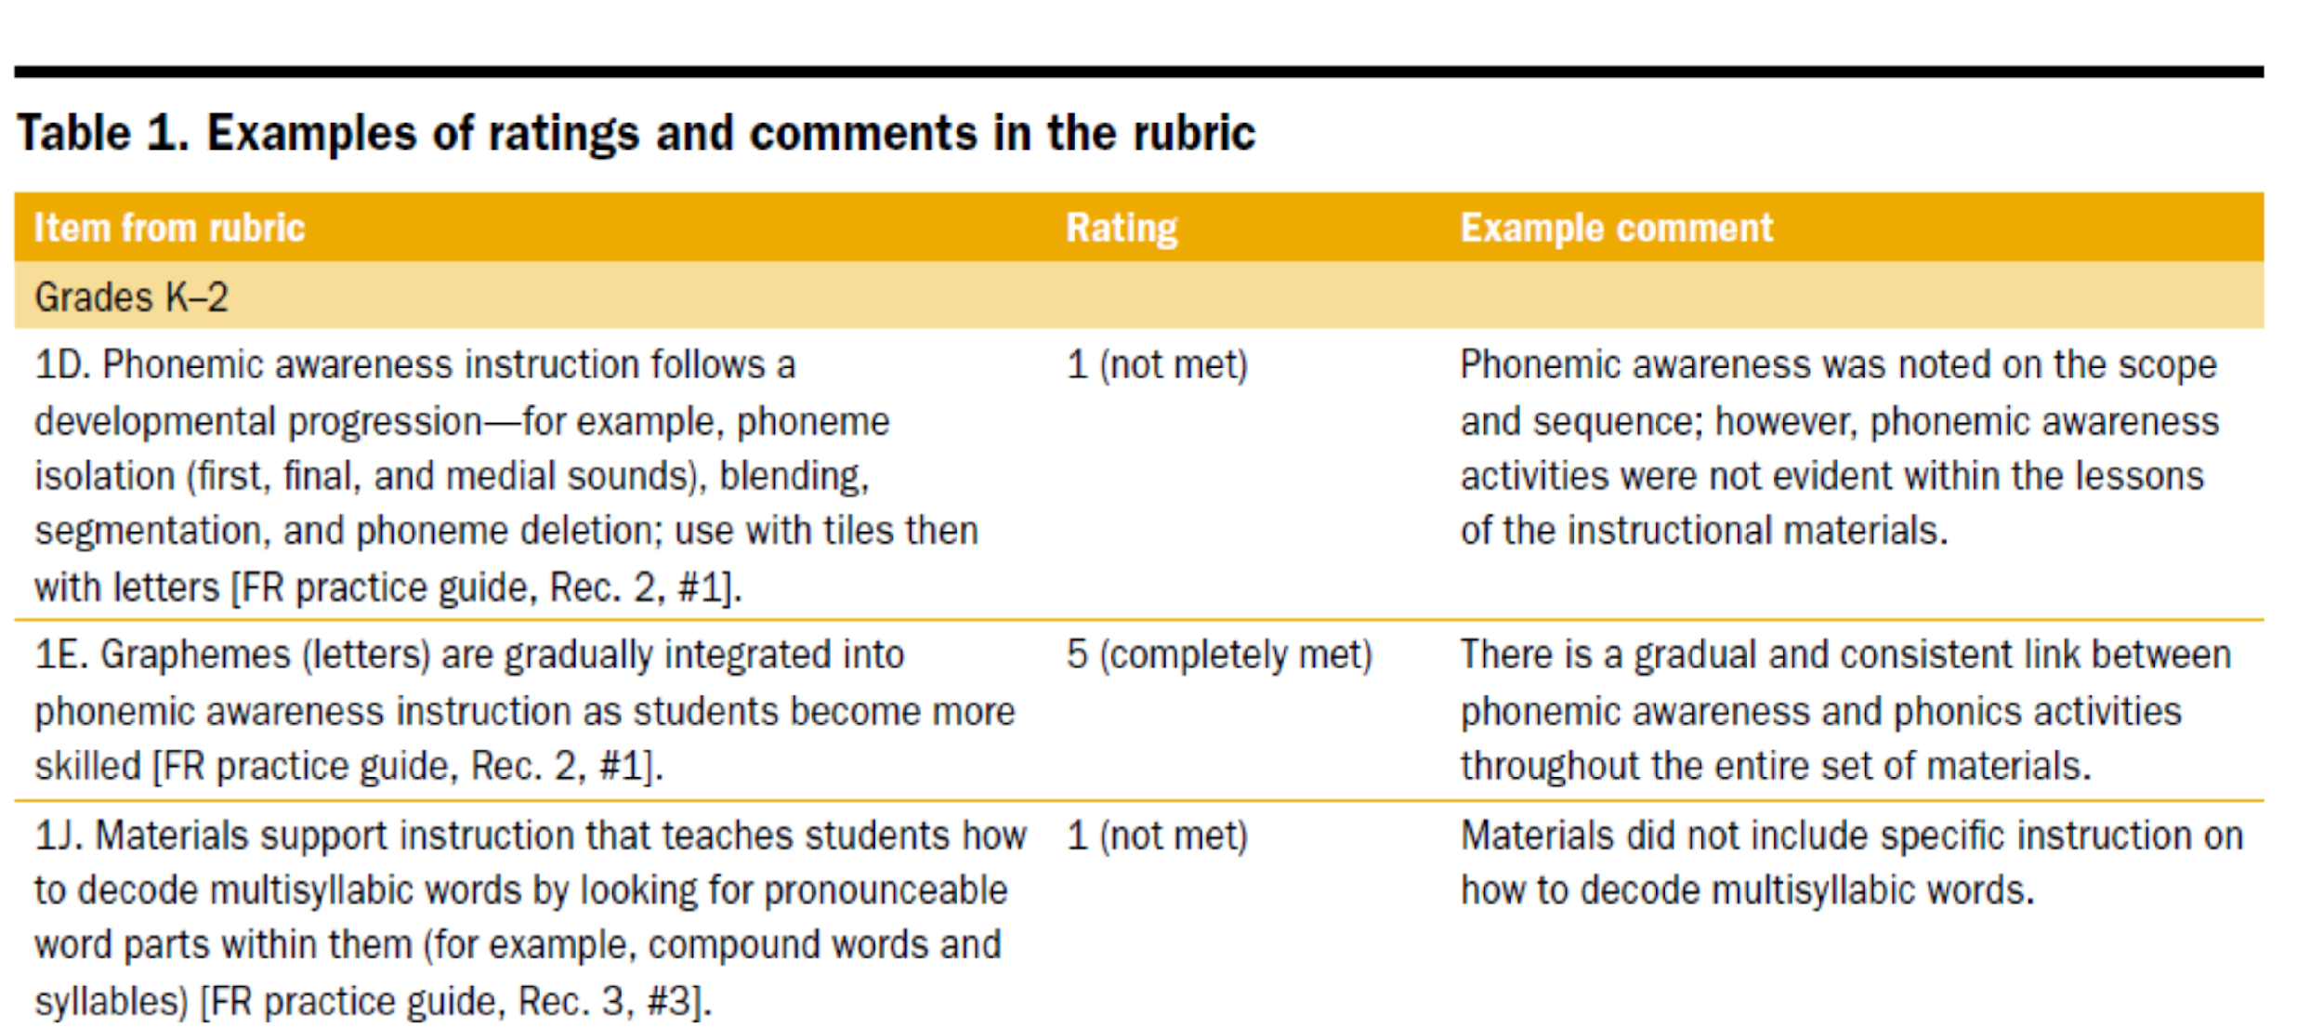
Examples of Ratings and Comments in the Rubric (Grades K-2)
Notes:
SAY Here are examples of the types of ratings and comments that could be made when reviewing K-2 literacy instructional materials using the rubric.

Slide 26
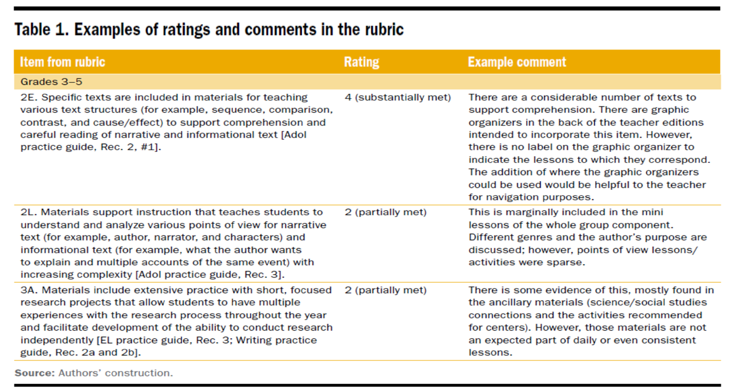
Examples of Ratings and Comments in the Rubric (Grades 3-5)
Notes:
SAY Here are examples of the types of ratings and comments that could be made when reviewing 3-5 literacy instructional materials using the rubric. For coaches working with secondary grades, it may be most helpful to refer to the instructional materials adoption specifications for your state or district if available/possible.
As an example, corresponding documents for Florida Department of Education instructional materials reviews are available at:
https://www.fldoe.org/academics/standards/instructional-materials/

Slide 27
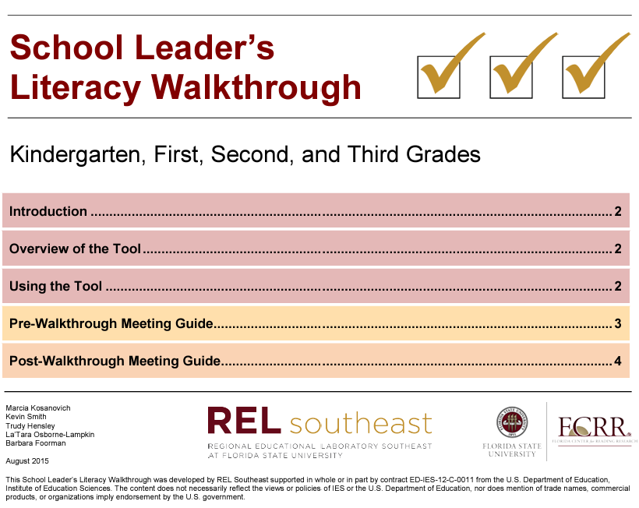

Application of Systematic Instruction and Intervention
School Leader’s Literacy Walkthrough for Grades K-3
Guide and Checklist for a School Leader’s
Walkthrough during Literacy Instruction
in Grades 4-12
Notes:
SAY These school leader’s literacy walkthrough tools are based on evidence-based practices and are aligned with recommendations from the literacy focused WWC practice guides.
The full FCRR/REL Southeast K-3 walkthrough is available at: https://ies.ed.gov/ncee/edlabs/regions/southeast/inc/docs/School_Leaders_Literacy_Walkthrough_Kindergarten_First_Second_and_Third_Grades.pdf.
The full REL Southeast 4-12 Walkthrough is available at: https://files.eric.ed.gov/fulltext/ED603501.pdf.

Slide 28
Purpose of the Walkthrough Tools
Provide user-friendly tools for school leaders (not evaluative).
Establish school-wide consistent language and expectations about literacy instruction.
Effectively communicate and collaborate with teachers.
Identify evidence-based practices for literacy instruction.
Enhance school leaders’ and teachers’ knowledge about literacy instruction.
Determine teachers’ needs for professional learning and resources.
Notes:
SAY These walkthrough tools were designed to be user-friendly and to provide data to help school leaders with several purposes noted on this slide.

Slide 29
Overview of the FCRR/REL Southeast K-3 Walkthrough Tool
Components of the Walkthrough Tool
Title Page
One Page Summary: Introduction, Overview of the Tool, Using the Tool
Pre-Walkthrough Meeting Guide
Post-Walkthrough Meeting Guide
Grade-Specific Checklists (K-3)
Components of Each Grade-Specific Checklist
Foundational Reading Skills
Reading Comprehension
Writing
Language
Speaking and Listening
Notes:
SAY The K-3 Walkthrough Tool has brief but clear directions on using the tool in a four-page overview document that also includes guiding questions for a school leader or coach to ask prior to and after the walkthrough. There are also grade specific checklists aligned with evidence-based literacy practices. In Session 7, you may recall using the vocabulary section of the Grade 2 walkthrough for an activity.

Slide 30
Overview of the REL Southeast 4-12 Walkthrough Tool
Introduction
Pre-Walkthrough Meeting Guide
Walkthrough Checklists for grade bands 4-5 (whole class and literacy intervention classes), 6-8 (English language arts classes, content area classes, intervention classes), and 9-12 (English language arts classes, content area classes, intervention classes)
Post-Walkthrough Meeting Guide
References
Designed to include specific “look-fors” based on research
The school leader meets with the teacher and completes the Pre-Walkthrough Meeting Guide.
The school leader chooses the appropriate Walkthrough Checklist and conducts a brief (5-15 minute) classroom walkthrough, completing the sections of the Checklist that align with the lesson.
The school leader completes the reflection section of the Post-Walkthrough Meeting Guide and completes the remainder of the Guide with the teacher.
Notes:
SAY The 4-12 Walkthrough Tool has brief but clear directions on using the tool in the introduction and also includes pre-and post-walkthrough meeting guides. There are also grade specific checklists aligned with evidence-based literacy practices and WWC practice guides for grade bands spanning 4-12 and for ELA, content area, and intervention classrooms. This is intended for 5-15 minute non-evaluative walkthroughs.

Slide 31
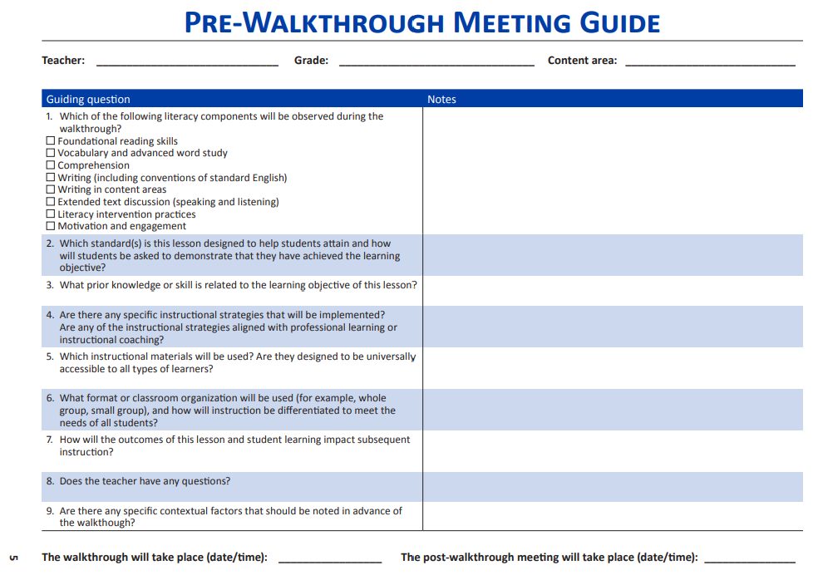

Collaborate and Practice
Try It Out: Pre-Walkthrough Meeting
When using this guide (Handout 4): - What might be challenging? - What is useful or important?
Notes:
SAY Using the pre-walkthrough meeting guide from Handout 4, conduct a brief pre-walkthrough meeting conversation with a partner focused on a reciprocal teaching comprehension lesson in a sixth-grade social studies classroom. One partner will play the role of the teacher and the other will play the role of the coach.
Allow 5 minutes for activity. Then ask the reflection questions on the slide.

Slide 32
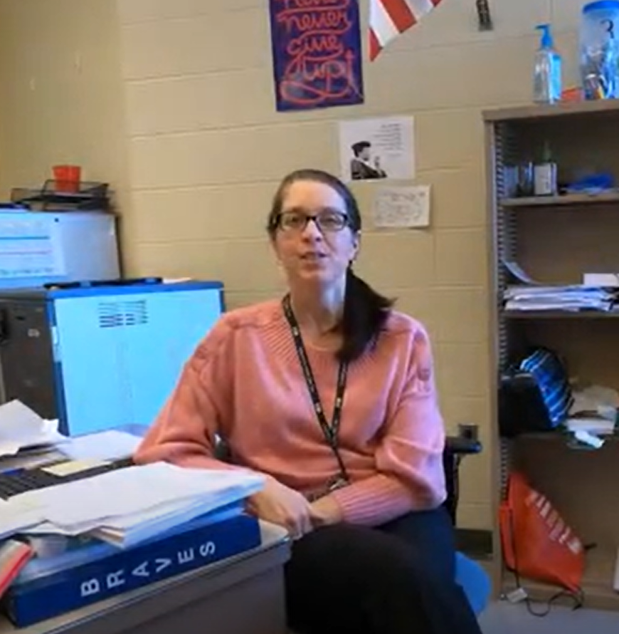
Try It Out: Grades 6-8 Content Area Class Literacy Checklist
Watch Video 2: Reciprocal Teaching
(Retrieved from: https://youtu.be/iJhu-mdUAVM?si=TuVIZJt4fmW0KUfg 01/04/24)
Complete the Grade 6-8 Content Area Class Literacy Checklist.
Focus on comprehension.
Notes:
SAY Using the Grade 6-8 Content Area Class Literacy Checklist from Handout 4, complete the look-fors for comprehension.
Play Video 2: Reciprocal Teaching (7:27)
Allow 5 minutes for completion of checklist following video. It may be helpful to show the video twice. You may also ask participants to consider the look-fors for vocabulary and advanced word study, extended text discussion, and motivation and engagement.

Slide 33

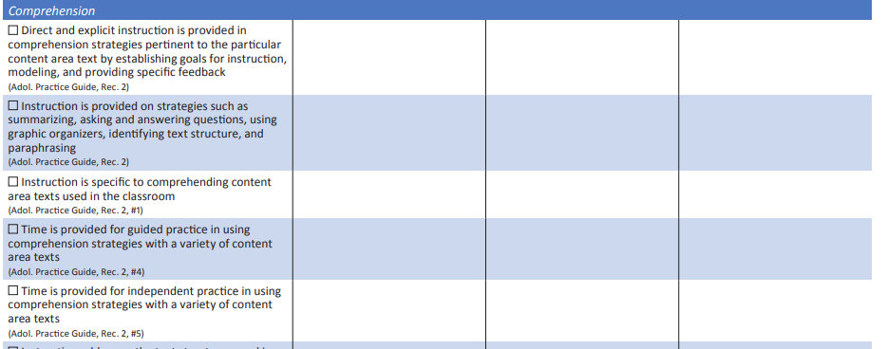
Try It Out: Grades 6-8 Content Area Class Literacy Checklist
Share your walkthrough evidence (notes) with your partner.
Did you notice similarities? Differences?
Notes:
SAY Share your results with your partner and discuss similarities and differences.
Allow 5 minutes for this activity.

Slide 34
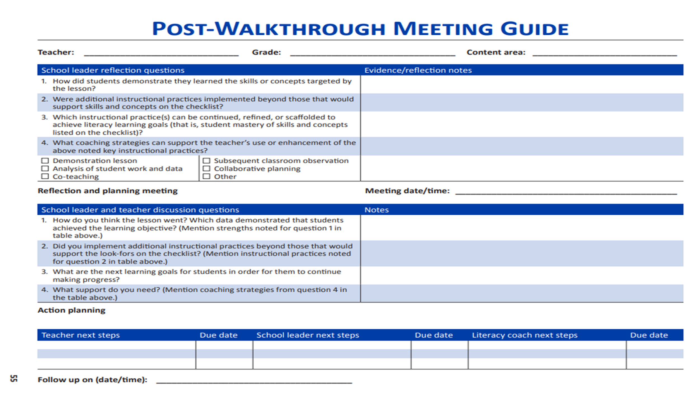
Try It Out: Post-Walkthrough Meeting
When using this guide (Handout 4)…
– What might be challenging? – What is useful or important?
Notes:
SAY Using the post-walkthrough meeting guide from Handout 4, conduct a brief post-walkthrough meeting conversation with your partner following the video lesson.
Allow 5 minutes for activity. Then ask the reflection questions on the slide.

Slide 35

Learn and Confirm
Foundational Skills in Support of Reading for Understanding in Kindergarten Through 3rd Grade
Notes:
SAY Here you’ll see the cover of the Foundational Skills to Support Reading for Understanding in Kindergarten Through 3rd Grade Practice Guide. It is available for download from the IES website:
http://ies.ed.gov/ncee/wwc/PracticeGuide.aspx?sid=21
Practice guides include a checklist for carrying out the panel’s recommendations, including the key concepts for implementing each recommendation.

Slide 36
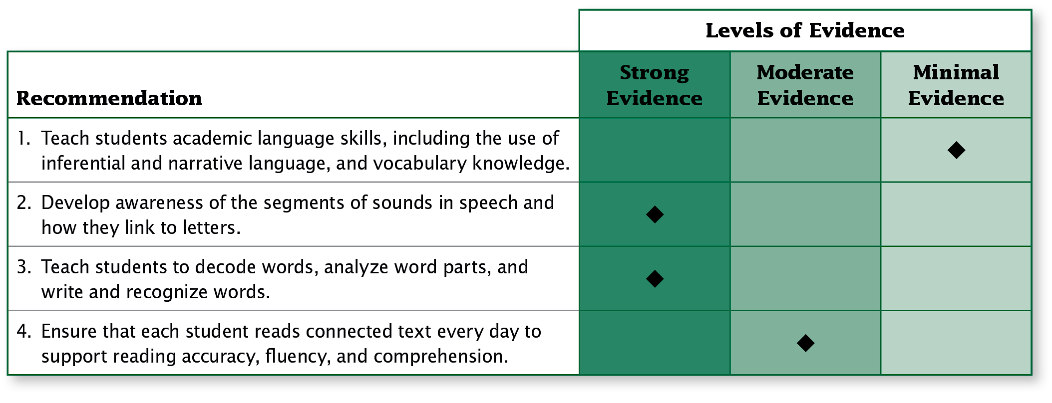
Strategic Use of Evidence-Based Practices Grounded in the Science of Reading
Notes:
SAY These are the four recommendations of the Foundational Reading Skills practice guide. A minimal level of evidence does not mean that a recommendation isn’t important. It means that more rigorous research is needed in the area.
This practice guide is available at the following link:
http://ies.ed.gov/ncee/wwc/PracticeGuide.aspx?sid=21
Under the “Summary of supporting research” header on Page 2, there is a description of how the levels of evidence for each recommendation were determined which continues onto Page 3.

Slide 37
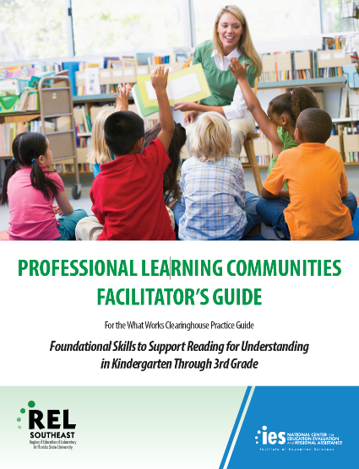
Professional Learning Communities Materials
PLC materials were designed for a facilitator’s use to guide teachers in applying the evidence-based strategies from the practice guide through collaborative learning experiences.
Notes:
SAY The Regional Educational Laboratory (REL) Southeast at Florida State University has developed a set of professional learning community (PLC) materials and videos to help teachers and other practitioners implement the guide’s recommendations in classrooms.
https://ies.ed.gov/ncee/edlabs/regions/southeast/plc.asp

Slide 38
Facilitator’s Guide Includes:
Framework for each session
Participant activities
Discussion questions
Small-group activities
Whole-group activities
Key points about videos
Online availability
Notes:
SAY The purpose of this facilitator’s guide is to provide PLC facilitators with a game plan for conducting each session. The intent is for the facilitator to read the directions and use his or her own unique style to convey the information, discuss topics, and explain activities.
To prepare for each session, facilitators should read the complete section on that session in this guide as well as the related portion of the foundational reading skills practice guide. In addition, facilitators should study and prepare all handouts and gather any other needed materials.
https://ies.ed.gov/ncee/edlabs/regions/southeast/plc.asp

Slide 39
Participant’s Activities Include:
Examples
Reflection questions
Lesson plan examples
Lesson plan templates
Video viewing guides
Sharing opportunities
Online availability
Notes:
SAY The participant’s activities guide includes the activities in which the participants engage during PLC sessions.

Slide 40
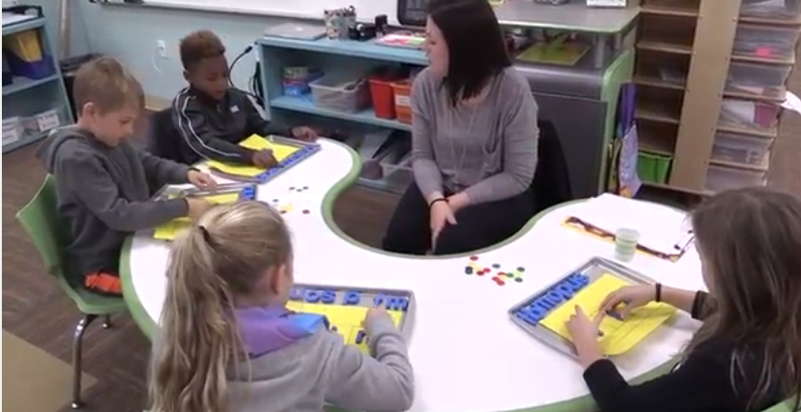
Videos: Classrooms & Animations
22 classroom videos
16 animation videos
Illustrate selected how-to steps
Available online
Notes:
SAY This PLC includes the use of multiple online videos, therefore an internet connection is required during the sessions. These videos illustrate the practices presented in selected How-to steps in the foundational reading skills practice guide.
There are 38 videos that range from 1 minute to about 7 minutes.

Slide 41

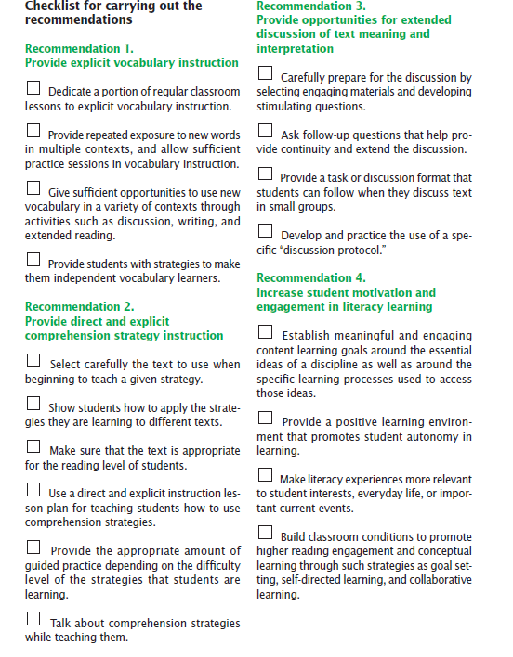
Learn and Confirm
Improving Adolescent Literacy: Effective Classroom and Intervention Practices
Notes:
SAY Here you’ll see the cover of the Adolescent Literacy practice guide, Improving Adolescent Literacy: Effective Classroom and Intervention Practices. It is available for download from the IES website: http://ies.ed.gov/ncee/wwc/pdf/practiceguides/adlit_pg_082608.pdf
Practice guides include a checklist for carrying out the panel’s recommendations, including the key concepts for implementing each recommendation.

Slide 42
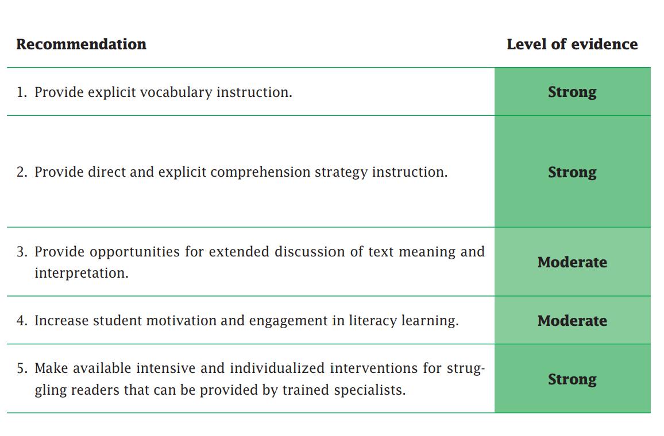
Strategic Use of Evidence-Based Practices Grounded in the Science of Reading
Notes:
SAY These are the five recommendations of the Improving Adolescent Literacy practice guide. A moderate level of evidence does not mean that a recommendation isn’t important. It means that more rigorous research may be needed in the area. You may recall that we discussed Recommendation 1 of this practice guide in Session 9.

Slide 43

Doing What Works: Adolescent Literacy
This free “one-stop” package contains all the materials you need to conduct six two-hour professional development sessions on improving student literacy for adolescent students (4-12).
Produced by the Doing What Works (DWW) project at WestEd, it includes
effective classroom and intervention practices divided into six modules:
Module 1: Overview of DWW and Adolescent Literacy
Module 2: Vocabulary Instruction
Module 3: Comprehension Strategies
Module 4: Engaging Text Discussion
Module 5: Intensive Intervention
Module 6: Four Effective Adolescent Literacy Practices
Notes:
SAY Doing What Works sessions start with expert research reviews to identify effective practices. The content is based on the IES Adolescent Literacy practice guide. DWW builds a bridge from research to action by using a Learn-See-Do structure to translate research into practical tools and resources for building knowledge and implementing practices.
All of the content for these sessions has been archived and can be downloaded from the website:
https://www.wested.org/resources/adolescent-literacy-six-professional-development-modules/
You can conduct each module as a standalone workshop or presentation, or you may combine two modules to create a longer session, depending on your audience and the length of time available for the presentation. In addition, Modules 1-5 would work well as a series of professional development sessions held over two or more days at a summer institute. Module 6 is well-suited for an overview of all four practices within the framework of an individual professional development or conference session.
The six modules are appropriate for a range of audiences—professional development and technical assistance providers, principals and reading specialists, teacher leaders or coaches, and classroom teachers. Upper elementary, middle school, and high school content area teachers also can benefit from learning about these practices and should be encouraged to participate in staff development sessions.

Slide 44
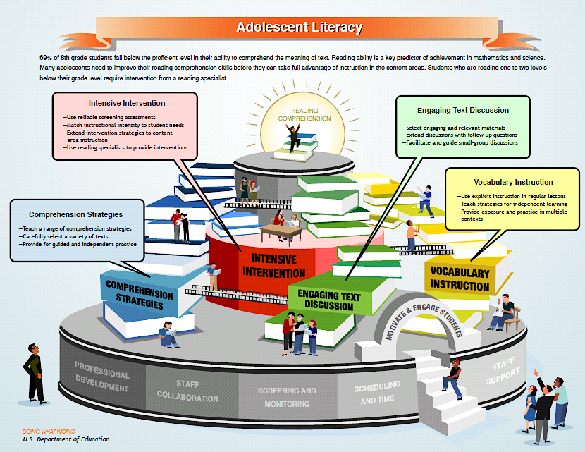
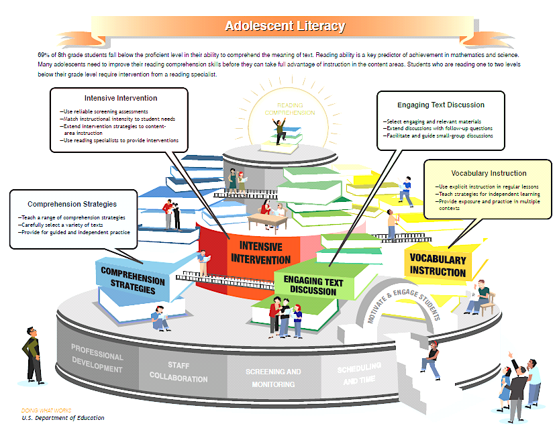
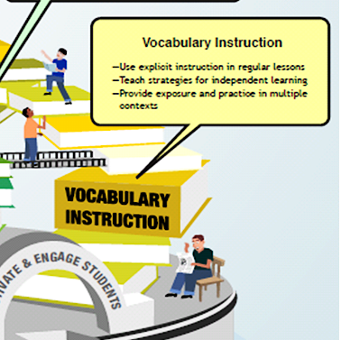
Notes:
SAY Here is a Visual Diagram to orient you to DWW’s Adolescent Literacy topic. The Visual Diagram, which is found in the materials for this course, provides a snapshot of four recommended research-based practices for improving Adolescent Literacy, which are:
Provide Vocabulary Instruction
Teach Comprehension Strategies
Engage Students in Text Discussion
Provide Intensive Intervention to Struggling Readers
The bridges in the diagram show how these practices are interrelated. Working together, the practices form a coherent framework for improving student reading comprehension. The gray base shows you the key supports that need to be in place to implement the practice. These practices are based on recommendations from the IES Practice Guide, Improving Adolescent Literacy: Effective Classroom and Intervention Practices
Available for download from the IES website: https://ies.ed.gov/ncee/wwc/practiceguide/8
During each workshop in this series, participants take a closer look at each area and preview a sampling of DWW LEARN-SEE-DO resources to help implement the featured practice.

Slide 45

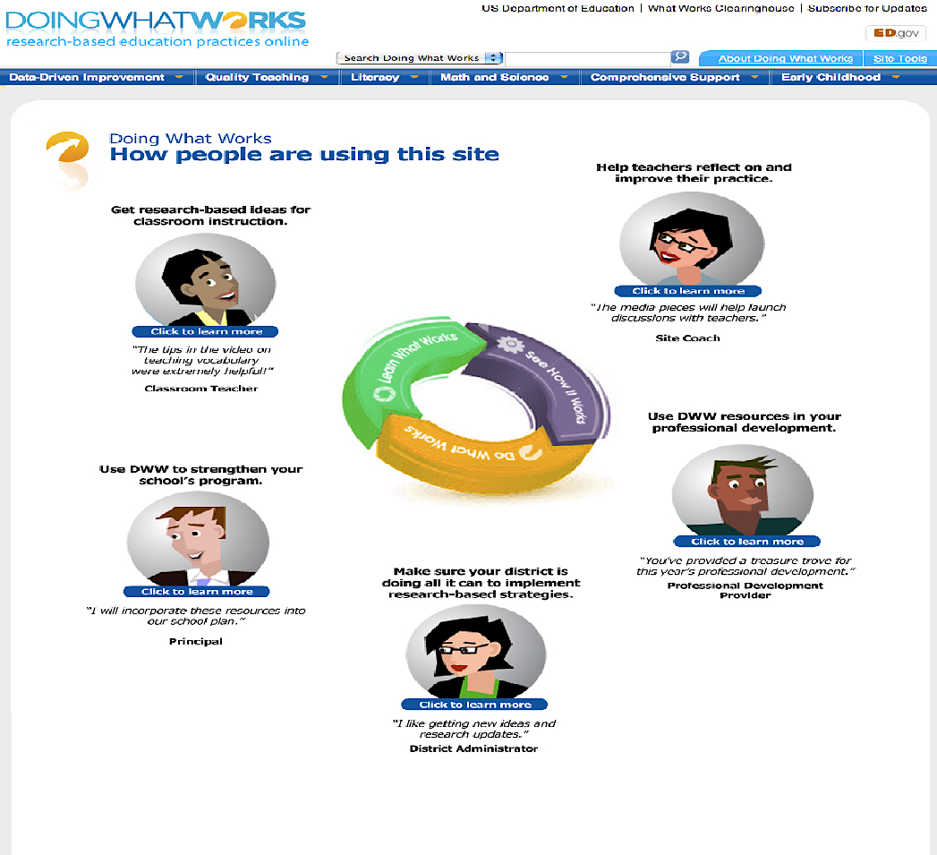
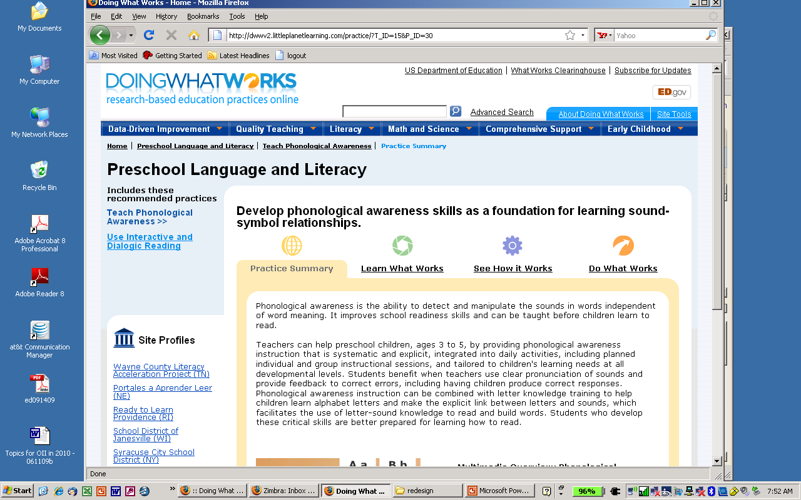
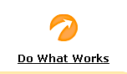
For Each Adolescent Literacy Practice...
Research base and key concepts
Expert interviews
School site videos and slideshows
Interviews and sample materials from schools
Ideas for action
Tools and templates to implement practices
Notes:
SAY The DWW Adolescent Literacy course is organized into three basic areas:
LEARN WHAT WORKS – this is where you will find the research behind the recommendation, as well as interviews with experts on the topic.
SEE HOW IT WORKS – this part of the course features principals and teachers discussing implementation of the practice and demonstrating strategies. This shows the practice in action.
DO WHAT WORKS – this section provides guidance for implementing the practice in your context and practical tools to help pull it all together.

Slide 46
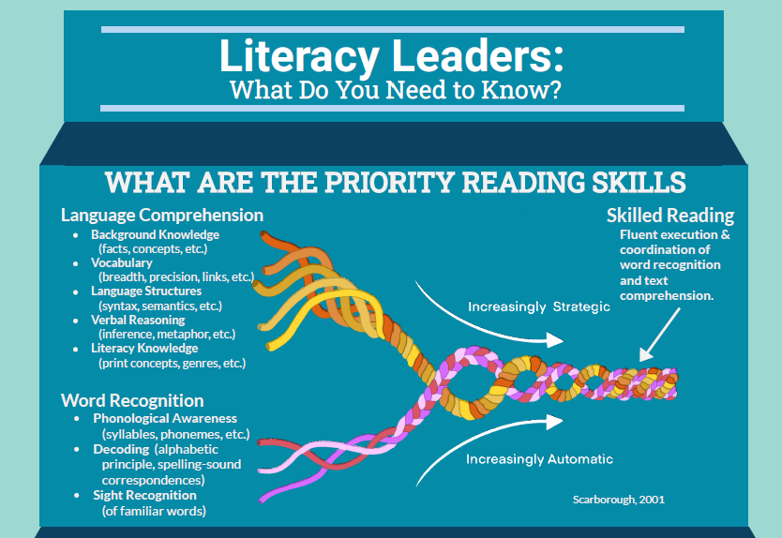
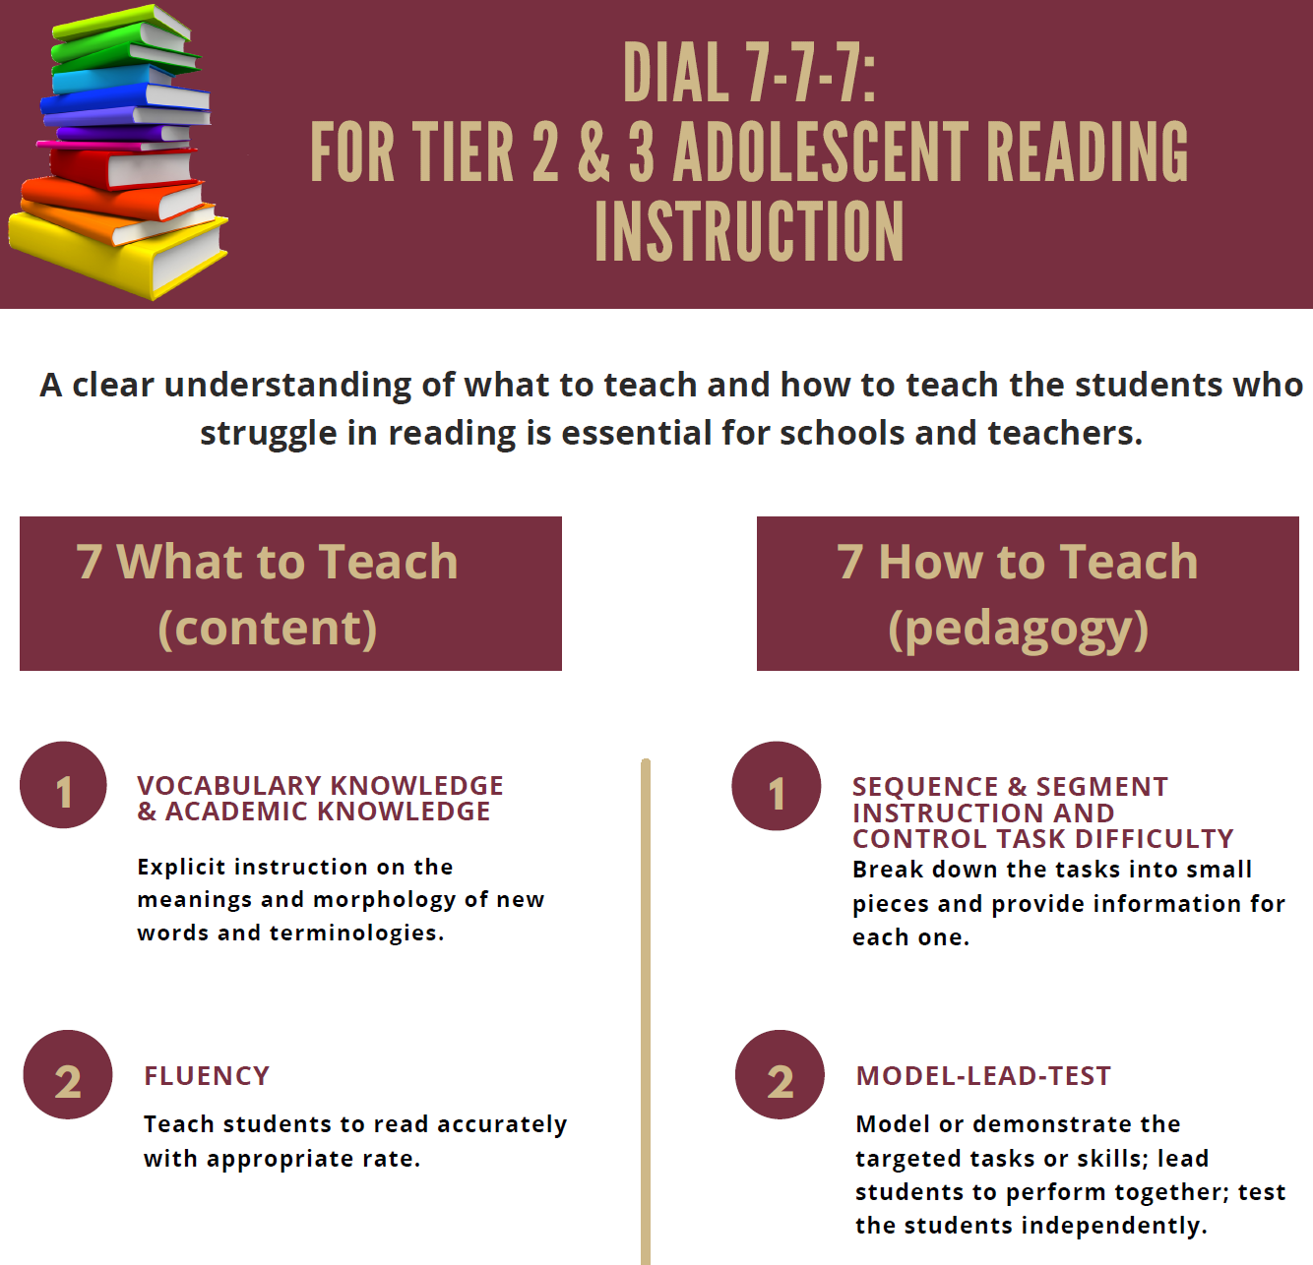
Learn and Confirm
Science of Reading Infographics for Instruction and Intervention
Handouts 5 and 6 are infographics containing guidance for educators in the implementation of priority reading skills and intervention for elementary and adolescent students. Review these infographics and consider how these practices may be carried forward in your local setting.
Notes:
SAY Handout 5 includes Scarborough’s rope, which many believe to be a helpful visual showing how priority reading skills are woven together into a tight rope of skilled reading. Handout 6 provides 7 content recommendations, 7 pedagogy recommendations, and 7 steps to plan for instruction in adolescent literacy intervention.

Slide 47
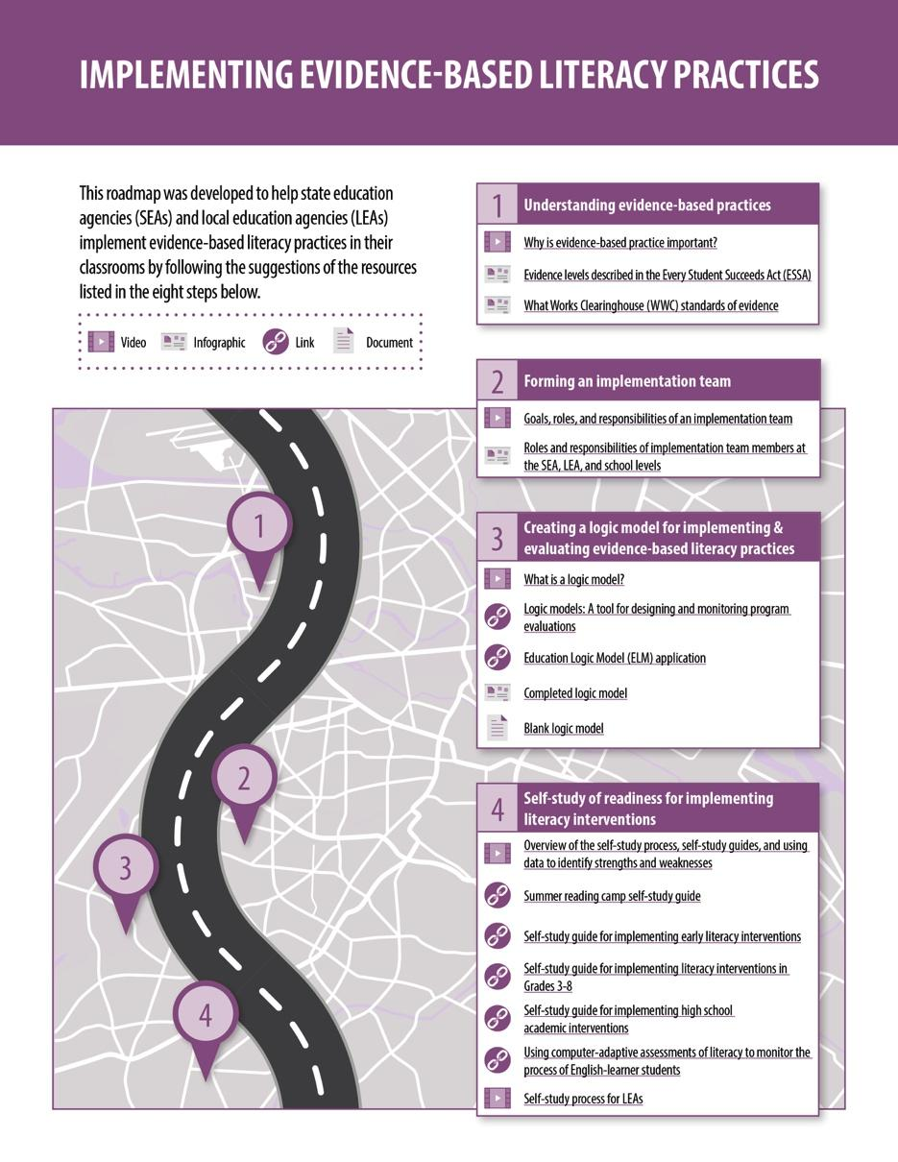
Collaborate and Practice
REL Southeast Literacy Roadmap
Handout 7 contains links to REL Southeast and IES literacy products in a school improvement framework.
Work with a partner to select one or more of the many tools that have been shared and develop a plan on Handout 8 for how the tool(s) could be used to support the strategic use of evidence-based practices grounded in the science of reading in your local setting.
Notes:
SAY Handout 7 contains links to many of the tools that have been shared in this session. Review these tools with a partner and determine which of these, along with other previous tools that have been shared during this session, would be helpful for you to use in supporting the strategic use of evidence-based practices grounded in the science of reading in your district and/or school. Use Handout 8 to identify those tools and develop a plan for implementation.
Allow 10 minutes for this activity.

Slide 48
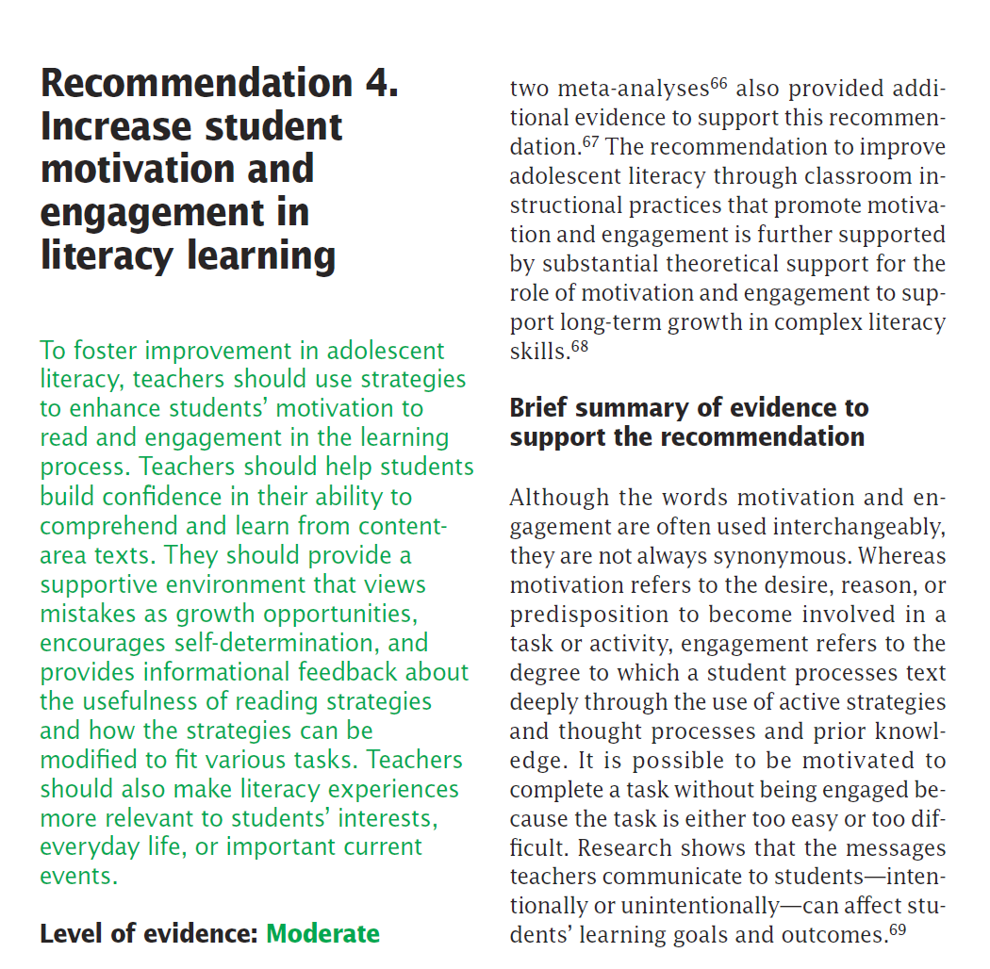
Learn and Confirm
The Role of Student Motivation and Active Engagement in Developing Literacy
Handout 9 contains information for Recommendation 4 of the IES Adolescent Literacy Practice Guide: Increase student motivation and engagement in literacy learning.
Work with a partner to read and summarize the “how to” steps for carrying out the recommendation and potential roadblocks and solutions on Handout 10.
Notes:
SAY Read Handout 9 with a partner and work to summarize the “how to” steps and potential roadblocks and solutions on Handout 10.
Allow 10 minutes for this activity.

Slide 49

Reflect, Plan, and Implement
Post-Session Reflection, Planning, and Implementation
READ
Handout 11: Foundations in Emergent Literacy Instruction Snapshot Series and Handout 12: Adolescent Literacy Visual Representation.
Video 3: Virtual Student Engagement.
Self-Study 1: Video Viewing Guide for Virtual Student Engagement and Directed Note-Taking for Infographic Use.
Be prepared to debrief at the beginning of Session 11.
WATCH
DO
Notes:
NOTE Spend time discussing the self-study participants will complete before Session 11.
Participants will need to read both Handout 11 and 12 and watch Video 3 in order to complete Self-Study 1.

Slide 50

Questions?
Notes:
SAY Are there any questions that you have regarding the content of this session, the self-study activities, or the course in general?
Answer any questions.

Slide 51




We have completed
Session 10
Notes:
SAY This is the end of Session 10. Thank you for your participation!
Confirm the date and time of the next session and provide one final self-study assignment reminder.

