Slide 1
Fundamentals of Literacy Coaching
Professional Development Modules
Module 4, Session 11
Using Data for Instruction
Notes:
SAY Welcome to the Literacy Coach Program – Session 11: Using Data for Instruction.

Slide 2
Module | Topic | Session | Minutes | Session Date
1 | Applying Principles and Practices that Foster a Positive Culture | Intro | 60
 |  | 1 | 120
 |  | 2 | 150
 |  | 3 | 150
2 | Applying Effective Pedagogy and Andragogy | 4 | 120
 |  | 5 | 120
 |  | 6 | 165
3 | Collecting Data to Inform Professional Learning | 7 | 150
 |  | 8 | 140
 |  | 9 | 170
4 | Planning, Implementing, and Analyzing Literacy Instruction | 10 | 175
 |  | 11 | 135
 |  | 12 | 165
 |  | 13 | 130
5 | Growing Professionally | 14 | 120
 |  | 15 | 120
6 | Planning and Implementing Coaching | 16 | 120
Notes:
NOTES
It is recommended that the sessions are completed in sequential order.
The timeline for completing the sessions can be flexible. If the recommended minutes for each session are not available, complete what you can with the time you have and then pick up where you left off the next time you meet.
Once a schedule of the sessions is established, have participants record the schedule in their Literacy Coach Program PD Guide if printed.
SAY Here is an overview of the modules and sessions of this course. There are six modules, and each module includes two to four sessions for a total of 15 content sessions. Module 1 addresses Applying Principles and Practices that Foster a Positive Culture, Module 2 covers Applying Effective Pedagogy and Andragogy, the focus of Module 3 is Collecting Data on Instructional Practices to Inform Professional Learning, the content of Module 4 is Planning, Implementing and Analyzing Standards-Based Literacy Instruction, the content of Module 5 is Growing Professionally, and the final module, Module 6, addresses Planning and Implementing Coaching.
You can record the date of each of our sessions in your Literacy Coach Program PD Guide.

Slide 3
Bridge to Practice Projects for Coaches
An activity designed to serve as a Bridge to Practice after each Module will provide evidence that coaches are able to apply the knowledge and skills they developed in this course in their schools. Coaches will complete the following activities:
A rubric is provided at the end of each Module for the corresponding Bridge to Practice project.
Module 1 | Develop a principal-coach partnership agreement.
Module 2 | Develop a needs assessment for professional development on evidence-based instructional practices and complete an ADDIE model for planning this professional development.
Module 3 | Develop and describe planned implementation of a professional learning action plan.
Module 4 | Create a video that reflects coaching to help teachers plan, implement, and analyze standards-based literacy instruction.
Module 5 | Complete a reflection on the course, including plans for continued professional growth.
Module 6 | Choose one teacher with whom you have seen significant growth as a result of coaching support and complete a reflection on what worked, why it worked, and which areas of growth were most evident.
Notes:
SAY We want to remind you that participating coaches will complete a bridge to practice project after each module. These projects will provide evidence that coaches are able to apply the knowledge and skills they developed in this course in their schools. You will learn more about each project as we work through the modules. We’ve shared an overview of the projects with you on this slide.
Coaches will
Module 1: develop a principal/coach partnership agreement;
Module 2: conduct a needs assessment for professional development on evidence-based instructional practices and complete an ADDIE model for planning this professional development;
Module 3: develop, implement, and evaluate a professional learning action plan;
Module 4: create a video that reflects coaching to help teachers plan, implement, and analyze standards-based literacy instruction;
Module 5: complete a reflection on the course including plans for continued professional growth.
Module 6: Choose one teacher with whom you have seen significant growth as a result of coaching support and complete a reflection on what worked, why it worked and which areas of growth were most evident.
You may turn in all your artifacts for the projects to your facilitator at the end of each module if requested.

Slide 4



Norms for Our Course
Cell phones on silent
Pay attention to self and others
Presume
positive intentions
Notes:
NOTES Consider your group to determine how much detail about the norms will be helpful to review.
SAY Professional learning opportunities usually consist of a team of educators, like us, that meet regularly to learn new topics, share ideas, and problem solve. We will build a community, meaning that we learn from each other, so sharing and participation are really important.
Professional learning opportunities typically have norms that the group can agree to in order to be productive. Here are three norms, or ground rules, for our way of work: cell phones on silent; pay attention to yourself and others; and presume positive intentions.
Pay attention to self and others This means to contribute, listen, and be aware of how you and others are responding to each other. Be sure to give everyone a chance to talk and encourage others who seem reluctant to join in. Sometimes people who are reluctant to talk are thinking. They may not be comfortable jumping in, but may have something important to say. Professional learning opportunities like this one encourage educators to learn from one another. Therefore, sharing, discussing and participating are important components.
Presume positive intentions This means to pause before responding. Usually when people contribute to a conversation, they intend to be constructive. So, always respond positively to keep the discussions productive.

Slide 5

Define and Discuss Session Goals and Content
Goals for Today
Learn how to use student data to make instructional decisions.
Learn how to analyze the effectiveness of lessons, instructional materials, and assessments.
Notes:
NOTES Share and discuss these goals for today’s session.

Slide 6

Debrief
Review of Module 4, Session 10
Discuss Handout 11: Foundations in Emergent Literacy Instruction Snapshot Series and Handout 12: Adolescent Literacy Visual Representation from Session 10.
Discuss Self-Study 1: Video Viewing Guide for Virtual Student Engagement and Directed Note-Taking for Infographic Use.
Discuss any questions or comments regarding the last session.
Notes:
NOTES Allow about 7 minutes for this debrief. If you have a small group, ask for volunteers to share with the whole group. If you have a large group, consider having triads discuss and then ask for a volunteer from each triad to share with the large group.

Slide 7
Literacy Coach Domain and Standards: Session 11
D. Knowledge of and ability to apply effective methods for planning, implementing, and analyzing standards-based literacy instruction based on the science of reading and evidence-based practices. Coaches will demonstrate their abilities in and understanding of:
8. How to use student data to make instructional decisions.
10. How to analyze the effectiveness of lessons, instructional materials and assessments using a variety of techniques (e.g., lesson plans, formative/summative assessments, and student work samples).
Notes:
SAY We will now begin to focus on the content of the literacy coach domains and standards. This is the Literacy Coach Domain and standards that will be covered during this session. Take a moment to review the domain and standards.

Slide 8

Learn and Confirm
Using Student Data to Make Instructional Decisions
“Data-driven decision making does not simply require good data; it also requires good decisions.”
“These calls for data-driven decision making often imply that data use is a relatively straightforward process. As such they fail to acknowledge the different ways in which practitioners use and make sense of data to inform decisions and actions.”
The conclusion is that data-driven decision making does not guarantee effective decision making.
(Hess, 2007, pg. 17; Ikemoto & Marsh, 2007 pg. 105; Marsh, et al., 2006)
Notes:
SAY The statements on the slide are from several studies regarding data-driven decision making. They reveal what your role is as a coach when it comes to helping your teachers. Even if the data is good, teachers need to know how to use that data to inform their instruction. We talked a lot about data, analyzing and interpreting data collaboratively, and data systems in Module 3, but this session is really about you, as a coach, helping individual teachers make sense of their classroom data. Further, it’s about helping them make good instructional decisions for their students.

Slide 9
Using Student Data to Make Instructional Decisions
When data is used to make instructional decisions, instruction is differentiated as the needs of all students are not the same.
In your small groups, discuss how you have helped teachers differentiate instruction based on data. Be prepared to share with the whole group.
Notes:
Notes Allow about 3 minutes for group discussion and 2 minutes for sharing out.
SAY We know that when we analyze and interpret data, it should lead to differentiation of instruction. After you’ve had a couple of minutes to discuss how you have helped teachers differentiate instruction based on data, we’ll share out some of your ideas in our whole group,

Slide 10
Using Data to Make Instructional Decisions
Interpreting data and using it to make instructional decisions involves:
Using more than one data point (triangulate data).
Looking for patterns and trends.
Formulating a hypothesis based on what is seen that you think will improve student performance.
Deciding how to test your hypothesis through changes to instruction, which may include changes to lesson content, instructional materials, and how instruction is delivered.
Collecting data to see if your hypothesis was correct and changes have resulted in improvement in student performance.
Notes:
SAY In Session 8 we looked at analyzing and interpreting data. To gain deeper insight into students’ learning needs, teachers should examine evidence from the multiple data sources. As a reminder, “triangulation” is the process of using multiple data sources to address a particular question or problem and using evidence from each source to illuminate or temper evidence from the other sources. It also can be thought of as using each data source to test and confirm evidence from the other sources in order to arrive at well-justified conclusions about students’ learning needs. When multiple data sources (e.g., results from the annual state assessment and district interim assessment) show similar areas of student strength and weakness, teachers can be more confident in their decisions about which skills to focus on. In Session 8 we looked at multiple data sources in order to interpret data at the school or classroom level. In this session we are looking at how to analyze and interpret student level data, with the goal of evaluating our lessons and differentiating instruction.

Slide 11

Collaborate and Practice
Let’s Practice Using Student Data to Make Instructional Decisions
With a partner, review Handouts 1, 2, and 3. Handout 1 is a data set and Handouts 2 and 3 will guide you through an activity to make instructional decisions using the data.
With your partner, complete the steps outlined in Handout 3. Discuss how you would guide a teacher through a process like this.
In your small groups, share how you grouped students and your rationale for grouping the way you did.
Notes:
Notes Allow 30 minutes for this activity. Participants will work with a partner, share their work with their small group, and then you’ll give participants a chance to share out regarding their small group work.
SAY We know that data should be used to inform instruction and we’ve talked about how to analyze and interpret data. We want to make sure that we can guide teachers so they know how to make good decisions using good data. We’ll use fictional first grade data from a reading assessment for this activity. With a partner, look at Handout 1 – this is the data set. You’ll see that the first page contains data for entire first grade – in this case there are only two first grade classes. As a coach, you will probably have access to grade level data, and we’ve talked about how to make decisions regarding data at that level. In this session, we’ll be working with the data for Teacher A. You’ll see that data on the remaining pages. PRS stands for Probability of Reading Success. Also, 1.1 and 1.2 are the passages students should be able to read in Assessment Period 1. You’ll find data for the class and also data for an individual student. When you look at the targeted diagnostic inventory, ME stands for Meets expectations and BE stands for Below expectations. Take a moment and become familiar with the data. Then read through Handout 2 – these are the instructions for the activity. Finally, Handout 3 is a chart where you can record your groups and the focus for instruction for each. With your partner, work to group your students. After you have finished, share how you grouped them with the rest of the group at your tables. Talk about why you grouped them the way you did. Please know that there are multiple ways students could be groups for a variety of reasons. The goal is to use information from multiple sources to group students in a way that makes instruction in critical reading skills most efficient. After you’ve finished the discussion at your tables, we’ll share out in our whole group.

Slide 12
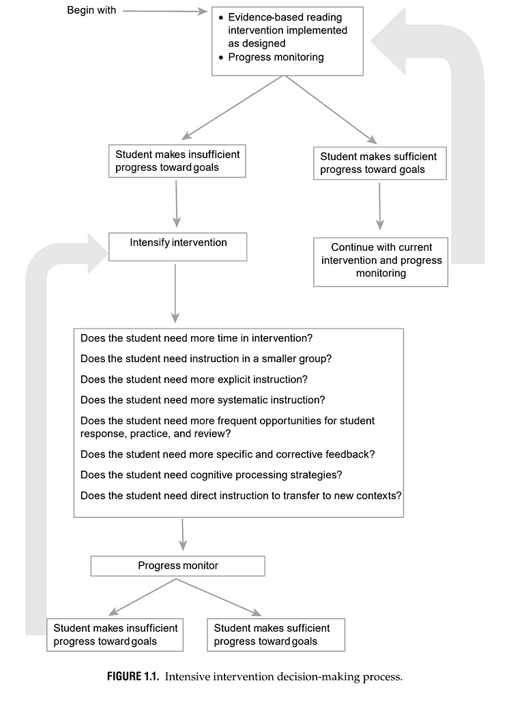
Learn and Confirm
Using Data to Make Instructional Decisions
Most children will learn to read with a high-quality, research-based Tier 1 curriculum.
When children do not progress in a Tier 1 curriculum, there are research-based approaches to adapting and intensifying reading instruction.
These approaches focus on instructional organization and/or delivery methods.
Wanzek et al. (2020) provide this figure as a way of making data-based decisions related to intensity.
(Wanzek, Al Otaiba, & McMaster, 2020)
Notes:
SAY The activity we just completed helped us to group students according to strengths and needs. We saw what they still needed to be taught. It is just as important that we also think about how instruction needs to be delivered. As reflected on the slide, most children will learn to read when high-quality, research-based instruction is provided. Most often teachers will depend on a core reading program as the major instructional tool to help them provide this instruction. Data is collected in a variety of ways including screeners, and curriculum based measures to ascertain whether or not students are making adequate progress. For those students who are not progressing as we would hope, interventions may need to be provided – oftentimes a first step is to differentiate instruction by adapting or intensifying instruction in small groups like the ones we just developed based on our data sets. The flowchart on the slide is a guide for teachers as they strive to make data-based decisions related to the intensity of instruction. How could this be helpful to you as a coach as you work with teachers?

Slide 13
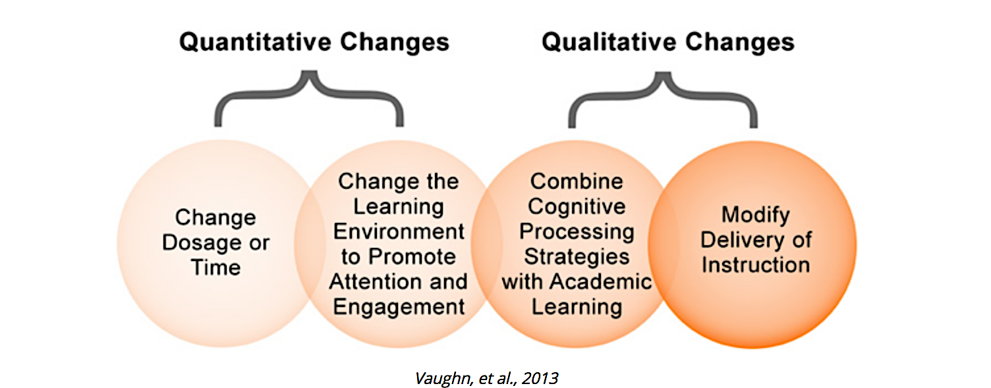
How Do We Intensify Instruction Based on Need?
Notes:
Notes Allow ten minutes for this activity, including about seven minutes for groups to work together and three minutes for sharing out.
SAY As we look at student data, we may find that we need to intensify instruction. You see on this slide some quantitative and qualitative changes you can make to do that. In your small groups, list some examples of what you think each of these looks like in the classroom. Be prepared to share with the whole group.

Slide 14
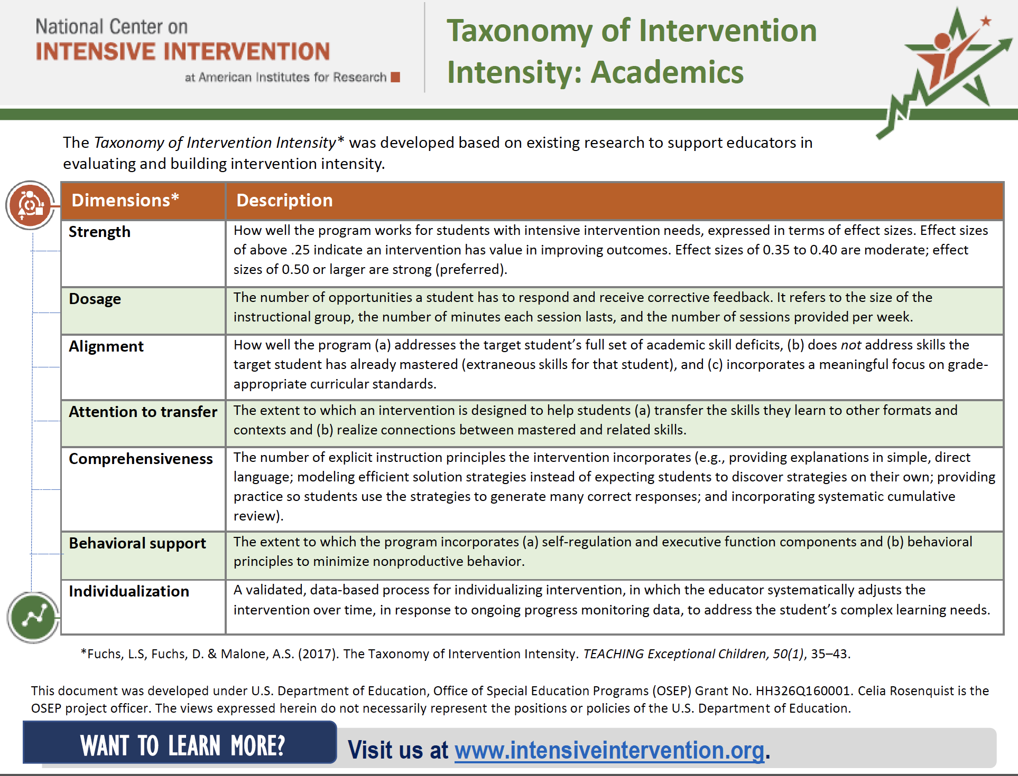
National Center for Intensive Intervention Provides Guidance for Increasing the Intensity of Academic Instruction
Review of Evidence-Based Curriculum
Individualizing Level of Intensity and Adaptations Based on Data
Notes:
Notes Provide about five minutes for participants to review Handout 4.
SAY When we examine student data, we should think about the effectiveness of our lessons, instructional materials we use as tools, and our assessments. Let’s take a look at Handout 4: Taxonomy of Intervention Intensity: Academics. We can say that when we use data to make instructional decisions, we are really using data to individualize instruction. The National Center on Intensive Intervention approaches the provision of appropriate instruction through the process of data-based individualization (DBI). This approach was first developed at the University of Minnesota and is a process, not a single intervention program or strategy. The process is ongoing and involves adjusting intervention and assessment over time. This taxonomy can be used to select or evaluate an intervention platform used as the foundation of the DBI process. It can also be used to guide the adaptation of intensification of an intervention during the intervention adaptation step of the DBI process. For more information on DBI, you can go to the National Center on Intensive Intervention website.

Slide 15
Intensifying Instruction
Organizational Changes to Intensify Instruction
Increase the time spent in intervention/instruction
Length of a session
More sessions each week
Decrease number of students in instructional groupings to ensure more opportunities for practice/feedback
(Wanzek, Al Otaiba, & McMaster, 2020)
Notes:
SAY When we look at data for students in a class, we undoubtedly will find that some students have responded to instruction as we would hope, and others are not progressing as we wish they were. This will probably require teachers to intensify instruction for those students. This can and should be done in the regular classroom by grouping students according to their strengths and needs. You see on your screen some ways that we can intensify instruction for students who need it. Notice that these are “organizational changes,” meaning there is a system in place whereby teachers review data, determine strengths and needs, group students accordingly, and provide the necessary instruction.

Slide 16
Intensifying Instruction
Instructional Changes to Intensify Instruction
Explicit Instruction
Instruction that includes modeling of the task, frequent opportunities for guided and independent practice with affirmative and corrective feedback, and gradual removal of supports
Systematic Instruction
Teaching practices in small, manageable steps
Frequent Opportunities to Respond with Feedback
Additional practice opportunities to monitor understanding and provide explicit feedback
(Wanzek, Al Otaiba, & McMaster, 2020)
Notes:
SAY Teachers can intensify instruction by providing explicit instruction that is systematic with frequent opportunities to respond. These definitions are provided by Wanzek, Al Otaiba & McMaster; however, others have developed similar definitions that may be more detailed.

Slide 17
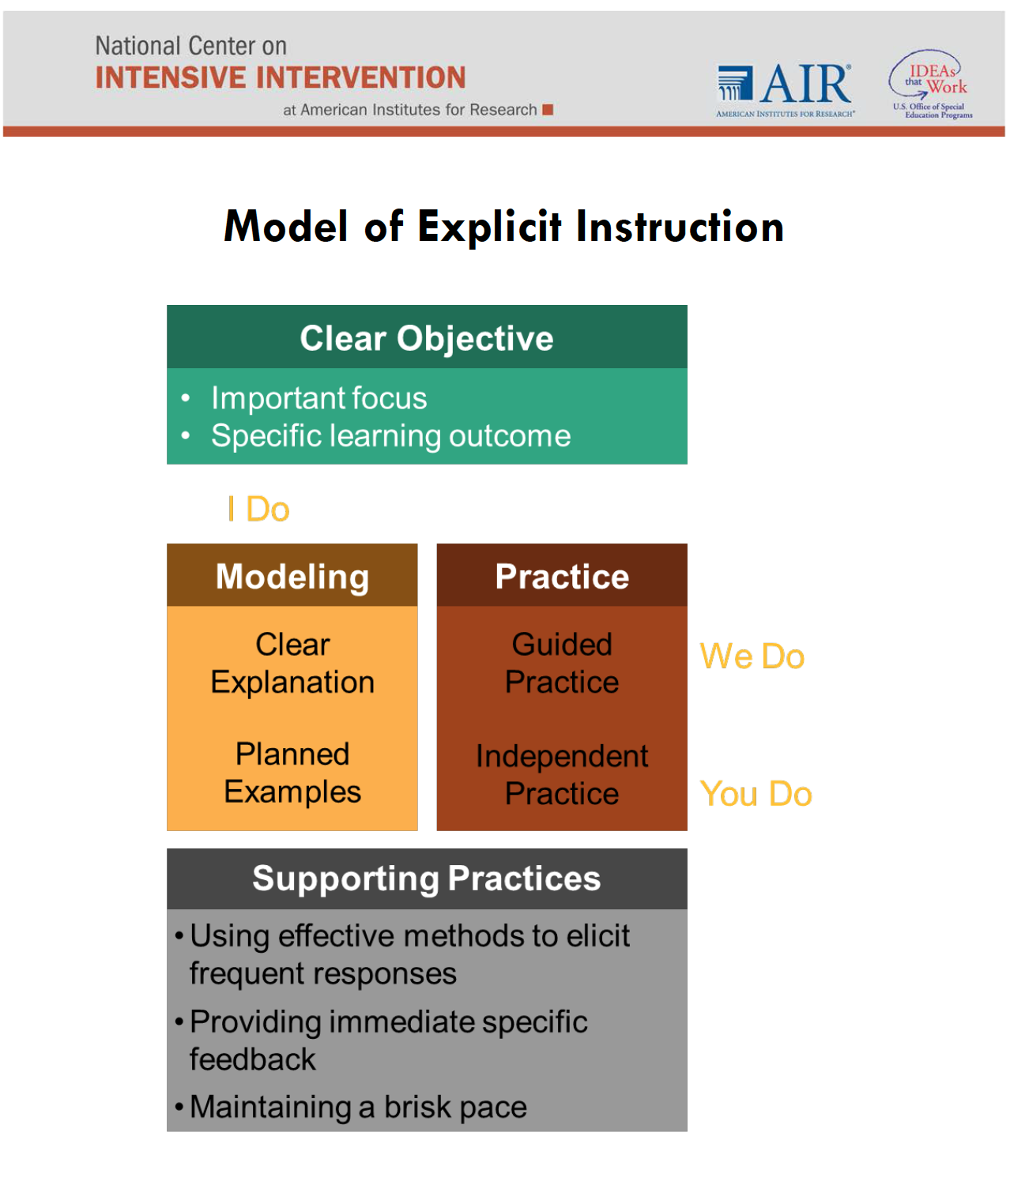
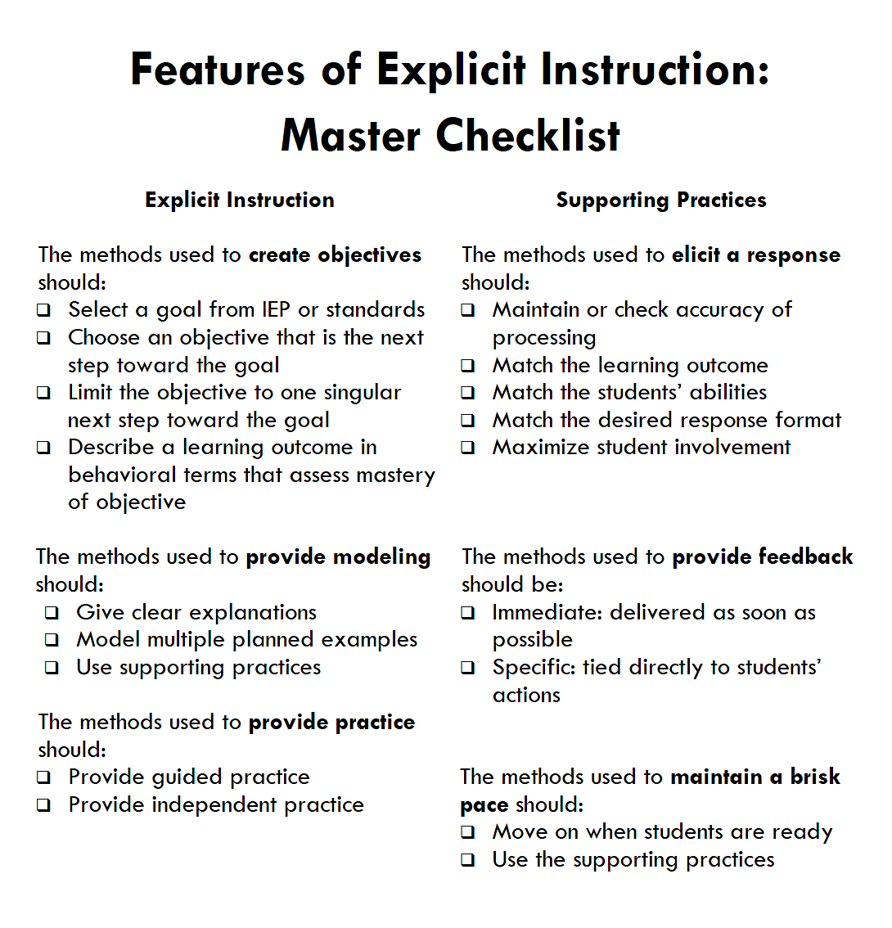
For more information
https://intensiveintervention.org/
Notes:
SAY This slide shares more information regarding what explicit instruction should look like and how to provide it. Notice the connection to the gradual release model – I do, we do, you do.

Slide 18
Intensifying Instruction
Instructional Changes to Intensify Instruction
Specific and Concrete Feedback
Immediate feedback that is specific to affirm what students have done correctly or how to perform the task effectively
Cognitive Processing Strategies
Embed instruction to help students set goals and monitor their own progress, reason through strategy use, persist in a task, and implement strategies to support memory (e.g., graphic organizers)
Teaching for Transfer
Provide opportunities to apply newly mastered skills in other contexts with feedback
(Wanzek, Al Otaiba, & McMaster, 2020)
Notes:
SAY Teachers can also intensify instruction by ensuring they are providing specific and concrete feedback, addressing cognitive processing strategies, and teaching for transfer.

Slide 19

Intensifying Instruction
Immediate and concrete feedback, based on data, is critical to helping students meet their learning goals. Complete Handout 5, the video viewing guide, as we watch Video 1: Austin’s Butterfly.
Talk about your responses to the questions on Handout 5 in your small groups and be prepared to share out.
Notes:
Notes Allow 15 minutes for this activity. The video is 6:32 long.
SAY This video shows how providing specific and actionable feedback can help even our youngest students improve their work. It also provides evidence of establishment of goals, and student persistence. Complete Handout 5 and then discuss your responses in your small groups. Then we’ll share our thoughts in the whole group.
Possible responses for Handout 5, although answers may vary:
The feedback was specific and actionable
It was direct and provided immediately
The student improved upon his work; multiple drafts were developed and this was considered a part of the process
The teacher explained what type of feedback would be most helpful and asked guiding questions
Critique and revision are considered part of the process and, therefore, time must be built into the schedule for them to occur
The students seem to learn that specific feedback is beneficial to the learning process and that work can be improved when soliciting and incorporating feedback.
The feedback we give to teachers needs to be specific and actionable, just like that we give to students. We also need to concentrate on just a couple of things - not everything at once.

Slide 20

Analyzing the Effectiveness of Lessons, Instructional Materials, and Assessments
In your role as a coach, it is important that you know how to analyze the effectiveness of lessons, instructional materials, and assessments using a variety of techniques (e.g., lesson plans, formative/summative assessments, and student work samples).
In Video 2, Using Data to Analyze the Effectiveness of Lessons, Cathi Braxton Addison, an English language arts content specialist from Jackson County, Florida, shares how coaches can work with teachers to ensure that instruction promotes student learning.
Notes:
Notes In your role as a coach, it is important that you are able to guide teachers as they analyze student data to differentiate instruction for their classes, but you also need to be able to analyze the effectiveness of their lessons, the instructional materials that are used, and assessments. You need to be able to guide teachers as they engage in this process as well. In this 2:20 video, Cathi Addison, long time language arts content specialist and coach from the Florida panhandle talks about this. She also reflects that observations are a good way to gather data that will be useful in the analysis. We will delve more deeply into teacher observations in Session 13.

Slide 21
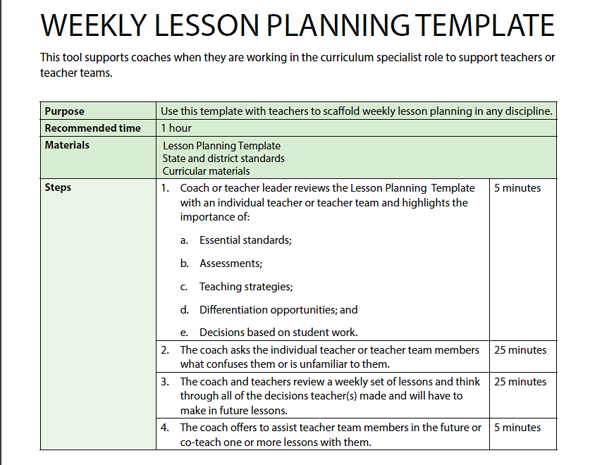
Analyzing the Effectiveness of Lessons, Instructional Materials, and Assessments
Effective lessons begin with planning. Handout 6 is a document to help guide coaches in co-planning with teachers. It also contains a sample lesson plan. Read through the handout and note any comments or questions.
Notes:
Notes Allow about five minutes for this activity.
SAY We first shared this guide to lesson planning developed by Killion & Harrison, along with the lesson plan template, in Session 3. You may already have a lesson planning template that is required by your school or district. Have you had the opportunity to use this guide to co-plan with teachers since we introduced this tool? How have you found it to be helpful? If you haven’t had the opportunity to use it, how could it be adapted to meet your needs?

Slide 22
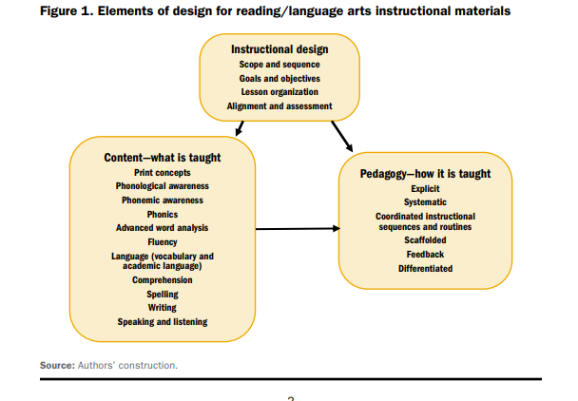
Analyzing the Effectiveness of Lessons, Instructional Materials, and Assessments
For lessons to be effective, it is important that teachers have tools that help them deliver instruction that is based on the science of reading.
Rubrics such as the Rubric for Evaluating Reading/Language Arts Instructional Materials for Kindergarten to Grade 5 can help state, district, and school-level practitioners review instructional materials to ensure they are using the most effective tool possible.
Notes:
SAY In Session 10 we looked at the Rubric for Evaluating Reading/Language Arts Instructional Materials for Kindergarten to Grade 5. As a reminder, this rubric contains an introduction that highlights the need for rigorous reviews of instructional materials, when to use the rubric, and the necessary knowledge and experience reviewers need to possess to use the rubric effectively. In addition, as you see on your screen, the elements of design for reading/language arts instructional materials are depicted. All of these need to be considered during a review of instructional materials.

Slide 23
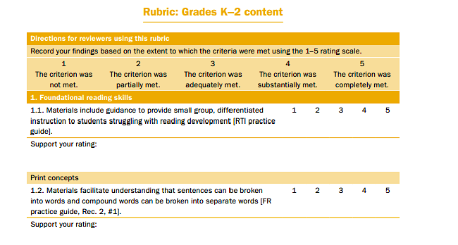
Analyzing the Effectiveness of Lessons, Instructional Materials, and Assessments
The Rubric for Evaluating Reading/Language Arts Instructional Materials for Kindergarten to Grade 5 contains separate review criteria—one for grades K-2 and the other for grades 3-5, since instruction looks very different in these grade bands.
Notes:
SAY As a reminder, this is what the rubric looks like for grades K-2. We reviewed this in Session 10. Evaluating these components will help ensure we are using evidence-based instructional materials – the best possible tools for our teachers.

Slide 24

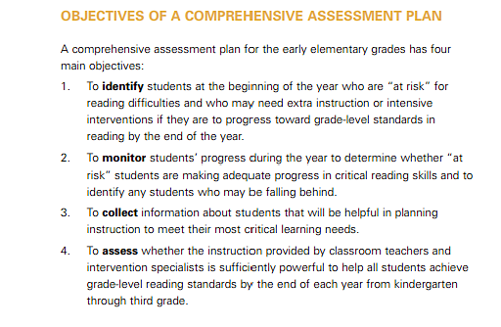
Analyzing the Effectiveness of Lessons, Instructional Materials, and Assessments
Notes:
SAY We know that assessments can tell us a lot about the effectiveness of our lessons and instructional materials. We talked earlier about the importance of selecting assessments that are valid, reliable, and provide us information we can use to guide instruction. This document, A Comprehensive K-3 Reading Assessment Plan: Guidance for School Leaders published by the Center on Instruction, is a great resource that can aid districts and schools in planning a comprehensive assessment system that will provide valuable information about student performance. This can help teachers adjust instruction as needed. You will read this document as part of your self-study activities for this session.

Slide 25
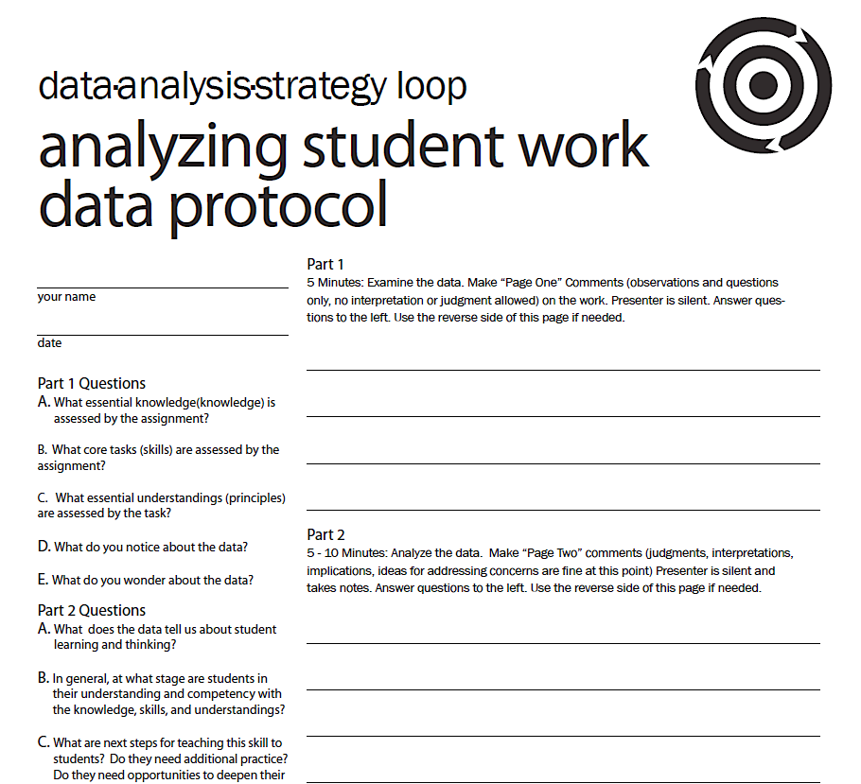
Analyzing the Effectiveness of Lessons, Instructional Materials, and Assessments
Student work provides evidence of learning. Therefore, student work samples help reveal the effectiveness of lessons, instructional materials, and assessments.
Handout 7 is a protocol for helping teachers and teams talk about their students’ work.
Notes:
Notes Allow five minutes for this activity.
SAY Review Handout 7: Analyzing Student Work Data Protocol which was developed by Two Rivers Public Charter School in Washington DC. The protocol contains guiding questions and room to write notes. Note that after the teacher presents the work to the group, the teacher is silent while the first two parts of the discussion take place. During Part 3 the discussion ensues with the teacher. How could you use this protocol with a group of teachers as they examine student work? How could you adapt this for use with an individual teacher?

Slide 26
Cultivating Family Support to Enhance the Effectiveness of Lessons
When parents are involved, student motivation, effort, concentration, attention, and positive outcomes in reading improve.
Harvard Family Research found in the School Transition Study (2007) that family involvement increases children's positive feelings about literacy, which in turn improves their literacy performance. In other words, children start feeling better about literacy and like literacy more when their parents are involved in their education.
(Gonzalez-DeHass, Willems,& Holbein, 2005)
Notes:
SAY We’ve looked at several tools to help us analyze the effectiveness of lessons, instructional materials and assessments; however, we need to remember that parents are our most important partners when it comes to literacy instruction. One way that we can ensure that lessons are effective is by cultivating family support. Research has shown the importance of enlisting the help of families and caregivers. In your role as a coach, you may be asked to communicate directly with parents, providing them with resources to support their children, or you may support the teachers you serve in their efforts to involve families in engaging in literacy activities at home.

Slide 27




Tools to Help Teachers Cultivate Family Support to Enhance
the Effectiveness of Lessons
Notes:
SAY Here you see the covers of some teacher guides that have been developed by the Regional Educational Laboratory Southeast at Florida State University to help teachers involve families in supporting their child’s literacy at home. They are based the Foundational Skills to Support Reading for Understanding in Kindergarten Through 3rd Grade practice guide published by the Institute of Education Sciences. You will hear more about these from the lead author, Dr. Marcia Kosanovich, in just a few minutes.

Slide 28

Tools to Help Teachers Cultivate Family Support to Enhance the Effectiveness of Lessons
Families can access this website directly to engage children in literacy activities.
Notes:
SAY This is the home page of a website that was developed to provide families with direct access to evidence-based activities to help them support their grade K-3 child’s literacy at home. Like the teacher guides, it is based on the foundational Skills to Support Reading for Understanding in Kindergarten Through 3rd Grade practice guide, and contains the same activities that are in the guides.

Slide 29

Tools to Help Teachers Cultivate Family Support to Enhance
the Effectiveness of Lessons
In Video 3, Teacher Resource Guides for Supporting Family Involvement in Foundational Reading Skills for Grades K-3, Dr. Marcia Kosanovich, lead author of the teacher guides to support family involvement in literacy, overviews the guides and the website developed to allow families direct access to literacy activities and support to engage their children in literacy.
Notes:
Notes Allow 15 minutes for this activity. The video is 9:13 long.
SAY Let’s watch as Dr. Marcia Kosanovich overviews the teacher guides to support family involvement and the associated website Supporting your Child’s Reading at Home. Keep these two questions in mind while we watch – we’ll talk about them after the video – How could you help teachers use these resources to promote family involvement in literacy? How could you use the resources to enhance communication that you may have with families?

Slide 30


Collaborate and Practice
Tools to Help Teachers Cultivate Family Support to Enhance the Effectiveness of Lessons
Notes:
Notes Participants should access Handouts 8 and Handout 9, which are the two infographics on the screen.
SAY As students grow older, it seems that families may be less involved in their education. However, families are still important partners. Look at the two infographics on Handout 8 and Handout 9, which provide helpful information for families regarding how they can support their child’s literacy skills. How can you encourage your teachers to reach out to parents of older students?

Slide 31

Dr. Dré Graham’s Video
Watch Video 4: Relationship Building to Increase Student Engagement
Notes:
SAY (Video is 5:43 long) Let’s watch as Dr. Graham overviews the keys to building relationships to increase student engagement. What can coaches do specifically to help?

Slide 32

Reflect, Plan, and Implement
Post-Session Reflection, Planning, and Implementation
READ
Self-Study 1: A Comprehensive K-3 Reading Assessment Plan: Guidance for School Leaders. Jot down two things you learned and two questions or wonderings. Bring these to Session 12.
Handout 7: Use the Analyzing Student Work Data Protocol with one or more teachers. Bring this with you to Session 12.
Be prepared to debrief at the beginning of Session 12.
Video 5: Formative Assessment White Boards and complete Self-Study 2.
DO
WATCH
Notes:
NOTE Spend time discussing the self-study activities that participants will complete before Session 12. Be sure that participants know how to access the materials. Emphasize that participants will need to complete the Analyzing Student Work Data Protocol (Handout 7) with at least one teacher before Session 12.
SAY During this session, we looked at student data in order to make instructional decisions, and we looked at how to analyze the effectiveness of lessons, instructional materials, and assessments. The self-study activities for this session are focused on assessment and analyzing student work.
Review the slide and provide time for participants to locate and skim the materials.

Slide 33

Questions?
Notes:
SAY Are there any questions that you have regarding the content of this session, the self-study activities, or the course in general?
Answer any questions.

Slide 34




We have completed
Session 11
Notes:
SAY This is the end of Session 11. Thank you for your participation!
Confirm the date and time of the next session and provide one final self-study assignment reminder.

