Slide 1
Fundamentals of Literacy Coaching
Professional Development Modules
Module 4, Session 12
Addressing the Needs of All Students
Notes:
SAY Welcome to the Literacy Coach Program – Session 12: Addressing the needs of all students.

Slide 2
Module | Topic | Session | Minutes | Session Date
1 | Applying Principles and Practices that Foster a Positive Culture | Intro | 60
 |  | 1 | 120
 |  | 2 | 150
 |  | 3 | 150
2 | Applying Effective Pedagogy and Andragogy | 4 | 120
 |  | 5 | 120
 |  | 6 | 165
3 | Collecting Data to Inform Professional Learning | 7 | 150
 |  | 8 | 140
 |  | 9 | 170
4 | Planning, Implementing, and Analyzing Literacy Instruction | 10 | 175
 |  | 11 | 135
 |  | 12 | 165
 |  | 13 | 130
5 | Growing Professionally | 14 | 120
 |  | 15 | 120
6 | Planning and Implementing Coaching | 16 | 120
Notes:
NOTES
It is recommended that the sessions are completed in sequential order.
The timeline for completing the sessions can be flexible. If the recommended minutes for each session are not available, complete what you can with the time you have and then pick up where you left off the next time you meet.
Once a schedule of the sessions is established, have participants record the schedule in their Literacy Coach Program PD Guide if printed.
SAY Here is an overview of the modules and sessions of this course. There are six modules, and each module includes two to four sessions for a total of 15 content sessions. Module 1 addresses Applying Principles and Practices that Foster a Positive Culture, Module 2 covers Applying Effective Pedagogy and Andragogy, the focus of Module 3 is Collecting Data on Instructional Practices to Inform Professional Learning, the content of Module 4 is Planning, Implementing and Analyzing Standards-Based Literacy Instruction, the content of Module 5 is Growing Professionally, and the final module, Module 6, addresses Planning and Implementing Coaching.
You can record the date of each of our sessions in your Literacy Coach Program PD Guide.

Slide 3
Bridge to Practice Projects for Coaches
An activity designed to serve as a Bridge to Practice after each Module will provide evidence that coaches are able to apply the knowledge and skills they developed in this course in their schools. Coaches will complete the following activities:
A rubric is provided at the end of each Module for the corresponding Bridge to Practice project.
Module 1 | Develop a principal-coach partnership agreement.
Module 2 | Develop a needs assessment for professional development on evidence-based instructional practices and complete an ADDIE model for planning this professional development.
Module 3 | Develop and describe planned implementation of a professional learning action plan.
Module 4 | Create a video that reflects coaching to help teachers plan, implement, and analyze standards-based literacy instruction.
Module 5 | Complete a reflection on the course, including plans for continued professional growth.
Module 6 | Choose one teacher with whom you have seen significant growth as a result of coaching support and complete a reflection on what worked, why it worked, and which areas of growth were most evident.
Notes:
SAY We want to remind you that participating coaches will complete a bridge to practice project after each module. These projects will provide evidence that coaches are able to apply the knowledge and skills they developed in this course in their schools. You will learn more about each project as we work through the modules. We’ve shared an overview of the projects with you on this slide.
Coaches will
Module 1: develop a principal/coach partnership agreement;
Module 2: conduct a needs assessment for professional development on evidence-based instructional practices and complete an ADDIE model for planning this professional development;
Module 3: develop, implement, and evaluate a professional learning action plan;
Module 4: create a video that reflects coaching to help teachers plan, implement, and analyze standards-based literacy instruction;
Module 5: complete a reflection on the course including plans for continued professional growth.
Module 6: Choose one teacher with whom you have seen significant growth as a result of coaching support and complete a reflection on what worked, why it worked and which areas of growth were most evident.
You may turn in all your artifacts for the projects to your facilitator at the end of each module if requested.

Slide 4



Norms for Our Course
Cell phones on silent
Pay attention to self and others
Presume
positive intentions
Notes:
NOTES Consider your group to determine how much detail about the norms will be helpful to review.
SAY Professional learning opportunities usually consist of a team of educators, like us, that meet regularly to learn new topics, share ideas, and problem solve. We will build a community, meaning that we learn from each other, so sharing and participation are really important.
Professional learning opportunities typically have norms that the group can agree to in order to be productive. Here are three norms, or ground rules, for our way of work: cell phones on silent; pay attention to yourself and others; and presume positive intentions.
Pay attention to self and others This means to contribute, listen, and be aware of how you and others are responding to each other. Be sure to give everyone a chance to talk and encourage others who seem reluctant to join in. Sometimes people who are reluctant to talk are thinking. They may not be comfortable jumping in, but may have something important to say. Professional learning opportunities like this one encourage educators to learn from one another. Therefore, sharing, discussing and participating are important components.
Presume positive intentions This means to pause before responding. Usually when people contribute to a conversation, they intend to be constructive. So, always respond positively to keep the discussions productive.

Slide 5

Define and Discuss Session Goals and Content
Goals for Today
Learn how to align instruction and intervention to a logical scope and sequence of reading skill development.
Learn how to apply standards-aligned systematic intervention for language and literacy development.
Learn about the stages of language and literacy development for all students.
Learn about literacy learning processes and language development of English Language Learners and Students with Disabilities in collaboration with English for Speakers of Other Languages and Exceptional Student Education departments.
Learn about Multi-Tiered System of Support and evidence-based practices, programs, and interventions.
Notes:
NOTES Share and discuss these goals for today’s session.

Slide 6

Debrief
Review of Module 4, Session 11
Discuss Self-Study 1 and discuss any questions or wonderings from the Comprehensive K-3 Reading Assessment Plan: Guidance for School Leaders.
Discuss Video 5 on Formative Assessment White Boards and Self-Study 2.
Discuss the Analyzing Student Work Data Protocol and how you used it with one or more teachers while completing Self-Study 3.
Discuss any questions or comments regarding the last session.
Notes:
NOTES Allow about 7 minutes for this debrief. If you have a small group, ask for volunteers to share with the whole group. If you have a large group, consider having triads discuss and then ask for a volunteer from each triad to share with the large group.
SAY After Session 11, you also had something to read, something to do, and something to watch. Let’s debrief. You read Self-Study 1: A Comprehensive K-3 Reading Assessment Plan: Guidance for School Leaders. What questions or wonderings did you have about that?
Look at what you recorded on Self-Study 2 about Video 4: Formative Assessment White Boards and share any relevant thoughts. Answers may vary.
You also completed Self-Study 3: Analyzing Student Work Data Protocol. How did you use this with one or more teachers? What were the results?

Slide 7
Literacy Coach Domain and Standards: Session 12
D. Knowledge of and ability to apply effective methods for planning, implementing, and analyzing standards-based literacy instruction based on the science of reading and evidence-based practices. Coaches will demonstrate their abilities in and understanding of:
2. How to align instruction and intervention to a logical scope and sequence of reading
skill development.
3. The application of standards-aligned systematic instruction and intervention for language and literacy development.
4. The stages of language and literacy development for all students.
6. Literacy learning processes and language development of English Language Learners and Students with Disabilities in collaboration with English for Speakers of Other Languages and Exceptional Student Education departments.
7. Multi-Tiered System of Support and evidence-based practices, programs and interventions.
Notes:
SAY We will now begin to focus on the content of the literacy coach domains and standards. This is the Literacy Coach Domain and standards that will be covered during this session. Take a moment to review the domain and standards.

Slide 8


Learn and Confirm
Aligning Instruction and Intervention to a Logical Scope and Sequence of Reading Skill Development
Video 1: Addressing the Needs of All Students presents an overview of aligning instruction and intervention to a logical scope and sequence of reading skill development.
Handout 1: Video Viewing Guide for Video 1. Watch the video, complete the viewing guide, and discuss at your tables.
Notes:
SAY Please review the questions on Handout 1: Video-Viewing Guide for Video 1: Addressing the Needs of All Students. Let’s watch a video of Dr. Laurie Lee present an overview of aligning instruction and intervention to a logical scope and sequence of reading skill.
NOTES
Allow 15 minutes for viewing the video and completing the handout. Show Video 1 (7 minutes) and allow time for participants to record their answers to the questions on Handout 1. Ask for volunteers to share their answers.
Possible responses for questions:
Phonological awareness instruction typically fades out during first grade.
A stand-alone intervention is curricular materials aligned to address specific student needs in literacy intervention and is separate and unrelated to the materials used in the core reading program.
An embedded intervention is curricular materials aligned to address specific student needs in literacy intervention and is aligned with and closely related to the materials used in the core reading program.
It may be helpful to struggling students for the materials to be aligned so they are taught skills in similar ways initially and in intervention. If struggling readers are provided different, and potentially conflicting, approaches to learning skills, it could be confusing.
Scope and sequence is a logical progression of instructional steps based on the science of reading to help ensure student mastery of foundational reading skills.
Coaches can be part of the instructional and intervention materials review process. They may also help support communications between teachers and interventionists.

Slide 9
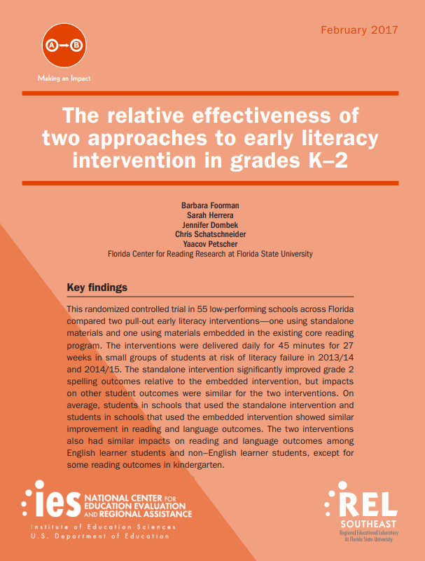
Findings of Foorman et al. (2018)
The content of standalone & embedded interventions was similar, but it was in the differences in the core components of spelling, inferential language, and comprehension where differential effects were found.
Embedded interventions can be as effective as standalone when well implemented.
Advantages to embedded: cost effective; aligned to tier 1 classroom instruction. But, cannot be implemented straight out of the shrink-wrap package. Practitioners must (a) develop a manual that includes a scope & sequence and implementation procedures, (b) provide training; and (c) monitor for fidelity.
Notes:
SAY As noted in the video, there can be benefits to the alignment of instruction and intervention, which are common language and understanding (particularly if there is a different instructor for intervention) and cost effectiveness. It is also important to ensure that students are receiving intervention instruction that is aligned with their individual needs. Time for catch up growth is too precious to waste on intervention skills that students do not need. Regardless of the intervention materials used, it is imperative to ensure a logical scope and sequence of reading skill development.

Slide 10
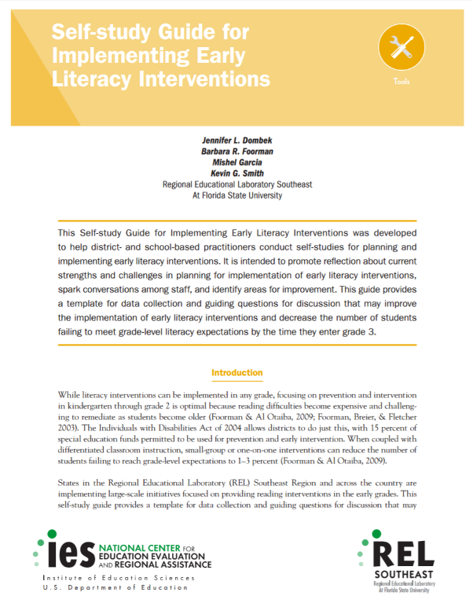



Self-Study Guides for Literacy/Academic Interventions
Video 2: The Self-Study Process
These REL Southeast Self-Study Guides for Literacy/Academic Interventions were developed to help district- and school-based practitioners conduct self-studies for planning and implementing literacy interventions. They are intended to promote reflection about current strengths and challenges in planning for implementation of literacy interventions, spark conversations among staff, and identify areas for improvement. These evidence-based guides provide a template for data collection and guiding questions for discussion that may improve the implementation of literacy interventions and decrease the number of students failing to meet grade-level literacy expectations.
Notes:
SAY These self-study guides may be helpful in considering the following 8 areas of literacy intervention implementation:
Student Selection, Assessment Selection and Data Use, Content and Instruction, Instructional Time, Interventionist or Teacher Selection, Professional Development and Ongoing Support, Communication, and Intervention or Classroom Environment.
As we watch Video 2: The Self-Study Process, consider how facilitating this process as a coach in your school might help with implementation of interventions and alignment of literacy instruction and interventions.
The length of Video 2 is 3:34.

Slide 11

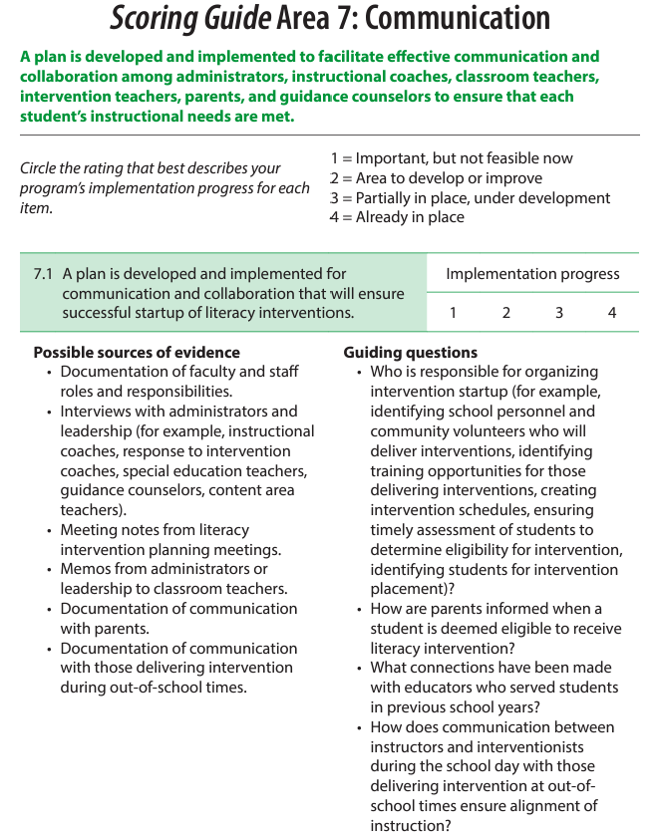
Collaborate and Practice
Review Handout 2: Scoring Guide Area 7: Communication (from the Self-Study Guide for Implementing Literacy Interventions in Grades 3-8).
Which possible sources of evidence and guiding questions focused on communication would be beneficial to a literacy coach in helping to ensure that literacy instruction is aligned with intervention?
Notes:
SAY Look at Handout 2: Scoring Guide Area 7: Communication. This is from the REL Southeast Self-Study Guide for Implementing Literacy Interventions in Grades 3-8. You’ll see Possible sources of evidence and Guiding questions designed to help school self-study teams determine how well communications are occurring in literacy intervention implementation. Which Possible sources of evidence and Guiding questions would be beneficial in helping to ensure that literacy instruction is aligned with intervention?
NOTE Allow 5 minutes for this discussion.

Slide 12
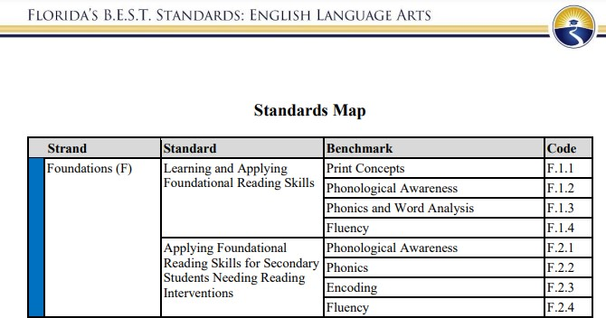
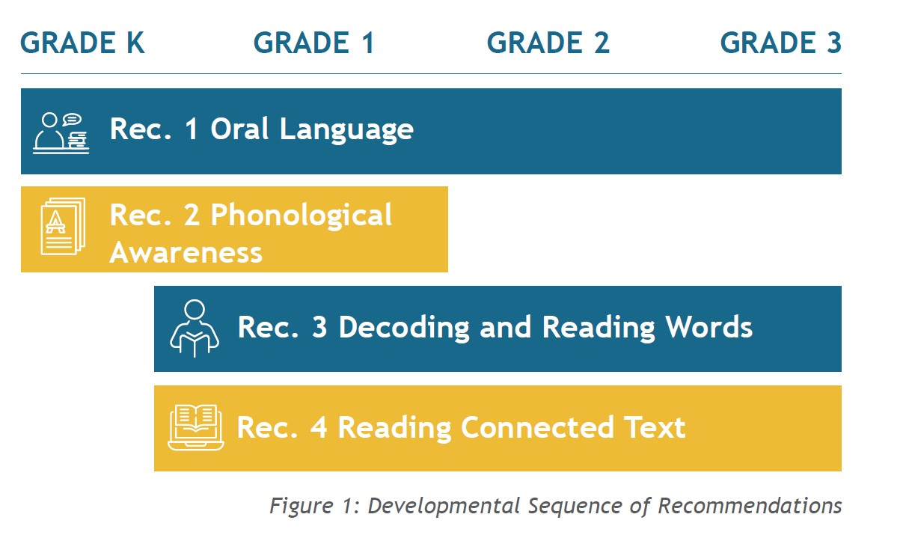
Learn and Confirm
Applying Standards-Aligned Systematic Intervention for Language and Literacy Development
These samples are from the Florida B.E.S.T Standards for Foundational Reading Skills and Secondary Reading Interventions. How do they (or your state’s foundational reading standards) align with the Developmental Sequence of Recommendations from the IES/WWC Practice Guide Foundational Skills to Support Reading for Understanding?
Notes:
SAY Please review Florida’s B.E.S.T. Standards for Learning and Applying Foundational Reading Skills and Applying Foundational Reading Skills for Secondary Students Needing Reading Interventions or review the foundational reading skills standards from your state. How do they align with the Developmental Sequence of the four recommendations from the IES/WWC Practice Guide Foundational Skills to Support Reading for Understanding in Kindergarten Through 3rd Grade. How do these standards align with the recommendations?
NOTES Sample response: The progression of the standards and the developmental sequence of recommendations is closely aligned from the earliest skills of phonological awareness to fluently reading connected text. However, oral language is a separate standard for Florida’s B.E.S.T. Standards.

Slide 13

Learn and Confirm
Applying Standards-Aligned Systematic Intervention for Language and Literacy Development
Video 3: Systematic Teaching in Tiers 2 and 3 presents an overview of applying systematic intervention for language and literacy development.
Summarize the main points of the video with your small group and discuss the role that coaches play in applying standards-aligned systematic interventions.
13
Notes:
SAY We will now watch a video based on the IES/WWC practice guide Assisting Students Struggling with Reading: Response to Intervention (RtI) and Multi-Tier Intervention in the Primary Grades. This video focuses on the Systematic Teaching in Tiers 2 and 3. Once the video is complete, summarize the main points of the video with your small group and discuss how coaching can support the application of standards-aligned systematic intervention for language and literacy development.
Notes: The length of Video 3 is 6:46. Allow 7 minutes for the discussion.

Slide 14


Learn and Confirm
The Stages of Language and Literacy Development for All Students
Reading is the integration of print and spoken language.
“It is now well accepted that reading is a language-based skill.”
Kamhi & Catts, 2012, p. 1.
Video 4: Research on Learning to Read
14
Notes:
SAY We will now watch a brief video that provides background of how reading and language is connected.
After the video ask: Why is it now well accepted that reading is a language-based skill?
Video 4 is 3:18 long.
Possible response: Rock solid research (over decades) on children’s behavior and the brain have led to this acceptance that reading is a language-based skill.
Kamhi, A. G., & Catts, H. W. (2012). Language and Reading Disabilities: Pearson New International Edition.

Slide 15
What Is Language?
Language is a complex and dynamic system of conventional symbols that is used in various modes for thought and communication. Contemporary views of human language hold that:
language evolves within specific historical, social, and cultural contexts;
language, as rule-governed behavior, is described by at least five parameters – phonologic, morphologic, syntactic, semantic, and pragmatic;
language learning and use are determined by the interaction of biological, cognitive, psychosocial, and environmental factors; and
effective use of language for communication requires a broad understanding of human interaction including such associated factors as nonverbal cues, motivation, and sociocultural roles.
American Speech Language and Hearing Association (ASHA, 1982)
15
Notes:
SAY In order to ensure a clear understanding of the stages of language and literacy development for all students, we will spend a few moments defining language, as presented on this slide, and then briefly reviewing and discussing the parameters and stages of language and then reading development. This slide provides the definition of language from the American Speech Language and Hearing Association.

Slide 16
Parameters of Language
Form
  Phonology – knowledge of how sounds come together to form words
    Important for phonological awareness or the ability to process, segment, blend, and manipulate sounds in words
    Phonemes = smallest unit of sound
  Morphemes - smallest unit of meaning
    Free and Bound
  Syntax - grammar, conventions for generating meaningful sentences/phrases
Content
  Semantics – knowledge of word meanings and relationships between words
  Vocabulary knowledge – depth and breadth
Use
  Pragmatics – rules for using language in conversation/discourse in a variety of settings/contexts; higher-level language use including interpreting figurative language, idioms, sarcasm, or information not explicitly stated
    Includes conversational, classroom, narrative, and event discourse
Form
Content
Use
Bloom & Lahey, 1978
16
Notes:
SAY The parameters of language can be categorized under form, content, and use. This slide provides an overview for the components of each parameter through the lens of these three categories developed by Bloom and Lahey.

Slide 17
Parameters of Language
Component | Definition | Receptive | Expressive
Phonology | Sound system of language, rules that govern sound combinations | Process sounds in words | Produce sounds in words
Semantics | Meaning of words and word combinations | Understanding word meanings & relationships | Use of word meanings & relationships
Morphology | Structure of words, construction of word forms | Understanding grammatical structure of words | Use of grammar in words
Syntax | Rule system governing order combination of words to form phrases, clauses, sentences | Understanding phrases & sentences | Use of grammar in phrases & sentences
Pragmatics | Sociolinguistic system that patterns use of language in communication | Understanding contextual language cues | Use of language in context
17
Notes:
SAY This table defines the five components of language development. Each includes the ability to express and understand these components of language. Discuss how these components are used together to express and receive language.
NOTE Allow 5 minutes for this discussion.

Slide 18

So, What Is Reading?
An active process in which the reader engages with text (written language) to gain information and generate meaning.
Spoken language includes cues (e.g., tone, gestures, facial expressions) that are missing from text. In written language, these meanings are often inferred from vocabulary, grammar, etc.
18
Notes:
SAY Now that we have discussed an overview of the parameters of language, we will spend a few moments defining reading, as presented on this slide, and then briefly reviewing and discussing the stages of language and literacy development for all students. Reading is different from language as language provides additional cues not represented in text requiring the reader to make inferences.

Slide 19
Language Development and Reading Development
Children who have trouble distinguishing between speech sounds will have trouble analyzing and linking speech to print.
Children who have limited word knowledge
  will have trouble understanding text, and
  may experience difficulty decoding words not in their vocabulary.
Children with difficulty with syntactic knowledge can have trouble gaining meaning from sentences.
Children who have difficulty interpreting and linking sentences in discourse or conversation will have trouble understanding and recalling stories or passages.
Tunmer & Hoover, 2019
19
Notes:
SAY The list presented on this slide will help align reading difficulties with the different stages of language and literacy development. Consider how these challenges are aligned with the different stages.
Ask the following questions:
How does knowing sounds impact learning to read words?
How does vocabulary impact learning to read words?
How does vocabulary impact understanding text?
Allow 5 minutes for this discussion.
Tunmer, W. E., & Hoover, W. A. (2019). The cognitive foundations of learning to read: A framework for preventing and remediating reading difficulties. Australian Journal of Learning Difficulties, 24(1), 75-93.

Slide 20

The Simple View of Reading (Gough & Tunmer, 1986)
Word Recognition X Language Comprehension = Reading Comprehension
Word recognition and listening comprehension are relatively independent of each other but are both highly correlated with reading comprehension.
Look at Handout 3 and discuss the correlation between the formula for the Simple View of Reading and Scarborough’s Reading Rope.
20
Notes:
SAY As discussed in Session 10, the Simple View of Reading is that Word Recognition times Language Comprehension equals Reading Comprehension (Skilled Reading). Look at Handout 3: Literacy Leaders: What Do You Need to Know? and discuss the correlation between the formula for the Simple View of Reading and Scarborough’s Reading Rope.
Ask the following questions:
What skills does a child need to learn to identify words accurately and fluently?
What skills does a child need to understand text read?
Discuss the importance of:
linking sounds to letters;
being able to do this fluently and effortlessly to attend to meaning;
predicting what is going to happen and connecting what we read with what we know;
motivation.

Slide 21
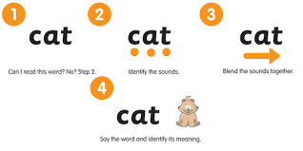
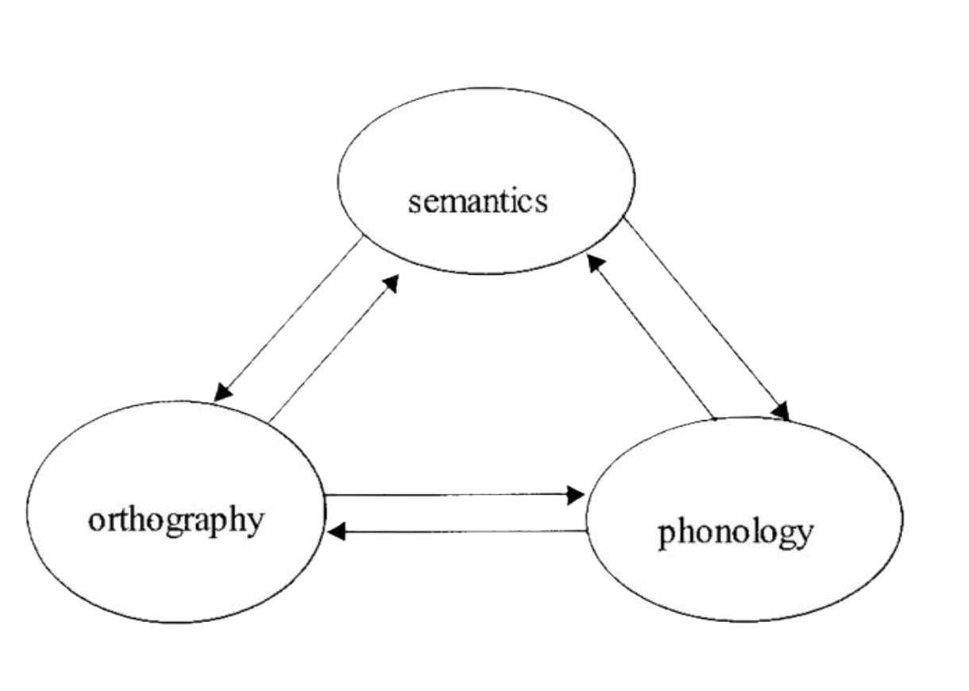
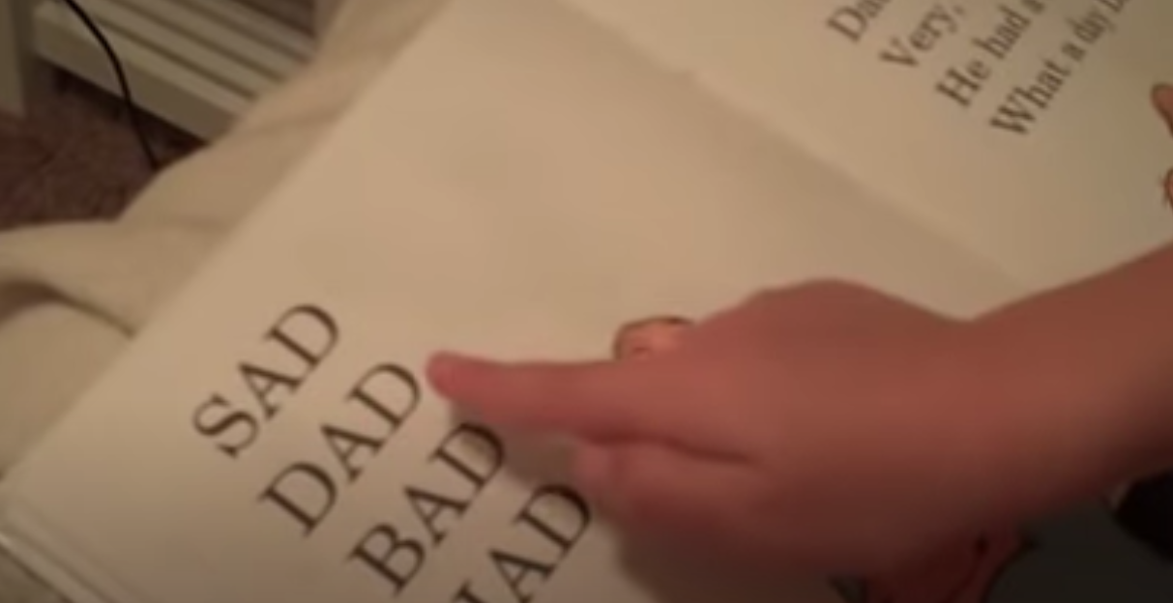
Word Recognition (code-focused skills)
Mapping sounds to letters and blending those sounds to form words (i.e., alphabetic principle).
Opportunities to practice decoding builds knowledge of letter sound patterns in words, increasing accuracy and fluency.
Over time, children become less reliant on phonetic decoding.
These skills are influenced by
  Phonology (speech sounds).
  Orthography (print symbols or letters).
  Semantics (word meanings).
Video 5: Learning to Read
21
Notes:
SAY These are the code-focused skills that support word reading and fluency. We will now watch a video of a child learning to read.
Show Video 5: Learning to Read (3:07).
How would you describe the child’s reading using the Simple View of Reading?
Discuss the relationship between word recognition and vocabulary.

Slide 22
Word Recognition
Word Recognition begins with understanding concepts of print, phonological awareness (building to phonemic awareness).
Children then begin to apply the alphabetic principle and move from beginning decoding to more advanced decoding.
Children become increasingly fluent in their ability to read words and connected text.
  Rate, accuracy, and expression
22
Notes:
SAY This slide explains how skilled decoding develops.

Slide 23
Comprehension (meaning-focused skills)
Good readers form a mental representation of text. This involves complex, higher-level mental processing (thinking, reasoning, imagining, interpreting).
Set a purpose for reading.
Apply knowledge of morphology, syntax, and grammar.
Make inferences.
Apply vocabulary knowledge.
Apply content and background knowledge.
Use knowledge of text structure.
Monitor understanding.
This process is the same whether listening to or reading text, and requires understanding at the word, sentence, and discourse levels to generate an accurate representation of text.
23
Notes:
SAY This slide provides the meaning-focused skills that support comprehension and explains what good readers do.
Ask the following questions:
What is comprehension?
What do readers need for effective comprehension?
In what way is comprehension more than testing understanding?

Slide 24
Discourse Level Processes
Reading for meaning
is dependent on listening comprehension or generating meaning from spoken words, sentences, or discourse.
requires word, sentence, and discourse levels of understanding to generate a clear, accurate representation of text or situation model.
requires application of foundational language skills (vocabulary, grammar).
requires application of advanced linguistic and cognitive processing to integrate world knowledge (domain content and/or interpersonal) with information from text to generate inferences.
is active and flexible as mental models are continually refined.
involves determining relevant and discarding irrelevant information.
requires knowledge of language and knowledge of the world.
24
Notes:
SAY Language comprehension involves several core processes, including letter and sound identification, the binding of those elements into words and sentences, the assignment of meaning to those parts, and potentially incorporating some of that information into memory. People rarely process single words or sentences without the supporting context that surrounds them. They more commonly experience large segments of language in textbooks, novels, newspaper articles, class lectures, and conversations. The goal of studying discourse processing is to understand how individuals build meaning from the extended language events that arise from natural communications.

Slide 25



Collaborate and Practice
Reading Development (K-12)
Video 6: Kindergarten
View videos from Kindergarten through high school.
Consider the cognitive (thinking) and linguistic (language) skills the child is applying when reading at this age/grade.
After viewing these videos, we will discuss the developmental progression we observe and describe this on Handout 4.
Video 7: Grade 5
Video 8: High School
25
Notes:
SAY We will now watch videos from Kindergarten, 5th grade, and high school that demonstrate reading development over time. After each video, stop and turn to your partner and share the cognitive (thinking) and linguistic (language) skills the child is applying. Then you will complete Handout 4.
Allow 15 minutes for this activity.
The length of Video 6 is 1:14.
The length of Video 7 is 2:02.
The length of Video 8 is 2:44.
After reviewing the elementary videos, stop and share with the large group the developmental progression observed (cognitive and linguistic).
After reviewing the high school video ask them to share with the large group the developmental progression observed (cognitive and linguistic).

Slide 26
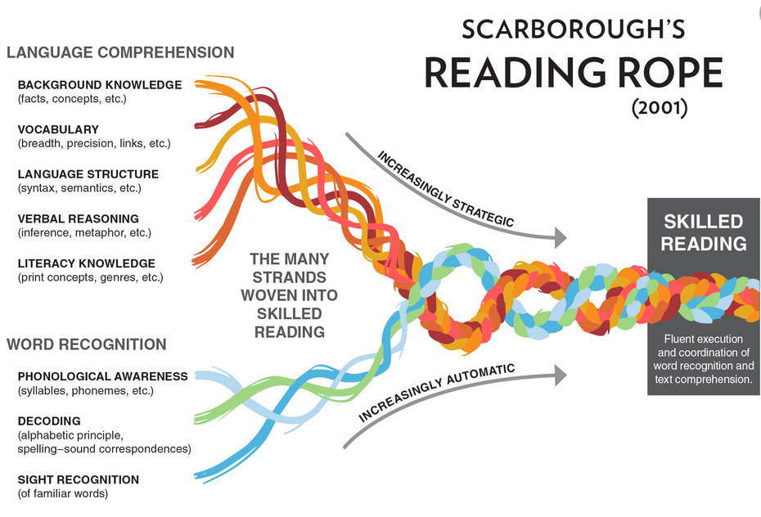
Reading Development and the Simple View of Reading
Word Recognition X Language Comprehension = Reading Comprehension
(Not so simple, is it?)
From the videos, you could see the developmental
progression observed using the Simple View of Reading.
It is important to integrate both decoding and language comprehension instruction from the start.
  Word reading skills
  Language comprehension skills that support
  listening comprehension
As children become increasingly effective decoders, emphasis on word reading skills decreases.
Video 9: Scarborough’s Reading Rope
26
Notes:
SAY Why is the Simple View of Reading far from simple? From the videos, you could observe integration with decoding and language comprehension from the earliest grades. The emphasis on word recognition typically decreases over time as readers become increasingly effective decoders and the role of the processes related to comprehension become more essential to understanding complex texts. It is essential to target all of these skills from the earliest grades. Video 9 on Scarborough’s Reading Rope, a visual representation of the Simple View of Reading, will walk us through an overview of this development.
The length of Video 9 is 1:31.

Slide 27
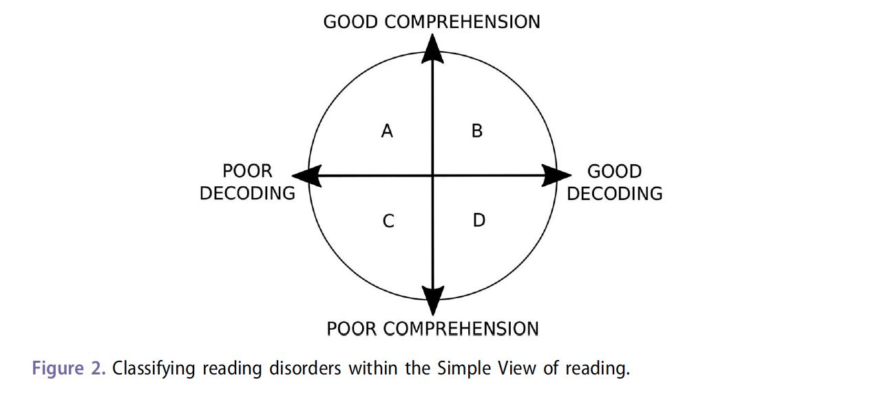
Classifying Reading Difficulties
When children are learning to read, reading comprehension is limited to decoding ability.
When children become better decoders, reading comprehension is increasingly associated with how well the learner comprehends language.
From the start, effective instruction requires practice and feedback targeting beginning, foundational skills (e.g., sound-letter correspondences, decoding, spelling) while also engaging the learner in more advanced language skills.
Nation, 2019; Tunmer & Hoover, 2019
27
Notes:
SAY The model from the Simple View of Reading can be used to explain the classification of reading difficulties.

Slide 28

Dyslexia
“…a difficulty with decoding and spelling fluency which is evident from early school years and persistent over time.” (Snowling et al., 2020 p. 507)
This difficulty also negatively impacts academic performance.
Can be mild, moderate or severe.
28
Notes:
SAY One reading difficulty that students may encounter is dyslexia. This slide provides a definition.

Slide 29
Dyslexia Continued
Fundamentally, dyslexia is a difficulty learning to decode and spell fluently.
  Difficulty applying newly acquired decoding skills to novel words
Dyslexia begins with problems in phonology that make it difficult to map sounds to graphemes (letters or letter combinations that represent a sound).
  Learning phonological skills improves reading skills, indicating that phonological skills are causally related to reading development.
  Problems with phonology manifest in the preschool years before children begin formal reading instruction.
Individuals with dyslexia often have difficulties in other areas including oral language problems that can impact language comprehension.
Snowling et al., 2020
29
Notes:
SAY Based on the definition and description of dyslexia, during which stages of language and literacy development does it develop? What are implications for instruction?

Slide 30
Specific Comprehension Deficit
Tends to be a smaller group than learners with word identification difficulties.
Experience difficulty with reading comprehension despite average or above average decoding skills.
Often identified later in elementary school when expectations shift from learning to read to reading to learn.
Adlof & Hogan, 2019; Catts et al., 2006
30
Notes:
SAY What are instructional implications for Specific Comprehension Deficit?
Possible response: Instruction for these students may need to focus on building vocabulary and background knowledge.

Slide 31
Learn and Confirm
Literacy learning processes and language development of English Language Learners and Students With Disabilities in collaboration with English for Speakers of Other Languages and Exceptional Student Education Departments
Read Handout 5: Effective Reading Intervention for Kids with Learning Disabilities.
Summarize your assigned section.
1. Introduction
2. Improving Word Recognition Skills: What Works?
3. Improving Reading Comprehension Skills: What works?
4. Evaluating Your Child’s Reading Program
Share your summary with the group.
While others are presenting, record a non-evaluative question to ask the presenter that may lead to collaborative discussion.
31
Notes:
NOTES
Determine whether this will be an individual or group activity. Assign each individual or group one section from the article to summarize. After participants complete the activity, ask for volunteers to share.
While sharing, remind participants to record a non-evaluative question to ask the presenter that may lead to a collaborative discussion. Ask for volunteers to share this question after each summary.
Allow 15 minutes for this activity.
SAY Please turn to Handout 5: Effective Reading Intervention for Kids with Learning Disabilities.
Each of you (or your group) will be assigned one section from this article to summarize and share with the whole group.
While others are presenting, you will record at least one non-evaluative question to ask the person sharing that may lead to a collaborative discussion

Slide 32


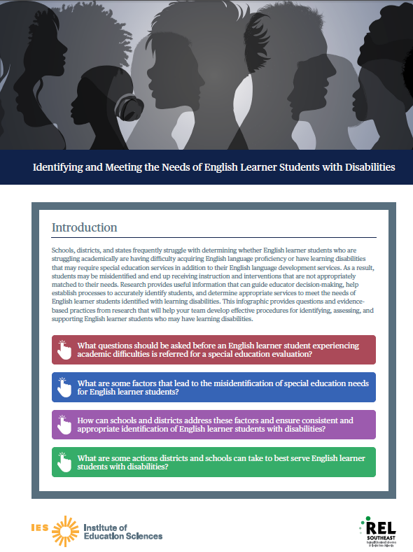
Evidence-Based Practices for Meeting the Needs of English Learners
Handouts 6, 7, and 8 are infographics containing guidance for educators in the implementation of evidence-based practices for elementary and secondary English Learner students and English Learners with disabilities. Review these infographics and consider how these practices may be carried forward in your local setting.
32
Notes:
SAY Handout 6 is a REL Southeast infographic that contains evidence-based instructional strategies for elementary English Learner students. Handout 7 is a REL Southeast infographic sharing evidence-based instructional strategies for secondary English learner students. Handout 8 is a REL Southeast infographic that provides evidence-based practices for identifying and meeting the needs of English Learner students with disabilities.
The practices on these infographics are a compilation of recommendations from IES/WWC practice guides on these topics along with other evidence-based sources. As you review these infographics, consider how these practices may be carried forward in your local school or district in collaboration with English for Speakers of Other Languages and Exceptional Student Education Departments.

Slide 33

Collaborate and Practice
REL West Tool: Assessing Professional Learning Needs for EL Teachers
Review Handout 9.
Work with a partner to select one or more of the resources (Handouts 5-9) that you feel would be helpful in your local setting.
Develop a plan on Handout 10 for how to use the selected resource(s) in your local setting in collaboration with ESOL and ESE Departments.
33
Notes:
SAY Handout 9 contains the introduction and overview of a tool from REL West designed to assess professional learning needs based on the IES/WWC Teaching Academic Content and Literacy to English Learners in Elementary and Middle School Practice Guide.
Review the pages of this guide and Handouts 5-9 with a partner and determine which of these would be helpful for you to use in your district or school to enhance literacy learning processes and language development of English Language Learners and Students With Disabilities in collaboration with English for Speakers of Other Languages and Exceptional Student Education Departments. Use Handout 10 to identify those resources and develop a plan for implementation.
Allow 15 minutes for this activity.

Slide 34
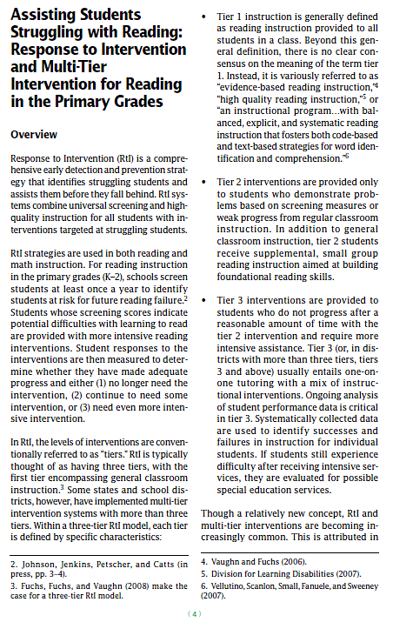
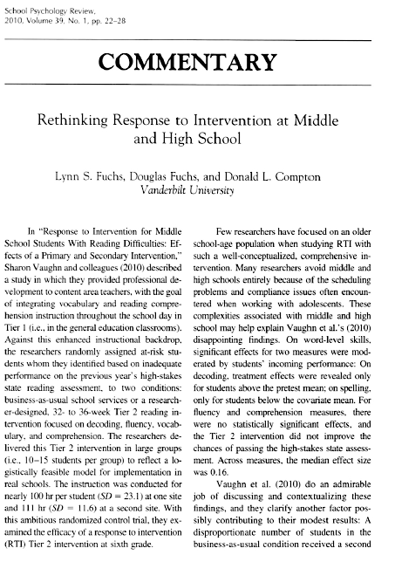
Learn and Confirm
Multi-Tiered System of Support and Evidence-Based Practices, Programs, and Interventions
Work with a partner to read one of these Handouts (Handout 11 or 12) and summarize recommendations and any potential roadblocks and solutions on Handout 13.
34
Notes:
SAY Handout 11 contains an overview of the IES practice guide: RtI for Reading in the Primary Grades and Handout 12 contains an article: Rethinking RtI at Middle and High School.
Read either Handout 11 or 12 with a partner and work to summarize the recommendations, potential roadblocks, and solutions on Handout 13.
Allow 15 minutes for this activity.

Slide 35

Learn and Confirm
Meeting the Needs of All Students
Video 10: Coach-Teacher Relationship is an overview of the importance of the coach-teacher relationship from Duval County exceptional student education teacher, Denise N. Pedro.
35
Notes:
SAY This brief video from Duval County exceptional student education teacher, and former Florida Literacy Association president, Denise N. Pedro, provides an overview of the importance of the coach-teacher relationship.
The length of this video is 2:56.

Slide 36

Reflect, Plan, and Implement
Post-Session Reflection, Planning, and Implementation
READ
Handout 14: Compelling Scientific Evidence on Reading Instruction.
Complete Self-Study 1: Compelling Scientific Evidence on Reading Instruction and Intervention.
Be prepared to debrief at the beginning of Session 13.
Video 11: How to Implement Effective Literacy Interventions.
DO
WATCH
36
Notes:
NOTE Participants will need to read Handout 14 and listen to Video 11 in order to complete Self-Study 1.

Slide 37

Questions?
Notes:
SAY Are there any questions that you have regarding the content of this session, the self-study activities, or the course in general?
Answer any questions.

Slide 38




We have completed
Session 12
Notes:
SAY This is the end of Session 12. Thank you for your participation!
Confirm the date and time of the next session and provide one final self-study assignment reminder.

