Slide 1
Fundamentals of Literacy Coaching
Professional Development Modules
Module 4, Session 13
Analyzing Implementation of Lessons With Teachers
Notes:
SAY Welcome to the Literacy Coach Program – Session 13: Analyzing Implementation of Lessons With Teachers

Slide 2
Module | Topic | Session | Minutes | Session Date
1 | Applying Principles and Practices that Foster a Positive Culture | Intro | 60
 |  | 1 | 120
 |  | 2 | 150
 |  | 3 | 150
2 | Applying Effective Pedagogy and Andragogy | 4 | 120
 |  | 5 | 120
 |  | 6 | 165
3 | Collecting Data to Inform Professional Learning | 7 | 150
 |  | 8 | 140
 |  | 9 | 170
4 | Planning, Implementing, and Analyzing Literacy Instruction | 10 | 175
 |  | 11 | 135
 |  | 12 | 165
 |  | 13 | 130
5 | Growing Professionally | 14 | 120
 |  | 15 | 120
6 | Planning and Implementing Coaching | 16 | 120
Notes:
NOTES
It is recommended that the sessions are completed in sequential order.
The timeline for completing the sessions can be flexible. If the recommended minutes for each session are not available, complete what you can with the time you have and then pick up where you left off the next time you meet.
Once a schedule of the sessions is established, have participants record the schedule in their Literacy Coach Program PD Guide if printed.
SAY Here is an overview of the modules and sessions of this course. There are six modules, and each module includes two to four sessions for a total of 15 content sessions. Module 1 addresses Applying Principles and Practices that Foster a Positive Culture, Module 2 covers Applying Effective Pedagogy and Andragogy, the focus of Module 3 is Collecting Data on Instructional Practices to Inform Professional Learning, the content of Module 4 is Planning, Implementing and Analyzing Standards-Based Literacy Instruction, the content of Module 5 is Growing Professionally, and the final module, Module 6, addresses Planning and Implementing Coaching.
You can record the date of each of our sessions in your Literacy Coach Program PD Guide.

Slide 3
Bridge to Practice Projects for Coaches
An activity designed to serve as a Bridge to Practice after each Module will provide evidence that coaches are able to apply the knowledge and skills they developed in this course in their schools. Coaches will complete the following activities:
A rubric is provided at the end of each Module for the corresponding Bridge to Practice project.
Module 1 | Develop a principal-coach partnership agreement.
Module 2 | Develop a needs assessment for professional development on evidence-based instructional practices and complete an ADDIE model for planning this professional development.
Module 3 | Develop and describe planned implementation of a professional learning action plan.
Module 4 | Create a video that reflects coaching to help teachers plan, implement, and analyze standards-based literacy instruction.
Module 5 | Complete a reflection on the course, including plans for continued professional growth.
Module 6 | Choose one teacher with whom you have seen significant growth as a result of coaching support and complete a reflection on what worked, why it worked, and which areas of growth were most evident.
Notes:
SAY We want to remind you that participating coaches will complete a bridge to practice project after each module. These projects will provide evidence that coaches are able to apply the knowledge and skills they developed in this course in their schools. You will learn more about each project as we work through the modules. We’ve shared an overview of the projects with you on this slide.
Coaches will
Module 1: develop a principal/coach partnership agreement;
Module 2: conduct a needs assessment for professional development on evidence-based instructional practices and complete an ADDIE model for planning this professional development;
Module 3: develop, implement, and evaluate a professional learning action plan;
Module 4: create a video that reflects coaching to help teachers plan, implement, and analyze standards-based literacy instruction;
Module 5: complete a reflection on the course including plans for continued professional growth.
Module 6: Choose one teacher with whom you have seen significant growth as a result of coaching support and complete a reflection on what worked, why it worked and which areas of growth were most evident.
You may turn in all your artifacts for the projects to your facilitator at the end of each module if requested.

Slide 4



Norms for Our Course
Cell phones on silent
Pay attention to self and others
Presume
positive intentions
Notes:
NOTES Consider your group to determine how much detail about the norms will be helpful to review.
SAY Professional learning opportunities usually consist of a team of educators, like us, that meet regularly to learn new topics, share ideas, and problem solve. We will build a community, meaning that we learn from each other, so sharing and participation are really important.
Professional learning opportunities typically have norms that the group can agree to in order to be productive. Here are three norms, or ground rules, for our way of work: cell phones on silent; pay attention to yourself and others; and presume positive intentions.
Pay attention to self and others This means to contribute, listen, and be aware of how you and others are responding to each other. Be sure to give everyone a chance to talk and encourage others who seem reluctant to join in. Sometimes people who are reluctant to talk are thinking. They may not be comfortable jumping in, but may have something important to say. Professional learning opportunities like this one encourage educators to learn from one another. Therefore, sharing, discussing and participating are important components.
Presume positive intentions This means to pause before responding. Usually when people contribute to a conversation, they intend to be constructive. So, always respond positively to keep the discussions productive.

Slide 5

Define and Discuss Session Goals and Content
Goals for Today
Learn how to observe and analyze the implementation of instructional practices and determine the effectiveness of teaching and learning in order to provide instructional support.
Learn how to develop a plan for effective coaching conversations informed by observations, data analysis, and classroom artifacts.
Notes:
NOTES Share and discuss these goals for today’s session.

Slide 6

Debrief
Review of Module 4, Session 12
Discuss the article, video, and self-study completed after Session 12, which focused on compelling scientific evidence on reading instruction and intervention.
Discuss any questions or comments regarding the last session.
Notes:
NOTES Allow about 7 minutes for this debrief. If you have a small group, ask for volunteers to share with the whole group. If you have a large group, consider having triads discuss and then ask for a volunteer from each triad to share with the large group.

Slide 7
Literacy Coach Domain and Standards: Session 13
D. Knowledge of and ability to apply effective methods for planning, implementing, and analyzing standards-based literacy instruction based on the science of reading and evidence-based practices. Coaches will demonstrate their abilities in and understanding of:
11. How to observe and analyze the implementation of instructional practices and determine the effectiveness of teaching and learning in order to provide instructional support.
12. Developing a plan for effective coaching conversations informed by observations, data analysis, and classroom artifacts.
Notes:
SAY We will now begin to focus on the content of the literacy coach domains and standards that will be covered during this session. Take a moment to review the domain and standards.

Slide 8

Learn and Confirm
Pedagogy – How Is It Taught?
Systematic & Explicit
Coordinated Instruction Sequences and Routines
Scaffolded
Ample Opportunities and Feedback
Differentiated
From Just Read, Florida! Reimagining Literacy Leadership
Notes:
SAY As we begin this session focused on the effectiveness of teaching and learning, it is important to review and consider the concepts of pedagogy that make teaching and learning effective.
Pedagogy is how content is taught. As part of a comprehensive ELA/reading curriculum, pedagogy should consist of:
Systematic and Explicit Instruction in a logical sequence and opportunities for the direct teaching of the standards.
Coordinated Instructional Sequences and Routines
Scaffolded Instruction, which refers to the support that is given to students in order for them to arrive at the correct answer. This support may occur as immediate, specific feedback that a teacher offers during student practice. For instance, the assistance the teacher offers may include giving encouragement or cues, breaking the problem down into smaller steps, using a graphic organizer, or providing an example.
Ample Practice Opportunities and Feedback
Differentiated Instruction

Slide 9

Learn and Confirm
Observing and Analyzing the Implementation of Instructional Practices and Determining the Effectiveness of Teaching and Learning in Order to Provide Instructional Support
Student-Centered Coaching
Student-centered coaching focuses on using student data to drive instructional decisions. Pedagogical changes are made according to student needs. Student data is used to focus on differentiation techniques and the art of teaching. As we know, no two students are exactly alike. They learn at different rates and have different abilities. It may be beneficial for coaches to work with teachers to adapt teaching to fit the needs of every individual student as possible. The goal is to ensure that EVERY student is provided opportunities to deeply engage in grade-appropriate assignments following strong instruction.
Notes:
SAY As noted in the video, there can be benefits to the alignment of instruction and intervention, which are common language and understanding (particularly if there is a different instructor for intervention) and cost effectiveness. It is also important to ensure that students are receiving intervention instruction that is aligned with their individual needs. Time for catch up growth is too precious to waste on intervention skills that students do not need. Regardless of the intervention materials used, it is imperative to ensure a logical scope and sequence of reading skill development.

Slide 10
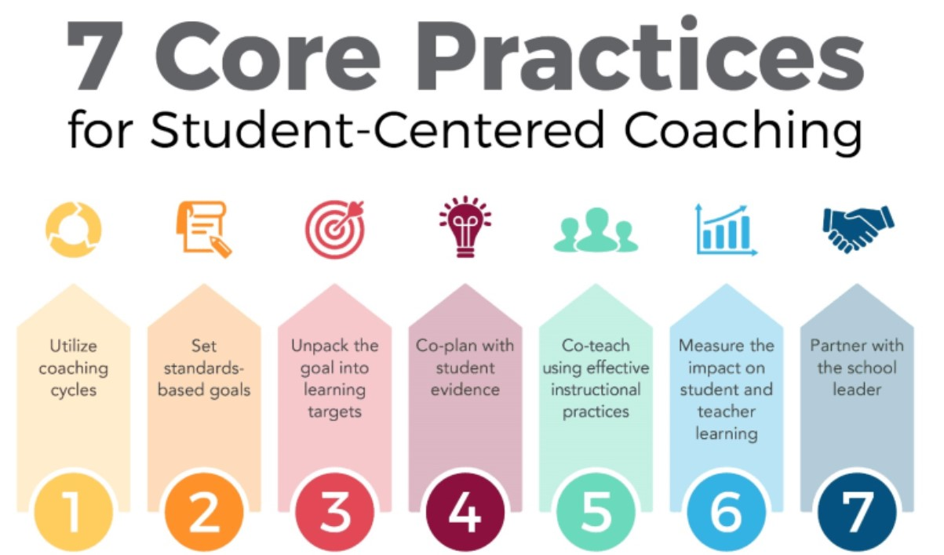
Student-centered Coaching
Notes:
SAY These are the 7 core practices for Student-centered coaching. I’ll share a little bit about each practice.
Organizing coaching through cycles: Coaching Cycles should be ongoing, aligned with standards and curriculum, focused on a goal that is set by the teacher, incorporating best instructional practices, and incorporating co-planning and co-teaching. Coaching cycles should be 4-6 weeks long with coaching/co-teaching/observations 1-3 times per week in the classroom during instructional time and include 1 weekly planning conversation (35-45 minutes long).
Setting goals for coaching cycles: Coaching cycle goals should be student-centered, standards focused, set by the teacher and focused on student pre-assessment data. Data should drive your instructional decisions.
Use standards-based learning targets: A Learning Target is a goal for students derived from standards, written in concrete, student-friendly language, tracked by students and teachers to assess growth and achievement about learning, and easily measurable.
Using student evidence to co-plan instruction: Student evidence includes information from observations and anything that makes student learning visible, performance assessments such as: reading and writing tasks, discussions with students, conferring notes and student work samples. Student Evidence usually doesn’t include summative assessments from the back of the book, bubble in assessments, or tasks that don’t involve reading, writing, or solving problems.
Co-teaching with a focus on effective instructional practices: There are many models of co-teaching. It may be most helpful for the classroom teacher to direct the coaching cycle. Coaches should co-plan, co-teach, and make decisions in conjunction with the teacher. Remember, it is the teacher’s classroom and you are a co-teacher, not an administrator. Also, in order for the teacher to successfully adopt the learning from the coaching cycle they will need to buy in to the process and feel that their voice is strong throughout the process. If they feel that the coaching cycle was truly a joint learning experience, they are more likely to follow through.
Measuring the impact of coaching on student and teacher learning: Coaches and teachers should constantly evaluate the impact of the coaching cycle. Use student data to inform decisions and drive instruction. As the coach, develop a plan for effective coaching conversations informed by observations, data analysis and classroom artifacts.
Partnering with the school leader: Support from administration is important. It is critical to share plans and communicate the process with leaders.

Slide 11
Observing and Analyzing the Implementation of Instructional Practices and Determining the Effectiveness of Teaching and Learning in Order to Provide Instructional Support
Pre-Conference: Planning to identify lesson outcomes and envision what students will be doing during the lesson that will indicate whether or not they have achieved those standards.
Lesson Observation: May focus on student performance indicating goal achievement, on-task behavior, or a particular student’s problem behavior OR collect data about techniques that teachers are striving to perfect: wait time, questioning strategies, proximity, movement, clarity of directions, etc.
Post-Conference: “What evidence demonstrates that students are progressing toward mastering the standard?”
Notes:
SAY The process outlined on this slide is a streamlined version of the Student-centered coaching framework that we will use to observe and analyze the implementation of an instructional practice.
Teacher observations can provide coaches with a great deal of information that can drive the coaching experience with a teacher. We need to be very clear that an observation conducted by a coach is NOT meant to be evaluative. Remember, the goal is to improve literacy instruction by determining a focus and setting impactful, attainable goals which will remove barriers and improve student achievement.

Slide 12
Observing and Analyzing the Implementation of Instructional Practices and Determining the Effectiveness of Teaching and Learning in Order to Provide Instructional Support
Observation-based and focused
Data collection that is agreed upon with the classroom teacher
Data collection used to determine possible coaching points
Notes:
SAY As noted in the student-centered coaching model, it is important to involve the teacher in determining the data that will be collected and the purpose of the observation. This embraces the collaborative nature of coaching.

Slide 13
Observing and Analyzing the Implementation of Instructional Practices and Determining the Effectiveness of Teaching and Learning in Order to Provide Instructional Support
Handout 1 is a template that could be used for planning a teacher observation. It has guiding questions for the pre-observation; space for notes during the observation itself; guiding questions for a post-observation conference; next steps; and follow-up.
Notes:
SAY Take a moment and review Handout 1, which can be used to document a teacher observation including a pre-conference, observation notes, post-conference, next steps, and follow-up. You may have a form that you already use for this purpose. If so, what kind of information does it capture?

Slide 14

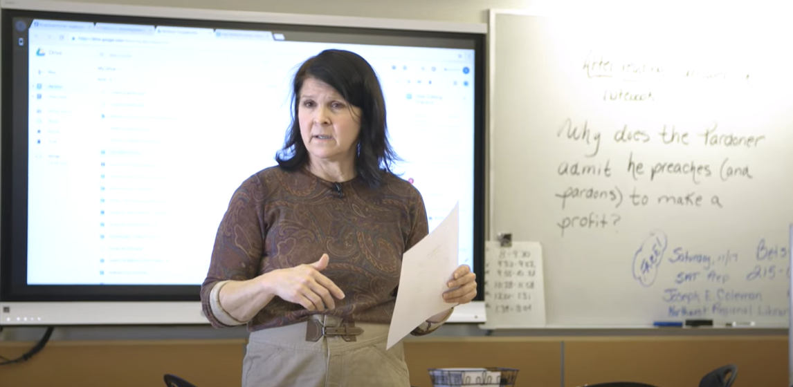
Collaborate and Practice
Bringing It All Together: Observing and Analyzing the Implementation of Instructional Practices and Determining the Effectiveness of Teaching and Learning in Order to Provide Instructional Support
Conduct a teacher observation using Handout 1 and Video 1: Gradual Release Model in a High School English Class.
The standard that the teaching addresses is “Improve writing by considering feedback from adults, peers, and/or online editing tools, revising for clarity and cohesiveness.” She is using the gradual release model to teach peer editing.
Notes:
Notes Allow 20 minutes for this activity. The video is 6:22 long.
SAY We are going to use Handout 1 to conduct a teacher observation. The teacher is using the gradual release model to teach the following standard: Improve writing by considering feedback from adults, peers, and/or online editing tools, revising for clarity and cohesiveness. In your small groups talk about the pre-observation questions. Formulate some potential answers for them. Assume the teacher has done some work with peer editing in that past, but not a great deal. I’ll give you a few minutes to talk with your group and then we’ll all conduct the observation. (Participants record their observation notes in Handout 1)
Discuss your notes with your small group, and then formulate answers to the debrief questions and considerations for next steps. Then we’ll share out with the whole group.
Whole group questions: What evidence does this observation provide that speaks to the effectiveness of the lesson? What instructional support may be helpful?

Slide 15

Learn and Confirm
Develop a Plan for Effective Coaching Conversations Informed by Observations, Data Analysis and Classroom Artifacts
Video 2: Post-Observation Coaching Discussion presents an effective coaching conversation
informed by an observation.
Handout 2: Video Viewing Guide for Video 2. Watch the video, complete the viewing guide,
and discuss at your tables.
Notes:
SAY Please review the questions on Handout 2: Video-Viewing Guide for
Video 2: Post Observation Coaching Discussion. Let’s watch a video of Dr. Enrique Puig lead a post observation coaching conversation.
NOTES
Allow 15 minutes for viewing the video and completing the handout. Show Video 2 (6 minutes) and allow time for participants to record their answers to the questions on Handout 2. Ask for volunteers to share their answers.
Possible responses for questions:
The coach keeps notes on times and activities. The coach works to transcribe verbatim what the teacher says and does. The coach keeps track of student activities, but keeps the students anonymous by assigning numbers.
The coach carefully analyzes the specific words that the teacher uses. He focuses on the nuances of that language (I want vs. you need, for example.)
What do you want ultimately for all your students? For life? How would your students respond if you taught in a way/used language to make them more independent? Do you agree? What do you think you’ll do differently tomorrow? Do you think that’s manageable? How do you think that your lesson went? After teacher response, “I think it went well…” – Better said, the 90-minute block?
The teacher responded directly at first but modified her responses several times after further probing and redirection. The teacher appreciated the further probing questions once considered. The teacher was in agreement with all of the decisions discussed. She realized the importance of the analysis of her teacher language.
The coach may need to get to know the students better and complete another observation focused on teacher language for independence to determine change/growth.
The teacher may need to consider changes in language focused on student independence and further consideration for time management.

Slide 16
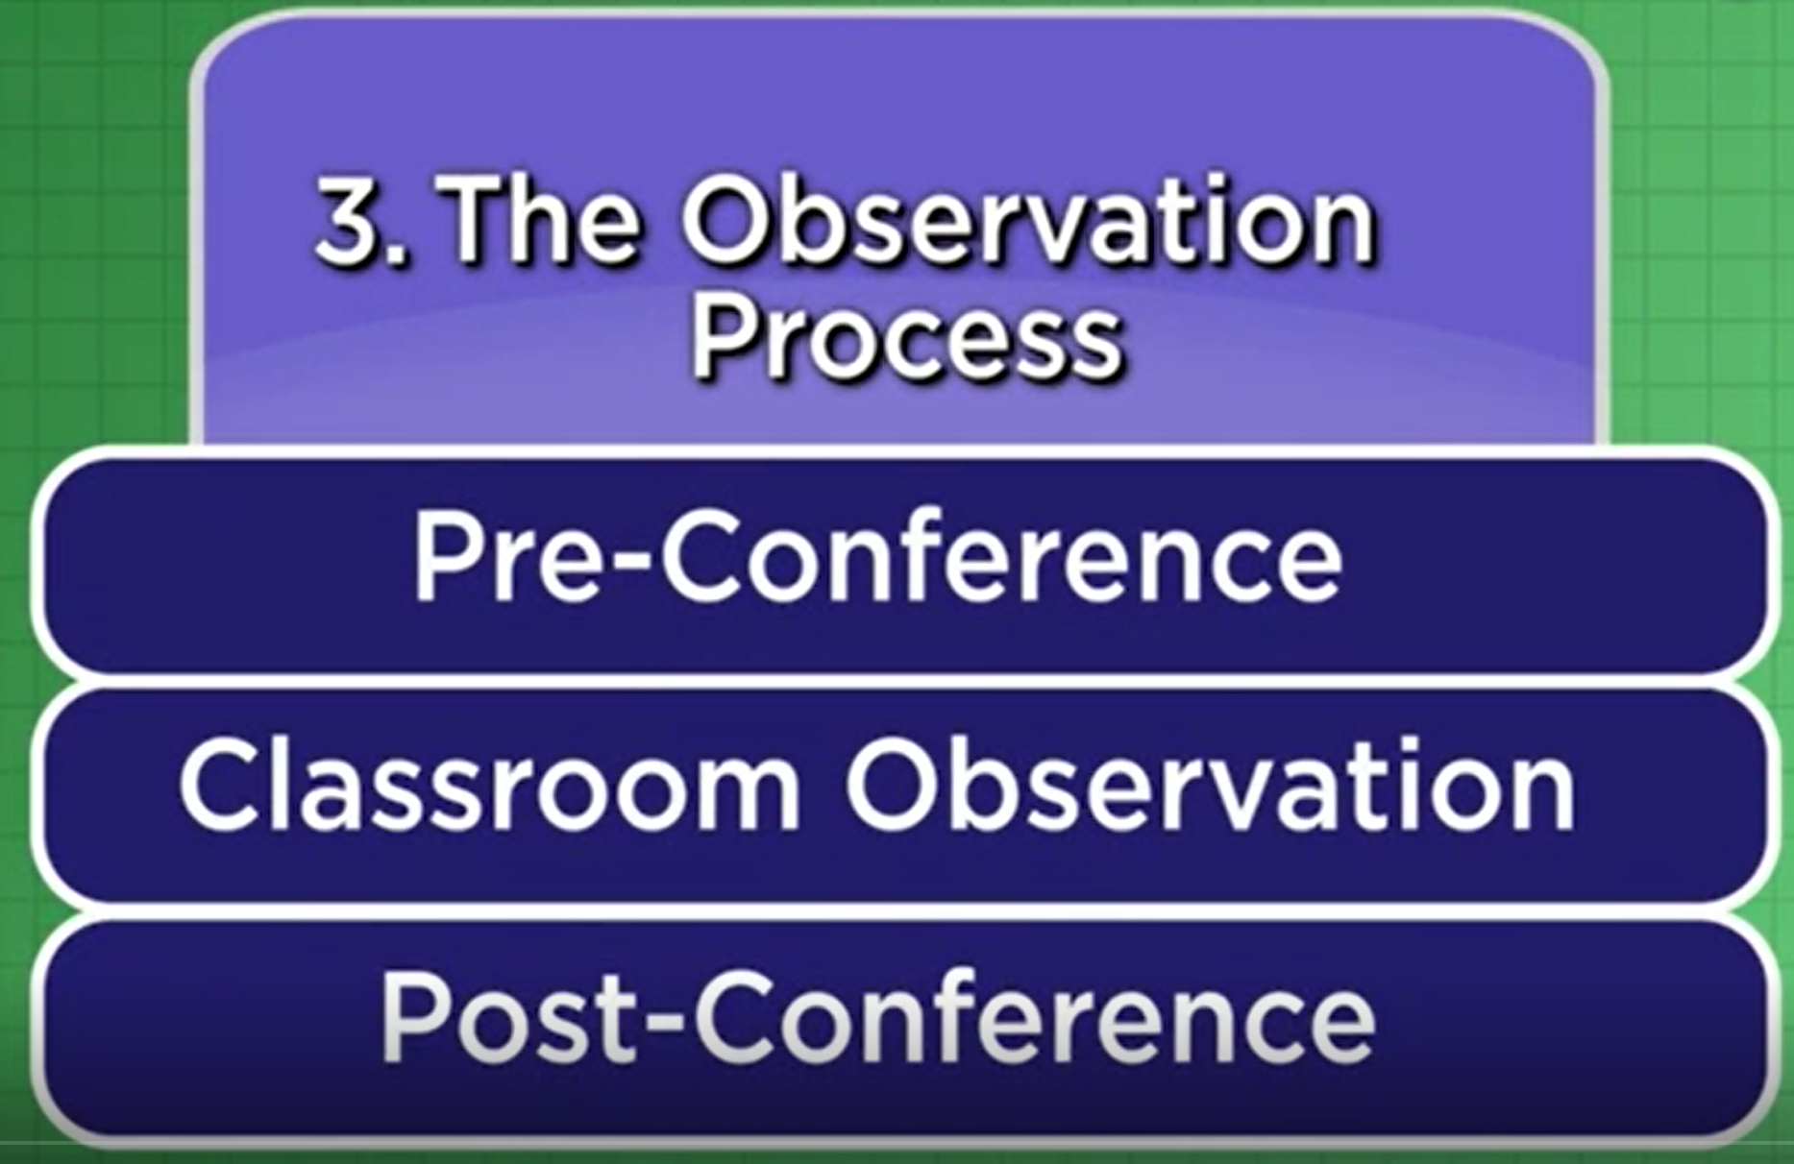
Collaborate and Practice
Develop a Plan for Effective Coaching Conversations Informed by Observations, Data Analysis and Classroom Artifacts
Video 3: Part 1 Pre-Observation Conference presents a pre-observation conference.
Handout 3: Coaching Conversation Planning Guide. Watch the video and then complete Coach Preparation Steps 1-3 with your table partners to the best of your ability, based on what you learned from the video. What additional information would be helpful?
Notes:
SAY Please review the questions for Coach Preparation Steps 1-3 on Handout 3: Coaching Conversation Planning Guide. Let’s watch a video of a pre-observation conference with a second grade teacher. Pay careful attention to the learning goal and targets that that the teacher describes and consider carefully the questions for Coach Preparation Steps 2 and 3. What information would still be helpful to have to plan for this observation as a coach?
NOTES
Allow 15 minutes for viewing the video and completing the handout. Show Video 3 (3:40 minutes) and allow time for participants to record their answers to the questions on Handout 3. Ask for volunteers to share their answers.

Slide 17

Collaborate and Practice
Develop a Plan for Effective Coaching Conversations Informed by Observations, Data Analysis and Classroom Artifacts
Video 4: Part 2 Classroom Observation presents an observation of an ELA lesson in a grade 2 classroom.
Handout 3: Coaching Conversation Planning Guide. Watch the video and then complete Coach Preparation Steps 4-5 with your table partners to the best of your ability, based on what you learned from the video. What additional information would be helpful?
Notes:
SAY Please review the questions for Coach Preparation Steps 4-5 on Handout 3: Coaching Conversation Planning Guide. Let’s watch a video of a classroom observation with a second grade teacher. What additional information would still be helpful to have in planning for a follow-up coaching conversation?
NOTES
Allow 15 minutes for viewing the video and completing the handout. Show Video 4 (4:35 minutes) and allow time for participants to record their answers to the questions on Handout 3. Ask for volunteers to share their answers.

Slide 18
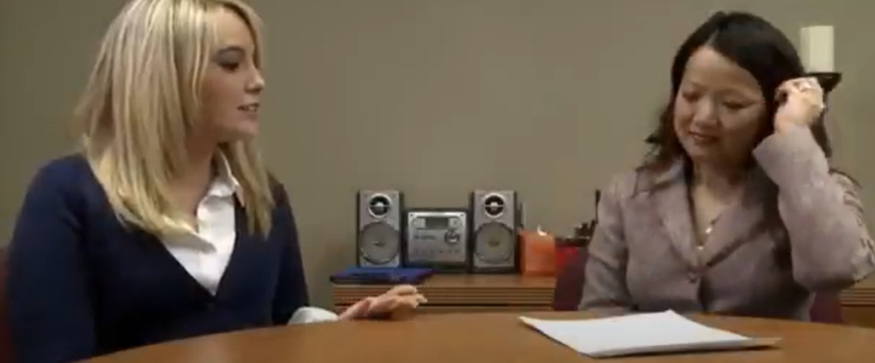
Collaborate and Practice
Develop a Plan for Effective Coaching Conversations Informed by Observations, Data Analysis and Classroom Artifacts
Video 5: Part 3 Post-Observation Conference presents a post-observation conference with a grade 2 teacher.
Handout 3: Coaching Conversation Planning Guide. Watch the video and then review your responses for Coach Preparation Step 5 with your table partners. What changes might you recommend for this post-observation conference?
Notes:
SAY Let’s watch a video of a post-observation conference with the same second grade teacher. After watching this video, please review the questions and your responses for Coach Preparation Step 5 on Handout 3: Coaching Conversation Planning Guide. What changes might you recommend for this post-observation conference?
NOTES
Allow 15 minutes for viewing the video and completing the handout. Show Video 4 (2:10 minutes) and allow time for participants to review their answers to the Step 5 on Handout 3 and discuss recommended changes. Ask for volunteers to share their answers.

Slide 19
Collaborate and Practice
Create a video that reflects coaching to help teachers plan, implement, and analyze standards-based literacy instruction
Read Handout 4: Video Rubric. Your culminating project for Module 4 will be to use Handout 4 as guidance to create a 15-30 minute video showing your ability to help a teacher plan, implement, and analyze standards-based literacy instruction along with a follow-up coaching conversation. Review Handout 4 and share any questions with your pair or small group and then with the whole group.
Notes:
NOTE Have each group or pair discuss the Video Rubric on Handout 4 and determine questions to prepare for the Bridge to Practice project for Module 4.
10 minutes: Activity.
SAY Please turn to Handout 4: Video Rubric.
Each of you (or your group) will discuss any questions about this handout and then each group will share thoughts and questions with the whole group.

Slide 20

Reflect, Plan, and Implement
Post-Session Reflection, Planning, and Implementation
READ Handout 5: Leveraging Video for Learning from the Center for Education Policy Research at Harvard University.
WATCH Video 6: Visibly Better.
DO Bridge to Practice: Complete Coaching Video using Handout 4: Video Rubric for video reflecting coaching to help teachers plan, implement, and analyze standards-based literacy instruction.
Be prepared to debrief at the beginning of Session 14.

Slide 21

Questions?
Notes:
SAY Are there any questions that you have regarding the content of this session, the self-study activities, or the course in general?
Answer any questions.

Slide 22



We have completed
Session 13
Notes:
SAY This is the end of Session 13. Thank you for your participation!
Confirm the date and time of the next session and provide one final self-study assignment reminder.

