Slide 1
Fundamentals of Literacy Coaching
Professional Development Modules
Module 5, Session 14
Analyzing Data to Grow as a Coach
Notes:
SAY Welcome to Fundamentals of Literacy Coaching Professional Development Modules – Session 14. This session is focused on analyzing data to help you grow professionally as a coach.

Slide 2
Module | Topic | Session | Minutes | Session Date
1 | Applying Principles and Practices that Foster a Positive Culture | Intro | 60
 |  | 1 | 120
 |  | 2 | 150
 |  | 3 | 150
2 | Applying Effective Pedagogy and Andragogy | 4 | 120
 |  | 5 | 120
 |  | 6 | 165
3 | Collecting Data to Inform Professional Learning | 7 | 150
 |  | 8 | 140
 |  | 9 | 170
4 | Planning, Implementing, and Analyzing Literacy Instruction | 10 | 175
 |  | 11 | 135
 |  | 12 | 165
 |  | 13 | 130
5 | Growing Professionally | 14 | 120
 |  | 15 | 120
6 | Planning and Implementing Coaching | 16 | 120
Notes:
NOTES
It is recommended that the sessions are completed in sequential order.
The timeline for completing the sessions can be flexible. If the recommended minutes for each session are not available, complete what you can with the time you have and then pick up where you left off the next time you meet.
Once a schedule of the sessions is established, have participants record the schedule in their Fundamentals of Literacy Coaching PD Guide if printed.
SAY Here is an overview of the modules and sessions of this course. There are six modules, and each module includes two to four sessions for a total of 15 content sessions. Module 1 addresses Applying Principles and Practices that Foster a Positive Culture, Module 2 covers Applying Effective Pedagogy and Andragogy, the focus of Module 3 is Collecting Data on Instructional Practices to Inform Professional Learning, the content of Module 4 is Planning, Implementing and Analyzing Standards-Based Literacy Instruction, the content of Module 5 is Growing Professionally, and the final module, Module 6, addresses Planning and Implementing Coaching.
You can record the date of each of our sessions in your Fundamentals of Literacy Coaching PD Guide.

Slide 3
Bridge to Practice Projects for Coaches
An activity designed to serve as a Bridge to Practice after each Module will provide evidence that coaches are able to apply the knowledge and skills they developed in this course in their schools. Coaches will complete the following activities:
A rubric is provided at the end of each Module for the corresponding Bridge to Practice project.
Module 1 | Develop a principal-coach partnership agreement.
Module 2 | Develop a needs assessment for professional development on evidence-based instructional practices and complete an ADDIE model for planning this professional development.
Module 3 | Develop and describe planned implementation of a professional learning action plan.
Module 4 | Create a video that reflects coaching to help teachers plan, implement, and analyze standards-based literacy instruction.
Module 5 | Complete a reflection on the course, including plans for continued professional growth.
Module 6 | Choose one teacher with whom you have seen significant growth as a result of coaching support and complete a reflection on what worked, why it worked, and which areas of growth were most evident.
Notes:
SAY We want to remind you that participating coaches will complete a bridge to practice project after each module. These projects will provide evidence that coaches are able to apply the knowledge and skills they developed in this course in their schools. You will learn more about each project as we work through the modules. We’ve shared an overview of the projects with you on this slide.
Coaches will
Module 1: develop a principal/coach partnership agreement;
Module 2: conduct a needs assessment for professional development on evidence-based instructional practices and complete an ADDIE model for planning this professional development;
Module 3: develop, implement, and evaluate a professional learning action plan;
Module 4: create a video that reflects coaching to help teachers plan, implement, and analyze standards-based literacy instruction;
Module 5: complete a reflection on the course including plans for continued professional growth.
Module 6: Choose one teacher with whom you have seen significant growth as a result of coaching support and complete a reflection on what worked, why it worked and which areas of growth were most evident.
You may turn in all your artifacts for the projects to your facilitator at the end of each module if requested.

Slide 4



Norms for Our Course
Cell phones on silent
Pay attention to self and others
Presume
positive intentions
Notes:
NOTES Consider your group to determine how much detail about the norms will be helpful to review.
SAY Professional learning opportunities usually consist of a team of educators, like us, that meet regularly to learn new topics, share ideas, and problem solve. We will build a community, meaning that we learn from each other, so sharing and participation are really important.
Professional learning opportunities typically have norms that the group can agree to in order to be productive. Here are three norms, or ground rules, for our way of work: cell phones on silent; pay attention to yourself and others; and presume positive intentions.
Pay attention to self and others This means to contribute, listen, and be aware of how you and others are responding to each other. Be sure to give everyone a chance to talk and encourage others who seem reluctant to join in. Sometimes people who are reluctant to talk are thinking. They may not be comfortable jumping in but may have something important to say. Professional learning opportunities like this one encourage educators to learn from one another. Therefore, sharing, discussing and participating are important components.
Presume positive intentions This means to pause before responding. Usually when people contribute to a conversation, they intend to be constructive. So, always respond positively to keep the discussions productive.

Slide 5

Goals for Today
Define and Discuss Session Goals and Content
Review Session 13 and debrief the self-study activities completed after the session.
Explore how to analyze individual performance data to determine and engage in professional learning to broaden your personal coaching and instructional knowledge.
Review previously developed principal-coach and coach-teacher partnership agreements.
Preview the self-study activities to be completed before Session 15.
Notes:
NOTES Share and discuss these goals for today’s session.

Slide 6

Review of Module 4, Session 13
Debrief
Discuss Handout 5: Leveraging Video for Learning from the Center for Education Policy Research at Harvard University.
Discuss Video 6: Visibly Better.
Discuss any questions regarding Session 13.
Submit the Bridge to Practice Project for Module 4 - coaching video.
Notes:
NOTES Allow about 7 minutes for this debrief.
If you have a small group, ask for volunteers to share with the whole group. If you have a large group, consider having triads discuss and then ask for a volunteer from each triad to share with the large group.

Slide 7
Literacy Coach Domain and Standards: Session 14
E. Ability to grow professionally. Coaches will be able to:
1. Analyze individual performance data to determine and engage in professional learning to broaden personal coaching and instructional knowledge.
Notes:
SAY This module has two sessions and focuses on growing professionally. This session will address the standard on the slide which relates to analyzing performance data in order to identify your own needs for professional development and to think about how you will obtain that professional development.

Slide 8
"Data are not taken for museum purposes; they are taken as a basis for doing something. If nothing is to be done with the data, then there is no use in collecting any.”
William Edwards Deming
The New Economics for Industry, Government, and Education
Notes:
SAY William Edwards Deming was an engineer, statistician, and professor who was thought by many to be a master of continual improvement. Although he worked primarily in the business world, this quote definitely pertains to education as well as business. In this session we will be talking about collecting and analyzing data that is related to your performance as a coach. Although the session focuses on collecting and analyzing data, we know that next steps must be taken. We must use the data to increase our knowledge and improve our quality of coaching services to our teachers.

Slide 9

Meeting the Standard
Learn and Confirm
What is “individual performance data”?
How do you use it to determine your own needs as a coach?
What can you do to learn more about coaching and instruction?
Notes:
SAY In order to meet this standard, we first have to know what individual performance data is and how we collect it. We also need to understand how we use it to determine our needs as a coach. After we have a clear understanding of our own needs, then we can think about what to do to learn more about the aspects of coaching and instruction that may improve our coaching.
First, when we talk about individual performance data, we are thinking about data that reflects if we accomplished the goals that we or someone else established for us, and how well we did that. We’ll talk a little bit about where we might obtain those data in a few minutes. We’ll also discuss how we use those data to determine our needs to continue our professional learning in specific areas, and we’ll think about some ways that we can ensure we are continuing to grow and develop as a coach.

Slide 10
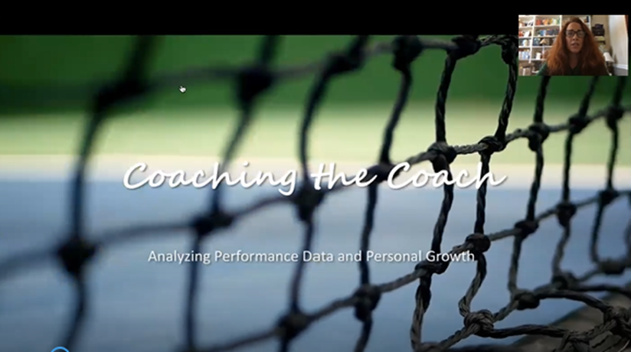
Video 1: Coaching the Coach
Notes:
Notes Play and discuss the video after you introduce it. Allow about 10 minutes for this. The video is 6:46 minutes long.
SAY To help us answer some of the questions on the preceding slide we wanted to get some advice from someone who has been doing the work of a coach for a long time. Mellissa Alonso Teston has served as a coach in our state for many years and has also coached coaches. Let’s listen to what she has to say about growing as a coach.

Slide 11
Sources of Individual Performance Data
Principal-Coach Partnership Agreement
Coach-Teacher Partnership Agreement
Coaching Logs
Classroom Walkthrough Data
ADDIE Model Adapted for Instructional Coaches
Self-assessments
Other
Notes:
SAY In order to determine the type of data we need to collect, we need to revisit the principal/coach partnership agreement, and the coach/teacher partnership agreement. In addition, we may want to use the ADDIE Model adapted for Instructional coaches. We’ll talk about what that looks like in a few minutes. Classroom walkthroughs and self-assessments are good sources of data as well.
Throughout our course we have talked a great deal about using data to help teachers make decisions. Most of the time we are talking about student data. While student data can be helpful, when we talk about “individual performance data” we are talking about data that can assist you in determining your progress toward goals that have been established for your coaching. This may be student data, but it also may be data that might be collected in a coaches log that documents the teachers you work with, how often, and the progress toward goals that have been established. What other data do you think might be helpful as you reflect upon your practice?

Slide 12
Analyzing Data Using Your Principal-Coach Partnership Agreement
Revisit:
The teachers you are working with
The goals that were established and their criteria
The progress that has been made and how that progress has been documented
Notes:
SAY Reflection should include analyzing data and occur throughout the course of the year. Self-reflection is valuable, but also taking time to reflect with your administrator is also important. For both of these, among other things, you may want to think about the teachers that you are working with, the goals you established with your principal, and the progress that has been made.

Slide 13
Analyzing Data Using Your Principal-Coach Partnership Agreement
Determine:
If you need to continue working with the same teachers or identify others
If you have met your goals, and if you need to establish new ones
If you have not met your goals, whether the progress that has been made is adequate
Resources that can help you grow as a coach so you can progress toward your established goals
Notes:
SAY Think about the teachers you are working with - – have they responded as you hoped? Have you established good relationships with them? Do you need to keep working with them or identify others? What goals did you and your principal establish – are you making progress? If not, what are some next steps? If so, is there anything that needs to be done differently, or do additional goals need to be considered?

Slide 14
Analyzing Data Using Your Principal-Coach Partnership Agreement
In your small groups talk about:
How many teachers are you working with—do you have enough time to adequately coach them?
What are the coaching goals you and your principal established? What progress are you making? How do you know?
What support has your principal agreed to provide—is this enough?
What is going well and how do you know?
What is challenging and how do you know?
What do you need to grow as a coach?
Notes:
NOTES Allow 15 minutes for this activity. Ask participants to review their principal/coach partnership agreement and then talk about the questions on the slide.
SAY Please take a few minutes to reflect on the agreement you have with your principals. Talk about the questions on the slide. Please don’t divulge any confidential information

Slide 15
Analyzing Data Using Your Coach-Teacher Partnership Agreement
Revisit:
The goals that were established and their criteria
The progress that has been made and how that progress has been documented
Notes:
SAY In addition to the principal/coach partnership agreement, the coach/teacher partnership agreement and the data collected that pertains to it, should be reflected upon often. Remind yourself of the goals you established with your teachers and their criteria. Be sure to document the progress that you’ve made and reflect upon it throughout the year. You can reflect on your own or meet with teachers to reflect together on how far you’ve come.

Slide 16
Analyzing Data Using Your Coach-Teacher Partnership Agreement
Determine:
If you have met your goals, and if you need to establish new ones
If you have not met your goals, whether the progress that has been made is adequate
Resources that will help you develop your coaching abilities and knowledge base to better serve your teachers
Notes:
SAY Reviewing the data you have collected, determine if and when the goals you established have been met. Did you establish short-term and longer-term goals? Do you need to create new goals? If you are not happy with your progress, what do you need to do?

Slide 17

Coach-Teacher Collaboration
Video 2: Coaching for Collaboration
Notes:
Notes Play and discuss the video after you introduce it. Allow about 6 minutes for this. The video is 4:58 minutes long.
SAY To help us consider some of the ways to increase coach/teacher collaboration and partnership, we wanted to get some advice from someone who has been supporting coaches for a long time. Whitney Augustine has served as a coach and a district supporter of coaches in our state for many years. Let’s listen to what she has to say about growing as a coach through cultivating and supporting collaboration among teachers.

Slide 18
Reviewing the Coach-Teacher Partnership Agreement
In your small groups talk about:
Are the goals for all your teachers the same or similar?
How are you monitoring progress?
Have you completed some goals? If so, do you need to establish new ones?
How much time are you spending with your teachers?
How are you differentiating?
Describe how you are establishing positive relationships with the teachers you serve.
Notes:
NOTES Allow 15 minutes for this activity. Ask participants to review their coach/teacher partnership agreement and then talk about the questions on the slide.
SAY Please take a few minutes to reflect on the agreement you have with the teachers you serve. Talk about the questions on the slide. Please don’t divulge any confidential information.

Slide 19
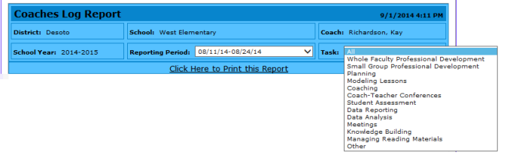
Using Data from Coaching Logs as Individual Performance Data
Components of a coaching log may include:
Time spent in various activities
Teachers who are being coached
Activities such as whole or small-group professional development and individual coaching sessions as well as the content of that coaching
Next steps
Notes:
SAY Coaching logs may be implemented by the district, school, or individual coach. These logs can be valuable in that they provide you with data you can reflect upon to determine how much time you are spending in meaningful coaching activities, which teachers you are coaching and how much time you are spending with them, the content of your coaching and how you are conducting it (small group, whole group, individually), and any next steps you need to take. This can tell you if you need to adjust your time because you are devoting too much time to activities that are not coaching (attending meetings, substituting for someone, etc.), if you are addressing the content you need to in order to meet your goals, and what you think you need to do next. An electronic form of a coaching log might be helpful as it could track the data over time and may be quicker to complete. Do you complete a coaching log? How often? And how do you use the data?

Slide 20
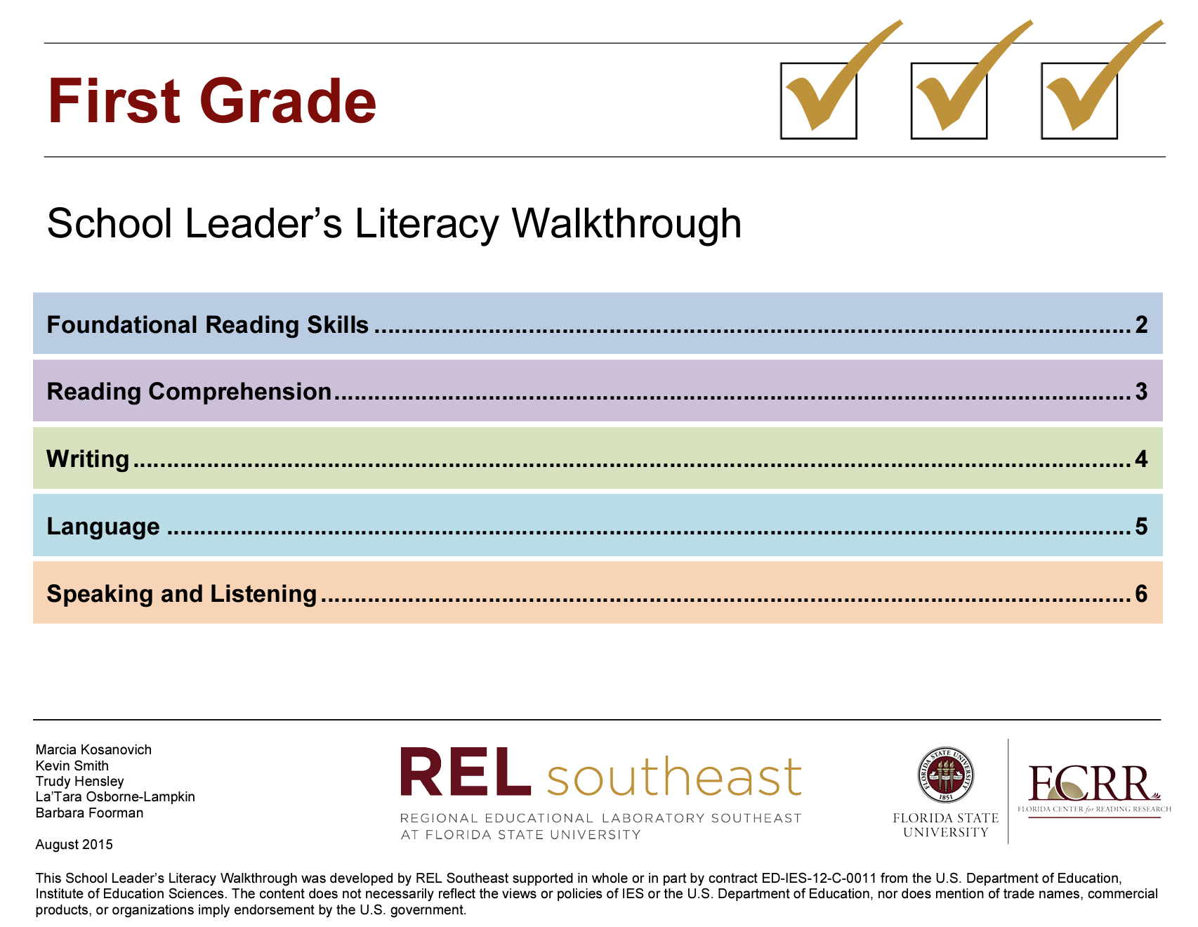
Using a Classroom Walkthrough to Collect and Analyze Individual Performance Data
Use the data you collect with a classroom walkthrough tool to answer questions like:
Do I see residue of my coaching in the lesson?
Do I need to spend more time with this teacher?
Is there evidence that I am making progress toward my goals?
Notes:
SAY You can collect and analyze classroom walkthrough data to improve your own performance as a coach. The goals you have as a coach are to help teachers change their practice based on professional development that has been provided, and then to see an increase in student achievement. Is that happening? If not, what do you need to do? If so, what do you do to get to the next level?

Slide 21
Revisiting the ADDIE Model
The ADDIE Model was first presented in Module 2.
The ADDIE Model is a five-step instructional design and project management tool commonly used to develop, implement, and evaluate performance improvement services.
An adapted version has been developed to help with implementation of the coaching process.
Notes:
SAY The culminating project for Module 2 involved conducting a needs assessment for professional development on evidence-based instructional practices and completing an ADDIE model for planning the professional development to meet that need. The five-step ADDIE model has been adapted to assist with implementation of the coaching process throughout the course of the school year. In the next few minutes, we’ll refresh our memories regarding the basic principles of the model and show how it has been adapted.

Slide 22
Revisiting the ADDIE Model
Some core values and principles of the ADDIE Model include:
A focus on outcomes
A systems perspective
The intent to add value
The effort to be systematic in all aspects in the design of interventions and solutions
Notes:
SAY These core values and principles are the same whether the ADDIE model is being used as a guide to develop specific professional development or to plan for coaching throughout the year.
Review the slide
SAY Let’s look at the Addie model that has been adapted to reflect data collection and use for the instructional coach.

Slide 23
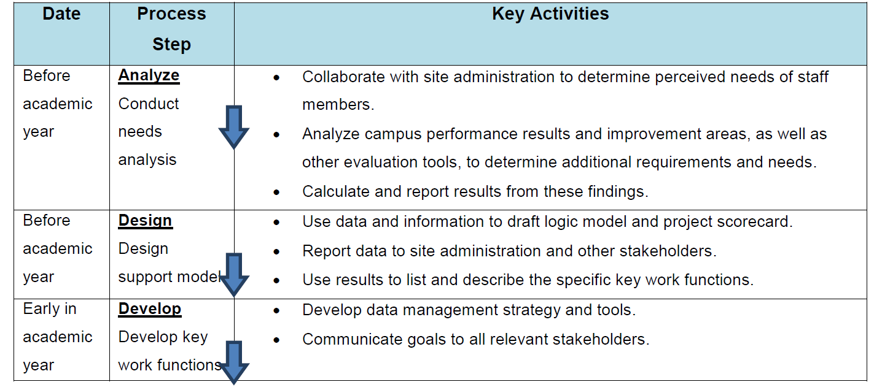
The ADDIE Model Adapted for an Instructional Coach
Notes:
SAY This ADDIE model was not adapted specifically for literacy coaches but was rather designed to be applicable to all types of instructional coaches. It includes a timeline, process steps, and key activities that can assist in the implementation of the process step. Here you see several steps that you might want to take before the school year begins or early in the year:
Conduct a needs analysis – this could be done with your principal.
Design a support model – that is decide what needs to be done to meet the needs you have identified and how you can be sure you are intentional about addressing the needs.
Develop some key work functions. This involves deciding what data are going to be collected to measure progress toward goals and ensuring that goals are communicated with all stakeholders, meaning teachers, other staff, and perhaps even students.
5 minutes: Ask if there are other key activities they think might be helpful in the implementation of the process steps.

Slide 24
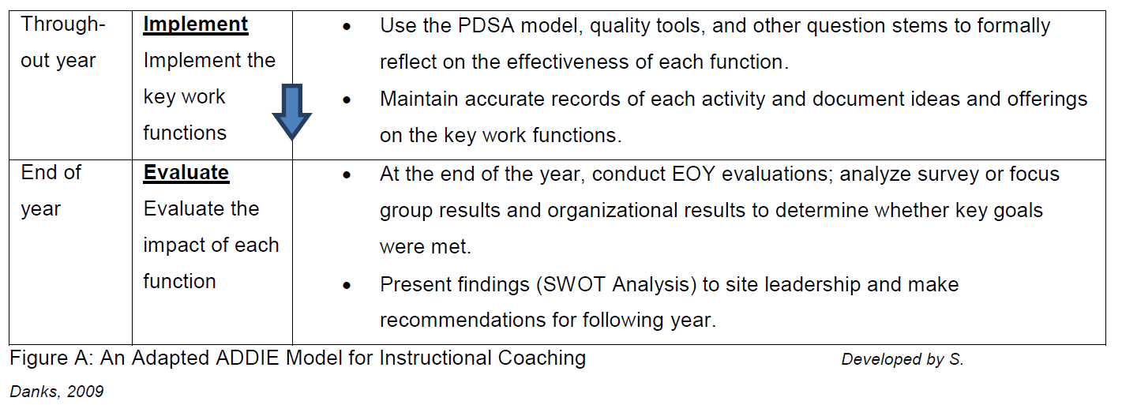
The ADDIE Model Adapted for an Instructional Coach
Notes:
SAY Here you see the timelines for the process steps you could implement during the course of the year and at the end of the school year. Throughout the year you should implement the Plan-Do-Study-Assess model to ensure that you are making progress toward your goals. At the end of the year you will want to conduct an end-of-year evaluation and present the findings of your analysis that identifies Strengths-Weaknesses-Opportunities-Threats to leadership at the school. This will help you to make recommendations for the following year.
5 minutes: Discuss other key activities that might be helpful in implementing these process steps.

Slide 25
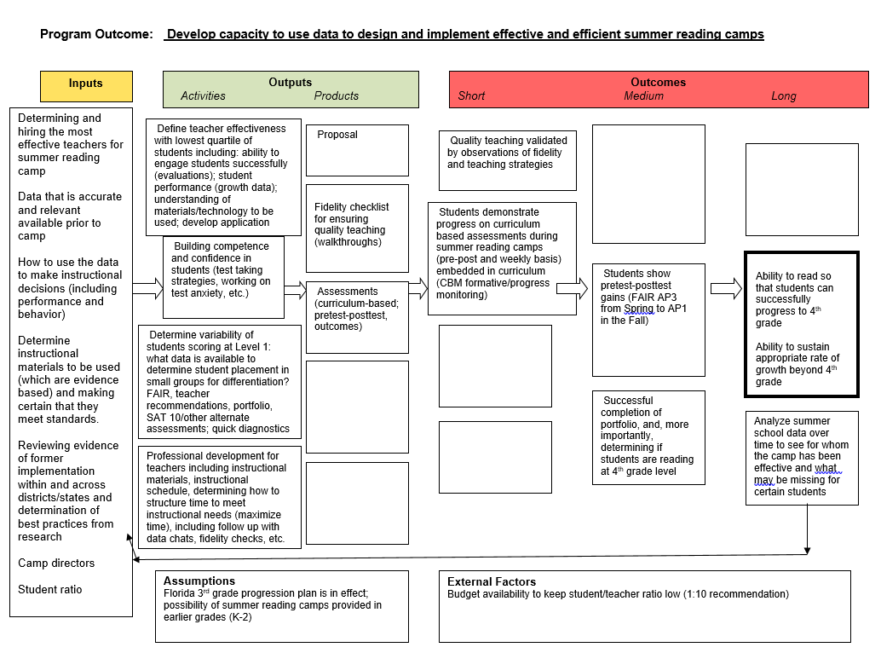
Notes:
SAY One of the key activities that could help in designing a support model – that should occur before the beginning of the school year – is developing a logic model. This is an example of a logic model for implementation of summer reading camps. Notice there are inputs which are all of the resources that are available. Now let’s skip over to the goals. You see two short-term goals, two medium term goals, and two long term goals. In the middle of the logic model, you see the outputs – those are activities and products that will help move you towards your goals. Finally at the bottom of the logic model you see some assumptions that we can make and also some external factors that are beyond our control. It is important to recognize these as we build the logic model. A logic model like this can help us think through what we want to accomplish as coaches and what it will take to get us there.

Slide 26

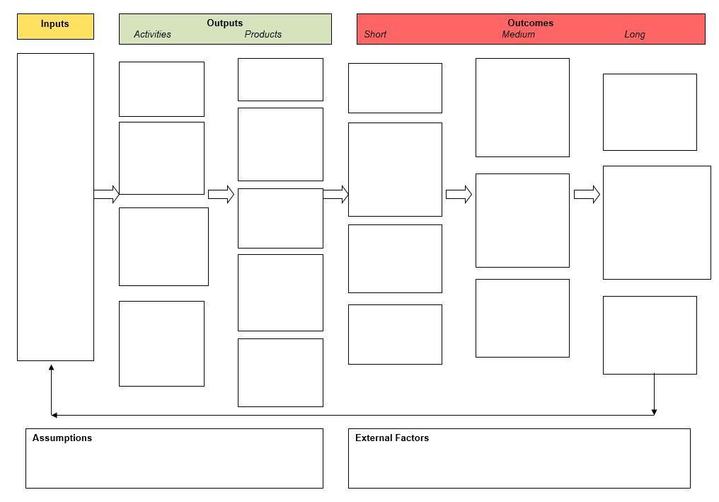
Collaborate and Practice
Notes:
Notes Allow about 15 minutes for this activity. You will lead a discussion and work together with participants to complete the logic model based on the scenario in Handout 1: Scenario for Logic Model.
SAY We are going to work together to complete a logic model based on the scenario in Handout 1. Take a few moments to read through the handout. Talk in your small groups about what your short-, medium- and long-term goals should be. You can use Handout 2: Blank Logic Model Template to guide your discussion.
Possible responses from participants regarding goals
Short term goals could include establishing a specific number of vocabulary words that should be taught; establishing how many read alouds are conducted; ensuring that teachers are explicitly teaching vocabulary.
Medium term goals could include increasing the number of words kindergarten students know at the middle and end of the year, increasing the number of words that students are using in their oral language at the middle and end of the year.
Long term goals could include sustaining practices for improving oral language and vocabulary skills from year-to-year; sustaining and continuing to increase the number of words students know and use in their oral language over time.
SAY Now let’s think about the inputs – or resources we have – to help us meet our goals.
Possible responses from participants regarding inputs:
Teacher expertise
Coaching
Vocabulary program
Classroom libraries
Media specialist
SAY What kind of activities would be helpful to conduct to make progress toward our goals?
Possible responses from participants regarding activities:
Dialogic reading
Intentional conversations and discussions that support the use of language
Explicit instruction in vocabulary
SAY What kinds of products might be helpful?
Possible responses from participants regarding products:
Informal vocabulary assessments
Logs of books read along with words taught
Play centers designed for cultivating oral language
SAY Let’s think about assumptions and external factors. Assumptions include anything that affects the work that we can assume to be true. For example, maybe we have to assume that most students need to improve their vocabulary and oral language skills. Or we might be able to assume that there is time in the day to conduct vocabulary instruction. What other kinds of assumptions might you make?
Possible responses from participants regarding assumptions:
Teachers are willing to implement practices introduced by the coach.
The coach will spend time in classrooms supporting teachers.
SAY Now let’s think about external factors – these are factors that you may or may not be able to control that might affect the work. For example, an external factor might be limited budget to purchase additional read-aloud books. What other external factors might affect the work?
Possible responses from participants regarding external factors
Varied levels of family support.
Consistent or lack of consistent school attendance.
SAY You can see how the logic model might guide you as you conduct professional development related to building vocabulary and oral language skills with kindergarten teachers and then support teachers as they implement what they have learned.

Slide 27
Logic Model Data – Think-Pair-Share
What kind of data can be collected that is related to the logic model we just created?
How might you use these data to help you grow as a coach?
Notes:
Notes Allow five minutes for participants to discuss the questions on the slide with a partner. Then ask some participants to share out.
Possible responses from participants (based on prior possible responses - these could vary depending on the goals established by participants on the prior slide):
Documentation of the establishment of the number of words that should be taught.
Documentation of the number of read alouds that are conducted.
Checklist to collect data on explicit teaching practices.
Documentation regarding the increase in vocabulary words taught.
Formal assessments of oral language use and vocabulary.
This data could help coaches to ensure that their coaching was on target, or help them to become aware that adjustments need to be made so they can better serve their teachers.

Slide 28
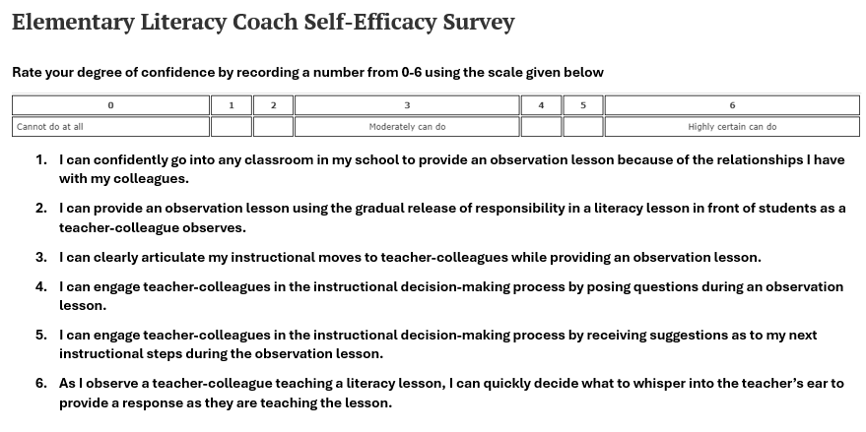
Analyzing Self-Assessment Data
Self-assessments in conjunction with other data can help to identify areas where you are strong and where you might need additional professional development.
Notes:
SAY How you feel about your own coaching performance is an important component of determining your own need for professional development. Even if you seem to have good results with a particular component of coaching, if you don’t have confidence in yourself, you may gain that confidence by learning more about that particular component. You will complete a self-efficacy survey as part of your self-study work after we conclude this session.

Slide 29
Summing It All Up…
What data do you think will be most helpful as you plan for professional learning to broaden personal coaching and instructional knowledge?
Who will you need to talk with to help you analyze the data?
How often do you think you should analyze data in order to make decisions regarding your own professional development?
What kind of professional development does your district have available for coaches?
Notes:
SAY As we conclude Session 14, discuss these questions in your small groups. Be prepared to share out in whole group when you conclude your discussion.
10 minutes – Allow time for participants to discuss in small groups and then share out in whole group.

Slide 30

Post-Session Reflection, Planning, and Implementation
Reflect, Plan, and Implement
READ
Handout 3: The ADDIE Model: Designing, Evaluating Instructional Coach Effectiveness
Complete Self-Study 1: Reflecting on the ADDIE Model.
Complete Self-Study 2: Elementary Literacy Coach Self-Efficacy Survey.
Reflect on your participation in Session 14 by completing Self-Study 3: Reflection and noting any questions. Bring the self-study assignments to Session 15.
Video 3: Everybody Needs a Coach. Be prepared to debrief at the beginning of Session 15.
DO
WATCH
Notes:
NOTE Spend time discussing the self-study participants will complete before Session 15.

Slide 31

Questions?
Notes:
SAY Are there any questions that you have regarding the content of this session, the self-study activities, or the course in general?

Slide 32




We have completed
Session 14
Notes:
SAY Congratulations on successfully completing Session 14! We look forward to seeing you at Session 15! We’ll begin that session by debriefing on the self-study assignments which include an activity sheet that you complete where you will reflect on Session 14.
Confirm the date and time of the next session.

