Slide 1
Fundamentals of Literacy Coaching
Professional Development Modules
Module 2, Session 4
Effective Practices in Teaching Students
Notes:
SAY Welcome to Fundamentals of Literacy Coaching Professional Development Modules – Session 4: Establishing Expectations.

Slide 2
Module | Topic | Session | Minutes | Session Date
1 | Applying Principles and Practices that Foster a Positive Culture | Intro | 60
 |  | 1 | 120
 |  | 2 | 150
 |  | 3 | 150
2 | Applying Effective Pedagogy and Andragogy | 4 | 120
 |  | 5 | 120
 |  | 6 | 165
3 | Collecting Data to Inform Professional Learning | 7 | 150
 |  | 8 | 140
 |  | 9 | 170
4 | Planning, Implementing, and Analyzing Literacy Instruction | 10 | 175
 |  | 11 | 135
 |  | 12 | 165
 |  | 13 | 130
5 | Growing Professionally | 14 | 120
 |  | 15 | 120
6 | Planning and Implementing Coaching | 16 | 120
Notes:
NOTES
It is recommended that the sessions are completed in sequential order.
The timeline for completing the sessions can be flexible. If the recommended minutes for each session are not available, complete what you can with the time you have and then pick up where you left off the next time you meet.
Once a schedule of the sessions is established, have participants record the schedule in their Fundamentals of Literacy Coaching PD Guide if printed.
SAY Here is an overview of the modules and sessions of this course. There are six modules, and each module includes two to four sessions for a total of 15 content sessions. Module 1 addresses Applying Principles and Practices that Foster a Positive Culture, Module 2 covers Applying Effective Pedagogy and Andragogy, the focus of Module 3 is Collecting Data on Instructional Practices to Inform Professional Learning, the content of Module 4 is Planning, Implementing and Analyzing Standards-Based Literacy Instruction, the content of Module 5 is Growing Professionally, and the final module, Module 6, addresses Planning and Implementing Coaching.
You can record the date of each of our sessions in your Fundamentals of Literacy Coaching PD Guide.

Slide 3
Bridge to Practice Projects for Coaches
An activity designed to serve as a bridge to practice after each Module will provide evidence that coaches are able to apply the knowledge and skills they developed in this course in their schools. Coaches will complete the following activities:
A rubric is provided at the end of each Module for the corresponding Bridge to Practice project.
Module 1 | Develop a principal/coach partnership agreement.
Module 2 | Develop a needs assessment for professional development on evidence-based instructional practices and complete an ADDIE model for planning this professional development.
Module 3 | Develop and describe planned implementation of a professional learning action plan.
Module 4 | Create a video that reflects coaching to help teachers plan, implement, and analyze standards-based literacy instruction.
Module 5 | Complete a reflection on the course including plans for continued professional growth.
Module 6 | Choose one teacher with whom you have seen significant growth as a result of coaching support and complete a reflection on what worked, why it worked, and which areas of growth were most evident.
Notes:
SAY We want to remind you that participating coaches will complete a Bridge to Practice project after each module. These projects will provide evidence that coaches are able to apply the knowledge and skills they developed in this course in their schools. You will learn more about each project as we work through the modules. We’ve shared an overview of the projects with you on this slide.
Coaches will
Module 1: develop a principal/coach partnership agreement;
Module 2: conduct a needs assessment for professional development on evidence-based instructional practices and complete an ADDIE model for planning this professional development;
Module 3: develop, implement, and evaluate a professional learning action plan;
Module 4: create a video that reflects coaching to help teachers plan, implement, and analyze standards-based literacy instruction;
Module 5: complete a reflection on the course including plans for continued professional growth.
Module 6: Choose one teacher with whom you have seen significant growth as a result of coaching support and complete a reflection on what worked, why it worked and which areas of growth were most evident.
You may turn in all your artifacts for the projects to your facilitator at the end of each module if requested.

Slide 4



Norms For Our Course
Cell phones on silent
Pay attention to self and others
Presume
positive intentions
Notes:
NOTES Consider your group to determine how much detail about the norms will be helpful to review.
SAY Professional learning opportunities usually consist of a team of educators, like us, that meet regularly to learn new topics, share ideas, and problem solve. We will build a community, meaning that we learn from each other, so sharing and participation are really important.
Professional learning opportunities typically have norms that the group can agree to in order to be productive. Here are three norms, or ground rules, for our way of work: cell phones on silent; pay attention to yourself and others; and presume positive intentions.
Pay attention to self and others This means to contribute, listen, and be aware of how you and others are responding to each other. Be sure to give everyone a chance to talk and encourage others who seem reluctant to join in. Sometimes people who are reluctant to talk are thinking. They may not be comfortable jumping in but may have something important to say. Professional learning opportunities like this one encourage educators to learn from one another. Therefore, sharing, discussing and participating are important components.
Presume positive intentions This means to pause before responding. Usually when people contribute to a conversation, they intend to be constructive. So, always respond positively to keep the discussions productive.

Slide 5

Goals for Today
Define and Discuss Session Goals and Content
Review Session 3 and debrief the self-study activities completed after the session.
Learn to recognize and use foundational principles of how students learn.
Learn to recognize and use scaffolding strategies that address the strengths and needs of individual students and small groups.
Preview the self-study activities to be completed before Session 5.
Notes:
NOTES Share and discuss these goals for today’s session.

Slide 6

Review of Module 1, Session 3
Debrief
Self-Study 1: Steps to Building a Teacher-Coach Relationship
What are important aspects of relationship building as a coach and ways to develop positive relationships with administrators, teachers, and other staff?
Any comments or questions about Session 3?
Self-Study 2: Video-Viewing Guide Principal Coach Support
Share responses to questions about Self-Study 2.
Submit Bridge to Practice Activity for Module 1
Notes:
NOTES Allow about 7 minutes for this debrief. If you have a small group, ask for volunteers to share with the whole group. If you have a large group, consider having triads discuss and then ask for a volunteer from each triad to share with the large group.
SAY After Session 3, you had something to read, something to do, and something to watch. Let’s debrief. You read Handout 10:Making the Most of the Teacher-Coach Relationship. Look at what you recorded on your Self-Study 1: Teacher Coach Partnership Agreement.
What are important aspects of the teacher coach partnership agreement?
Did you note any comments or questions about Session 3?
Answers to Module 1, Session 3, Self-Study 1 may vary.
You also watched Video 3: Why Principals Must Support Coaches and completed Self-Study 2: Video-Viewing Guide for Principal Coach Support. Ask participants to share their answers to the questions on Self-Study 2.

Slide 7
Module 2: Applying Effective Pedagogy and Andragogy
Define and Discuss Session Goals and Content
Goal: Participants will gain the knowledge and ability to apply principles and practices of effective pedagogy and andragogy.
Session 4 Effective practices in teaching students
Session 5 Effective practices in teaching adults
Session 6 Selecting and applying methods to support teacher growth
Notes:
NOTES Provide an overview of the goal and content for Module 2.

Slide 8
Literacy Coach Domain and Standards: Session 4
B. Knowledge of and ability to apply effective pedagogy and andragogy.
Coaches will be able to:
1. Identify and apply foundational principles of how students learn.
6. Identify and apply scaffolding strategies that address the strengths and needs of individual students and small groups (e.g., differentiation of instruction for individual students and small groups based on strengths and areas of growth).
Notes:
SAY This is the literacy coach domain and two standards that will be covered during this session. We are going to address both of these standards as we work through this session together.

Slide 9


Learn and Confirm
Question….
How DO students learn?
Notes:
SAY Talk at your tables about this question. Jot down a few points and be prepared to share.
Possible Responses: By being taught directly, through practice, by connecting new information to what they already know
Allow 5 minutes for discussion.

Slide 10
Another question….
Why could I ask you the previous question and expect you would have logical responses?
Notes:
Notes Ask the question on the screen. Possible responses include the fact that I knew that the people in the group had background in this area and that they could make connections to what they already knew.

Slide 11
Students Learn….
Through explicit and systematic instruction that is differentiated to meet their needs and helps them make connections.
When they receive instruction that is scaffolded to help them accomplish tasks while building their knowledge and abilities to complete the task independently.
By being active participants in their own learning and receiving corrective feedback when necessary.
Notes:
Notes Review the information on the screen
SAY We are going to focus on these aspects of how students learn during this session. The bolded words on your screen reflect those areas where the Florida Department of Education has developed Practice Profiles – that is, teams of educators came together, reviewed research, and determined the definitions of explicit instruction, systematic instruction, differentiated instruction, scaffolded instruction, and corrective feedback. In addition, the profiles contain indicators that reflect the type of practices that are indicative of this kind of instruction. The Practice Profiles may be helpful to you as you coach teachers to implement instruction that will most benefit students.

Slide 12
How Students Learn
Students learn through explicit instruction, which could be defined as:
Intentional teaching with a clear and direct presentation of information to learners which is focused on critical standards-aligned content. It engages all learning and does not require student inferencing during the introduction of new content, concepts, or skills. This type of instruction does not make assumptions about skills and knowledge learners already have or will acquire on their own.
(Florida Practice Profile)
Notes:
SAY The Florida Practice Profiles, developed by educators, and provided to districts by the state of Florida, contain definitions of important practices for teachers to use to promote student learning. These include explicit instruction, systematic instruction, scaffolded instruction, differentiated instruction, and corrective feedback. On the slide, you see the definition for explicit instruction. We’re going to take a deep dive into providing explicit instruction in this session.
Here is a link to the Florida Practice Profiles: https://fcrr.org/leaders/florida-practice-profiles

Slide 13
How Students Learn
Students learn through systematic instruction, which could be defined as:
A planned sequence that includes logical progression of content, concepts, and skills, from simple to complex, with cumulative teaching/review and practice to enable learners to achieve learning goals. Instructional routines help learners integrate new and existing knowledge through multiple opportunities for students to practice over time.
(Florida Practice Profile)
Notes:
SAY The definition of systematic instruction is on your screen. As we talk about explicit instruction, the concept of providing systematic instruction will be well-represented. In order for students to learn, instruction needs to be explicit and systematic – there needs to be clarity and order.

Slide 14
How Students Learn
“Decades of research clearly demonstrate that for novices (comprising virtually all students), direct, explicit instruction is more effective and more efficient than partial guidance. So, when teaching new content and skills to novices, teachers are more effective when they provide explicit guidance accompanied by practice and feedback, not when they require students to discover many aspects of what they must learn.”
(Clark, Kirschner, & Sweller, 2012, p. 6)
Notes:
SAY This quote from Clark, Kirschner, & Sweller reflects that research clearly validates the fact that instruction that is explicit, and systematic, and provides students with the opportunity for practice with feedback is most effective and efficient.
Clark, R. E., Kirschner, P. A., & Sweller, J. (2012). Putting Students on the Path to Learning: The Case for Fully Guided Instruction. American Educator, 36(1), 6-11.

Slide 15

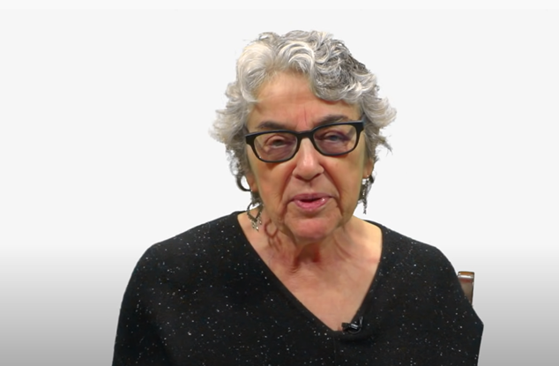
Collaborate and Practice
Elements of Explicit Instruction
As we watch Video 1: Utilizing Explicit Instruction by Anita Archer, complete Handout 1: Video-Viewing Guide for Video 1.
Video retrieved from https://www.facebook.com/watch/?v=320845308601739 on 01/04/24 .
Notes:
Notes Allow about 15 minutes for this activity. Show Video 1: Utilizing Explicit Instruction by Anita Archer (5:46) and encourage participants to complete the video reflection guide. After the video ask the participants to discuss their completed guides in their small groups. Then have groups share out in whole group.
SAY We are going to watch a video on explicit instruction by Anita Archer. Please complete Handout 1: Video-Viewing Guide for Utilizing Explicit Instruction as you watch. We’ll discuss our completed guides in small groups after the video concludes and then we’ll share out in whole group.
Video retrieved from https://www.facebook.com/watch/?v=320845308601739 on 01/04/24.

Slide 16

Elements of Explicit Instruction from Archer & Hughes
Read Handout 2:
16 Elements of Explicit Instruction
Notes:
Notes Allow about five minutes for participants to read the handout.
SAY Please review Handout 2: 16 Elements of Explicit Instruction – we’ll be looking for these elements in a video after we’ve had a few minutes to read through it.
Archer, A. L., & Hughes, C. A. (2011). Explicit instruction: Effective and efficient teaching. New York: Guilford Press.
https://my.vanderbilt.edu/spedteacherresources/what-is-explicit-instruction/

Slide 17

Elements of Explicit Instruction in Action
As we view Video 2: Word-Building, keep in mind the comments from Anita Archer you observed in Video 1. You can use your video guide as a reference. Identify the elements of explicit instruction that you see from Handout 2.
Video retrieved from https://www.youtube.com/watch?v=4Tm2U2zOQ_M on 01/04/24.
Notes:
Notes Allow 15 minutes for this activity. View Video 2: Word-Building from Foundational Reading Skills (5:45). Encourage participants to identify the elements of explicit instruction from Handout 2 that they see in the video. Allow group members to discuss and then share out in whole group.
SAY We just viewed a brief video where Anita Archer explained explicit instruction and how to utilize it. We’ve also reviewed the handout sharing 16 elements of explicit instruction. Now we’re going to watch a video of instruction in the classroom. Jot down evidence of explicit instruction that you see in this video. Also note which of these practices you would consider to be systematic instruction. You’ll discuss these in your table groups and then we’ll share out.
Possible responses – Teacher sequences skills logically (2); breaks down complex skills and strategies in smaller instructional units (3); Provides step by step demonstrations (7); Uses clear and concise language (8); Requires frequency responses (11); Delivers the lesson at a brisk pace (14)
Video retrieved on from https://www.youtube.com/watch?v=4Tm2U2zOQ_M 01/04/24.

Slide 18

Learn and Confirm
Coaching Teachers to Provide Explicit Instruction
Increases in teachers implementing explicit instruction were achieved in a study conducted by Hammond & Moore by providing professional development sessions and following up with these coaching practices:
Demonstrations of the practices introduced in the professional development
Regular observations of teachers
Constructive written and verbal feedback
(Hammond & Moore, 2018)
Notes:
SAY So we know that students learn through explicit and systematic instruction. But how do we coach to ensure that teachers incorporate these practices in their teaching? Hammond & Moore found that providing professional development sessions regarding how to teach explicitly and systematically and then following up on those sessions with teachers in classrooms was helpful. Providing demonstrations with students in classrooms, observing teachers work with students, and providing constructive written and verbal feedback was all important to improving teacher practice in these areas.
Hammond, L., & Moore, W. M. (2018). Teachers taking up explicit instruction: The impact of a professional development and directive instructional coaching model. Australian Journal of Teacher Education (Online), 43(7), 110-133.

Slide 19
How Students Learn
Students learn through scaffolded instruction, which is:
The intentional support provided by a teacher for learners to carry out a task or solve a problem, to achieve a goal that they could not do without support. It is temporary support matched to the current understanding or skill level of learners. The intent is to provide a decreasing level of support until learners are empowered to perform independently.
(Florida Practice Profile)
Notes:
SAY The definition of systematic instruction is on your screen. As we talk about explicit instruction, the concept of providing systematic instruction well-represented. In order for students to learn, instruction needs to be explicit and systematic – there needs to be clarity and order.

Slide 20
Scaffolding
Scaffolding increases student learning of new content and skills and builds self-sufficiency in their application.
(Biancarosa & Snow, 2006)
Notes:
SAY Research tells us that when we provide support for students and gradually remove it as their knowledge and skills increase, we build self-sufficiency.
Biancarosa, G., & Snow, C. E. (2004). Reading next: A vision for action and research in middle and high school literacy: A report from Carnegie Corporation of New York. Alliance for Excellent Education.

Slide 21
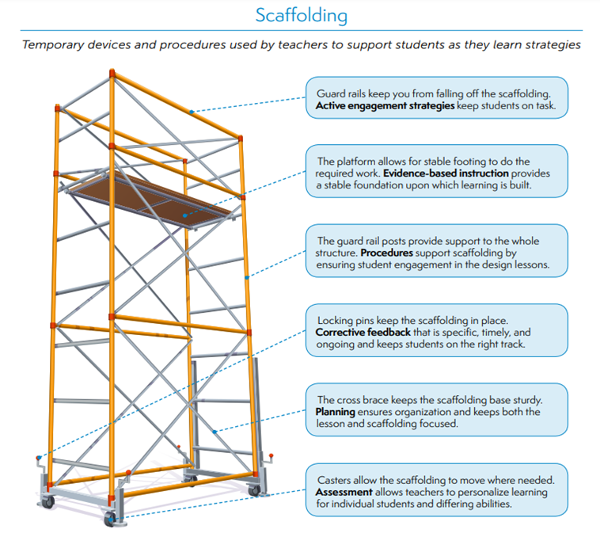
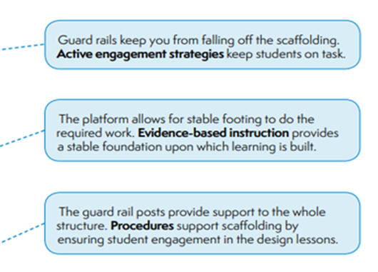
Notes:
SAY This illustration of scaffolded instruction along with some components is part of an infographic developed by the Institute of Education Sciences.
Full infographic available at:
https://ies.ed.gov/ncee/edlabs/infographics/pdf/REL_SE_Evidence-based_teaching_practices.pdf

Slide 22
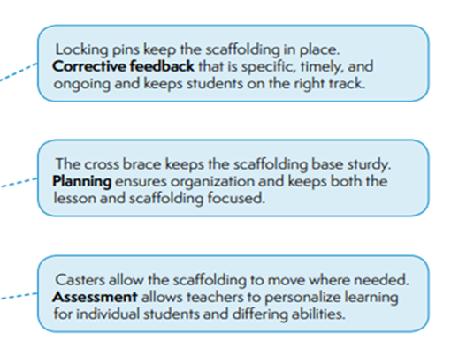
Notes:
SAY This illustration of scaffolded instruction along with some components is part of an infographic developed by the Institute of Education Sciences.
Full infographic available at:
https://ies.ed.gov/ncee/edlabs/infographics/pdf/REL_SE_Evidence-based_teaching_practices.pdf

Slide 23
Collaborate and Practice
Scaffolded Instruction
Read Handout 3: Instructional Scaffolding to Improve Learning.
Discuss at your tables:
What are the benefits of scaffolding student learning?
What might be some pitfalls?
What types of scaffolding have you used or seen teachers use
in classrooms?
Notes:
Notes Allow about 10 minutes for this activity. Review the slide.

Slide 24
Scaffolding Student Learning During Instruction
As we view Video 2: Word-Building again, identify the scaffolding that you see from Handout 3: Instructional Scaffolding to Improve Learning, as well as others you have used to support students.
Video retrieved from https://www.youtube.com/watch?v=4Tm2U2zOQ_M on 1/04/24.
Notes:
Notes Allow 15 minutes for this activity. View Video 3: Word-Building (again). Encourage participants to identify scaffolding techniques that they see from Handout 3 and others they have used in the video. Allow group members to discuss and then share out in whole group.
Video retrieved from https://www.youtube.com/watch?v=4Tm2U2zOQ_M on 1/04/24 .

Slide 25
Learn and Confirm
How Students Learn
Students learn through differentiated instruction which is:
Adapting instruction in response to the distinct assessed skills and needs of individual learners in order to increase their access and opportunities to meet specific learning goals.
(Florida Practice Profile)
Notes:
SAY We know that students do not all have the same strengths and needs. Teachers must be sure that the instruction they provide will help students meet their learning goals, and thus meet the Florida standards. Let’s review the definition of differentiated instruction as delineated in the Practice Profile (read the definition).

Slide 26
Differentiated Instruction
“While differentiated literacy instruction is one way that educators respond to academic diversity, it is not one strategy or practice – it is a diverse collection of educational practices and programs that provide students with multiple ways to learn and construct meaning.”
(Puzio, Colby, & Algeo-Nichols, p. 460)
Notes:
SAY To be clear, differentiated instruction is not just one thing. Students are individuals, and although differentiation can occur with small groups of students, the instructional practices used must meet the needs of ALL students. Therefore, it could be said that we don’t treat all students equally – or the same – we take an approach of equity – providing students with the instruction that is specific to their needs.
Puzio, K., Colby, G. T., & Algeo-Nichols, D. (2020). Differentiated Literacy Instruction: Boondoggle or Best Practice?. Review of Educational Research, 90(4), 459-498.

Slide 27
Collaborate and Practice
Let’s Talk…
You just viewed a teacher delivering a small-group lesson in word building. Discuss the following in your small groups:
How could you adapt this lesson, differentiating your instruction, to provide more or less scaffolding for this activity for subsequent groups that require different levels of support?
Notes:
Notes Allow about 10 minutes for this activity – five minutes for discussion and five minutes for small groups to share out. A suggestion for less scaffolding may include asking students to write words rather than move the letters into the sound boxes. A suggestion for more scaffolding might include providing the ending sounds of a word and asking students to move letters into the first sound box. For instance, provide ___at and then ask the child to make the word “bat,” and then “mat,” etc.
SAY Think about the video we just viewed on word building. Discuss the question on the slide in your small groups and be prepared to share out.

Slide 28
Learn and Confirm
Active Participation
Active participation is a result of a deliberate and conscious attempt on the part of a teacher to cause students to participate overtly in a lesson.
(Pratton & Hales, 1986, p. 211)
Notes:
SAY Although there is not a Florida Practice Profile for active participation, we know that one of the ways that students learn is to actively participate in their own learning. Active participation is visible – when a student is participating OVERTLY in the lesson it is something you can see. This takes “engagement” to the next level. While we may think students are engaged because they seem to be listening, they are compliant, or they are not acting out, you can’t “see” their learning. If students are actively participating – they are writing, responding, actively working – you can see if students are learning what you are teaching or if you need to adapt the instruction.
Pratton, J., & Hales, L. W. (1986). The effects of active participation on student learning. The Journal of Educational Research, 79(4), 210-215.

Slide 29
Active Participation
“Active participation forces the teacher and student in the learning process to spend proportionally more time and activity doing something that requires thinking, responding, and verifying what the learner does or does not know. Therefore, immediate adjustments can be made by the teacher for the student's benefit.”
(Pratton & Hales, 1986, p. 211)
Notes:
SAY This quote from Pratton and Hales reflects that active participation can provide teachers with the information they need to provide feedback to students that can improve their performance. In addition, when students actively participate, teachers know where they need to adjust their instruction.
Pratton, J., & Hales, L. W. (1986). The effects of active participation on student learning. The Journal of Educational Research, 79(4), 210-215.

Slide 30

Collaborate and Practice
Active Participation
As we view Video 3: Inferential Language, Read Aloud, & Discussion, jot down what the teacher does to cause students to overtly participate in the lesson.
Video retrieved from https://www.youtube.com/watch?v=JshNkNrblkA on 01/04/24.
Notes:
Notes Allow about 10 minutes for this activity.
SAY Given the definition of “active participation” let’s view this video (5:12) of a kindergarten read aloud. The teacher provides opportunities for students to actively participate. Write down what this teacher does to facilitate the participation that you see. Also think about what you would do to help a teacher increase active participation in their class. After the video, we will share what you noted in your small groups, your thoughts regarding coaching to increase active participation, and then we will share out in our whole group.
Video retrieved from https://www.youtube.com/watch?v=JshNkNrblkA on 1/04/24.

Slide 31
Learn and Confirm
How Students Learn
Students learn when they are provided with corrective feedback which is:
Clearly communicated, timely, and developmentally appropriate information that is aligned to learning goals or objectives that specifically addresses the learners’ errors or misconceptions.
(Florida Practice Profile)
Notes:
SAY The definition of corrective feedback developed by educators and provided by the Florida Department of Education is (read the definition).

Slide 32
Corrective Feedback
“Its (corrective feedback) effect is very large, which suggests that students highly benefit from feedback when it helps them not only to understand what mistakes they made, but also why they made these mistakes, and what they can do to avoid them next time.”
(Wisniewski, Zierer, & Hattie, 2020, p. 12))
Notes:
SAY Research confirms that providing corrective feedback is a valuable practice and helps students to understand the mistakes they made, why they made them, and how they can avoid them in the future.
Wisniewski, B., Zierer, K., & Hattie, J. (2020). The power of feedback revisited: a meta-analysis of educational feedback research. Frontiers in Psychology, 10, 3087.

Slide 33
Corrective Feedback
Activity
Peruse Handout 4: Writing Rubric.
Read Handout 5: 10th Grade Paper, which is a student response to the prompt: Scheduling Leisure Time
As a group, develop three statements that reflect the feedback you would provide this student based on the requirements of the rubric.
Notes:
Notes: Allow about 15 minutes for this activity.
SAY We’ve talked about the importance of providing corrective feedback and that this is effective at helping students meet their learning goals. However, that feedback needs to be specific, timely, and actionable.
Review the activity steps on the slide. Note that the rubric is just one example and there are probably others you use in your state, district, or school. The purpose of using the rubric is to guide us in providing feedback.
After you formulate your feedback statements in your small groups, we’ll share them with the whole group.

Slide 34

Post-Session Reflection, Planning, and Implementation
Reflect, Plan, and Implement
Handout 6: Teachers Taking up Explicit Instruction: The Impact of a Professional Development and Directive Instructional Coaching Model and note any questions about the article.
Complete Self-Study 1: Reflections on Session 4. Note any questions about the content or format of Session 4.
Video 4: Active Participation Part 1 – Dr. Anita Archer and complete Self-Study 2: Video-Viewing Guide for Active Participation.
Video retrieved from https://www.youtube.com/watch?v=yXLoOb10W2g on 1/04/24.
READ
DO
WATCH
Notes:
SAY We have talked a lot about how students learn - through explicit and systematic instruction that is differentiated to meet their needs and helps them make connections. They also learn best when instruction is scaffolded enabling them to accomplish tasks that they would not be able to accomplish otherwise. Finally, they learn when they receive corrective feedback to help them understand their mistakes and avoid them in the future.
As we near the end of today’s session, here are the self-study activities to complete before we meet for Session 4. These assignments will provide you with the opportunity to examine how students learn more deeply. First, read the Handout 6, which is the article: The Impact of a Professional Development and Directive Instructional Coaching Model. That may help you as you reflect upon the content of today’s session and complete Self-Study 1. After you complete that, please view the video on active participation by Anita Archer and complete the video reflection homework sheet. We’ll debrief at the beginning of Session 5.
https://drive.google.com/file/d/1wC0hTTCxqY-4nhCi2XoEBWkBAusKeRj0/view?usp=sharing
Video retrieved from https://www.youtube.com/watch?v=yXLoOb10W2g on 01/04/24.

Slide 35

Questions?
Notes:
SAY Are there any questions that you have regarding the content of this session, the self-study activities, or the course in general?

Slide 36




We have completed
Session 4
Notes:
SAY Congratulations on successfully completing Session 4! We look forward to seeing you for Session 5 as we continue Module 2.
Confirm the date and time of the next session.

