Slide 1
Fundamentals of Literacy Coaching
Professional Development Modules
Module 6, Session 16
Planning and Implementing Coaching
Notes:
SAY Welcome to Fundamentals of Literacy Coaching Professional Development Modules – Session 16: Planning and Implementing Coaching

Slide 2
Module | Topic | Session | Minutes | Session Date
1 | Applying Principles and Practices that Foster a Positive Culture | Intro | 60
 |  | 1 | 120
 |  | 2 | 150
 |  | 3 | 150
2 | Applying Effective Pedagogy and Andragogy | 4 | 120
 |  | 5 | 120
 |  | 6 | 165
3 | Collecting Data to Inform Professional Learning | 7 | 150
 |  | 8 | 140
 |  | 9 | 170
4 | Planning, Implementing, and Analyzing Literacy Instruction | 10 | 175
 |  | 11 | 135
 |  | 12 | 165
 |  | 13 | 130
5 | Growing Professionally | 14 | 120
 |  | 15 | 120
6 | Planning and Implementing Coaching | 16 | 120
Notes:
NOTES
It is recommended that the sessions are completed in sequential order.
The timeline for completing the sessions can be flexible. If the recommended minutes for each session are not available, complete what you can with the time you have and then pick up where you left off the next time you meet.
Once a schedule of the sessions is established, have participants record the schedule in their Fundamentals of Literacy Coaching PD Guide if printed.
SAY Here is an overview of the modules and sessions of this course. There are six modules, and each module includes two to four sessions for a total of 15 content sessions. Module 1 addresses Applying Principles and Practices that Foster a Positive Culture, Module 2 covers Applying Effective Pedagogy and Andragogy, the focus of Module 3 is Collecting Data on Instructional Practices to Inform Professional Learning, the content of Module 4 is Planning, Implementing and Analyzing Standards-Based Literacy Instruction, the content of Module 5 is Growing Professionally, and the final module, Module 6, addresses Planning and Implementing Coaching.
You can record the date of each of our sessions in your Fundamentals of Literacy Coaching PD Guide.

Slide 3
Bridge to Practice Projects for Coaches
An activity designed to serve as a Bridge to Practice after each Module will provide evidence that coaches are able to apply the knowledge and skills they developed in this course in their schools. Coaches will complete the following activities:
A rubric is provided at the end of each Module for the corresponding Bridge to Practice project.
Module 1 | Develop a principal-coach partnership agreement.
Module 2 | Develop a needs assessment for professional development on evidence-based instructional practices and complete an ADDIE model for planning this professional development.
Module 3 | Develop and describe planned implementation of a professional learning action plan.
Module 4 | Create a video that reflects coaching to help teachers plan, implement, and analyze standards-based literacy instruction.
Module 5 | Complete a reflection on the course, including plans for continued professional growth.
Module 6 | Choose one teacher with whom you have seen significant growth as a result of coaching support and complete a reflection on what worked, why it worked, and which areas of growth were most evident.
Notes:
SAY We want to remind you that participating coaches will complete a bridge to practice project after each module. These projects will provide evidence that coaches are able to apply the knowledge and skills they developed in this course in their schools. You will learn more about each project as we work through the modules. We’ve shared an overview of the projects with you on this slide.
Coaches will
Module 1: develop a principal/coach partnership agreement;
Module 2: conduct a needs assessment for professional development on evidence-based instructional practices and complete an ADDIE model for planning this professional development;
Module 3: develop, implement, and evaluate a professional learning action plan;
Module 4: create a video that reflects coaching to help teachers plan, implement, and analyze standards-based literacy instruction;
Module 5: complete a reflection on the course including plans for continued professional growth.
Module 6: Choose one teacher with whom you have seen significant growth as a result of coaching support and complete a reflection on what worked, why it worked and which areas of growth were most evident.
You may turn in all your artifacts for the projects to your facilitator at the end of each module if requested.

Slide 4



Norms for Our Course
Cell phones on silent
Pay attention to self and others
Presume
positive intentions
Notes:
NOTES Consider your group to determine how much detail about the norms will be helpful to review.
SAY Professional learning opportunities usually consist of a team of educators, like us, that meet regularly to learn new topics, share ideas, and problem solve. We will build a community, meaning that we learn from each other, so sharing and participation are really important.
Professional learning opportunities typically have norms that the group can agree to in order to be productive. Here are three norms, or ground rules, for our way of work: cell phones on silent; pay attention to yourself and others; and presume positive intentions.
Pay attention to self and others This means to contribute, listen, and be aware of how you and others are responding to each other. Be sure to give everyone a chance to talk and encourage others who seem reluctant to join in. Sometimes people who are reluctant to talk are thinking. They may not be comfortable jumping in but may have something important to say. Professional learning opportunities like this one encourage educators to learn from one another. Therefore, sharing, discussing and participating are important components.
Presume positive intentions This means to pause before responding. Usually when people contribute to a conversation, they intend to be constructive. So, always respond positively to keep the discussions productive.

Slide 5

Goals for Today
Define and Discuss Session Goals and Content
Review Session 15 and debrief the self-study activities completed after the session.
Overview forms, resources, and protocols to support coach planning and implementation, including those that can help:
  Develop a school profile and strategic plan
  Support and document the impact of coaching
  Communicate literacy efforts to stakeholders
  Support the recognition and celebration of progress and considerations for improvement
Notes:
NOTES Share and discuss these goals for today’s session. The overarching goal of this session is to provide forms and resources to support coach planning and implementation. This module is intended to serve as a resource to support literacy coach planning and implementation with sample documents that provide guidance and structure.

Slide 6

Review of Module 5, Session 15
Debrief
Self-Study 1: Reflecting on the Instructional Coaching Article by Jim Knight
What insights did you gain from reviewing Handout 5?
Which of the eight factors shared resonated most?
Any comments or questions about Session 15?
Self-Study 2: Reflection on Video
Share responses to questions about Self-Study 2.
Submit the Bridge to Practice project for Module 5 – reflection on the course including plans for continued professional growth.
Notes:
NOTES Allow about 7 minutes for this debrief. If you have a small group, ask for volunteers to share with the whole group. If you have a large group, consider having triads discuss and then ask for a volunteer from each triad to share with the large group.
SAY After Session 15, you had something to read, something to do, and something to watch. Let’s debrief. You read Handout 5. Look at what you recorded on Self-Study 1: Instructional Coaching.
Review the questions on the side. Answers may vary.
You also selected and watched a video on coaching and completed the video-viewing guide. Let’s review your responses to the questions on the guide.
Share your responses to Self-Study 2 with a partner and consider any responses or thoughts from this discussion that your team might wish to share with the group.
Answers will vary.

Slide 7

Developing a School Profile and Strategic Plan
Learn and Confirm
  Creating a Coach Pacing Guide and Glossary (Peek at the Year)
    Supporting a common language through a Glossary
    Pacing for each month provides support for coaches to plan ahead and understand priorities for specific times of the year
  Identifying needs and priorities (Needs Assessment Form)
  Creating an Action Plan
Notes:
SAY It is important that we take time to consider the development of a school profile and strategic plan so that, as a coach, you’ll know that everyone at your school is using common language, you are able to plan ahead and understand priorities for specific times of the year, you are able to identify needs and priorities, and you have an agreed upon action plan. We will be reviewing some resources that can help with this.

Slide 8

Collaborate and Practice
Developing a School Profile and Strategic Plan Activity - Jigsaw
With a partner or in your small group, read the handout you were assigned and discuss how you think this resource could be helpful in your role as a coach.
Be prepared to share a summary of the resource with the whole group and how you think it could be helpful in your role as a coach.
(MDE, 2023)
Notes:
NOTES Be sure participants have access to Handouts 1-3. Ask participants to work with a partner or divide the participants into three small groups. Give each small group a different Handout – either Handout 1 – Literacy Coach Glossary; Handout 2 – Literacy Coach Pacing Guide; or Handout 3 – Sample Needs Assessment and Priority Form. Allow about 5 minutes for each group to review their hand out and about 5 minutes for the groups to share out.
SAY Each group has a different resource that could be helpful in developing a school profile and strategic plan. Review your resource and discuss how this could be helpful to you in your role as a coach. Each group will share a summary of their resource and how they think it could be helpful.

Slide 9
Developing a School Profile and Strategic Plan Creating an Action Plan
Access and read Handout 4: Sample School Literacy Action Plan
How could having a School Literacy Action Plan help you in your role as a coach?
(MDE, 2020)
Notes:
NOTES Review the slide.
SAY Handout 4 is a sample School Literacy Action Plan from the Mississippi Department of Education. Read through the School Literacy Action Plan and consider how you might use such a template to create a literacy action plan for your school. Discuss the benefits of creating and sharing such a School Literacy Action Plan across a school, district, and/or state.

Slide 10
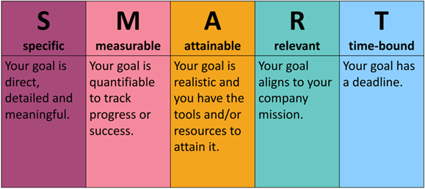
Developing a School Profile and Strategic Plan Creating an Action Plan Through SMART Goals
Notes:
SAY In Session 9, we introduced SMART Goals, needs assessments, and professional learning action plans to you. In this section, we will consider how to create an action plan ensuring that SMART Goals are used for this purpose. Review the areas of SMART goals noted on the screen and let me know if you have any questions about them.

Slide 11
Developing a School Profile and Strategic Plan Creating an Action Plan Through SMART Goals
G
Goals
R
Roles
R
Resources
A
Accountability
T
Timeframe
E
Empowerment
  How do you create clear SMART goals?
  Who is going
  to be involved?
  What resources are needed?
  How do you access these resources?
  Who “owns” what part(s) of the process or action steps?
  All expectations need a timetable with final outcomes.
  Delegation:
  Purpose
  Importance
  Details
  Success
  Measurements
  Questions
Notes:
SAY A next step that may be helpful in creating an Action Plan is to use a framework, such as the table above, to consider other areas or elements that would need to be involved in implementing the plan. For example, once the SMART Goals are written, what are the roles of everyone who would be involved in implementation and evaluation? What resources are needed to move forward? Who will actually do the work or “own” the different parts of the process or action steps? What timeframe will be put in place for each expected step along with way? What is the timetable for the final outcomes? How could the work be delegated to others, empowering them in specific ways to ensure success? Think back to the Professional Learning Action Plan that you completed in Session 9. How would this framework align with that plan?

Slide 12
Developing a School Profile and Strategic Plan Creating an Action Plan through SMART Goals
Here’s a SMART goal that was submitted by an administrator on their School Literacy Action Plan:
Increase the percentage of third grade students scoring at/above benchmark from 32% at BOY to 70% at EOY. (See Handout 4 – Section 1b: Data for Grades 1-3 and Section 2a: Overall Goal Based on Data.)
Using the questions below, rewrite the goal so it is a SMART goal and discuss how you will support an administrator in writing and applying SMART goals for their School Literacy Action Plans.
Questions to consider:
Why is this not a SMART goal?
Which piece of the SMART goal is missing?
How will you coach your administrator into making this a SMART goal?
How do you approach the conversation about the goal being attainable?
Notes:
SAY Read the steps to the activity on this slide. Using Handout 4, use the following goal, that has been submitted by an administrator on their School Literacy Action Plan, to complete the activity:
Increase the percentage of third grade students scoring at/above benchmark from 32% at BOY to 70% at EOY.
Answer each of the questions above and rewrite this goal as a SMART Goal using Handout 4 – Section 2b: SMART Goals.

Slide 13
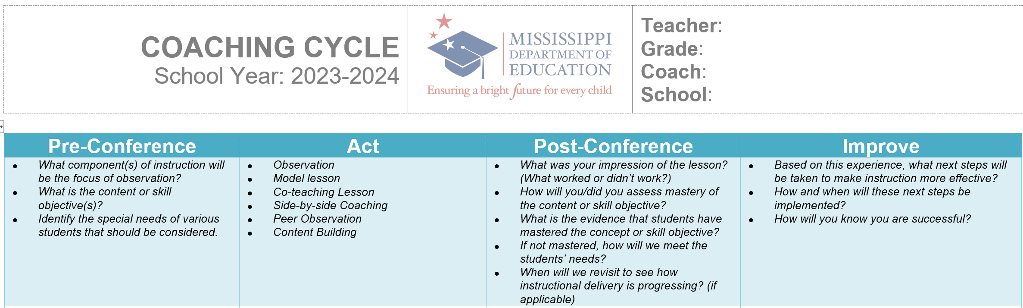
Learn and Confirm
Utilizing Protocols and Documentation to Support Coaching and Impact
(MDE, 2023)
Notes:
NOTES Review the slide.
SAY As a coach, it is important to document your work in order to support your coaching efforts and determine the impact your work may have with teachers and across school(s). In support of their coaches, the Mississippi Department of Education developed protocols and tools that are used by coaches to document their work and better understand their impact. We will be reviewing some of these tools during this section of the session and discussing how these may be used by you and other coaches you may know and work with.

Slide 14
Collaborate and Practice
Utilizing Protocols and Documentation to Support Coaching and Impact
Literacy Coach Shadowing Form
It is important that coaches build a portfolio of artifacts that supports the work they do with teachers and how that work helps improve their instructional practice.
Access and read Handout 5: Sample Literacy Coach Shadowing Form.
How could using a Literacy Coach Shadowing Form help you and others in the role of a coach?
Why would having such a Literacy Coach Shadowing Form be beneficial for documenting coaching support and impact?
(MDE, 2023)
Notes:
NOTES Review the slide.
SAY Handout 5 is a sample Literacy Coach Shadowing Form from the Mississippi Department of Education. Read through the Literacy Coach Shadowing Form and consider how you might use such a form to support coaching efforts. Discuss the benefits of creating and sharing such a Literacy Coach Shadowing Form across a school, district, and/or state and how it may be helpful for documenting coaching support and impact.

Slide 15
Utilizing Protocols and Documentation to Support Coaching and Impact
Coaching Cycle Documentation Form
Handouts 6-10 are resources that may be helpful as you work with individual teachers. They include a coaching cycle form (Handout 6), a learning walk protocol (Handout 7), an informal observation tool (Handout 8), a demonstration lesson focus form (Handout 9), and a lesson planning form (Handout 10). In your small groups or with a partner think about your role as a coach as you review the handouts and discuss the following:
How could using these resources provide evidence of your coaching and how it has worked to change teacher practice?
(MDE, 2023)
Notes:
NOTES Review the slide.
SAY In the next few minutes we are going to review several resources from the Mississippi Department of Education that may be helpful to you as you work with individual teachers. Locate each of these handouts in the participant guide and review them with a partner or in your small group. Talk about how using forms like these could help you document your coaching and the impact you’ve made on teacher practice.

Slide 16
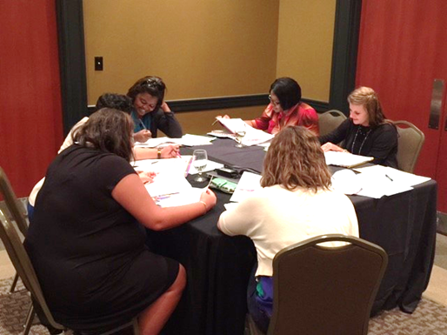
Learn and Confirm
Communicating Literacy Efforts to Stakeholders
Helping stakeholders such as school staff, students, community members, and families understand legislation and/or district expectations for literacy achievement
Communicating with transparency screening and performance data outcomes and goals for children
Modeling strategies for parents to support their children at home through efforts such as family literacy events
Notes:
NOTES Review the slide.
SAY In the next few minutes we are going to think about several ways that coaches have the important opportunity and responsibility of communicating to various stakeholder groups, such as teachers and administrators, parents, and even district level staff. Some ways that this may occur are through sharing, in plain language, district, state, or federal literacy efforts, initiatives, and/or legislation; communicating about assessments, what they measure, their results, and subsequent instructional goals for students; modeling literacy strategies for parents that they can in turn use at home to support instruction for their students.

Slide 17
Collaborate and Practice
Communicating Literacy Efforts to Stakeholders
Helping All Stakeholders Understand Legislation and/or District Expectations for Literacy Achievement
Questions to consider:
Is new literacy legislation or district policy being put in place?
Do any changes have implications for school policy or programs?
Will school expenditures or staff resources be needed to implement the policy?
*Adapted from REL Northeast & Islands Toolkit: Disseminating Results Externally
Notes:
SAY These questions and those on the next slide may be helpful to consider if there are new literacy legislative mandates or district policies going into place, particularly those that may increase expectations for literacy achievement. With a partner, think of a new policy that has been implemented in your school or district recently and consider and discuss answers to these questions regarding that policy. How might understanding the answers to these questions help coaches better understand the policy and how to communicate it to other stakeholders?

Slide 18
Collaborate and Practice
Communicating Literacy Efforts to Stakeholders
Helping All Stakeholders Understand Legislation and/or District Expectations for Literacy Achievement
Questions to consider (continued):
Will students or faculty be impacted by the policy? If so, how many?
Does the policy address a high-profile issue in the district or school (e.g., teacher effectiveness, academic outcomes, racial or gender achievement gaps)?
Has there been media coverage of the new policy?
*Adapted from REL Northeast & Islands Toolkit: Disseminating Results Externally
Notes:
SAY These are a few additional questions may be helpful to consider if there are new literacy legislative mandates or district policies going into place, particularly those that may increase expectations for literacy achievement. With a partner, think of a new policy that has been implemented in your school or district recently and consider and discuss answers to these additional questions regarding that policy. How might understanding the answers to these questions help coaches better understand the policy and how to communicate it to other stakeholders?

Slide 19
Communicating Literacy Efforts to Stakeholders
Helping Students and Families Understand Legislation and/or District Expectations for Literacy Achievement
Considerations:
Summarize key points of the policy and share with stakeholders in plain language verbally or in writing.
Consider your audience – parents’ native languages may be important.
Disseminate information through multiple channels.
*Adapted from REL Northeast & Islands Toolkit: Disseminating Results Externally
Notes:
SAY Most parents care little about the technical details of a policy but are acutely interested in the implications: What does it mean for my child? Her school? His teachers? Will this policy affect instruction? My child’s learning? His social or emotional growth? Will this policy help the district better serve my child?
When communicating with parents about policy, whether verbally or in writing, coaches should focus on key points of interest for all stakeholders. Communication to parents should be written in clear, straightforward language and avoid education jargon used in the field, but little understood by non-educators. The coach should also make reasonable efforts to share information in parents’ native languages, for those who do not speak English. This is particularly important in districts with large populations of students and families for whom English is not their native language.
To reach as many parents as possible, coaches should disseminate information through multiple channels. These include well-publicized public meetings (in the evening and during the day to accommodate diverse parent work schedules), email communication, printed documents sent home with children, printed documents posted on school-based bulletin boards, and district and school social media pages and websites.

Slide 20
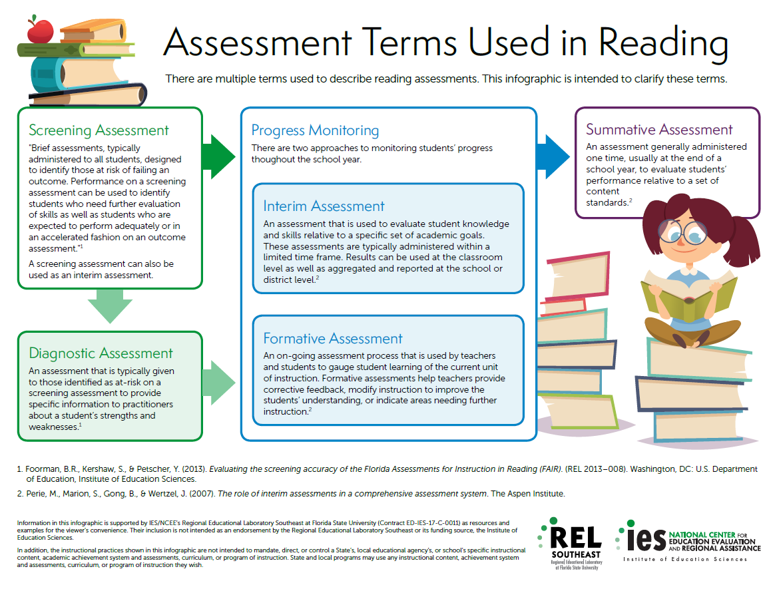
Collaborate and Practice
Communicating Literacy Efforts to Stakeholders: Parents
Communicate with transparency screening and performance data outcomes and goals for children.
Create a parent-friendly description for the definitions of screening and summative assessments provided in Handout 11: Assessment Terms Used in Reading.
Notes:
SAY We looked at Handout 11: Assessment Terms Used in Reading, back in Session 8. One skill that you’ll need as a coach is the ability to explain literacy assessment concepts and results to teachers and parents. With a partner, read the definitions for Screening Assessment and Summative Assessment in the infographic and develop a parent friendly description of these two terms. Be prepared to share your description with the group.

Slide 21
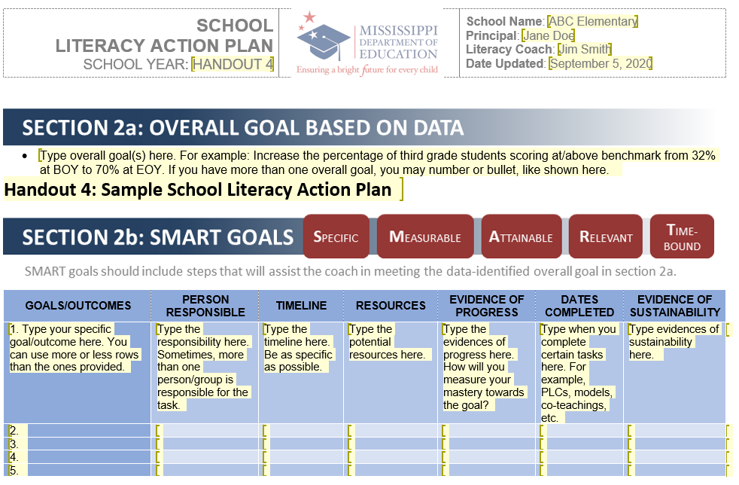
Collaborate and Practice
Communicating Literacy Efforts to Stakeholders: Parents
Communicating with transparency screening and performance data outcomes and goals for children is important.
Create a parent-friendly description for the performance data outcomes and goals for children from the SMART goal that you created in Handout 4: Sample School Literacy Action Plan.
Notes:
SAY On Handout 4: Sample School Literacy Action Plan, you converted the overall goal listed: Increase the percentage of third grade students scoring at/above benchmark from 32% at BOY to 70% at EOY to a SMART goal on Section 2b.
With a partner, review the SMART goal that you wrote for that activity and create a parent friendly version of the performance data outcomes and SMART goal.

Slide 22

Communicating Literacy Efforts to Stakeholders
Modeling Strategies For Parents to Support Their Children at Home Through Efforts Such as Family Literacy Events
Handout 12: Talking While You Read Trifold
Notes:
SAY In Session 11, we shared some tools and resources from FCRR and the REL Southeast that could be used to help teachers cultivate family literacy support at home. For grades K-3, there are four grade-specific Teacher Guides for teachers to use during Family Literacy Nights and Parent-Teacher Conferences. Each Teacher Scaffold within the guides has associated Family Activities. The Family Activities include easy-to-follow plans and materials to help families support their child’s foundational reading skills.
This activity is Talking While You Read Trifold. It includes an overview of how to use the PEER strategy to have a conversation while reading with a child. There is also a story on the trifold with questions placed where they are most helpful to prompt the child.
Using Handout 12: Talking While You Read Trifold, take turns modeling this strategy with one partner playing the role of a coach and the other playing the role of a parent.

Slide 23
Recognizing and Celebrating Progress and Supporting Improvement
Teacher Progress
Access and read Handout 13: 10 Ways to Collaborate with Your Literacy Coach.
With a partner, identify possible points of progress and celebration from the first nine ways teachers can collaborate with literacy coaches.
Discuss the tenth way to collaborate from the handout and what these celebrations do look like or could look like for the teachers with whom you collaborate.
How could you work with teachers to identify and overcome obstacles to support improvement?
Notes:
SAY It is important for coaches to recognize and celebrate progress at the teacher, grade level, and school levels and even at the district and state levels.
Handout 13: 10 Ways to Collaborate With Your Literacy Coach provides good insight for teachers from a long-time coach about how teachers may best work with literacy coaches successfully.
Read Handout 13 and afterwards, consider with a partner possible points of progress and celebration for the first 9 ways this coach notes collaboration with teachers may occur. For the final way, think about and discuss what those celebrations could look like. How might you also work with teachers to identify and overcome obstacles to support improvement?

Slide 24
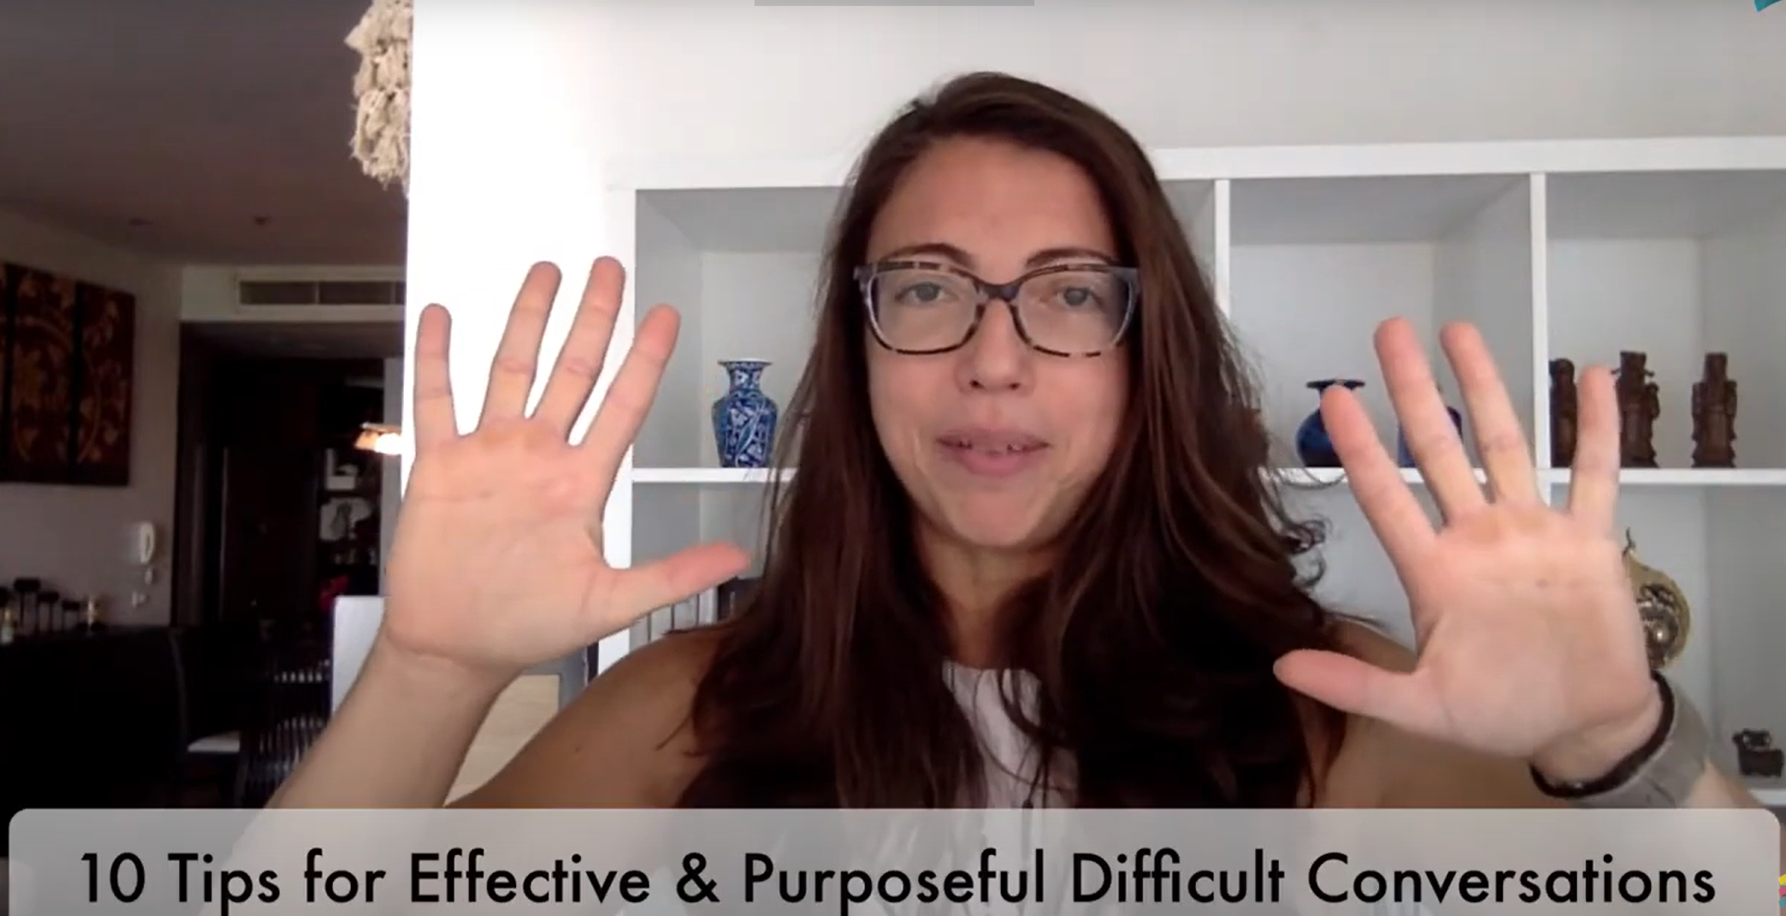
Collaborate and Practice
Recognizing and Celebrating Progress and Supporting Improvement
Supporting Improvement
Video 1: Courageous Conversations
Watch this 8-minute video.
Note the 10 tips shared for effective and purposeful difficult conversations.
Respond to the questions on Handout 14: Video Viewing Guide for Courageous Conversations.
Discuss your responses at your tables.
Notes:
NOTES
Allow 20 minutes for viewing the video and completing the activity. Show Video 1 (8 minutes) and allow time for participants to record their answers to the questions on Handout 14.
SAY We know that one of the key opportunities for coaches to support teacher improvement is to facilitate courageous conversations. These conversations provide an integral way for coaches to meet the challenge of transforming educator’s experience and relation to feedback and coaching.
Please review the questions on Handout 14: Video-Viewing Guide for Video 1: Courageous Conversations. Let’s watch a video of a coaching expert who has been discussing how to plan for and move forward with courageous coaching conversations for over a year.
Ask for volunteers to share their answers to the questions on Handout 14.
Possible responses for questions:
Write down what you want to say. Practice what you want to say. Set your meeting for a neutral time and place, consider inviting a neutral party, whether documentation is needed, and time sensitivity. Choose simple and concise language.
Use a neutral tone. Clarify the purpose and goals. Take time to genuinely listen for understanding. Identify and clarify the issue. Set agreements for success.
Send a follow up email in writing about what was agreed upon.
Responses will vary.
Responses will vary.
Video retrieved from: https://www.youtube.com/watch?v=t7ufD6egOro

Slide 25

Learn and Confirm
Recognizing and Celebrating Progress and Supporting Improvement
Classroom/Teacher-Level Progress
Grade-Level Progress
School-Level Progress (for an idea see Handout 15)
District-Level Progress
State-Level Progress (for an idea see Handout 16)
Notes:
NOTES Allow about 10 minutes for this activity. Organize participants into four groups. Provide a piece of chart paper and markers for each group. Assign “classroom/teacher level progress” to one group, “grade level progress” to one group, “school level progress” to the second group, “district level progress” to the third group, and “state level progress” to the fourth group. After charts are complete, take a gallery walk.
SAY It is important that we not only celebrate progress and support improvement at the teacher level. We also need to recognize that we are part of a bigger picture. When progress is made in a particular grade level we’ve been working with, or when the school as a whole is improving the literacy abilities of our students, we should take time to celebrate! In addition, when our district and state makes progress, we should celebrate that too. Each of your group has been assigned a level of progress to celebrate. On your chart paper share some ways we can celebrate progress, or support improvement, at each of these levels. Handouts 15 and 16 might help you as you think about how you might celebrate at each of these levels. You’ll have about ten minutes to finish your charting and then we’ll take a gallery walk so we can all benefit from the ideas shared.
NOTES: If a group has trouble thinking of ideas, here are some suggestions that could be shared to get participants thinking:
Grade Level Progress:
Highlight successful coaching implementation steps with grade level teams at faculty meetings
Share grade level year end results at a faculty meeting or via newsletter, social media, or website blog post
Co-write a blog or newsletter column or co-present grade level success results with a grade level lead or department chair
School Level Progress:
Develop and use success criteria for school literacy policy implementation (See Handout 15)
Share school level year end results at a faculty meeting or via newsletter, social media, or website blog post
Celebrate student learning gains and experiences by providing a celebratory event for students, parents, and teachers
Provide opportunities for students to share their experiences, talents, and skills through performances, bulletin boards, etc.
District Level Progress:
Highlight successful coaching plan implementation steps with other coaches at a regional or district coach cadre meeting
Share district level year end results at a faculty meeting or via newsletter, social media, or website blog post
Celebrate student learning gains and experiences by helping to organize district-wide celebratory events for students, parents, and teachers
Provide opportunities for educators and students to share their experiences, talents, and skills across schools through collaborative projects, performances, etc.
State Level Progress:
Share state level year end results at a faculty meeting or via newsletter, social media, or website blog post (See Handout 16)
Participate in statewide celebrations such as Celebrate Literacy Week or Read Across America Day
Present on your progress at a state, regional, or even national literacy event.

Slide 26
Bridge to Practice Project for Module 6
Choose one teacher with whom you have seen significant growth as a result of coaching support and complete a reflection on what worked, why it worked, and which areas of growth were most evident.
Read Handout 17: Reflection Rubric to develop the reflection.
Submit your reflection to your facilitator as instructed.
Notes:
NOTES Review the slide. You may have participants submit their project to you electronically, or as a hard copy. It is up to you. Have each group or pair discuss the Handout 17: Reflection Rubric and determine questions to prepare for the Bridge to Practice project for Module 6.
5 minutes: Activity.
SAY Please turn to Handout 17: Reflection Rubric.
Each of you (or your group) will discuss any questions about this handout and then each group will share thoughts and questions with the whole group.

Slide 27

Questions?
Notes:
SAY Are there any questions that you have regarding the content of this session, the Bridge to Practice activity, or the course in general?

Slide 28




We have completed
Session 16
Notes:
SAY Congratulations on successfully completing Session 16!
Confirm the date when the Bridge to Practice reflection activity is complete.

